Slide 1

W3C Web of Things Summary, Status, and Next Steps
27 May 2019

Slide 2
W3C Web of Things
Goal: Support IoT Interoperability via Open Standards
W3C WoT Interest Group (IG) https://www.w3.org/2016/07/wot-ig-charter.html
Started spring 2015
~200 participants
Informal work and outreach
“PlugFest” validation with running code
Exploration of new building blocks
“OpenDays” with external speakers
Liaisons and collaborations with other organizations and SDOs
Second Workshop on Web of Things planned for 3-5 June 2019 in Munich
W3C WoT Working Group (WG) https://www.w3.org/2016/12/wot-wg-2016.html
Started end of 2016 (effectively Feb 2017)
~100 participants
Normative work on specific deliverables
W3C Patent Policy for royalty-free standards
Only W3C Members and Invited Experts
Notes published on Protocol Bindings, Security, and Scripting API
Architecture and Thing Description were published as Candidate Recommendations 16 May 2019

Slide 3

APPLICATION PROTOCOL
BROWSER APPLICATIONS
IOT APPLICATIONS
JQUERY AJAX
CLOUD, EDGE/FOG, AND IOT SERVICES
EMAIL WEB FTP SSH
FAAS DIGITAL TWINS ML/AI ANALYTICS
JAVASCRIPT HTML XML JSON
SQL SPARQL
TCP UDP
TABLES RDF/JSON-LD
IP
HTTP
INTERACTIONS
FLASK EXPRESS
IOTSCHEMA ETSI-SSN OGS…
ETHERNET WIFI
JSON XML CBOR JPEG…
FIBER SONET 5GHZ 2.4GHZ
PYTHON NODE.JS C++
ONEM2M OCF ECHONET OPC-UA…
HTTP COAP MQTT BACNET ZWAVE…
PHYSICAL TRANSPORT
WEB SERVICES
IOT DEVICES
Internet
Web
IoT

Slide 4
APPLICATION 1
APPLICATION 2
APPLICATION 3
APPLICATION 4
APPLICATION 5
APPLICATION 6
THING DESCRIPTION
SEMANTIC ANNOTATION
INTERACTION AFFORDANCES
PAYLOAD DATA SCHEMA
SECURITY SCHEME
PROTOCOL BINDING
ECOSYSTEM A
ECOSYSTEM B
ECOSYSTEM C
ECOSYSTEM D
ECOSYSTEM E
ECOSYSTEM F

Slide 5
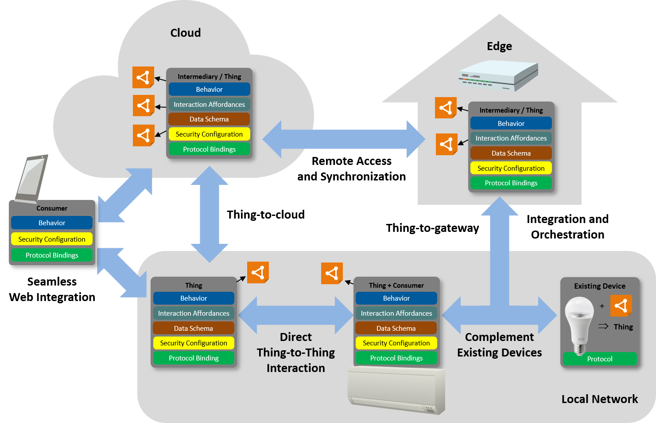
Abstract WoT Architecture

Slide 6
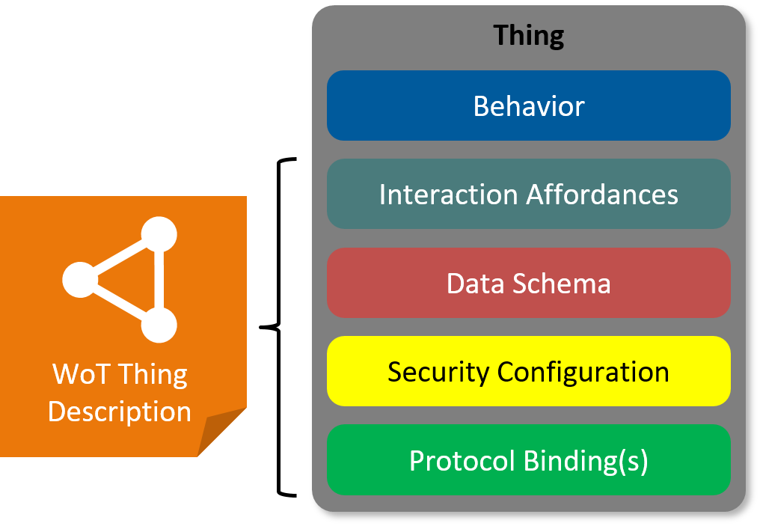
WoT Thing Description
WoT Thing Description describes several architectural aspects of a thing.
Thing description are used by consumers, who can interact with the thing based on information in the TD.
A JSON-LD based serialisation format is defined in the Thing Description specification.

Slide 7

W3C WoT WG Deliverables
WoT Thing Description (TD)
JavaScript
WoT Scripting API
Information model and JSON-LD 1.1 serialization to describe Thing instances with metadata. Uses formal interaction model and domain-specific vocabularies to uniformly describe Thing interaction affordances, which enables semantic interoperability.
Any IoT Device
Standardized JavaScript API for an IoT runtime system similar to the Web browser. Provides an interface between applications and Things to simplify IoT application development and enable portable apps across vendors, devices, edge, and cloud.
Runtime
Application Script
Scripting API
The index.html
for Things
Interaction Model
Data Model
Events
WoT Binding Templates
Properties
Protocol Bindings
Actions
Capture how the formal Interaction Model is mapped to concrete protocol operations (e.g., CoAP) and platform features (e.g., OCF). These templates are re-used by concrete TDs.
HTTP
CoAP
MQTT
…
WoT Security and Privacy
UA Binary
Modbus
Cross-cutting support and guidance to support appropriate security and privacy mechanisms and considerations.
BACnet

Slide 8
WoT Thing Description (TD) – JSON-LD 1.1
W3C WoT TD vocabulary
JSON-LD (Linked Data)
Converts to RDF triples
{
"@context": [
"https://www.w3.org/ns/td",
{ "iot": "http://iotschema.org/" }
],
"id": "urn:dev:org:32473:1234567890",
"name": "MyLEDThing",
"description": "RGB LED torchiere",
"@type": ["Thing", "iot:Light"],
"securityDefinitions": ["basic_sc": {
"scheme": "basic",
"in": "header"
}],
"security": ["basic_sc"],
"properties": {
"brightness": {
"type": "integer",
"minimum": 0,
"maximum": 100,
"@type": ["iot:Brightness"],
"iot:Unit": "iot:Percent",
"forms": [ ... ]
}
},
"actions": {
"fadeIn": {
Domain-specific vocabulary
Security Metadata
JSON Schema
Compatible
data schemas
Optional semantic types
Protocol
Bindings
Extended metadata using domain-specific
vocabulary

Slide 9
WoT Binding Templates – Instantiated in TDs
...
"properties": {
"brightness": {
... "forms": [
{ // Defaults: GET to read, PUT to write
"href": "https://myled.example.com:8080/pwr",
"contentType": "application/json"
}
]
}
},
"actions": {
"fadeIn": {
...
"forms": [
{
"href": "coaps://myled.example.com:5684/pwr",
"contentType": "application/ocf+cbor",
"coap:methodCode": 3, // PUT instead of POST to invoke
"coap:options": [ {
"coap:optionNumber": 2053, // OCF-Content-Format-Version
"coap:optionValue": "1.1.0"
} ]
}
]
Basics to build the request
Deviation from defaults
Notes:
coap:methodCode = PUT
coap:optionNumber 2053 = OCF-Content-Format-Version

Slide 10
Status and Recent Developments
Decision to adopt JSON-LD 1.1 proposed features to allow:
Default values
Object name:value notation
More similarity to standard JSON practices
Security metadata
Focus on HTTP(S), CoAP(S), and MQTT(S)
Protocol Bindings
Focus on HTTP, CoAP, and MQTT and structured payloads compatible with JSON
Support for Observe, using subProtocols (eg long polling in HTTP) when appropriate
Architecture and Thing Description published as Candidate Recommendations 16 May 2019
Notes published on Protocol Bindings, Security, and Scripting API

Slide 11

https://www.w3.org/WoT/ws-2019/cfp.html

Slide 12
Roadmap / Next steps
REC Publication of Architecture and Thing Description: 1 Aug 2019
New charter of the WoT Interest Group currently being defined
Charter Period: July 2019 – June 2021
Please participate and contribute to the evolution of the Web of Things

Slide 13
W3C WoT Summary
Counter fragmentation in the IoT
Web of Things to Internet of Things is similar to the Web to Internet relation
Narrow waist: common interaction model and metadata description
Take patterns from the World Wide Web and adapt and apply them to the IoT
JSON Schema and Linked Data
URIs and Media Types
JavaScript runtime
By describing and complementing
Not competing with existing IoT standards, as not prescribing a full-stack solution
Instead, describes existing solutions so they can work with each other (interoperate)
W3C WoT defines common building blocks to enable semantic interoperability
WoT Thing Description (TD)
WoT Binding Templates
WoT Scripting API

Slide 14
W3C WoT Resources
W3C WoT Wiki
https://www.w3.org/WoT/IG/wiki (IG/WG organizational information)
W3C WoT Interest Group
https://www.w3.org/2016/07/wot-ig-charter.html (charter)
https://lists.w3.org/Archives/Public/public-wot-ig/ (mailing list)
https://github.com/w3c/wot (technical proposals)
W3C WoT Working Group
https://www.w3.org/2016/12/wot-wg-2016.html (charter)
https://www.w3.org/WoT/WG/ (dashboard)
W3C WoT Candidate Recommendations
https://www.w3.org/TR/wot-architecture/
https://www.w3.org/TR/wot-thing-description/
W3C WoT Working Drafts / Group Notes
https://www.w3.org/TR/wot-binding-templates/
https://www.w3.org/TR/wot-scripting-api/
https://www.w3.org/TR/wot-security/
W3C WoT Editors’ Drafts and Issue Tracker
https://github.com/w3c/wot-architecture/
https://github.com/w3c/wot-thing-description/
https://github.com/w3c/wot-binding-templates/
https://github.com/w3c/wot-scripting-api/
https://github.com/w3c/wot-security/
Reference Implementation: node-wot
https://github.com/eclipse/thingweb.node-wot

Slide 15
Contacts
Dr. Michael McCool
Intel
michael.mccool@intel.com
Dr. Matthias Kovatsch
Huawei
matthias.kovatsch@huawei.com

