Slide 1

WoT Status Update and Next Steps
TPAC 2019, Sept 2019
Michael McCool: Intel Principal Engineer / W3C WoT WG Co-chair

Slide 2
W3C Web of Things
Goal: Support IoT Interoperability via Open Standards
W3C WoT Interest Group (IG) https://www.w3.org/2016/07/wot-ig-charter.html
Started spring 2015
~200 participants
Informal work and outreach
“PlugFest” validation with running code
Exploration of new building blocks
“OpenDays” with external speakers
Liaisons and collaborations with other organizations and SDOs
Second Workshop on Web of Things held 3-5 June 2019 in Munich
Charter renewal submitted Sept 2019
W3C WoT Working Group (WG) https://www.w3.org/2016/12/wot-wg-2016.html
Started end of 2016 (effectively Feb 2017)
~100 participants
Normative work on specific deliverables
W3C Patent Policy for royalty-free standards
Only W3C Members and Invited Experts
Architecture and Thing Description were published as Candidate Recommendations on 16 May 2019
Notes published on Protocol Bindings, Security, and Scripting API
Charter renewal in progress; work items and deliverables under discussion

Slide 3

W3C Web of Things – Building Blocks
WoT Architecture
Overarching umbrella with architectural constraints and guidance on how to use and combine building blocks.
WoT Thing Description (TD)
Security Guidelines
WoT Scripting API
JSON-LD representation format to describe Thing instances with metadata. Uses formal interaction model and domain-specific vocabularies to uniformly describe how to use Things, which enables semantic interoperability.
Standardized JavaScript object API for an IoT runtime system similar to the Web browser. Provides an interface between applications and Things to simplify IoT application development and enable portable apps across vendors, devices, edge, and cloud.
Any IoT Device
Common Runtime
Application Script
Behavior
The index.html
for Things
Interaction Model
Data Model
WoT Binding Templates
Properties
Protocol Bindings
Capture how the formal Interaction Model is mapped to concrete protocol operations (e.g., CoAP) and platform features (e.g., OCF). These templates are re-used by concrete TDs.
Actions
Events
HTTP
…
CoAP
MQTT

Slide 4
W3C Web of Things – Building Blocks
REC Track
WoT Architecture
Overarching umbrella with architectural constraints and guidance on how to use and combine building blocks.
WoT Thing Description (TD)
Security Guidelines
WoT Scripting API
REC Track
JSON-LD representation format to describe Thing instances with metadata. Uses formal interaction model and domain-specific vocabularies to uniformly describe how to use Things, which enables semantic interoperability.
Standardized JavaScript object API for an IoT runtime system similar to the Web browser. Provides an interface between applications and Things to simplify IoT application development and enable portable apps across vendors, devices, edge, and cloud.
WG Note
Any IoT Device
Common Runtime
Application Script
Behavior
The index.html
for Things
Interaction Model
Data Model
WoT Binding Templates
Properties
Protocol Bindings
Capture how the formal Interaction Model is mapped to concrete protocol operations (e.g., CoAP) and platform features (e.g., OCF). These templates are re-used by concrete TDs.
Actions
Events
HTTP
…
CoAP
MQTT

Slide 5
Published Candidate Recommendations
WoT Architecture
Constraints that define the difference between IoT and W3C WoT
Definition of Interaction Affordances
Definition of Web forms
Use cases and requirements
Terminology
Interplay of W3C WoT building blocks
Examples
WoT Thing Description (TD)
Information model & representation format for Thing metadata, generic data model, and hypermedia-based interface desriptions
Namespace and vocabulary definitions
Parsing and serialization rules
Extension points
Examples

Slide 6

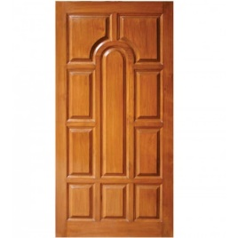

Published Candidate Recommendations
WoT Architecture
Constraints
Things must have TD (W3C WoT)
Must use hypermedia controls (general WoT)
URIs
Standard set of methods
Media Types
Interaction Affordances
Metadata of a Thing that shows and describes the possible choices (what) to Consumers, thereby suggesting how Consumers may interact with the Thing
WoT Thing Description (TD)
{
"@context": [
"https://www.w3.org/2019/wot/td/v1",
{ "iot": "http://iotschema.org/" }
],
"id": "urn:dev:org:32473:1234567890",
"title": "MyLEDThing",
"description": "RGB LED torchiere",
"@type": ["Thing", "iot:Light"],
"securityDefinitions": ["default": {
"scheme": "bearer"
}],
"security": ["default"],
"properties": {
"brightness": {
"@type": ["iot:Brightness"],
"type": "integer",
"minimum": 0,
"maximum": 100,
"forms": [ ... ]
}
},
"actions": {
"fadeIn": {
...
Pull
Handle = Affordance
What?
How?
Door = Thing
Open
Turn

Slide 7
Published WG Notes
WoT Security and Privacy Guidelines
Details beyond the security considerations in each specification for a holistic security and privacy configuration of Things
Security testing plan
WoT Binding Templates
Documentation for how to describe existing IoT ecosystems (e.g., OCF or generic Web) with WoT Thing Description
WoT Scripting API
Proposal for a standard API to consume and produce WoT Thing Descriptions
Provides interface between applications and network-facing API of IoT devices (cf. Web browser APIs)
Documents learnings from the design process

Slide 8
Status and Recent Developments
Decision to adopt JSON-LD 1.1 proposed features to allow:
Default values
Object notation (name: value) instead of arrays
Alignment with common JSON practices
Security metadata
Focus on HTTPS (Basic Auth, Digest, Tokens, OAuth2)
Protocol Bindings
Focus on HTTP and structured payloads compatible with JSON
Support for Events also using subprotocols (e.g., long polling in HTTP)
Extension Points
CoAP(S), MQTT(S), and further security schemes (e.g., ACE)
Semantic annotations with custom vocabularies (JSON-LD @context and @type)

Slide 9
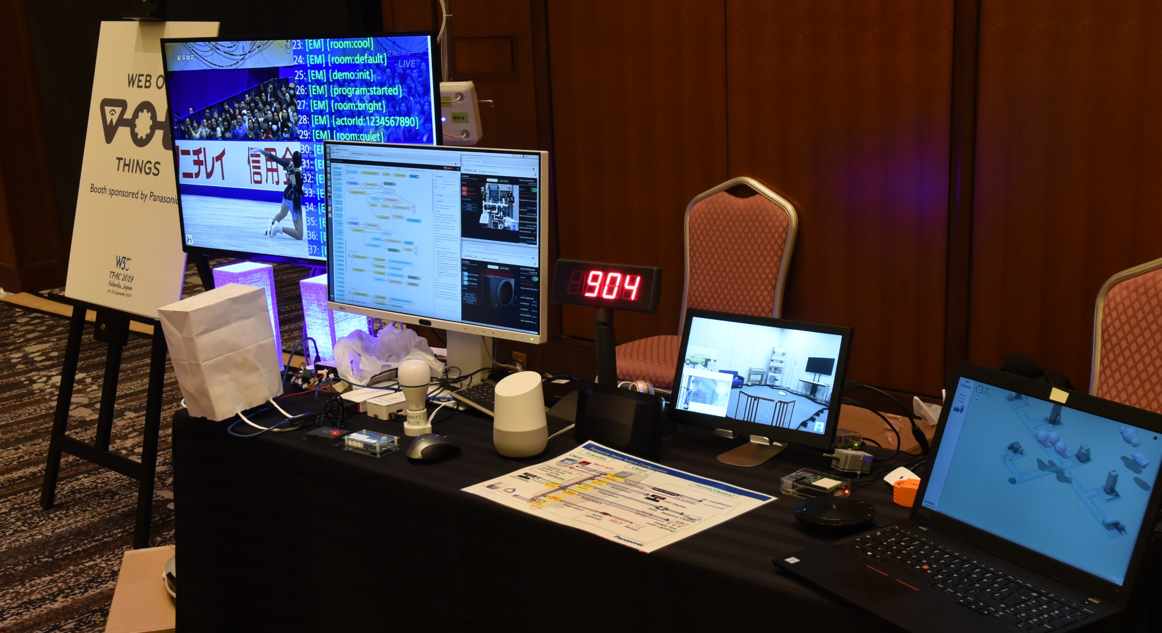
Plugfest, Use Cases, and Demos

Slide 10
WoT Next Steps: Munich Workshop
Update
Next
New
TD Security Schemes
Oauth2 flows
PoP tokens
ACE
TD Link Relation types
TD hierarchies
IANA
TD Vocabulary
Producer
Full JSON Schema
TD Default Values
Refactoring
Readability etc.
Update WoT Arch use cases
More examples
“Profile” for Plug&Play
TD default values without override
Limit URI schemes, media types, etc.
Implementation View Spec
“Web Thing API”-like
Specify details such as error responses, common features, etc.
Could represent the “Profile”
Complex Interactions
Monitor, cancel Actions
Action/Event queues
Error recovery
Hypermedia responses
Observe Defaults
Method / subprotocol
Protocol Vocabulary
CoAP(S) (including CoAPS+WS)
Privacy-preserving lifecycle and identity management
Thing Templates
Discovery
Directory
Peer-to-Peer
Protocol Vocabulary
MQTT(S) (including MQTT+WS)

Slide 11
WG Charter Proposal: Work Items
https://cdn.statically.io/gh/mmccool/wot/wg-charter-draft/charters/wot-wg-charter-draft-2019.html?env=dev
Architectural Requirements, Use Cases, and Vocabulary
Understand and state requirements for new use cases, architectural patterns, and concepts.
Link Relation Types:
Definition of specific link relation types for specific relationships.
Observe Defaults:
For protocols such as HTTP where multiple ways to implement "observe" is possible, define a default.
Implementation View Spec:
More fully define details of implementations.
Interoperability Profiles:
Support plug-and-play interoperabilty via a profile mechanism
Define profiles for specific application domains and use cases.
Thing Description Templates:
Define how Thing Descriptions can defined in a modular way.
Complex Interactions:
Document how complex interactions can be supported via hypermedia controls.
Discovery:
Define how Things are discovered in both local and global contexts and Thing Descriptions are distributed.
Identifier Management:
Mitigate privacy risks by defining how identifiers are managed and updated.
Security Schemes:
Vocabulary for new security schemes supporting targeted protocols and use cases.
Thing Description Vocabulary:
Extensions to Thing Description vocabulary definitions.
Protocol Vocabulary and Bindings:
Extensions to protocol vocabulary definitions and protocol bindings.

Slide 12
WG Charter Proposal: Work Items
https://cdn.statically.io/gh/mmccool/wot/wg-charter-draft/charters/wot-wg-charter-draft-2019.html?env=dev
Architectural Requirements, Use Cases, and Vocabulary
Understand and state requirements for new use cases, architectural patterns, and concepts.
Link Relation Types:
Definition of specific link relation types for specific relationships.
Observe Defaults:
For protocols such as HTTP where multiple ways to implement "observe" is possible, define a default.
Implementation View Spec:
More fully define details of implementations.
Interoperability Profiles:
Support plug-and-play interoperabilty via a profile mechanism
Define profiles for specific application domains and use cases.
Thing Description Templates:
Define how Thing Descriptions can defined in a modular way.
Complex Interactions:
Document how complex interactions can be supported via hypermedia controls.
Discovery:
Define how Things are discovered in both local and global contexts and Thing Descriptions are distributed.
Identifier Management:
Mitigate privacy risks by defining how identifiers are managed and updated.
Security Schemes:
Vocabulary for new security schemes supporting targeted protocols and use cases.
Thing Description Vocabulary:
Extensions to Thing Description vocabulary definitions.
Protocol Vocabulary and Bindings:
Extensions to protocol vocabulary definitions and protocol bindings.

Slide 13
WG Charter Proposal: Deliverables
https://cdn.statically.io/gh/mmccool/wot/wg-charter-draft/charters/wot-wg-charter-draft-2019.html?env=dev
Normative:
Architecture (Update)
Thing Description (Update)
Thing Description (Next)
Interoperability Profiles
Discovery
Informative:
Use case and requirement documents
Test suites and implementation reports for the specifications
Security and Privacy Guidelines (W3C Note)
Security and Privacy Best Practices (W3C Note)
Protocol Bindings (W3C Note)
Scripting API (W3C Note)
Management API Template (W3C Note)
Script Packaging (W3C Note)
Developer's Guide (W3C Note)
Other Primer or Best Practice documents to support developers and users
Key Collaborations:
Privacy
Distributed ID
JSON-LD

Slide 14
W3C WoT Resources
W3C WoT Wiki
https://www.w3.org/WoT/IG/wiki (IG/WG organizational information)
W3C WoT Interest Group
https://www.w3.org/2016/07/wot-ig-charter.html (charter)
https://lists.w3.org/Archives/Public/public-wot-ig/ (mailing list)
https://github.com/w3c/wot (technical proposals)
W3C WoT Working Group
https://www.w3.org/2016/12/wot-wg-2016.html (charter)
https://www.w3.org/WoT/WG/ (dashboard)
W3C WoT Candidate Recommendations
https://www.w3.org/TR/wot-architecture/
https://www.w3.org/TR/wot-thing-description/
W3C WoT Working Drafts / Group Notes
https://www.w3.org/TR/wot-binding-templates/
https://www.w3.org/TR/wot-scripting-api/
https://www.w3.org/TR/wot-security/
W3C WoT Editors’ Drafts and Issue Tracker
https://github.com/w3c/wot-architecture/
https://github.com/w3c/wot-thing-description/
https://github.com/w3c/wot-binding-templates/
https://github.com/w3c/wot-scripting-api/
https://github.com/w3c/wot-security/
Reference Implementation: node-wot
https://github.com/eclipse/thingweb.node-wot

Slide 15
Contacts
https://www.w3.org/WoT/WG/
Dr. Michael McCool
Principal Engineer
Intel
Technology Pathfinding
michael.mccool@intel.com
Dr. Matthias Kovatsch
Principal Researcher
Huawei Technologies
Applied Network Technology Lab
matthias.kovatsch@huawei.com

