Slide 1

W3C WoT – T2TRG Workshop Architecture TF Use Cases Lifecycle Profiles
Michael.Lagally@oracle.com
8.6.2020

Slide 2
Architecture TF work items
Requirements, Use Cases, and Vocabulary
Requirements of new use cases, architectural patterns, and concepts.
Link Relation Types: Define link relation types between things.
Interoperability Profiles: Plug-and-play interoperabilty via a profile mechanism.
Thing Description Templates: classes of things and an inheritance mechanism, modularisation.
Complex Interactions: Use of hypermedia controls to describe complex interactions and thing behaviour.
Lifecycle:
Terminology for states and transitions for products, devices, and information.
Onboarding: Define how trust can be established between Things, gateways.
Identifier Management: Mitigate privacy risks by defining how identifiers are managed and updated.

Slide 3
Architecture TF work items
Requirements, Use Cases, and Vocabulary
Requirements of new use cases, architectural patterns, and concepts.
Link Relation Types: Define link relation types between things.
Interoperability Profiles: Plug-and-play interoperabilty via a profile mechanism.
Thing Description Templates: classes of things and an inheritance mechanism, modularisation.
Complex Interactions: Use of hypermedia controls to describe complex interactions and thing behaviour.
Lifecycle:
Terminology for states and transitions for products, devices, and information.
Onboarding: Define how trust can be established between Things, gateways.
Identifier Management: Mitigate privacy risks by defining how identifiers are managed and updated.

Slide 4
Use Cases
Status and next steps

Slide 5
Use Cases
~20 new use case are in the pipeline, more to come
Active Contributors:
Intel, Fujitsu, Siemens, NHK, Singapore Govtech, Conexxus, TU Munich, Oracle
Target domains include:
Smart Cities, Industrial, Transportation, Manufacturing, Logistics, Smart Grids, Home Automation, Healthcare and Medical, Retail, Smart Home, several „technology“ use cases

Slide 6
Use Case Categories and Domains
Multi-Vendor System Integration
Out of the box interoperability of devices.
Digital twin to analyze and troubleshoot physical assets in real time, predict future problems, minimize downtime, and perform simulations.
Multi vendor and protocol interoperability by communicating across different protocols.
Accessibility
Audiovisual Devices Acting as Smartphone Extensions
Unified Smart Home Control and Status
Automotive
Smart Car Configuration Management
Energy / Smart Grids
Integrate generation, storage, grid management and consumption of energy
Transportation
Fleet management, public transport, managing shipping, air cargo, train cargo, last mile transportation.
Smart Buildings
IoT in (commercial) buildings such as office buildings, hotels, airports, train stations and sport stadiums.
Sensor networks for optimizing energy consumption of buildings.
Shared Devices and resources
Standardized use of shared resources.

Slide 7
Use Case Categories and Domains
Retail
Integrating and interconnecting multiple devices into common retail workflows.
Audio/Video
Synchronise Home WoT devices with TV programs.
Agriculture
Smart Agriculture (Greenhouse Horticulture) to create an optimal environment for growing plants.
Smart City
Managing mobile devices and sensors in a Smart City
Health
Monitor the health of people in public places to control the spread of infectious diseases.
Connected devices in ICU units.
Health Notifiers.
Manufacturing
Monitoring production lines and plants and predicting and preventing fault conditions.
Multimodal System Integration
Multimodal Recognition Support and synergistic Interactions.
Device lifecycle
Common lifecycle model.
Oauth2 Flows
Use cases for each OAuth2 flow.

Slide 8
Use Case Shortlisting
Shortlist Use cases to:
Make sure the use cases address real market needs
Make best use of limited resources
Prioritize use cases that grow the IoT market and WoT adoption
Primary question:
What advantage does the use of WoT bring to spec adopters?

Slide 9
Architecture Discussion Process
Security/ Privacy
Shortlist
Gaps
TD
Use Case
Use Case
s
Use Case
Requirement
Use Case
Scripting
New Building Block
Discovery
System Configuration
Profile

Slide 10
How to shortlist use cases?
WoT WG/IG members are requested to vote
W3C questionnaire will be published this week.
Decision Criteria:
Is there a champion ?
Is there a customer ?
Is there a product ?

Slide 11
Requirements
For each shortlisted use case we need a (one page) requirement document at:
https://github.com/w3c/wot-architecture/tree/master/REQUIREMENTS
Template: https://github.com/w3c/wot-architecture/blob/master/REQUIREMENTS/requirements-template.md
Examples are available

Slide 12
W3C WoT IG Use Case TF
Recently we started a new IG TF for collecting additional UCs
Objective
Collect input from a wider IoT market audience
Scenarios
Use Cases
Requirements
Output:
IG Group Note

Slide 13
Lifecycle

Slide 14
Goal
Describe the operational lifecycle model across different standards
Describe security model
Describe state transitions
Align terminology
Identify requirements on:
Architecture
Security
Thing description
Other WoT deliverables

Slide 15
Status
TF analyzed several lifecycle models, including:
OCF
OneM2M
LwM2M
T2TRG RFC 8576
Proposals on a unified state model is in discussion
Agreement on fundamental states
State names / transitions under discussion

Slide 16
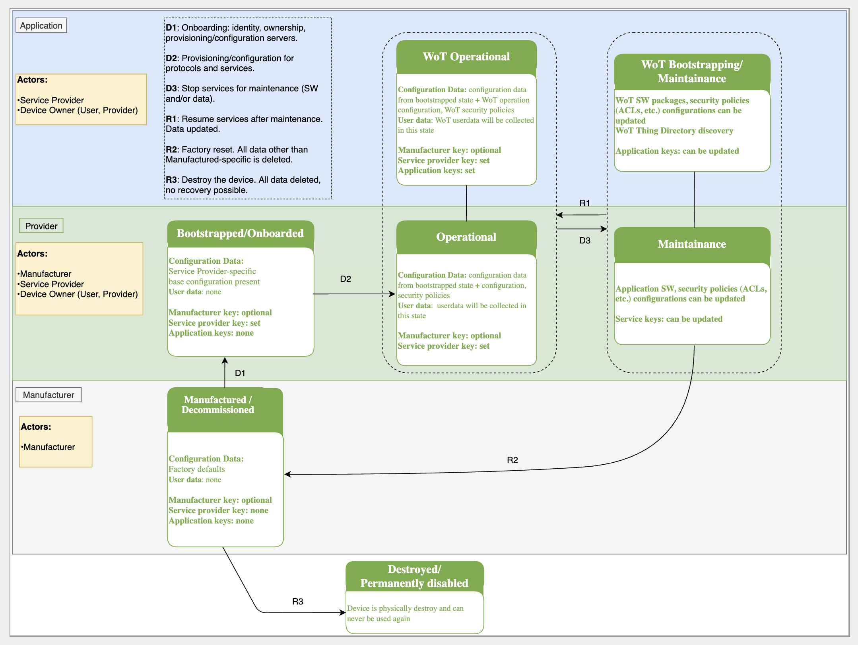
Thing lifecycle diagram (draft)

Slide 17
System lifecycle
The thing lifecycle is embedded in a wider „system“ lifecycle
System lifecycle includes:
Onboarding/offboarding a device to consumer(s)
Registering/deregistering a device with a (optional) thing directory

Slide 18
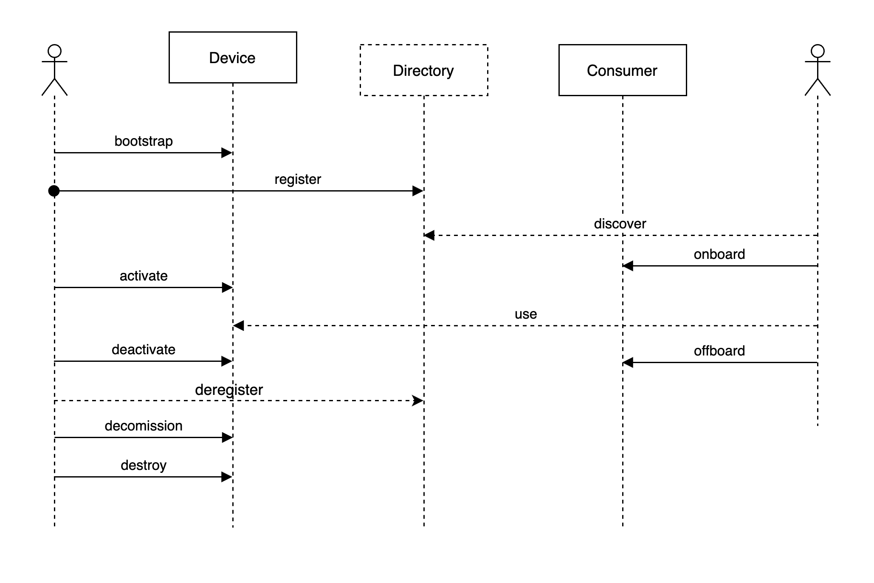
Example directory flows (draft)

Slide 19
Profiles

Slide 20
Motivation
The W3C Web of Things Architecture and Web of Things Thing Description define a powerful mechanism and a format to describe myriads of very different devices, which may be connected over various protocols.
The format is very flexible and open and puts very few normative requirements on devices that implement it.
Use Cases require „out of the box interoperability“
A generic client is impossible to implement.

Slide 21
WoT Profile
The WoT Profile specification serves two purposes:
Generic Profiling Mechanism
to describe a profile in an unambiguous way. This mechanism can be used to define additional profiles.
Core Profile
Define a subset the Thing Description for use with selected protocols.
Formalize the results of several plug-fests that were conducted by the WoT Interest Group and of tests that were conducted as part of the development.
It is expected that additional profiles for thing templates and other protocols will be defined in the near future.

Slide 22
WoT Core Profile

Slide 23
Profile Status
Last year a strawman proposal was submitted
Includes a generic profiling mechanism
Architecture TF recently focused on Use Cases / Lifecycle
-> work stalled for several months
Profile work will be resumed at upcoming (virtual) WoT F2F

Slide 24
References
WoT Architecture
https://github.com/w3c/wot-architecture
WoT Use Cases
https://github.com/w3c/wot-architecture/tree/master/USE-CASES
Lifecycle Proposals
https://github.com/w3c/wot-architecture/tree/master/proposals/lifecycle
Profiles
https://github.com/w3c/wot-profile

