Slide 1
WoT Lifecycle
Zoltan Kis + Michael Lagally
24.6.2020

Slide 2
Goal
Describe the operational lifecycle model across different standards
Describe security model
Describe state transitions
Align terminology
Identify requirements on:
Architecture
Security
Thing description
Other WoT deliverables

Slide 3
Status
TF analyzed several lifecycle models, including:
OCF
OneM2M
LwM2M
T2TRG RFC 8576
Proposals on a unified state model is in discussion
Agreement on fundamental states
State names / transitions under discussion

Slide 4
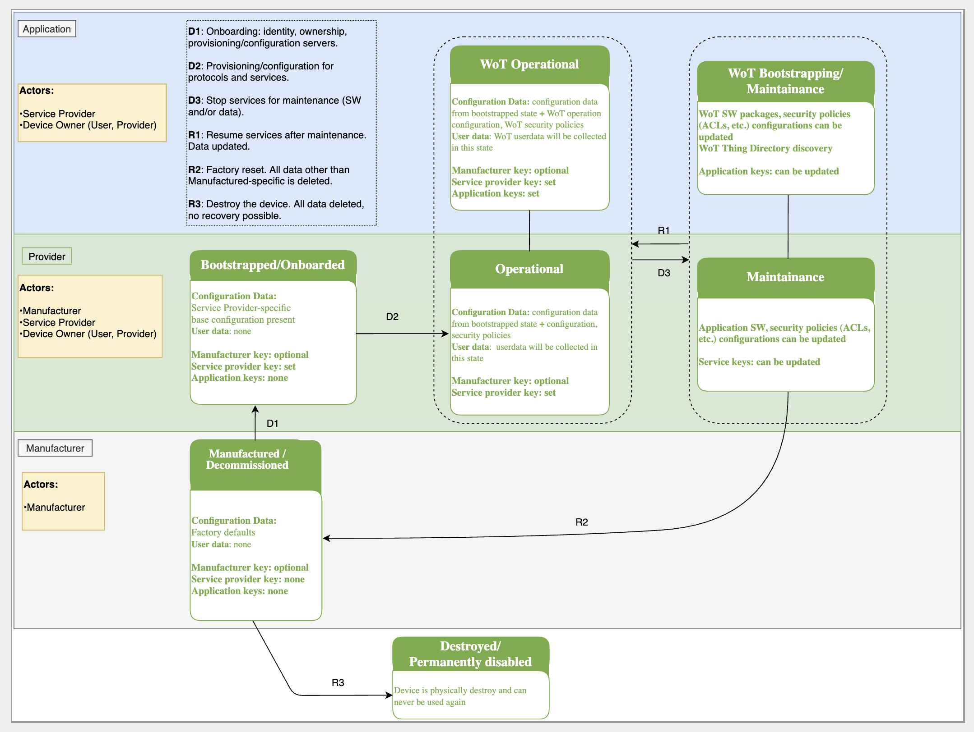
Thing lifecycle diagram (draft)

Slide 5
Lifecycle Specification draft

Slide 6
System lifecycle
The thing lifecycle is embedded in a wider „system“ lifecycle
System lifecycle includes:
Onboarding/offboarding a device to consumer(s)
Registering/deregistering a device with a (optional) thing directory

Slide 7
System state diagram (proposal)
<t.b.d (Michael)>

Slide 8
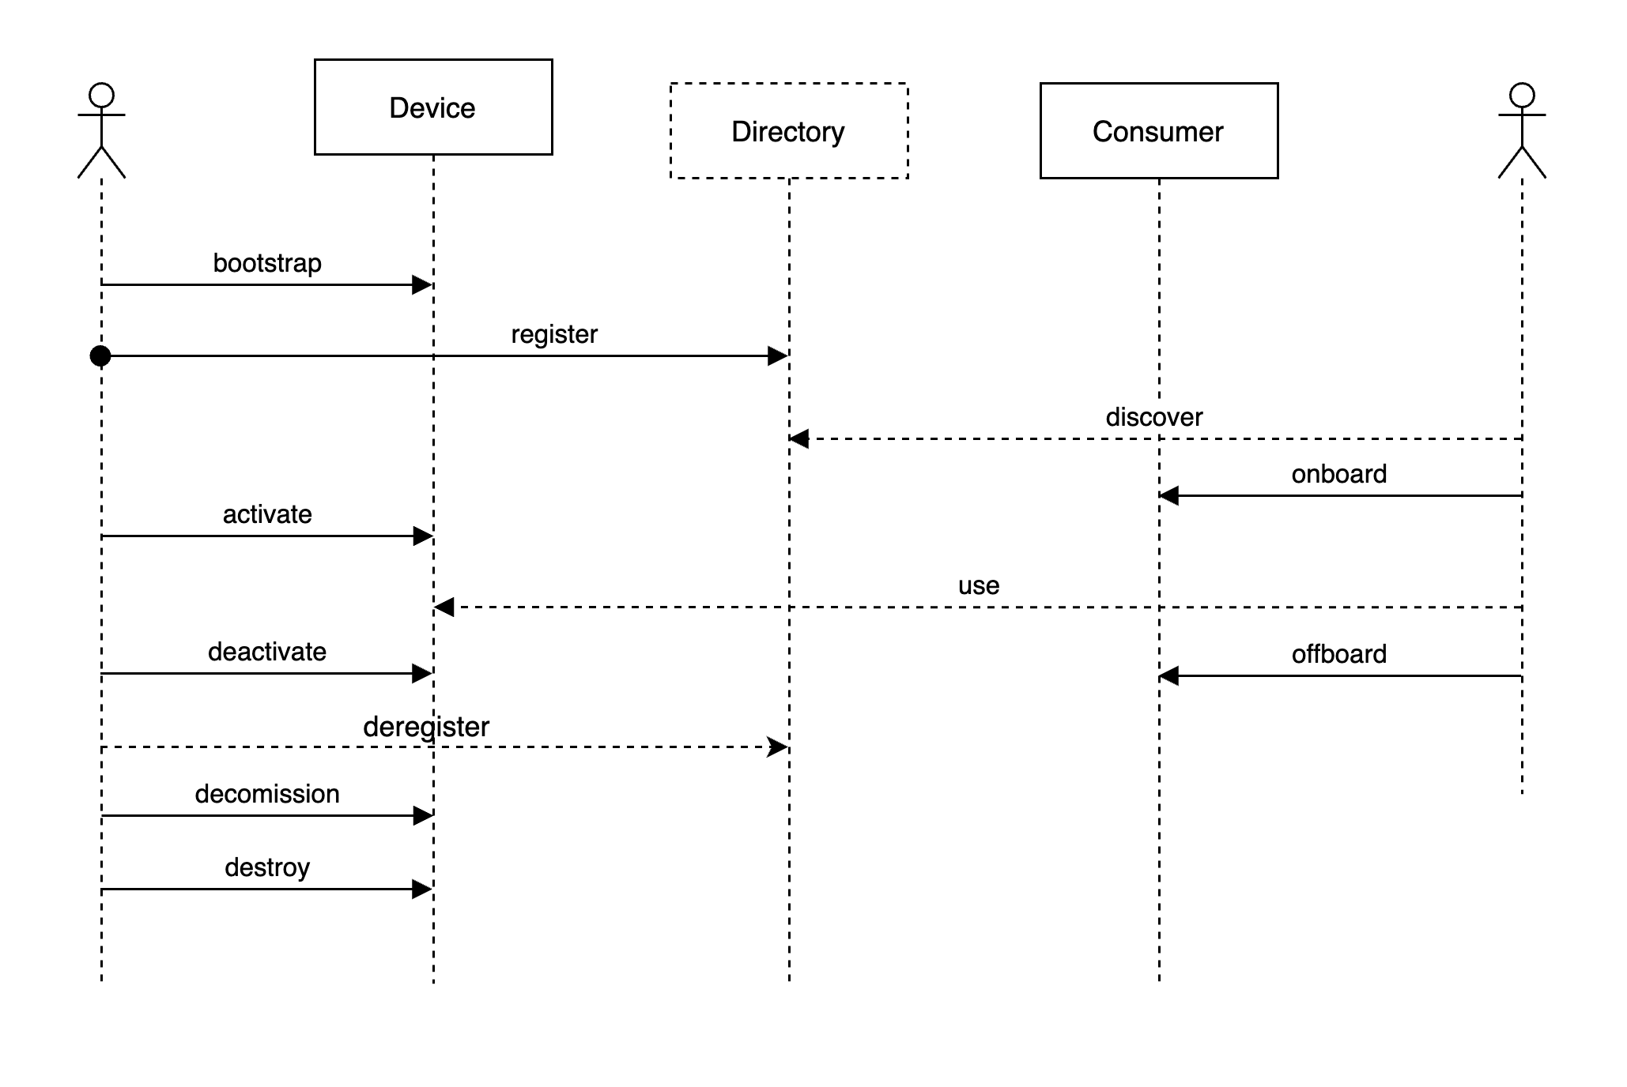
Example directory flows (draft)

Slide 9
References
WoT Architecture
https://github.com/w3c/wot-architecture
WoT Use Cases
https://github.com/w3c/wot-architecture/tree/master/USE-CASES
Lifecycle Proposals
https://github.com/w3c/wot-architecture/tree/master/proposals/lifecycle
Profiles
https://github.com/w3c/wot-profile

