Slide 1
WoT Profiles
Michael.Lagally@oracle.com
24.6.2020

Slide 2
Motivation
The W3C Web of Things Architecture and Web of Things Thing Description define a powerful mechanism and a format to describe myriads of very different devices, which may be connected over various protocols.
The format is very flexible and open and puts very few normative requirements on devices that implement it.
Use Cases require „out of the box interoperability“
A generic client is impossible to implement.

Slide 3
Is there a problem?
Current WoT spec defines a generic description language
Implementers are free to pick what they like, only very few constraints
No out of-the-box device interaction across different stakeholders
Several stakeholders raised interoperability concerns (e.g. TAG)

Slide 4
Is there a problem?
A generic TD consumer is unimplementable!
Because:
Device implementers are free to pick TD features as they like, only very few constraints in the TD spec.
Some things are not described in the TD, e.g. error behavior
Significant implementation differences are permitted (e.g. PUT vs. POST to set a property).
Implications:
No out of-the-box device interaction across different stakeholders.
Each new device class (potentially) requires implementation additional features at the consumer.

Slide 5
How to ensure Interoperability?
Specification
Unambiguous specification language, i.e. normative guarantees (RFC2119)
Complete specification that covers all corner cases
Domain / Target Specific Profiles
Reference Implementation
Compliance Framework
Test Suites with guaranteed specification coverage
Certification and validation program

Slide 6
How to ensure Interoperability?
Specification
Unambiguous specification language, i.e. normative guarantees (RFC2119)
Complete specification that covers all corner cases
Domain / Target Specific Profiles
Reference Implementation
Compliance Framework
Test Suites with guaranteed specification coverage
Certification and validation program

Slide 7
How do other specs solve this?
Example: DVB-GEM 1.3.1 / ETSI TS 102 728 V1.2.1
http://www.etsi.org/deliver/etsi_ts/102700_102799/102728/01.02.01_60/ts_102728v010201p.pdf
Selecting a target specific subset of specification features
Additional normative constraints
Additional clarifications of ambiguities

Slide 8
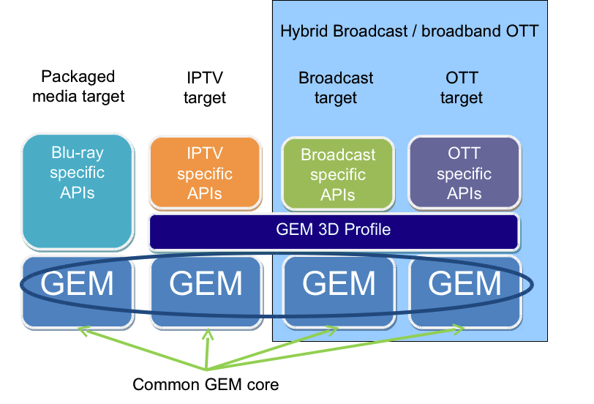
How do other specs solve this?
Example: DVB-GEM
http://www.etsi.org/deliver/etsi_ts/102700_102799/102728/01.02.01_60/ts_102728v010201p.pdf
Common core profile ensures cross target interoperability
Combined profiles are possible
Conformance testing regime enables interoperability guarantees

Slide 9
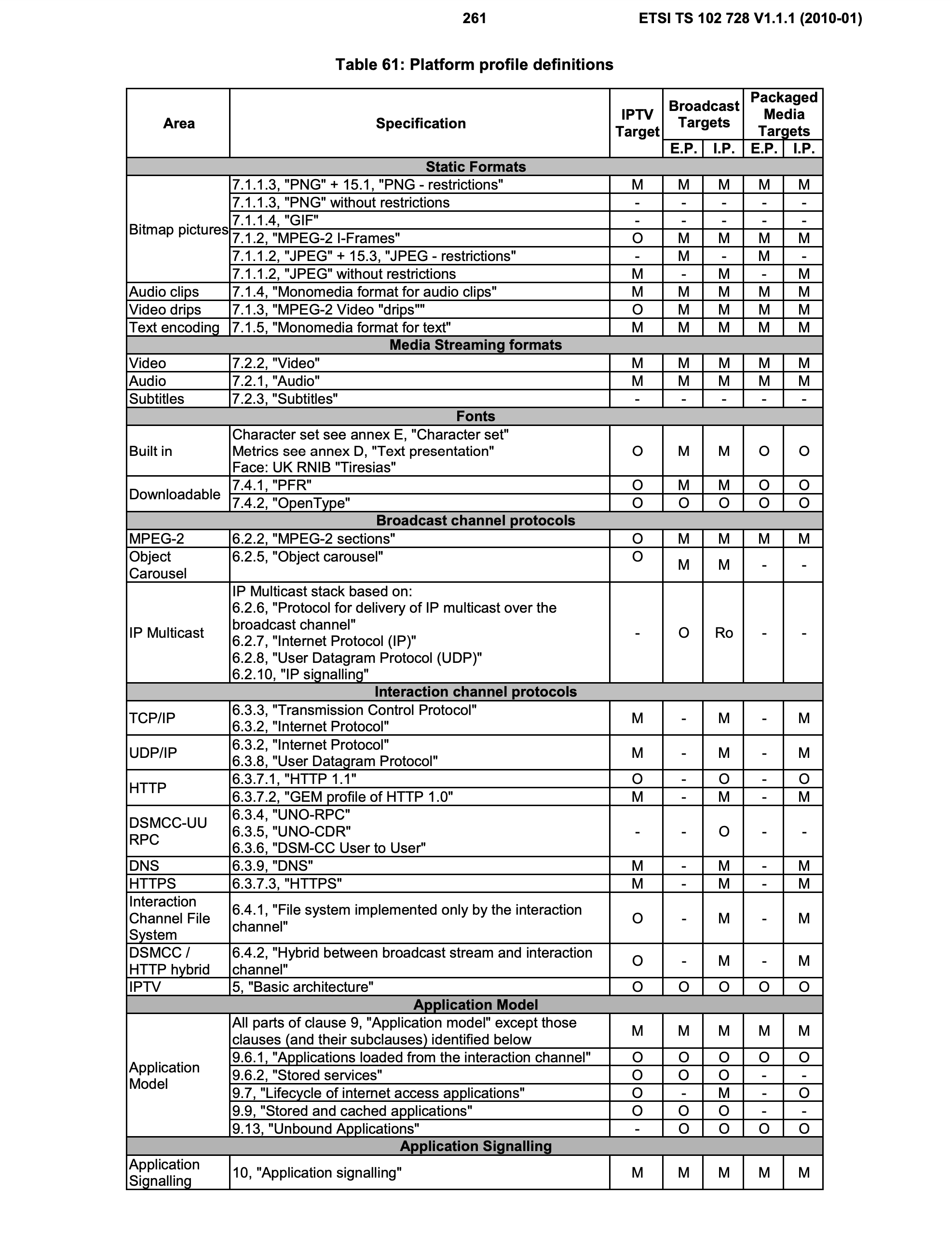
How do other specs solve this?
Example: DVB-GEM
Selecting a target specific subset of specification features
Additional normative requirements / constraints
Additional clarifications of ambiguities

Slide 10
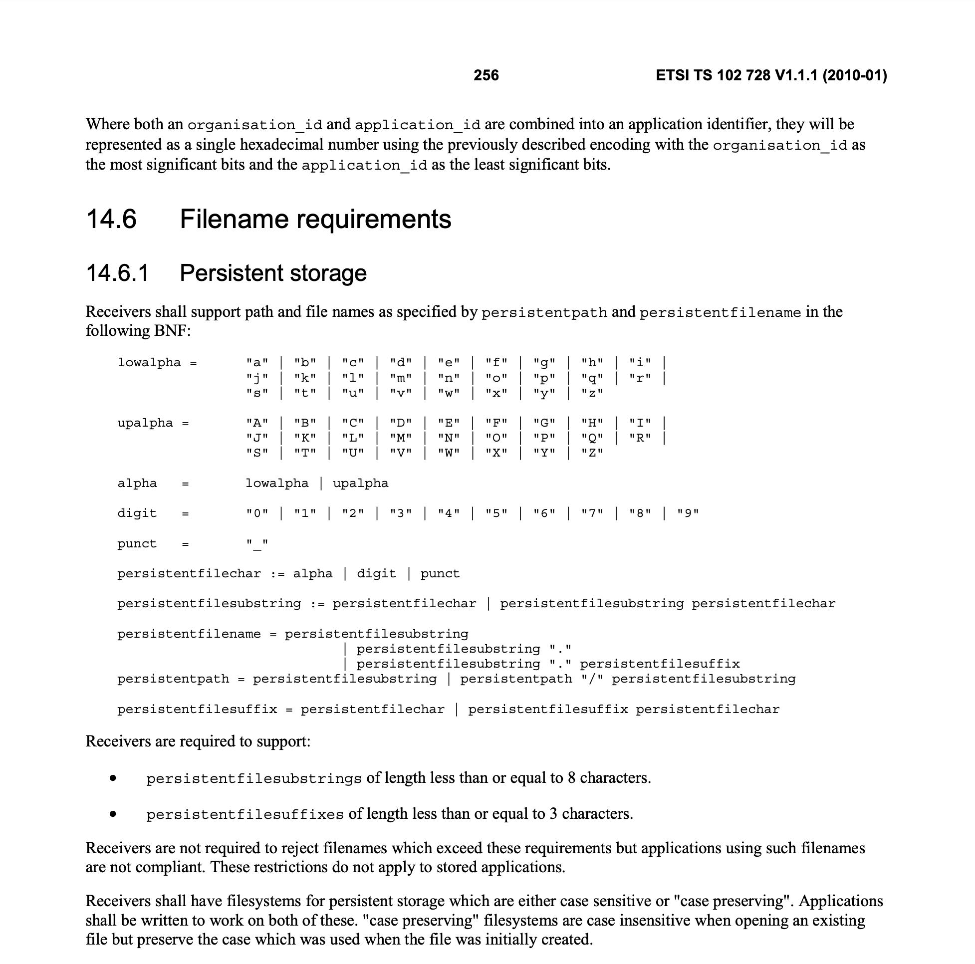
How do other specs solve this?
Example: DVB-GEM
Selecting a target specific subset of specification features
Additional normative requirements / constraints
Additional clarifications of ambiguities

Slide 11
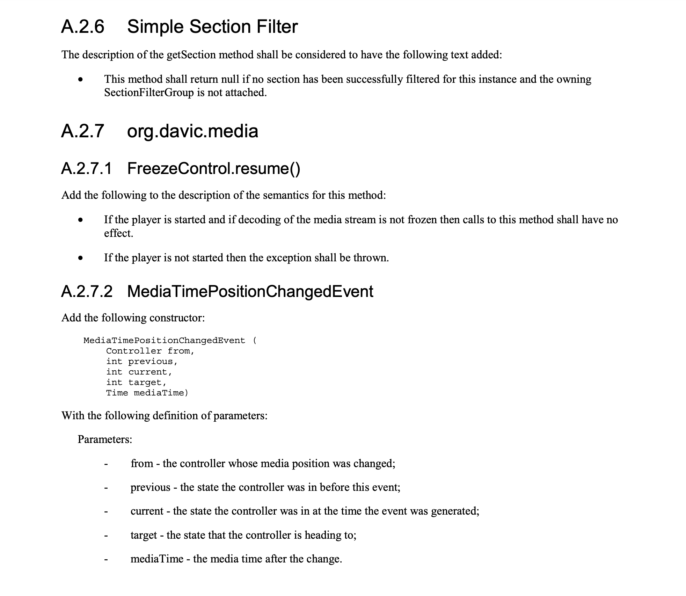
How do other specs solve this?
Example: DVB-GEM
Selecting a target specific subset of specification features
Additional normative requirements / constraints
Additional clarifications of corner cases / ambiguities

Slide 12
Scenarios, Use Cases and Requirements

Slide 13
Key Scenarios
As an end user, I want to know whether a device will work with my system before I purchase it to avoid wasting money.
Installers of IoT devices want to be able to determine if a given device will be compatible with the rest of their installed systems and whether they will have access to its data and affordances.
As a developer, I want TDs to be as simple as possible so that I can efficiently develop them.
Here "simple" should relate to the end goal, "efficiently develop"; that is, TDs should be straightforward for the average developer to complete and validate.
As a developer, I want to be able to validate that a Thing will be compatible with a Consumer without having to test against every possible consumer.

Slide 14
Use Cases
Multi-Vendor System Integration
Out of the box interoperability of devices. wot-profile.md
Digital twin to analyze and troubleshoot physical assets in real time, predict future problems, minimize downtime, and perform simulations. digital-twin.md
Multi vendor and protocol interoperability by communicating across different protocols. X-Protocol-Interworking.md
Other use cases benefit from having profiles too.

Slide 15
Proposed Requirements (under discussion)
Interoperability
Limit and reduce complexity
Ambiguities
Human readability
Developer guidance
Multiple profiles
Composable profiles
Validatible TDs
Identification of profiles
Profile should define a finite set of features and capabilities to implement by the consumer.
Limit resource consumption
Follow Security and Privacy Best Practices
Developer Mode
See: https://github.com/w3c/wot-profile/blob/master/REQUIREMENTS/requirements.md

Slide 16
Strawman Proposal

Slide 17
Objective
Define a profile on basis of the published TD and architecture specifications.
Drive WoT adoption by publishing the profile as soon as possible.
Don‘t invent new features, rather constrain and clarify existing specifications.

Slide 18
WoT Profile
The WoT Profile specification serves two purposes:
Generic Profiling Mechanism
to describe a profile in an unambiguous way. This mechanism can be used to define additional profiles.
Core Profile
Define a subset the Thing Description for use with selected protocols.
Formalize the results of several plug-fests that were conducted by the WoT Interest Group and of tests that were conducted as part of the development.
It is expected that additional profiles for thing templates and other protocols will be defined in the near future.

Slide 19
Profiling mechanism
Constraints on the vocabulary of TD classes
Make specific vocabulary terms mandatory
Constraints on class relationships
limited cardinality, e.g. only one form per interaction affordance
Constraints on values on vocabulary terms
e.g. only a single string, where string or array of strings is permitted
Constraints on data schemas
e.g. no arbitrary nested objects, arrays of arrays
Constraints on security
Security mechanisms are selected only at top level

Slide 20
Core device profile
Guarantees a minimum level of interoperability
Reading and writing of properties
Invoking actions
How?
Formalize proven interoperability results of the plug-fests
Define additional constraints, e.g. no „at risk“ features
Focus on „easy to implement“

Slide 21
Core Profile Proposal
Constraints on the protocol binding - Default Binding Profile for HTTP(S).
Pre-defined mapping of http verbs to operations, e.g. PUT to writeproperty, POST with return payload for invokeaction, etc.
Only a single “Forms” endpoint per interaction affordance.
Constrained set of data types (e.g. no arrays of arrays) in addition to constrained payload structure.
Limited subprotocol(s) to handle observe and async events.
Only a single security profile at top level for a TD.
Additional profiles may be developed that allow (require) protocol, payload, and data type adaptation.

Slide 22
WoT Core Profile

Slide 23
Profile Status
Last year a strawman proposal was submitted
Includes a generic profiling mechanism
Architecture TF recently focused on Use Cases / Lifecycle
-> work stalled for several months
Profile work will be resumed at upcoming (virtual) WoT F2F

Slide 24
Strawman Walkthrough
Strawman proposal: http://w3c.github.io/wot-profile/

Slide 25
References
WoT Architecture
https://github.com/w3c/wot-architecture
Profile Repo @ Github
https://github.com/w3c/wot-profile
Strawman proposal:
http://w3c.github.io/wot-profile/

