Slide 1
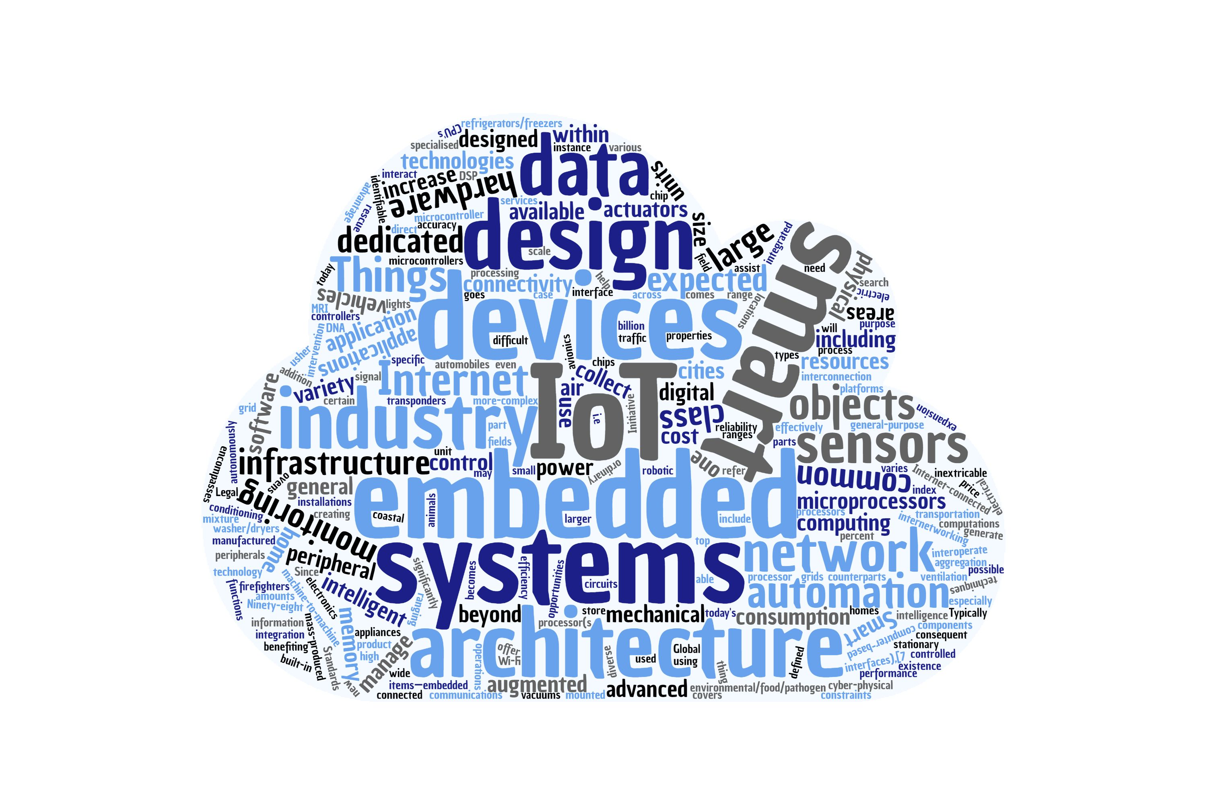
Evaluation of ROS as an Addition to the W3C WoT by Marcus Wolf Schmidt July 3rd, 2020 W3C WoT Binding Templates Taskforce Weekly Call

Slide 2
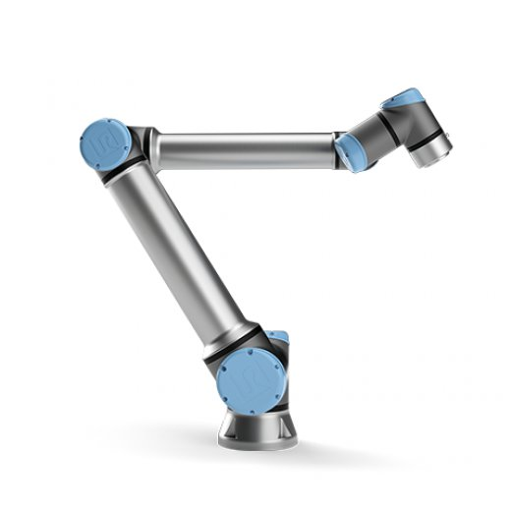
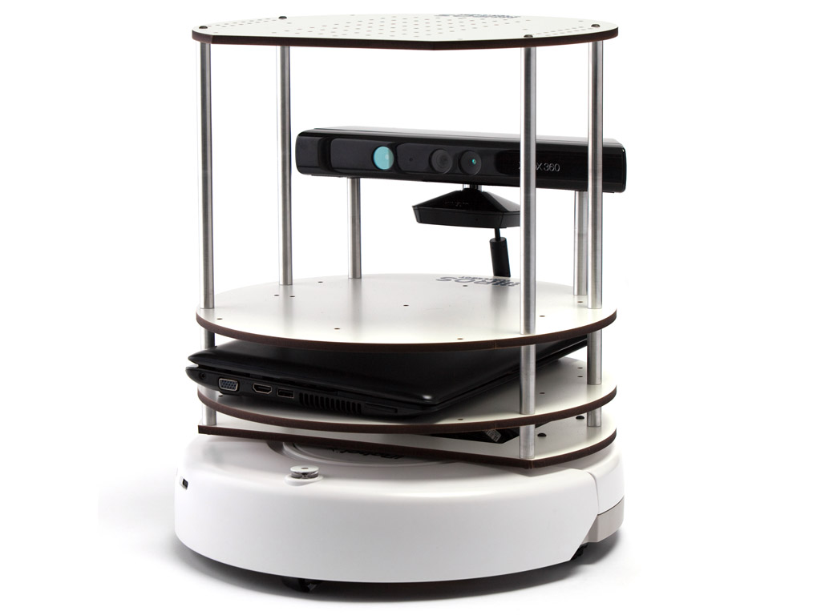
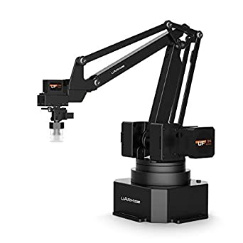

Slide 3
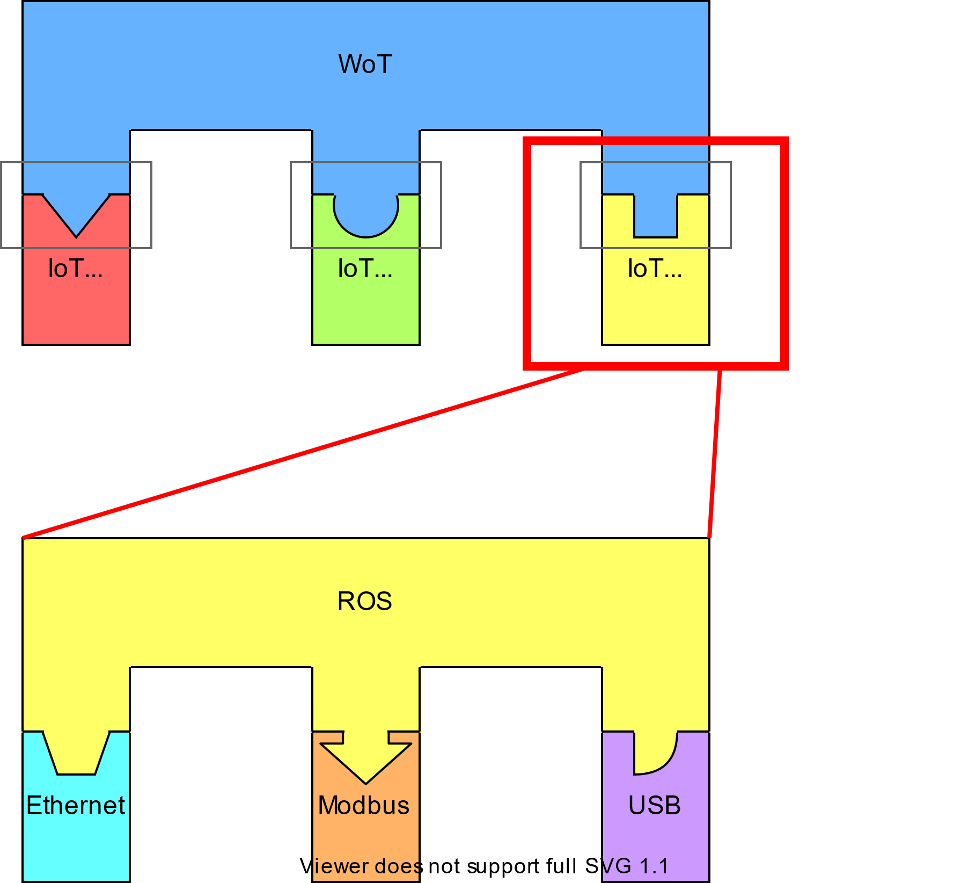





Robot Operating System (ROS)
WoT
Open Source project for robotic frameworks
Allows for various interfaces (e.g. Ethernet, Modbus, USB)
Focus on reusability of code
HTTP
MQTT
ROS
ROS

Slide 4
ROS Nodes
Listener
Talker
ROS
Master

Slide 5
ROS Master Node
Only ONE per ROS environment
Helps Nodes find each other
Communicates over XMLRPC
Provides a parameter server

Slide 6
Simple ROS Nodes
Multiple Nodes per environment and device/robot
Nodes exchange data directly
Communicates over XMLRPC and other protocols
Nodes register themselves on the Master

Slide 7
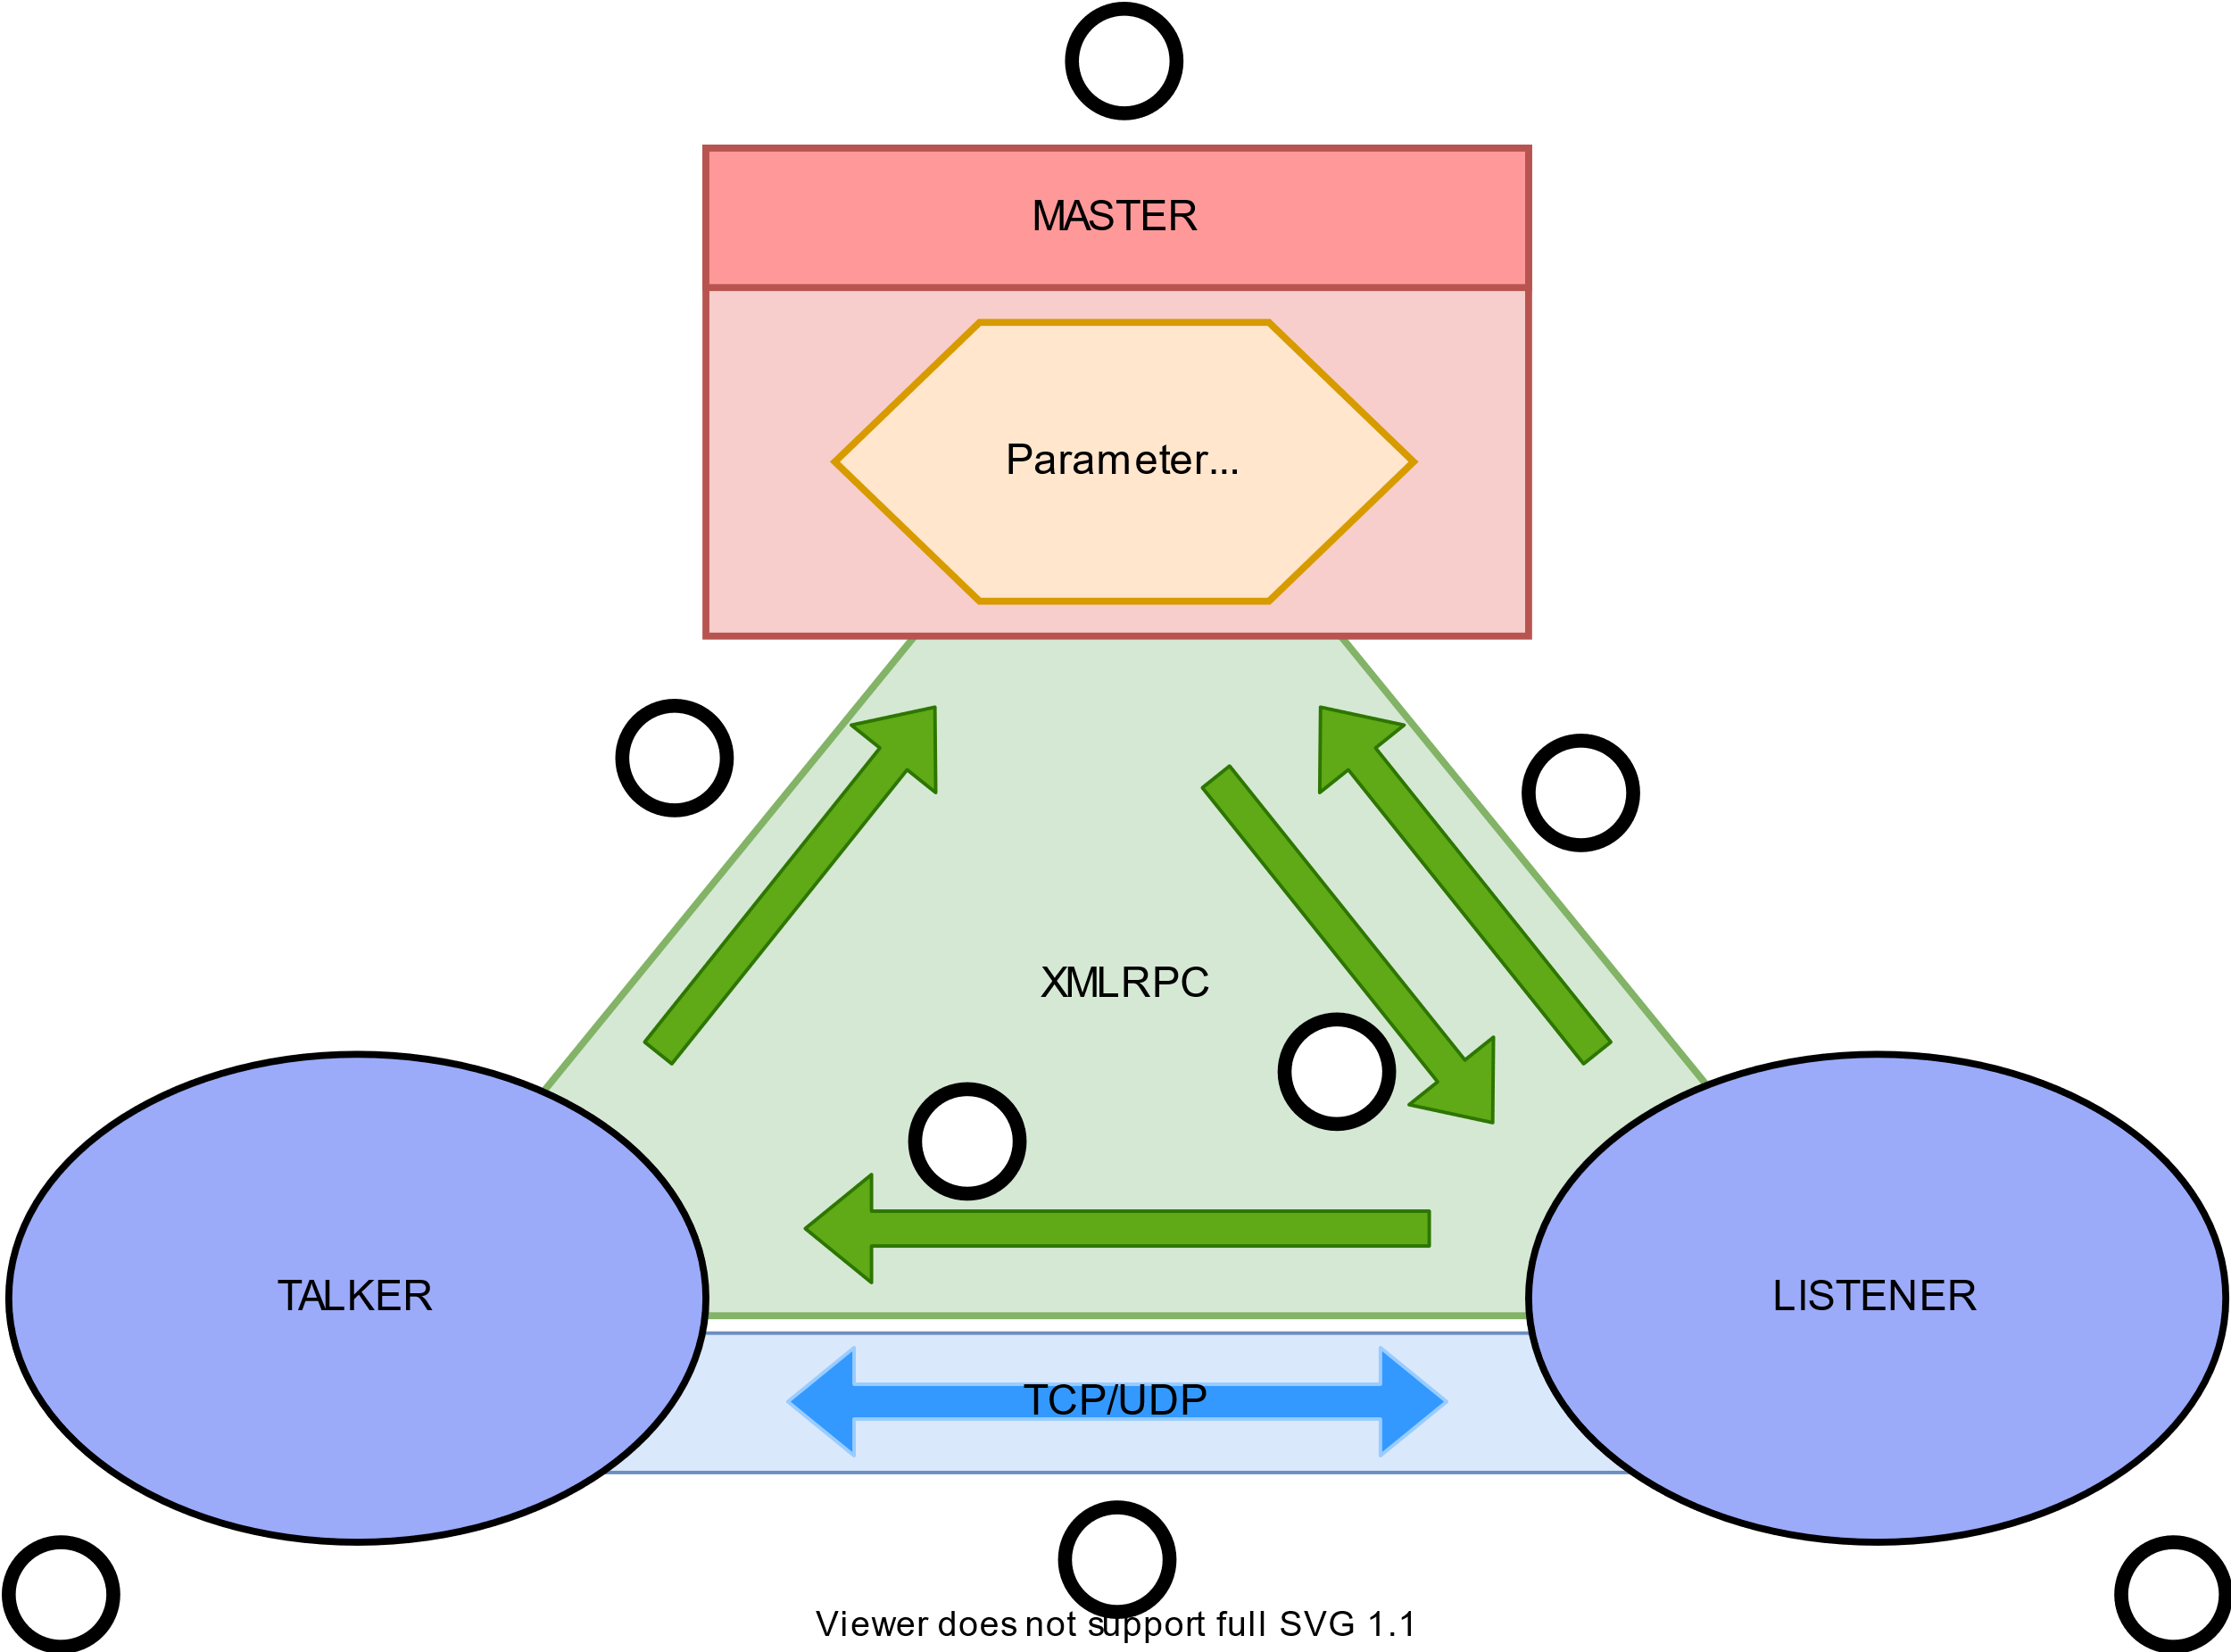



ROS Architecture
a
MASTER
Parameter
Server
2
1
3
4
TALKER
LISTENER
b
5
c

Slide 8
ROS and the W3C WoT
Publisher
Subscriber
Parameter Server
Services

Slide 9



W3C WoT Thing Description
Thing Description
readproperty
writeproperty
invokeaction
subscribeevent
observeproperty
ROS Mapping
Parameter Server
Publisher
Subscriber

Slide 10
What about Services
Publisher
Subscriber
Parameter Server
Services

Slide 11
Thing Description Vocabulary
1 {
2 "@context": ["https://www.w3.org/2019/wot/td/v1",
3 {“ros”:”http://www.example.org/ros-binding”}],
4 "title": "Uarm",
5 "properties": {
6 "location":{
7 "title":"Return location",
8 “type":"integer",
9 "forms": [{
10 "href":"ros.xmlrpc://192.168.0.100:11311/uarm/properties/location",
11 "contentType":"application/json",
12 "op":"readproperty",
13 “ros:methodName”:”getParam”
14 }]
15 }
16 },
17 "actions":{
18 “beep":{
19 "title":"Beep",
20 "forms":[{
21 "href":"ros.tcp://192.168.0.100:11311/uarm/actions/beep",
22 "contentType":"ROS/String",
23 "op":"invokeaction",
24 "ros:registerClass":"Publish"
25 }]
26 }
27 },
28 "events":{
29 "error":{
30 "title":"Error Event”,
31 "forms":[{
32 "href":"ros.tcp://192.168.0.100:11311/uarm/events/error",
33 "contentType":"ROS/String",
34 "op":"subscribeevent",
35 "ros:registerClass":"Subscribe"
36 }]
37 }
}
}

Slide 12
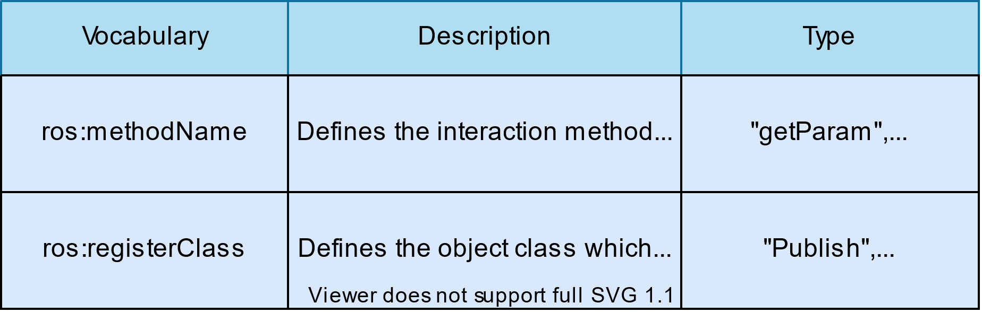






Vocabulary Table
“getParam“,“setParam“
“Publish“, “Subscribe“,(“Service“)

Slide 13
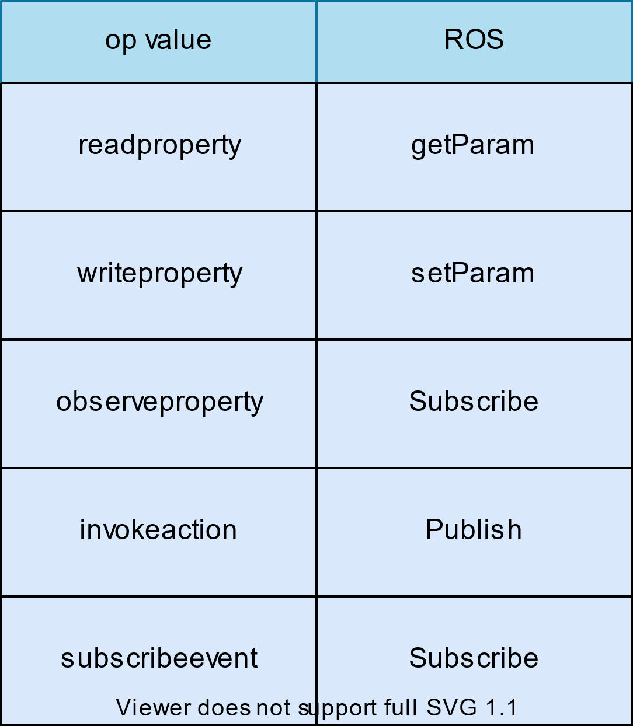



Vocabulary Mapping

Slide 14
Dicussion
Relevant Github Issue:
https://github.com/w3c/wot-thing-description/issues/912

Slide 15
Conclusion

Slide 16
Thank you for your attention

