Slide 1
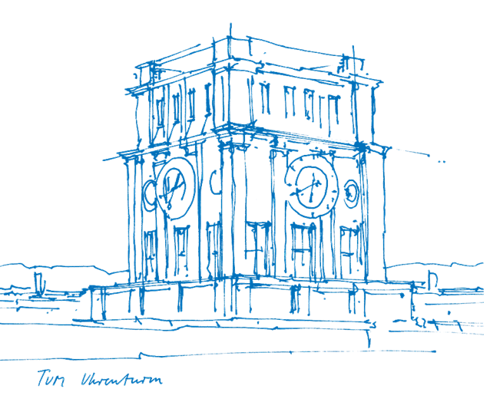
Web of Things System Description for Representation of Mashups W3C TPAC 2020
Ege Korkan
October 21st, 2020

Slide 2
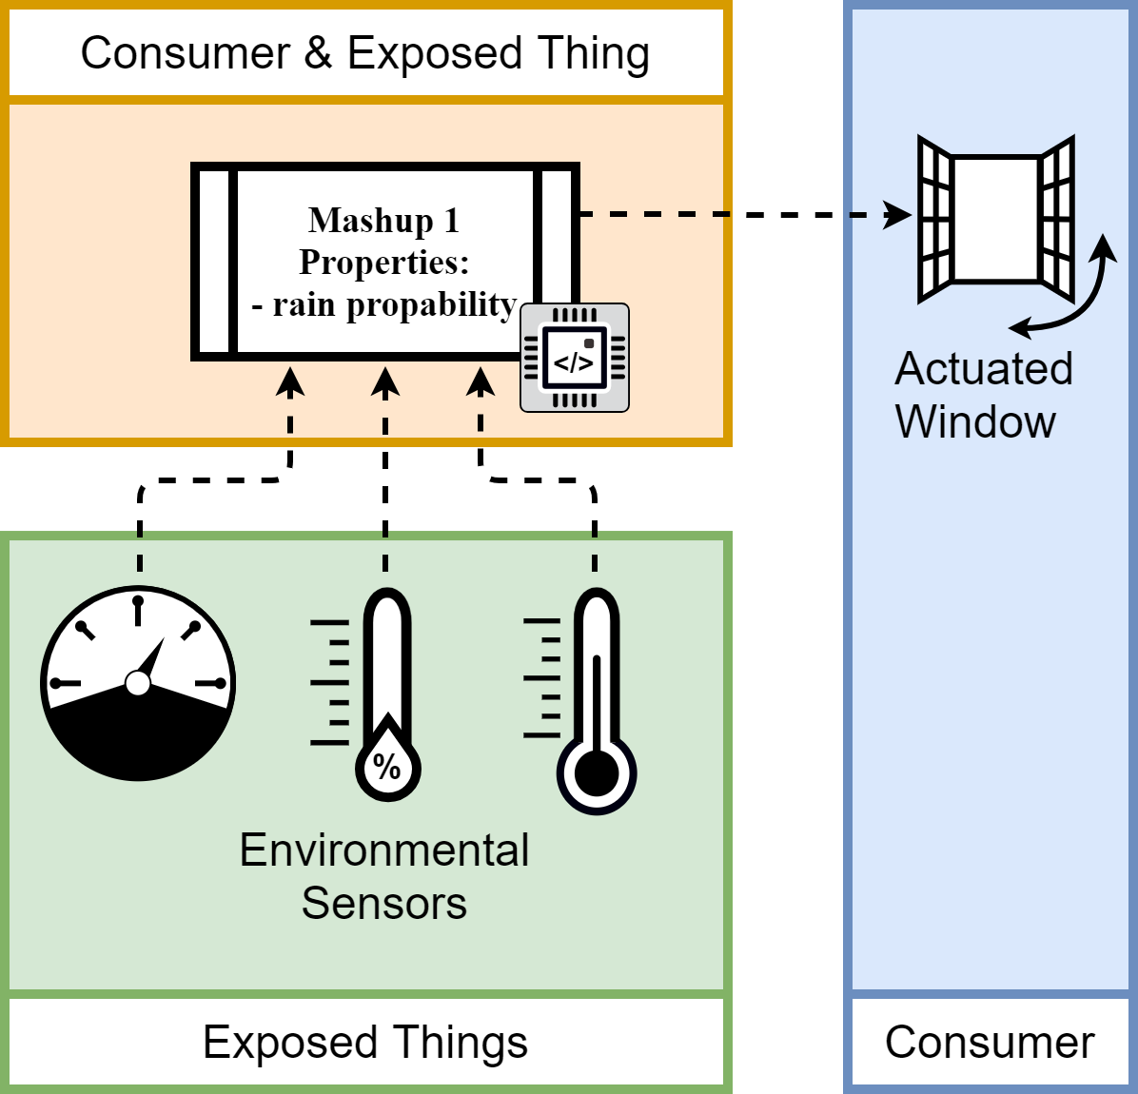
Mashups
Notes:
Big benefit of WoT:
simpler Mashup creation
creation of Interaction Affordances.
How to represent such a Mashup?

Slide 3
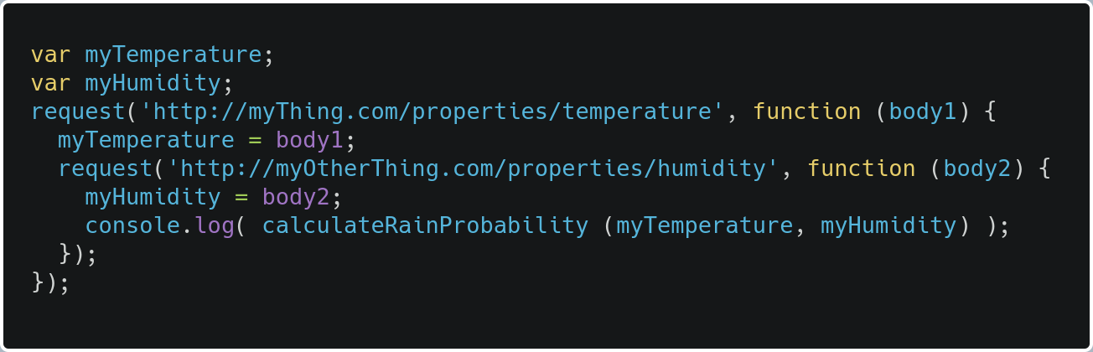
How are Mashups done today?
Code with an arbitrary language, library/framework
Notes:
New repr. To face the number of possible useful mashups

Slide 4
var myTemperature;
var myHumidity;
request('http://myThing.com/properties/temperature', function (body1) {
myTemperature = body1;
request('http://myOtherThing.com/properties/humidity', function (body2) {
myHumidity = body2;
console.log( calculateRainProbability (myTemperature, myHumidity) );
});
});

Slide 5
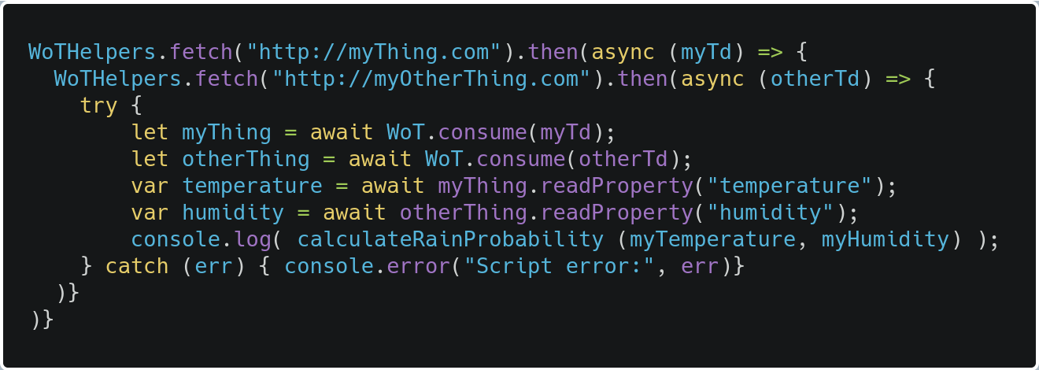
How are Mashups done today?
Scripting API!
Notes:
New repr. To face the number of possible useful mashups

Slide 6
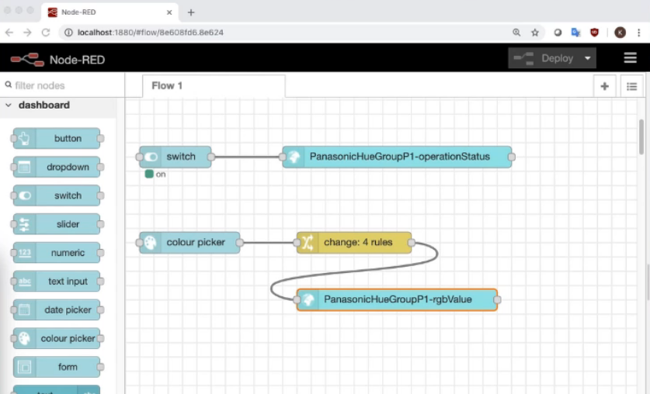
How are Mashups done today?
Node-RED with node-gen
Notes:
New repr. To face the number of possible useful mashups

Slide 7
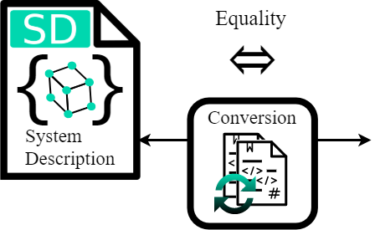
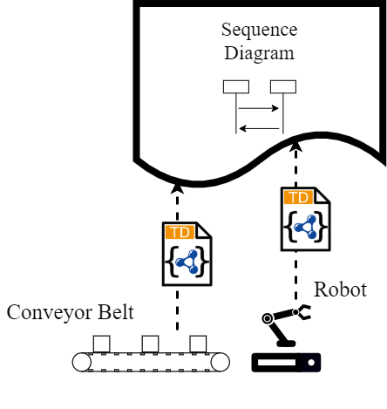
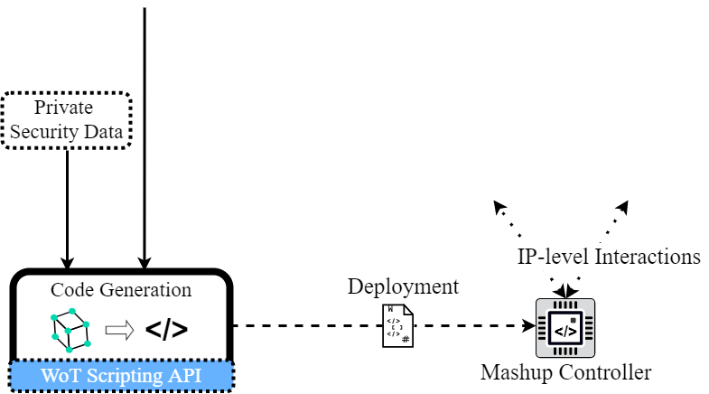
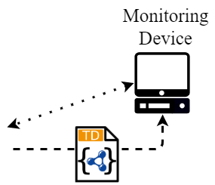
Mashup Management Approach
WoT Sequence Diagram
WoT System Description
Conversion
Automatic code generation
Interaction Affordances creation
Published on COINS2020 Conference on September 2020
Notes:
Application logic (loops, if, wait, getter/setter, references) and interactions!

Slide 8
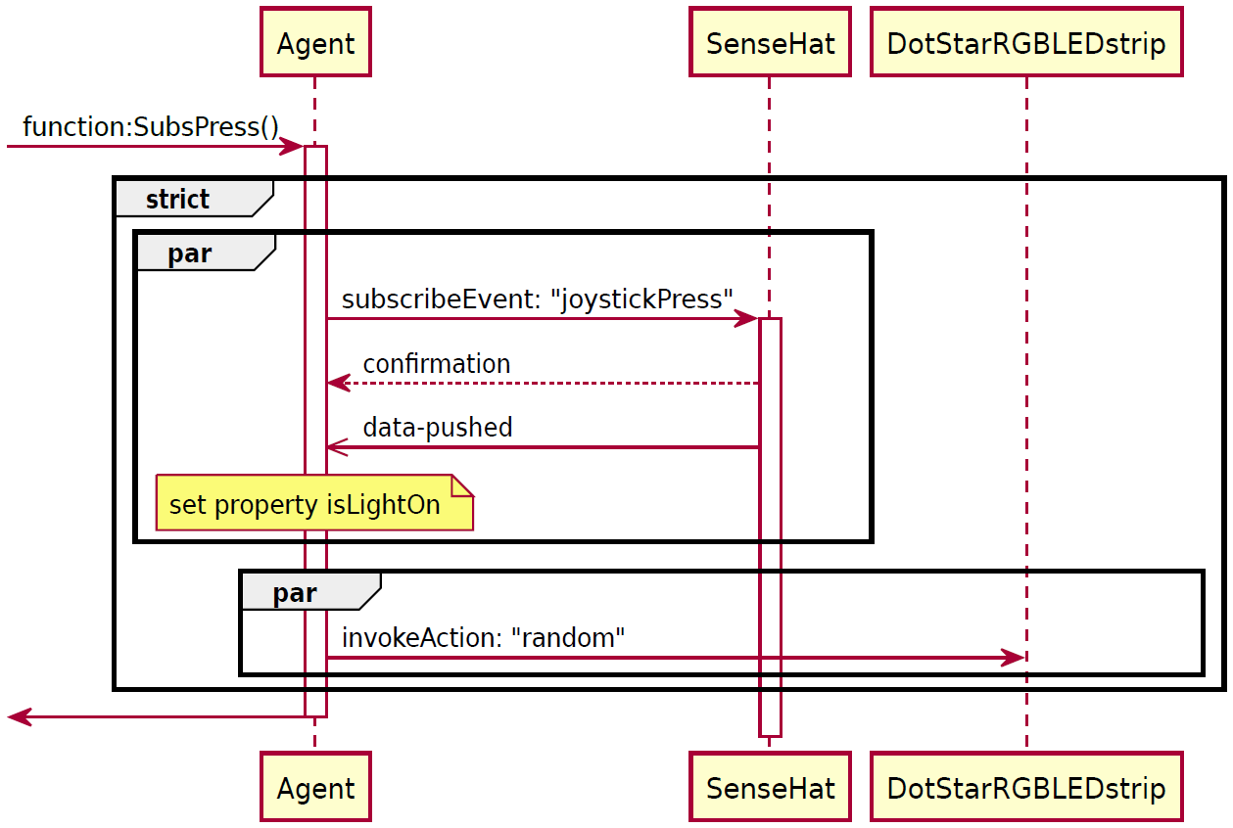
WoT Sequence Diagram – Example
Mashup Controller
Involved Things
Type & Name
Interaction Sequence
Setter Function

Slide 9
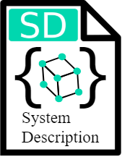


WoT System Description – Structure
Keywords
Things:
Things involved in the Mashup
Path:
Application logic
Functions & Variables:
Internal logic and data
Keywords for their child elements
Semantics
JSON-LD context
SD ontology
+

Slide 10
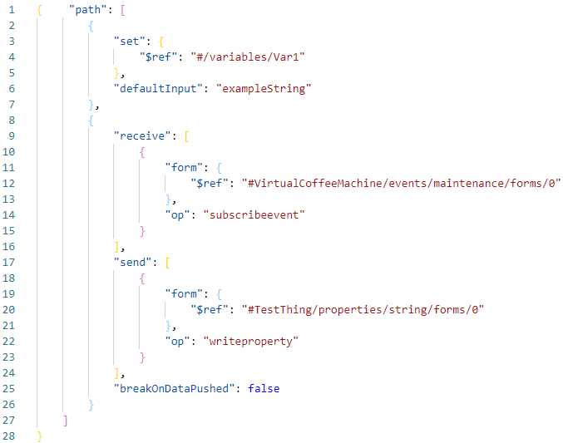

WoT System Description – Example
Setter Function
Interaction Sequence
JSON Schema Definition
System Description

Slide 11









Algorithms
Conversion algorithms (System Description <-> Sequence Diagram)
Parse
Generate
Input
Internal Representation
Output
Code generation
Add Protocol Imports
Index
System Description
SD
Application Code
Internal Representation
Parse
Code Generation
Implementation

Slide 12


Evaluation – Case Studies 1 & 2
1
Scenario 1 Simple, Turn LEDs for 10s on, if button is pushed.
Scenario 2 W3C 2nd WoT Workshop, Smart home scenario. Provide come home/go away (lights on/off). -> Provide, for example Smart Assistant Integration
Push Button
LED-strip
2
ZigBee Lamp 1
ZigBee Gateway
ZigBee Lamp 2
ZigBee Lamp 3
WebThings Gateway
Actions:
Come Home
Go Away
LED-strip

Slide 13
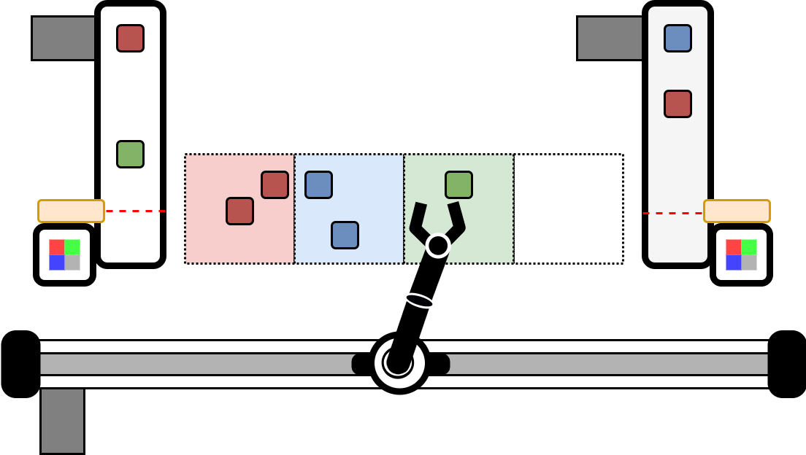
Evaluation – Case Study 3
Conveyor Belt with objects
Scenario 3 ESI industrial scenario testbench. Task: Sort objects from conveyor belts.
Dropping Area
Infrared Sensor
Color Sensor
Robot Arm on Actuated Slider
3
Robot Arm
Conveyor Belt 1
Infrared Sensor 1
Conveyor Belt 2
Infrared Sensor 2
Color Sensor 1
Color Sensor 2

Slide 14
Further Information
Code generation implementation, examples, JSON-LD context file, grammar and more at https://github.com/tum-esi/wot-system-description
Paper available at https://www.ei.tum.de/fileadmin/tueifei/esi/2020-05-26_CRV_WoT-System-Description-COINS-compressed.pdf
Evaluation data (SDs, Sequence Diagrams, generated code) available as zip on request
Video from the conference: https://www.youtube.com/watch?v=yOfA24lbGj0
Notes:
To conclude this presentation:
We have presented the definition of WoT Sequence Diagram and WoT System Description.
Thus, an insight in a Mashup’s application logic and an open, machine-understandable format are provided.
Furthermore, this allows to improve the documentation, storage and sharing of WoT Mashups.
We achieve this, by combining the advantages of both representations through conversion algorithms.
And make the Mashup creation process less manual and more systematic by automatic code generation, which also allows simple creation of Interaction Affordances.
Finally, we have shown with three case studies that we have improved the Mashup management in the Web of Things and established groundwork for further improvements there.

Slide 15
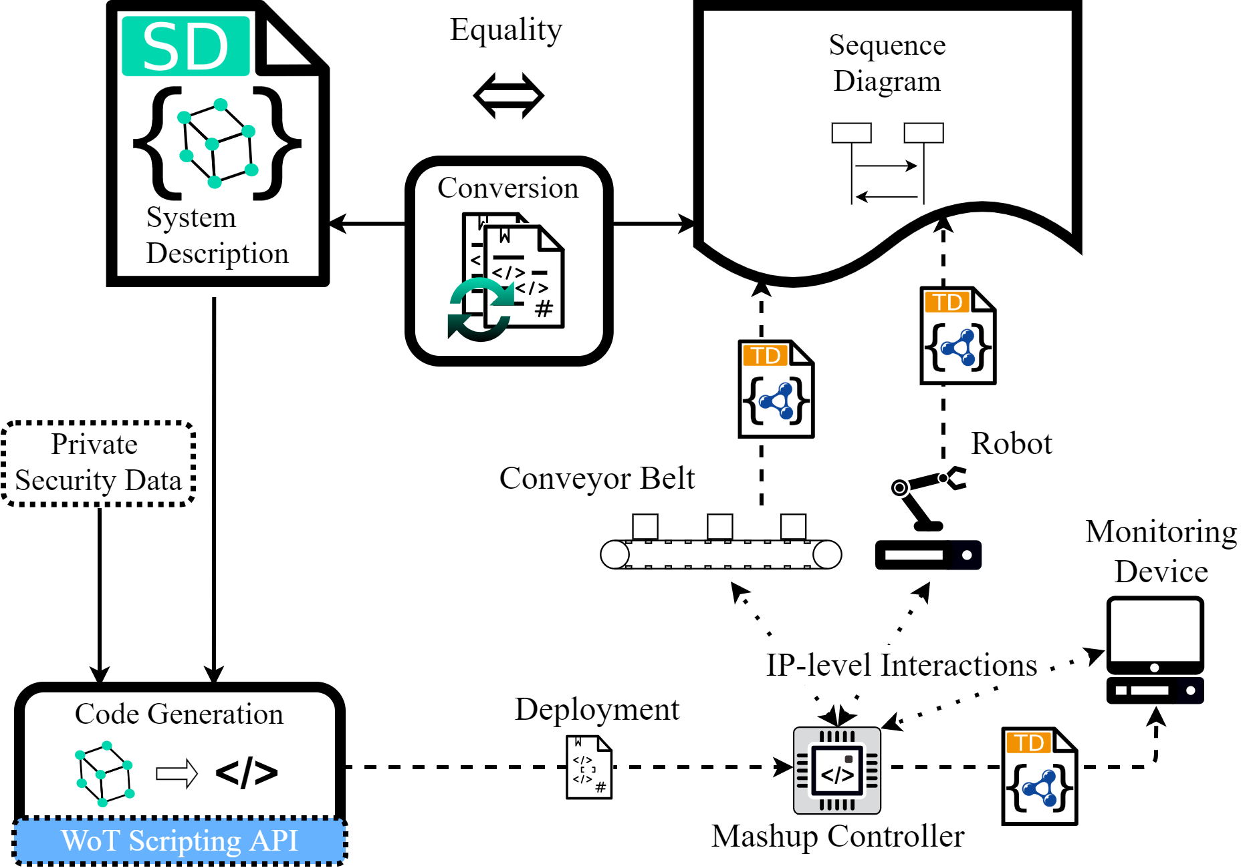
Conclusion
WoT Sequence Diagram -> gives an insight
WoT System Description -> open, machine-understandable
Conversions combine advantages
Code generation reduces manual effort
Simple Interaction Affordance creation
Evaluation with three case studies
Improved WoT Mashup Management
Notes:
To conclude this presentation:
We have presented the definition of WoT Sequence Diagram and WoT System Description.
Thus, an insight in a Mashup’s application logic and an open, machine-understandable format are provided.
Furthermore, this allows to improve the documentation, storage and sharing of WoT Mashups.
We achieve this, by combining the advantages of both representations through conversion algorithms.
And make the Mashup creation process less manual and more systematic by automatic code generation, which also allows simple creation of Interaction Affordances.
Finally, we have shown with three case studies that we have improved the Mashup management in the Web of Things and established groundwork for further improvements there.

Slide 16

Contact
Ege Korkan
Research Associate
Associate Professorship of Embedded Systems and Internet of Things
Department of Electrical and Computer Engineering
Technical University of Munich
E-Mail: ege.korkan@tum.de
Phone: +49.89.289.23573
Website: https://www.ei.tum.de/en/esi/staff/korkan/
Personal Website: http://egekorkan.com/
Twitter: @egekorkan

Slide 17





















Questions?
1
2
3
4
5
6
7
8
9
10
11
12
13
14
15
16
17
18
19

Slide 18
References & Download
https://iot-analytics.com/state-of-the-iot-update-q1-q2-2018-number-of-iot-devices-now-7b/
https://www.w3.org/WoT/IG/wiki/images/4/40/Wot-large.png
https://plantuml.com
https://json-ld.org/images/json-ld-data.png
https://json-schema.org/assets/logo.svg
H. Störrle, “Semantics of Interactions in UML 2.0,” in Proc. HCC., IEEE, 2003, pp. 129–136.
https://github.com/npm/logos/blob/master/npm%20logo/npm-logo-black.png
https://www.typescriptlang.org/favicon.ico
https://nodejs.org/static/images/logos/nodejs-new-pantone-black.svg
K.-H. Le, S. K. Datta, C. Bonnet, and F. Hamon, “WoT-AD: A Descriptive Language for Group of Things in Massive IoT,” in Proc. 5th WF-IoT. IEEE, 2019, pp. 257–262.
E. Korkan, H. B. Hassine, V. E. Schlott, S. Käbisch, and S. Steinhorst, “WoTify: A platform to bring Web of Things to your devices,” arXiv preprint arXiv:1909.03296, 2019.
https://wotify.org
L. Sciullo, C. Aguzzi, M. Di Felice, and T. S. Cinotti, “WoT Store: Enabling Things and Applications Discovery for the W3C Web of Things,” in Proc. 16th CCNC. IEEE, 2019, pp. 1–8.
https://iot.mozilla.org/gateway/
Download this Presentation:
PowerPoint (PPTX): https://1drv.ms/p/s!AmKo76mC4ZS5k78BO8PRReyfEe1qxg?e=uhX6oQ
PDF: https://1drv.ms/b/s!AmKo76mC4ZS5k78CIjDGQQISY2ANLg?e=5u2Cuj

Slide 19
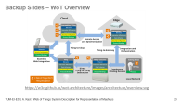
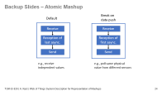
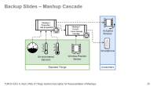
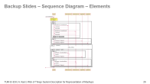
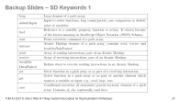
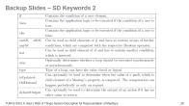
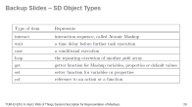
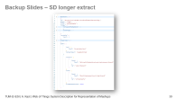
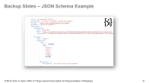
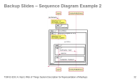
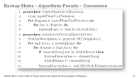
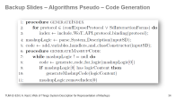
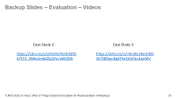
Backup Slides – Overview

Slide 20
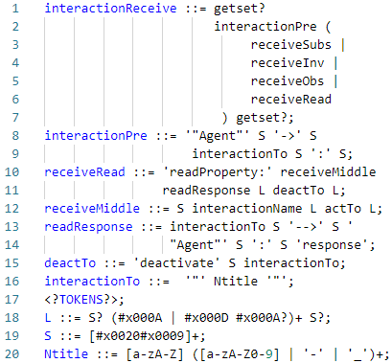
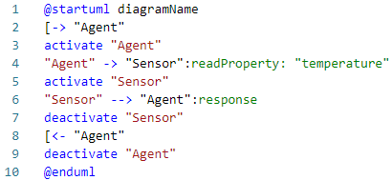
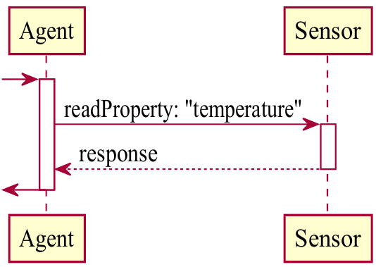
Approach – WoT Sequence Diagram – Definition
Subset of UML Sequence Diagrams standard
PlantUML as implementation
Grammar to specify the subset
Grammar
Notation Example
Presentation

Slide 21
Backup Slides – Atomic Mashup
Break on data push
Default
Receive
Receive
Reception of last async.
Reception of first async.
Send
Send
e.g., receive independent values
e.g., poll same physical value from different sensors

Slide 22



Approach – Proof of Equality – Methodology
State formalisms to represent a WoT Mashup
Conclude formalisms from Sequence Diagram (and System Description)
Compare to show their equality
Conclude overall proof
$$ⅇ≔e_{1}e_{2}…{\left.e_{n} \right|∀}_{i∈n}:e_{i}∈C,n≥1$$
1
Application logic sequence
Set of all application logic elements
$$ⅇ$$
$$C$$
2
$$strict\left(x,y\right)≔xy |∈X,Y$$
$$X,Y$$
Not further constraint sets
3
Concatenation of elements.
$$SequenceDiagram\left(m\right)⟺SystemDescription(m)$$
4
With $m∈M$the set of possible Mashups

Slide 23
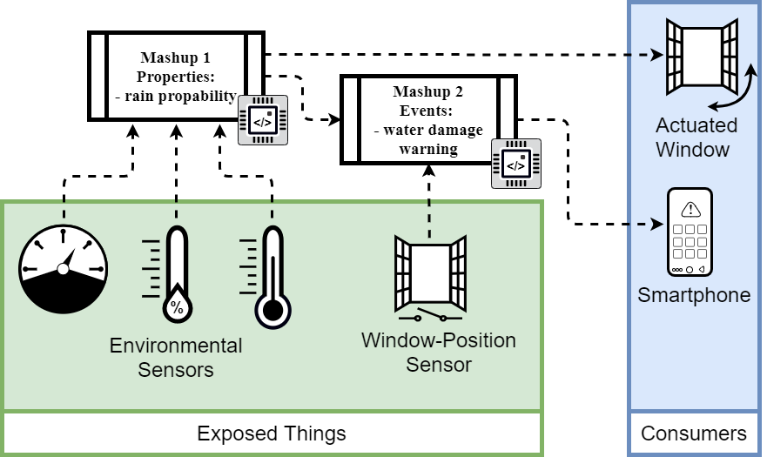
Backup Slides – Mashup Cascade

Slide 24
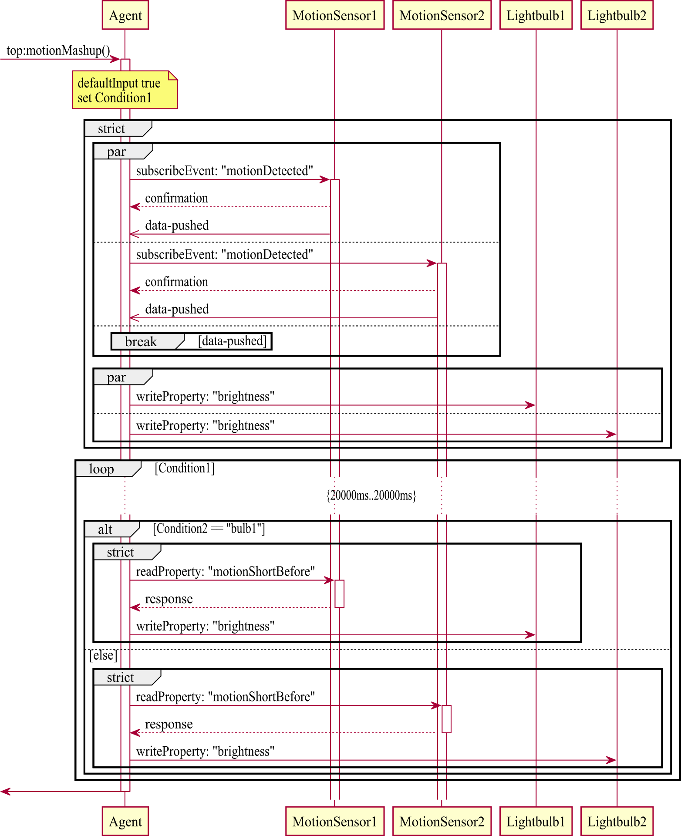
Backup Slides – Sequence Diagram – Elements

Slide 25
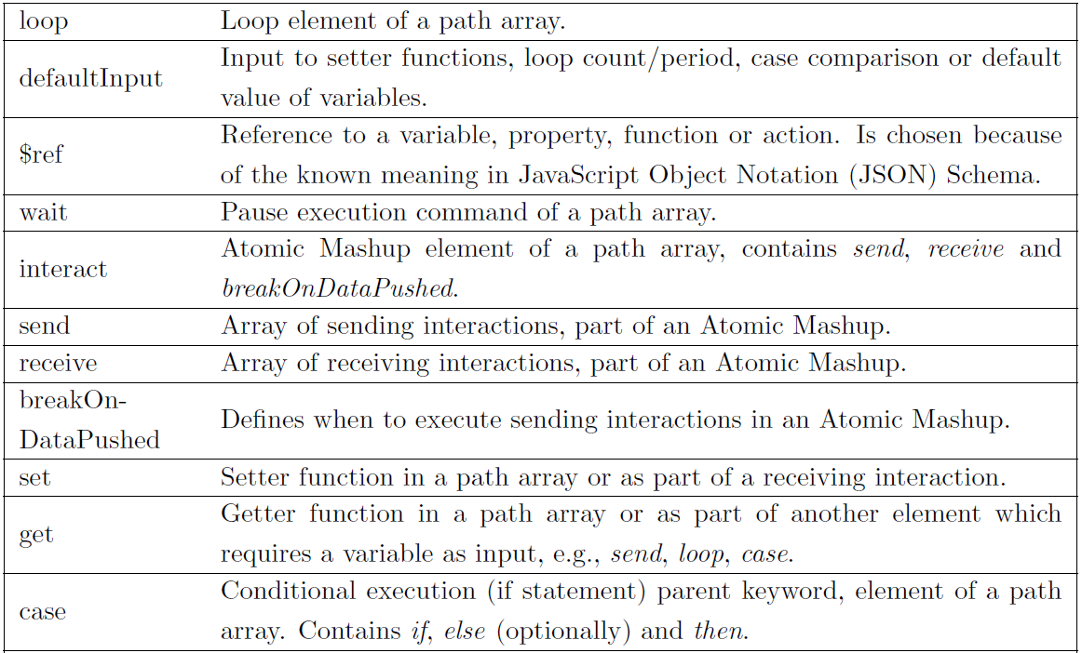
Backup Slides – SD Keywords 1

Slide 26
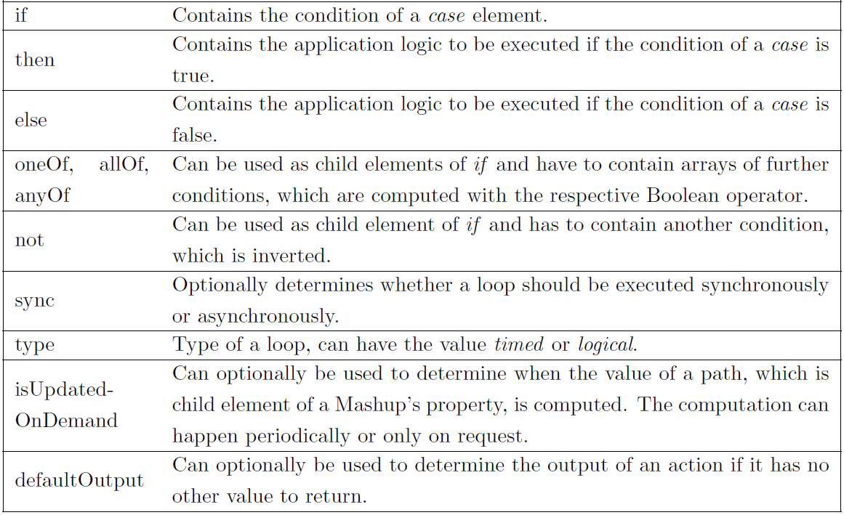
Backup Slides – SD Keywords 2

Slide 27
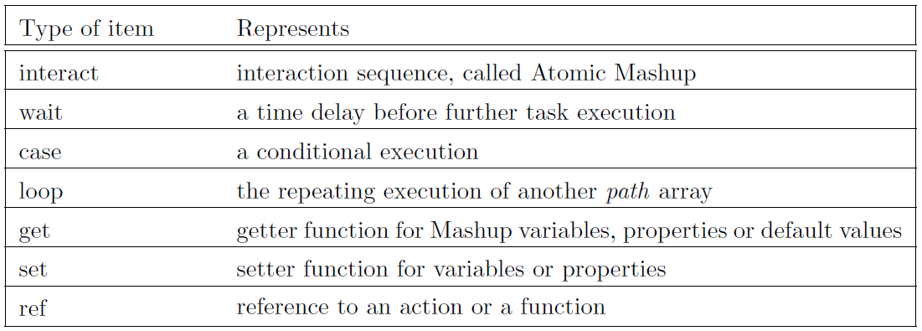
Backup Slides – SD Object Types

Slide 28
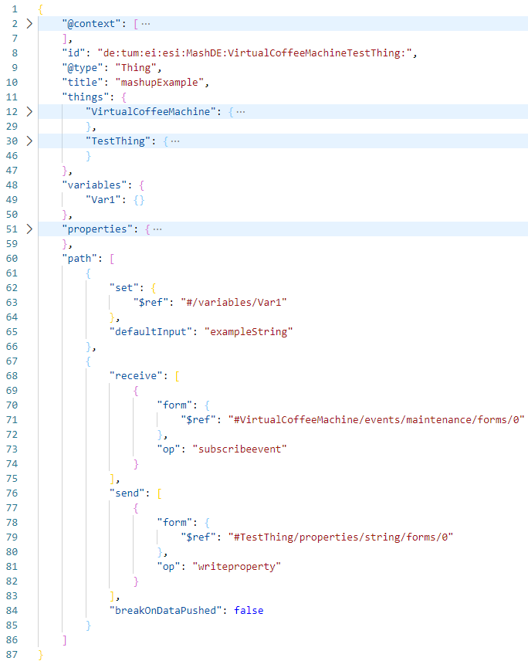
Backup Slides – SD longer extract

Slide 29
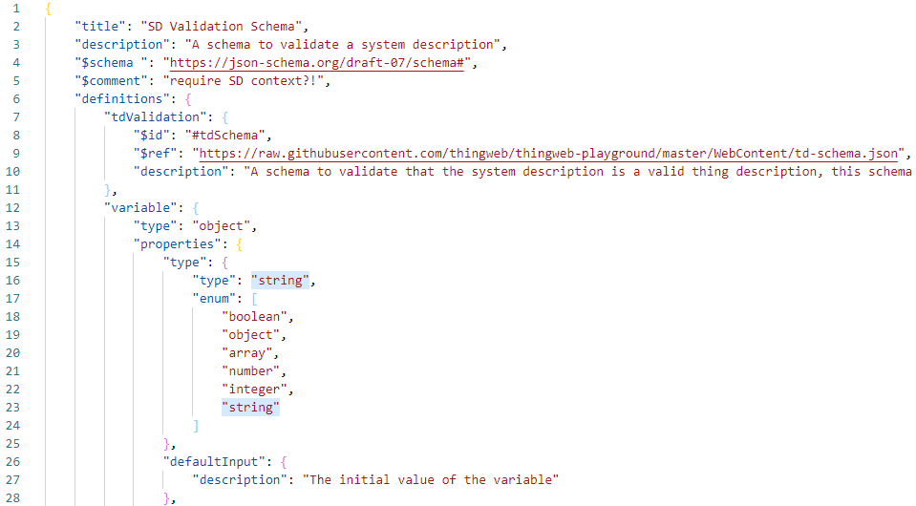
Backup Slides – JSON Schema Example

Slide 30
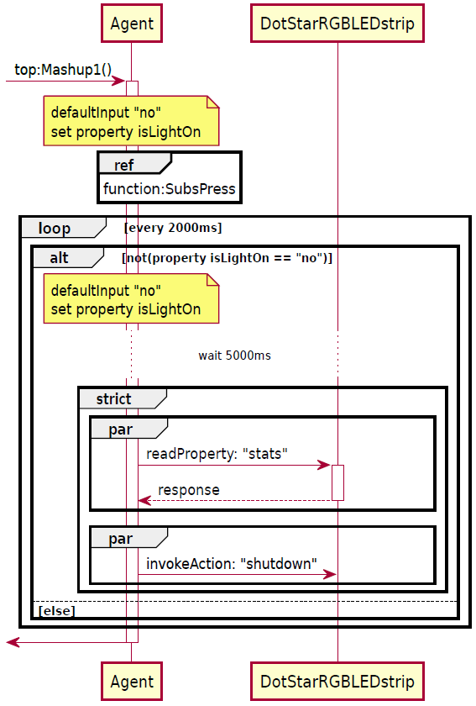
Backup Slides – Sequence Diagram Example 2

Slide 31
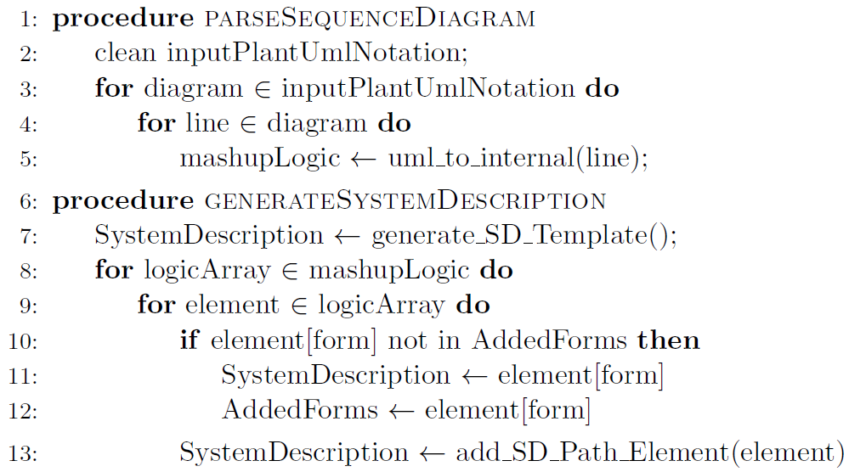
Backup Slides – Algorithms Pseudo – Conversion

Slide 32
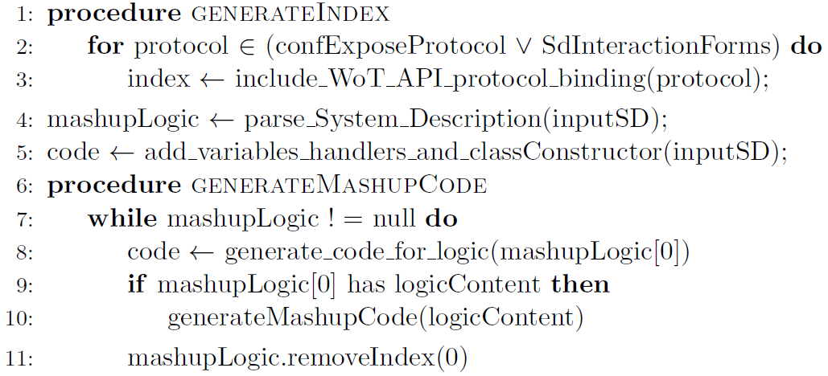
Backup Slides – Algorithms Pseudo – Code Generation

Slide 33
Backup Slides – Evaluation – Videos
Case Study 2
Case Study 3
https://1drv.ms/v/s!AmKo76mC4ZS5k7573_H69oUmbATyIA?e=VAEGDh
https://1drv.ms/v/s!AmKo76mC4ZS5k758DjnnKp0ThrZr6A?e=4qIrMV

