Slide 1
Discovery Architecture Overview
October 20, 2020
Michael McCool
Notes:
Script:
The goal of the Web of Things is to enhance IoT interoperability.

Slide 2
Discovery - Summary
Defines (prescriptively) a mechanism to distribute TDs
Support ad-hoc retrieval
Support "late binding"
Support spatial and content-based search
Both local and global contexts
Spatial search not limited to local network
Both peer-to-peer and directory-based retrieval supported
Two-phase introduction/exploration
Support for a variety of introduction ("First Contact") protocols
Actual metadata only released in second, "exploration" phase after authentication and authorization
Emphasis on privacy protection
Need to protect queries and exploration services
Need to avoid privacy risks both from direct information and inferred information leaks

Slide 3
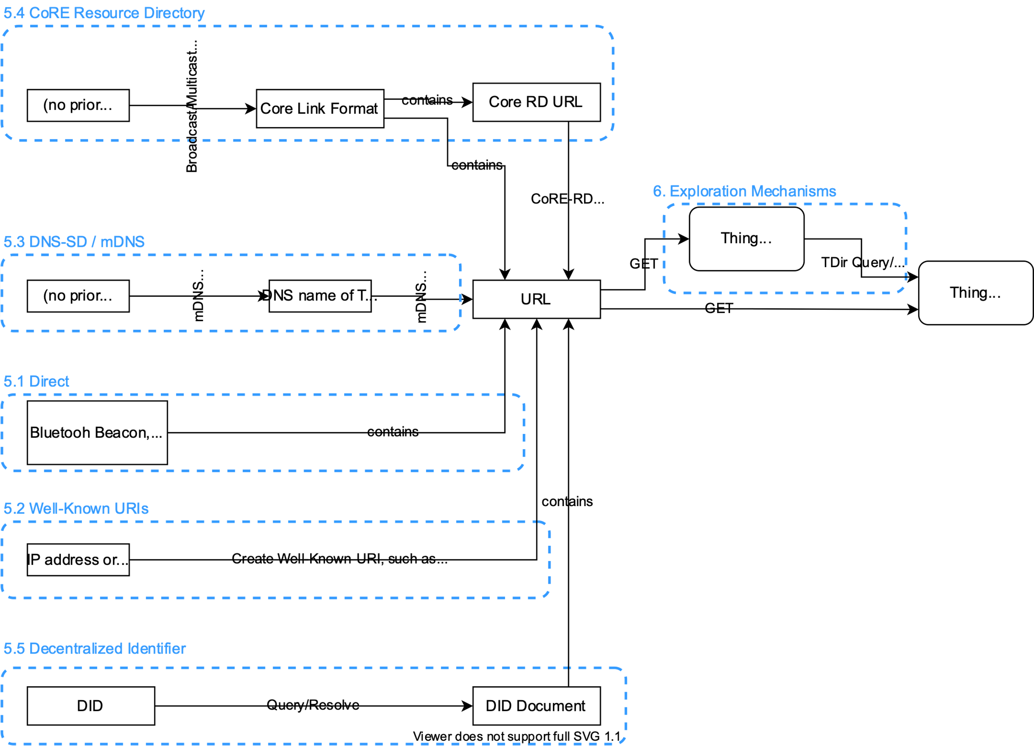
Overview
Phase 1: Introduction
Multiple mechanisms supported
No metadata released at this point
Just identifies an exploration mechanism → URL
Phase 2: Exploration
Authentication required
Can be peer-to-peer or directory based

Slide 4
Introduction Mechanisms
Direct
Just a URL, by any means (including typed in manually); NO TYPE
Also covers a variety of other mechanisms: QR codes, Bluetooth beacons, etc.
Well-Known URIs
Use RFC8615 conventions, so if you know e.g. the IP address of device, you find the TD:
{{base}}/.well-known/wot-thing-description
DNS-SD
Service Name: _wot with subtype _directory._sub._wot
Multicast DNS also supported (in local networks)
Additional information in TXT records, including alt path and type
CoRE Link Format and CoRE RD
Set of typed links → define types to identify and differentiate Things and Directories
DID Documents
Set of typed links → define types to identify and differentiate Things and Directories

Slide 5
Differentiation of Exploration Services
Two types of exploration
Direct link to TD, e.g. hosted by device
Link to directory service where TDs can be queried
Introduction gives just a URL
Some Introduction services can also provide a type, some can't
Have to assume there is no type available when the link is provided...
Exploration URL Resolution:
ALL URLs provided by introduction services resolve to TDs
For a device, that is the device's own TD
For a directory, that is the directory's TD, marked with "Directory" @type
For introduction services that can do so, there is also a sub-type defined for directories

Slide 6
Directory Query Mechanisms
Syntactic
Semantic
JSONPath
Mandatory (MUST)
Popular
Not a standard (or even that well documented...)
XPath
Recommended (SHOULD)
Same functionality as JSONPath
An actual W3C standard
SPARQL Endpoint
Optional (MAY)
Not all directories need to support it
Relatively expensive to implement
Discussion: Is SPARQL too powerful?
Easy to form pathological queries that take excessive compute time to complete

Slide 7
Major Open Issues
Geospatial Query: https://github.com/w3c/wot-discovery/issues/79
Need to define a geospatial query filter for directory searches, e.g. point and radius/elevation interval
Open 1: Definition of an Introduction mechanism with geospatial filters (a DNS extension is being considered by IETF, however)
Open 2: Where does the geospatial information for TDs come from?
Open 3: Protecting privacy
JSONPath
Not an actual standard... being discussed by IETF, however
Federated/Chained/Merged Queries
Can directories query other directories? (Right now: No...)
Registration of TDs (and System Lifecycle in WoT Architecture)
How do directories get TDs in the first place?

Slide 8
Resources
Repo
https://github.com/w3c/wot-discovery
Editor's Draft (and FPWD Candidate):
https://w3c.github.io/wot-discovery/
Requirements:
https://github.com/w3c/wot-discovery/blob/master/requirements.md
Note: being migrated to WoT Architecture document

Slide 9
Notes:
Script:
Thank you.

