Slide 1
Discovery: Introduction Mechanisms
Kunihiko Toumura
October 20, 2020

Slide 2
Outline
Overview
Current described mechanisms:
Direct
Well-known URI
DNS-based service discovery
CoRE Link Format and Core Resource Directory
Decentralized Identifier (DID) documents
Discussions
Security/Privacy
Any other introduction mechanisms?

Slide 3
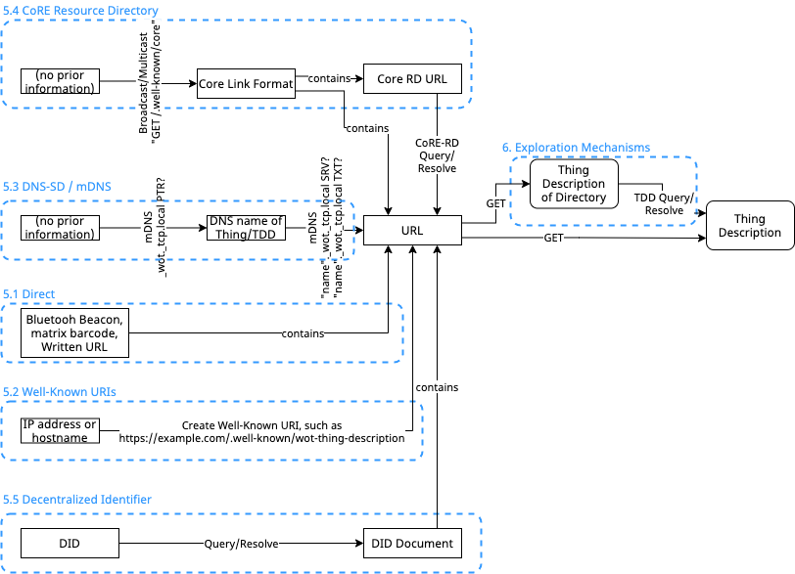
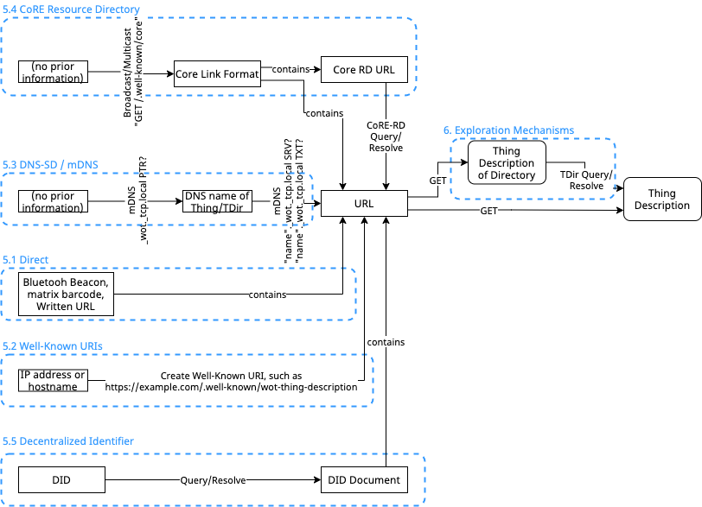
Overview
Introduction Mechanisms
Introduction Mechanism:
Find an URL which points to Thing Description of Thing or Thing Directory.
Consumer may issue HTTP GET request to the URL to retrieve a TD.
Accessing to TD SHOULD be authenticated
Utilize existing discovery mechanisms. Avoid inventing mechanisms.
TD’s Content-type MUST be: application/td+json
”@type” of Directory TD MUST be “Directory”
Type for Thing TD is ”Thing”, but not mandatory.

Slide 4

Direct
Any mechanism that result in a single URL.
Bluetooth beacons, Matrix barcodes, and written URL.
A GET on all such URLs MUST result in a TD.
QR code that contains an URL
‘http://ktorpi.local:1880/.well-known/wot-thing-description’

Slide 5
Well-known URI
RFC8615: Well-Known Uniform Resource Identifiers (URIs)
Thing or Directory Service can host their Thing Description as a site-wide metadata
“wot-thing-description” (tentative) for URL suffix
Example 1: a Consumer heuristically get a FQDN of some site: tdd.example.com, then issue HTTP request GET https://tdd.example.com/.well-known/wot-thing-description to try to retrieve a Thing Description
Example 2: Broadcast/multicasting CoAP request GET /.well-known/wot-thing-description

Slide 6
DNS-based service discovery (1/2)
DNS-based Service Discovery (RFC6763)
Multicast DNS (RFC6762)
Use (multicast) DNS query to discover Things or Directory Services
DNS-SD Service Instance Name:
<Instance>.<Service>.<Domain>
<Service> MUST be:
Thing: _wot._tcp (HTTP or HTTPS) or _wot._udp (CoAP)
Directory Service: _directory._sub._wot._tcp or _directory._sub._wot._udp
When Consumer resolves above domain name, it receives following TXT records:
td: Absolute pathname of the Thing Description of the Things or Directory Service
type: Type of the Things Description, i.e. Thing or Directory.

Slide 7
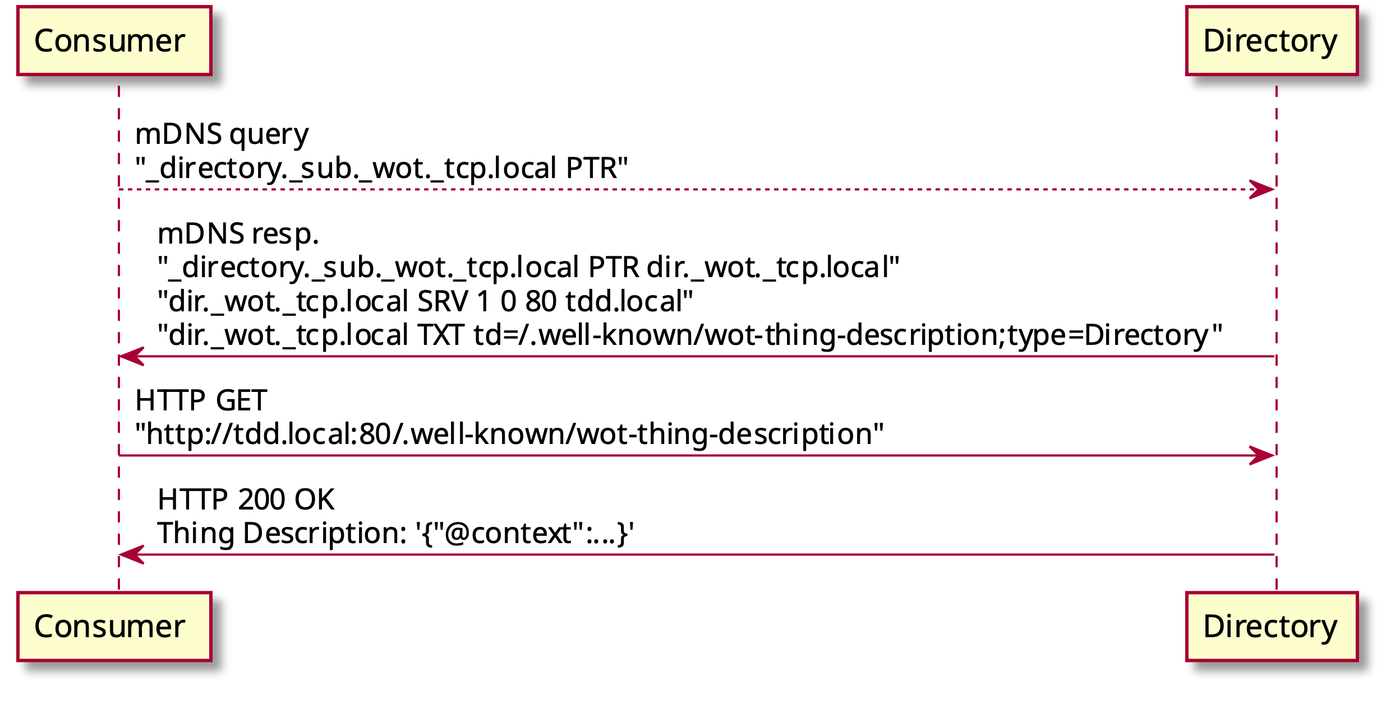
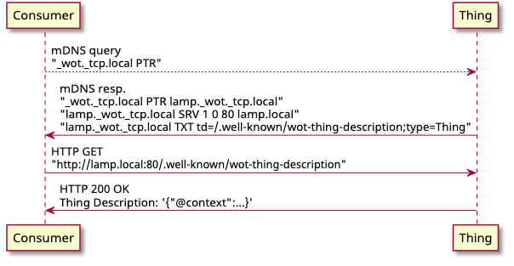
DNS-based service discovery (2/2)
Example sequence of Directory Discovery by mDNS

Slide 8
CoRE Resource Directory (CoRE-RD)
+--------------+
+ RD +
+--------------+
| 1
|
|
|
|
//////\\\\
< contains >
\\\\\/////
|
0+ |
ooooooo 1 +---------------+
o base o-------| registration |
ooooooo +---------------+
| | 1
| +--------------+
oooooooo 1 | |
o href o----+ /////\\\\
oooooooo | < contains >
| \\\\\/////
oooooooo 1 | |
o ep o----+ | 0+
oooooooo | +------------------+
| | link |
oooooooo 0-1 | +------------------+
o d o----+ |
oooooooo | | 1 oooooooo
| +-----o target o
oooooooo 1 | | oooooooo
o lt o----+ ooooooooooo 0+ |
oooooooo | o target o-----+
| o attribute o | 0+ oooooo
ooooooooooo 0+ | ooooooooooo +-----o rel o
o endpoint o----+ | oooooo
o attribute o |
ooooooooooo | 1 ooooooooo
+----o context o
ooooooooo
Figure 3: ER Model of the content of the RD
draft-ietf-core-resource-directory-25
We can use CoRE-RD as an introduction mechanism of Thing or Directory Service.
Link for a Thing Description is stored as a CoRE Link (RFC6690).
Endpoint type(et):
TD for Thing: wot.thing
TD for Directory Service: wot.directory

Slide 9
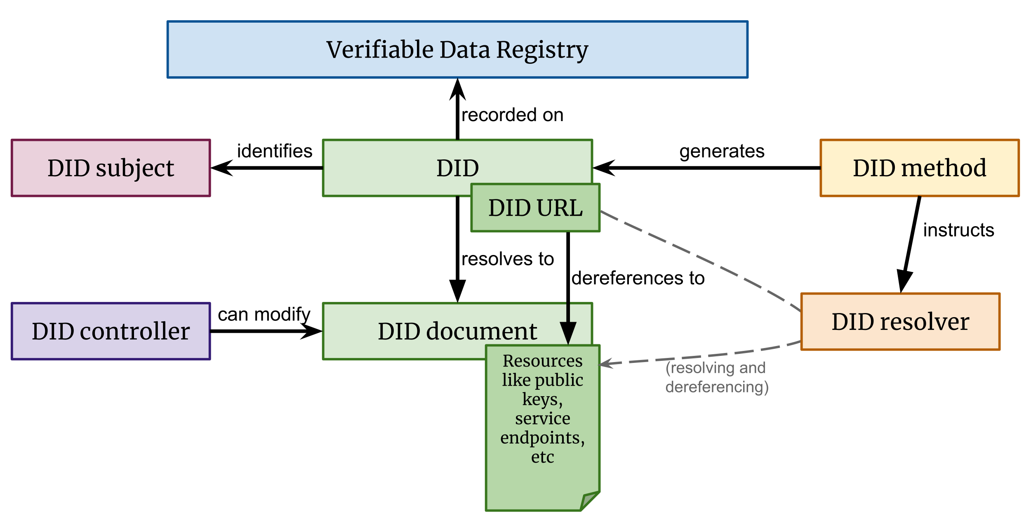
Decentralized Identifier (DID)
DID can be used for pointing a Thing Description of Thing or Thing Directory.
DID is resolved to DID documents, by DID resolver.
DID document can contain a Service Endpoint which point to Thing or Thing Directory
{ …
"service": [{
"id": "did:example:wotdiscoveryexample#td",
"type": "WotThingDescription",
"serviceEndpoint": "https://wot.example.com/td"
}]
}
Example Service Endpoint description in DID document

Slide 10
Discussions
Security/Privacy Considerations
Some introduction mechanisms should be used in trusted environment…
Direct, well-known URL and DNS-SD are not protected from unautholized access.
We should use them in a private network which is protected by authentication (WPA, 802.1x, VPN, etc.), or in a space that is protected by physical security.
… and/or TD should be protected by authentication
HTTP basic/digest auth, OAuth, etc.
Are there any other mechanisms that should be included in the specification?

