Slide 1
WoT and OAuth 2.0
Cristiano Aguzzi
20/10/2020

Slide 2
Outline
OAuth 2.0 overview
OAuth 2.0 flows
Code flow
Code – WoT scenarios
Device flow
Device – WoT scenarios
Client flow
Client – WoT scenarios
Open points & discussion

Slide 3




OAuth 2.0
OAuth 2.0 is an authorization protocol widely known for its usage across several web services. It enables third-party applications to obtain limited access to HTTP(s) services on behalf of the resource owner or of itself.
Client
Authorization
server
Resource
server
Resource
owner

Slide 4
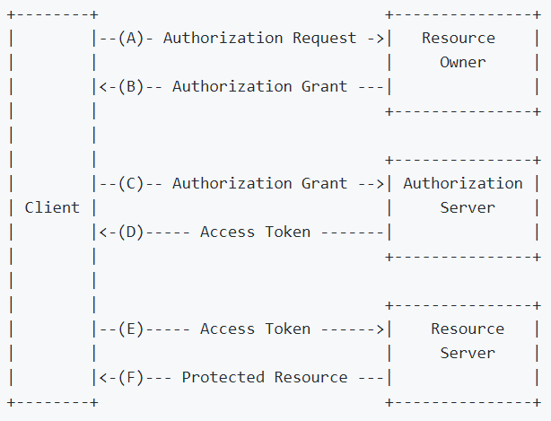
OAuth 2.0

Slide 5
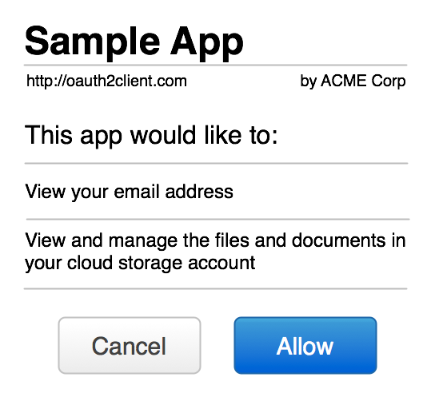
OAuth 2.0 Scopes
Scope is a mechanism in OAuth 2.0 to limit an application's access to a user's account.
An application can request one or more scopes, this information is then presented to the user in the consent screen, and the access token issued to the application will be limited to the scopes granted.

Slide 6


WoT and OAuth2.0
Is Oauth 2.0 a nice fit for IoT and Web of Thing?

Slide 7
oAuth2.0 flows/grants
Code
Implicit
Resource Owner Password Credentials
Client Credentials
Extension flows
Device

Slide 8

Code
Resource Owner
Client
Resource Server
Redirection URL
Prompt authorization request
Return Web page
GET Redirection URL
User Agent
Authorization
Server

Slide 9
Code
Resource Owner
Client
Resource Server
Redirection URL
Return authorization code
Grant authorization
User authorization
User Agent
Authorization
Server

Slide 10
Code
Resource Owner
Client
Resource Server
Authorization Code
User Agent
Authorization
Server

Slide 11
Code
Resource Owner
Client
Resource Server
Access the resource
Access Token
User Agent
Authorization
Server

Slide 12

Code – WoT Scenarios
Device owner
Smart Home
Dashboard Application
WoT
Washing machine

Slide 13
Code – WoT Scenarios
Device owner
Smart Home
Dashboard Application
Thing Description Directory

Slide 14
Device
Device flow was born to cope with limited input devices. In particular, if a device was not able to prompt a full fledge browser it couldn’t use OAuth 2.0. Typically, device flow is used in Smart TVs, Home Assistant speakers, and wearables.

Slide 15
Device
Resource Owner
Client
Resource Server
Display Code and URL
Request User Code and URL
User Agent
Authorization
Server

Slide 16
Device
Resource Owner
Client
Resource Server
Polls for access token
User Agent
Authorization
Server

Slide 17
Device
Resource Owner
Client
Resource Server
Display Code and URL
Access resource
Access URL/
Insert code
Gets
access token
Authorization Granted
User Agent
Authorization
Server

Slide 18


Device - WoT Scenarios
Device owner
Smart Radio
WoT speakers

Slide 19
Client
Resource Owner
Client
Resource Server
Access resource
Return Access token
Send Client ID and Client Secret
User Agent
Authorization
Server

Slide 20
Client - Scenarios
Proprietary companion application
WoT
Washing machine

Slide 21
Client - Scenarios
The Client Credentials grant type is used by clients to obtain an access token outside of the context of an end-user. From RFC 6749:
The client can request an access token using only its client credentials (or other supported means of authentication) when the the client is requesting access to the protected resources under its control, or those of another resource owner that has been previously arranged with the authorization server (the method of which is beyond the scope of this specification).
Therefore the client credential grant might be used:
- When the resource owner is a public authority. For example, in a smart city context, the authority provides a web service where to register an application id.
- Industrial IoT. Consider a smart factory where the devices or services are provisioned with client credentials.

Slide 22
Open points
Provide examples about how to use deprecated flows
Multiple OAuth 2.0 flows in security definitions
https://github.com/w3c/wot-thing-description/issues/929
Address implementations variability
https://github.com/w3c/wot-thing-description/issues/923
Node-WoT implementation
https://github.com/eclipse/thingweb.node-wot/issues/325
How WoT scripts can handle OAuth 2.0 code gracefully
https://github.com/w3c/wot-scripting-api/issues/214

Slide 23
WoT and OAuth 2.0
Cristiano Aguzzi
20/10/2020

