Slide 1
Discovery: Updates in Introduction Mechanisms
Kunihiko Toumura
March 17, 2021

Slide 2
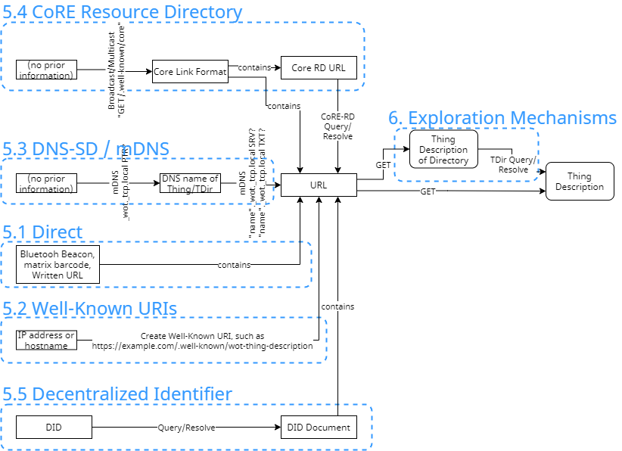
Overview
Introduction
Exploration
Introduction Mechanism:
The way to find an URL which points to TD of Thing or Thing Description Directory.
Currently, five mechanism are described in draft specification.

Slide 3
Updates since last vF2F
No significant changes.
Correct type usage in CoRE Link:
Endpoint type(et) -> Resource type(rt)
See: Issue w3c/wot-discovery#120
Editorial changes:
added “8. IANA Considerations” chapter

Slide 4
Call for Implementations
Direct
(if there is a written TD URL and it can be fetched, can we say, “this mechanism is implemented.”?)
Well-known URIs
Hitachi’s myRasPiLED
https://github.com/w3c/wot-testing/blob/main/events/2021.03.Online/TDs/Hitachi/README.md
DNS-based Service Discovery
Hitachi’s myRasPiLED
https://github.com/w3c/wot-testing/blob/main/events/2021.03.Online/TDs/Hitachi/README.md
Fraunhofer LinkSmart
https://github.com/w3c/wot-testing/blob/main/events/2020.06.Online/prototypes/linksmart.md
Node-RED nodegen autopopulation server (mDNS version)
https://github.com/w3c/wot-testing/tree/main/events/2020.09.Online/prototypes/Hitachi
CoRE Link Format and CoRE-RD
Phillip Blum’s fork of RIOT-OS?
https://github.com/Citrullin/RIOT/commit/4c9901f
DID Documents
None.

Slide 5
Appendix

Slide 6
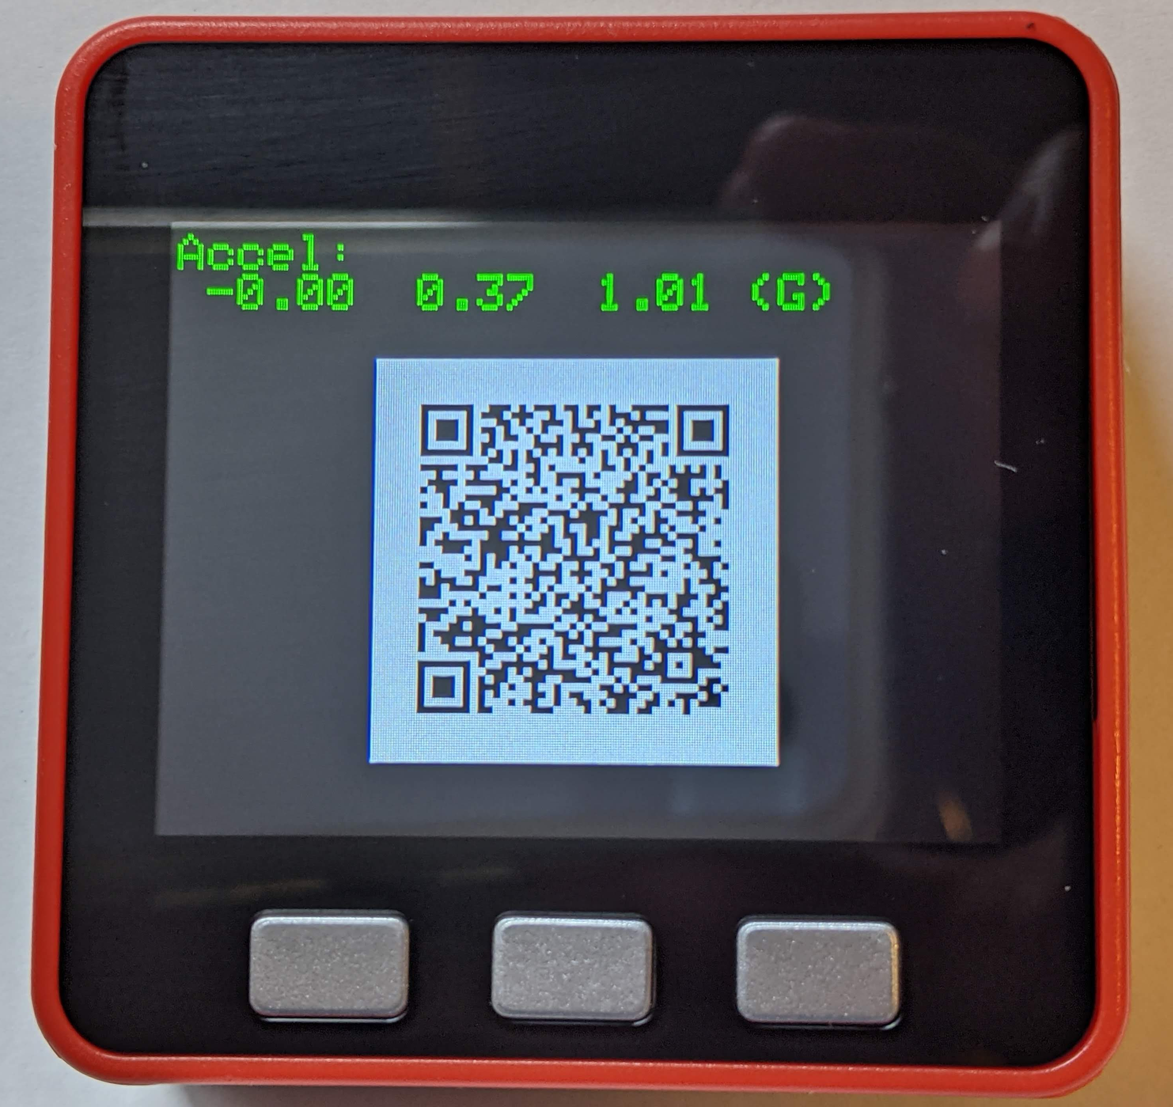
Direct
Any mechanism that result in a single URL.
Bluetooth beacons, Matrix barcodes, and written URL.
A GET on all such URLs MUST result in a TD.
QR code that contains an URL
‘http://ktom5stack.local/.well-known/wot-thing-description’

Slide 7
Well-known URI
RFC8615: Well-Known Uniform Resource Identifiers (URIs)
Thing or Directory Service can host their Thing Description as a site-wide metadata
“wot-thing-description” (tentative) for URL suffix
Example 1: a Consumer heuristically get a FQDN of some site: tdd.example.com, then issue HTTP request GET https://tdd.example.com/.well-known/wot-thing-description to try to retrieve a Thing Description
Example 2: Broadcast/multicasting CoAP request GET /.well-known/wot-thing-description

Slide 8
DNS-based service discovery (1/2)
DNS-based Service Discovery (RFC6763)
Multicast DNS (RFC6762)
Use (multicast) DNS query to discover Things or Directory Services
DNS-SD Service Instance Name:
<Instance>.<Service>.<Domain>
<Service> MUST be:
Thing: _wot._tcp (HTTP or HTTPS) or _wot._udp (CoAP)
Directory Service: _directory._sub._wot._tcp or _directory._sub._wot._udp
When Consumer resolves above domain name, it receives following TXT records:
td: Absolute pathname of the Thing Description of the Things or Directory Service
type: Type of the Things Description, i.e. Thing or Directory.

Slide 9
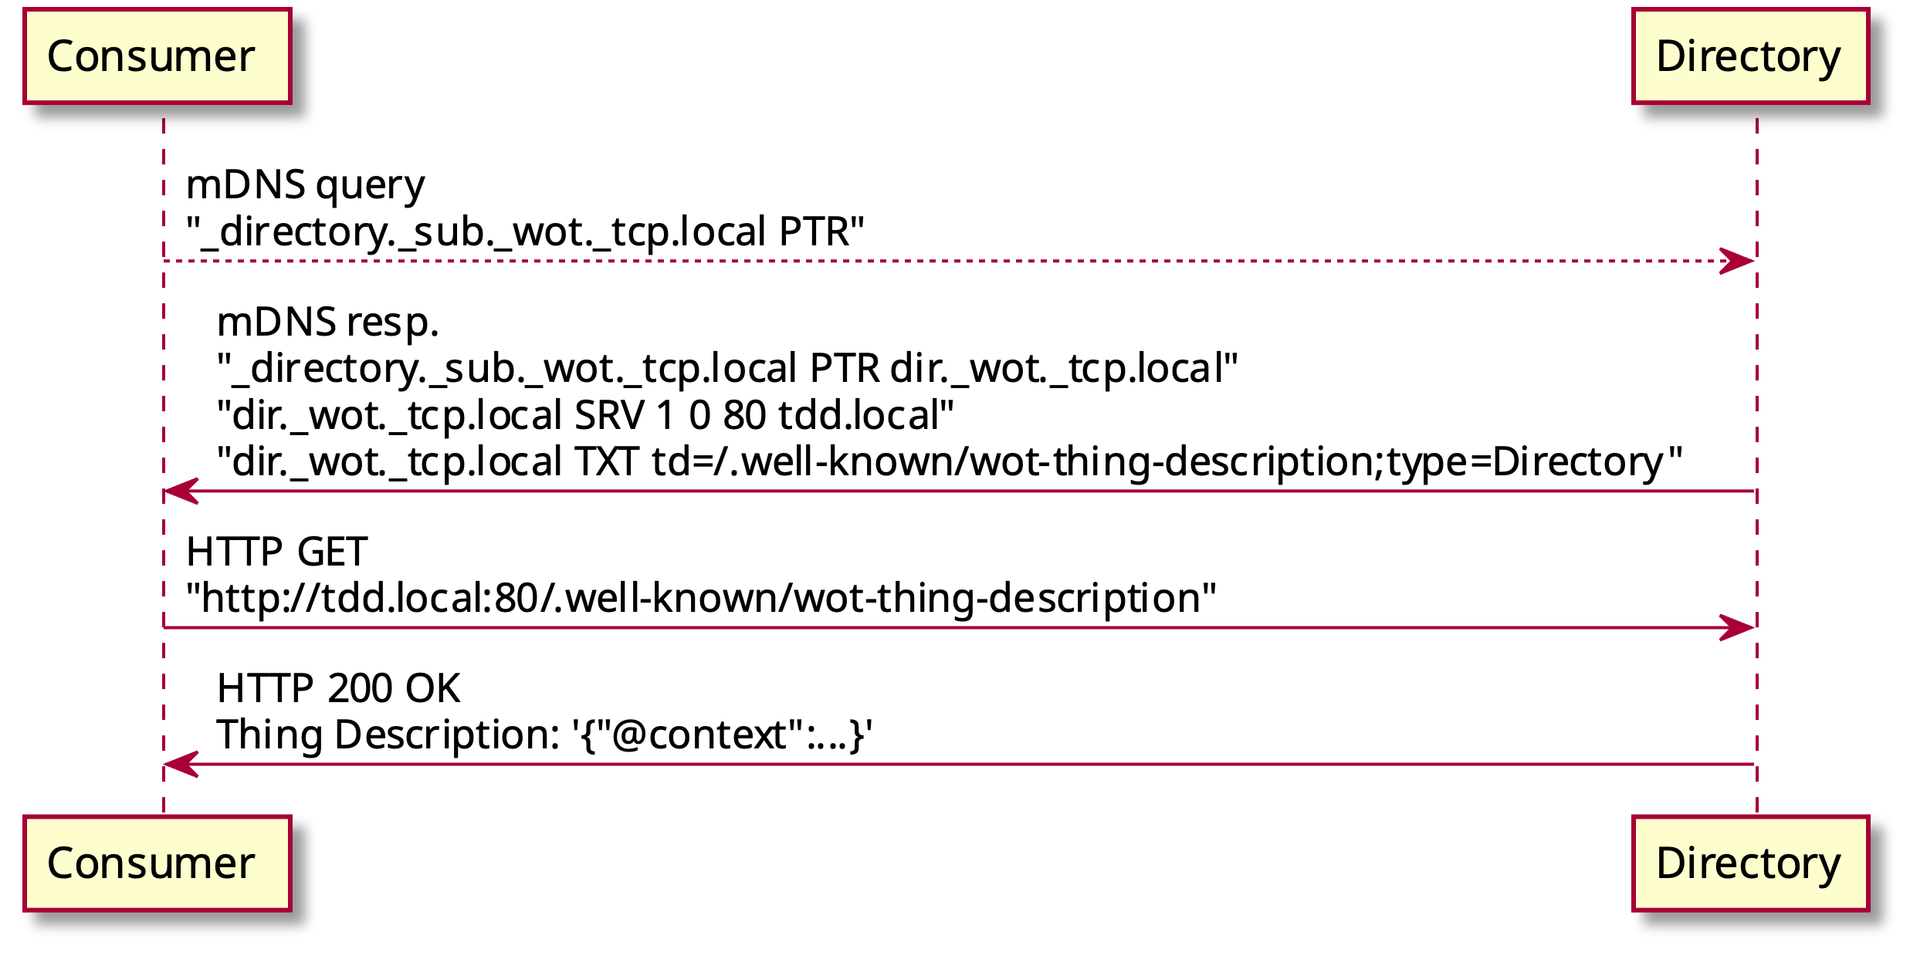
DNS-based service discovery (2/2)
Example sequence of Directory Discovery by mDNS

Slide 10
CoRE Resource Directory (CoRE-RD)
+--------------+
+ RD +
+--------------+
| 1
|
|
|
|
//////\\\\
< contains >
\\\\\/////
|
0+ |
ooooooo 1 +---------------+
o base o-------| registration |
ooooooo +---------------+
| | 1
| +--------------+
oooooooo 1 | |
o href o----+ /////\\\\
oooooooo | < contains >
| \\\\\/////
oooooooo 1 | |
o ep o----+ | 0+
oooooooo | +------------------+
| | link |
oooooooo 0-1 | +------------------+
o d o----+ |
oooooooo | | 1 oooooooo
| +-----o target o
oooooooo 1 | | oooooooo
o lt o----+ ooooooooooo 0+ |
oooooooo | o target o-----+
| o attribute o | 0+ oooooo
ooooooooooo 0+ | ooooooooooo +-----o rel o
o endpoint o----+ | oooooo
o attribute o |
ooooooooooo | 1 ooooooooo
+----o context o
ooooooooo
Figure 3: ER Model of the content of the RD
draft-ietf-core-resource-directory-25
We can use CoRE-RD as an introduction mechanism of Thing or Directory Service.
Link for a Thing Description is stored as a CoRE Link (RFC6690).
Endpoint type(et) Resource type(rt):
TD for Thing: wot.thing
TD for Directory Service: wot.directory

Slide 11
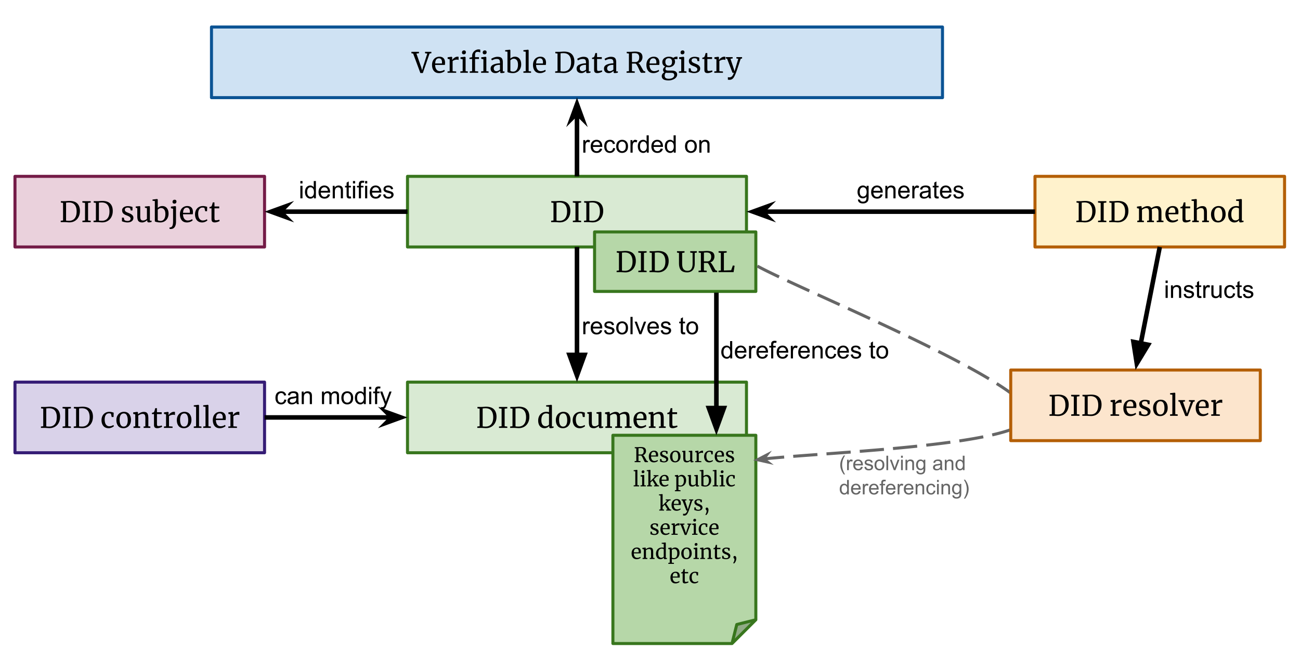
Decentralized Identifier (DID)
DID can be used for pointing a Thing Description of Thing or Thing Directory.
DID is resolved to DID documents, by DID resolver.
DID document can contain a Service Endpoint which point to Thing or Thing Directory
{ …
"service": [{
"id": "did:example:wotdiscoveryexample#td",
"type": "WotThingDescription",
"serviceEndpoint": "https://wot.example.com/td"
}]
}
Example Service Endpoint description in DID document

