Slide 1
Semantic Discovery in Directories
Andrea Cimmino (Universidad Politécnica de Madrid)
17/03/21

Slide 2
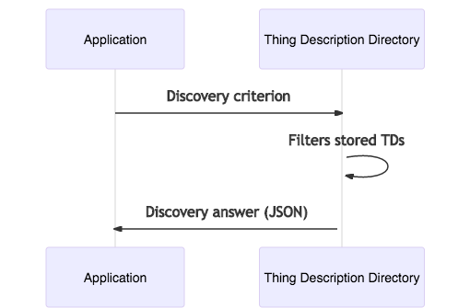
Discovery in a nutshell

Slide 3
Thing Description Directory (TDD) and discovery
TDD syntactic discovery criterion:
(Syntactic discovery) MUST support JSONPath as discovery criterion
(Syntactic discovery) SHOULD support XPath as discovery criterion
TDD semantic discovery criterion:
(Semantic discovery) May support SPARQL as discovery criterion
TDD discovery answer:
A set (array) of Thing Descriptions (TD) meeting the criterion are found
A set (array) of Thing Descriptions (TD) fragments fulfilling the criterion are found
Discovery results could be paginated (depending on the discovery criterion)

Slide 4
SPARQL semantic discovery API
The discovery criterion is a SPARQL query
https://www.w3.org/TR/rdf-sparql-query/
W3C standard
All SPARQL queries should use content-negotiation to return JSON-LD or JSON
Supported: SELECT, ASK, CONSTRUCT, and DESCRIBE
Not-Supported: UPDATE
Response code:
200 (Ok) with application/json Content-Type header
Error codes:
400 (Bad Request): SPARQL query not provided or contains syntax errors.
401 (Unauthorized): No authentication.
403 (Forbidden): Insufficient rights to the resource.
501 (Not Implemented): SPARQL API not supported.

Slide 5

SPARQL queries
PREFIX wot: <https://www.w3.org/2019/wot/td#>
PREFIX sch: <https://www.w3.org/2019/wot/json-schema#>
PREFIX hyp: <https://www.w3.org/2019/wot/hypermedia#>
SELECT DISTINCT ?href WHERE {
?device wot:hasPropertyAffordance ?property .
?property sch:propertyName "status” .
?property wot:hasForm ?form .
?form hyp:hasTarget ?href .
}
Find the href of devices that have the property status
- XPath: *//properties/status//href

Slide 6
SPARQL queries
PREFIX wot: <https://www.w3.org/2019/wot/td#>
PREFIX sch: <https://www.w3.org/2019/wot/json-schema#>
PREFIX hyp: <https://www.w3.org/2019/wot/hypermedia#>
SELECT DISTINCT ?href WHERE {
?device wot:hasPropertyAffordance ?property .
?property sch:propertyName "status” .
?property wot:hasForm ?form .
?form hyp:hasTarget ?href .
}
PREFIX%20wot%3A%20%3Chttps%3A%2F%2Fwww.w3.org%2F2019%2Fwot%2Ftd%23%3E%0APREFIX%20sch%3A%20%3Chttps%3A%2F%2Fwww.w3.org%2F2019%2Fwot%2Fjson-schema%23%3E%0APREFIX%20hyp%3A%20%3Chttps%3A%2F%2Fwww.w3.org%2F2019%2Fwot%2Fhypermedia%23%3E%0A%0ASELECT%20DISTINCT%20%3Fhref%20WHERE%20%7B%0A%3Fdevice%20wot%3AhasPropertyAffordance%20%3Fproperty%20.%0A%3Fproperty%20sch%3ApropertyName%20%22status%E2%80%9D%20.%0A%3Fproperty%20wot%3AhasForm%20%3Fform%20.%0A%3Fform%20hyp%3AhasTarget%20%3Fhref%20.%0A%7D%0A%00

Slide 7
SPARQL semantic discovery API example
"searchSPARQL": {
"description": "SPARQL semantic search",
"uriVariables": {
"query": {
"title": "A valid SPARQL 1.1. query",
"type": "string",
"format": "iri-reference"
}
},
"forms": [
{
"href": "/search/sparql?query={query}",
"htv:methodName": "GET",
"response": {
"description": "Success response",
"htv:statusCodeValue": 200
},
"scopes": "search"
},
{
"href": "/search/sparql",
"htv:methodName": "POST",
"response": {
"description": "Success response",
"htv:statusCodeValue": 200
},
"scopes": "search"
}
]
}

Slide 8
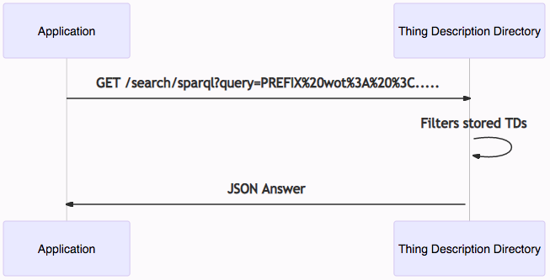
SPARQL semantic discovery API example
"searchSPARQL": {
"description": "SPARQL semantic search",
"uriVariables": {
"query": {
"title": "A valid SPARQL 1.1. query",
"type": "string",
"format": "iri-reference"
}
},
"forms": [
{
"href": "/search/sparql?query={query}",
"htv:methodName": "GET",
"response": {
"description": "Success response",
"htv:statusCodeValue": 200
},
"scopes": "search"
},
{
"href": "/search/sparql",
"htv:methodName": "POST",
"response": {
"description": "Success response",
"htv:statusCodeValue": 200
},
"scopes": "search"
}
]
}

Slide 9
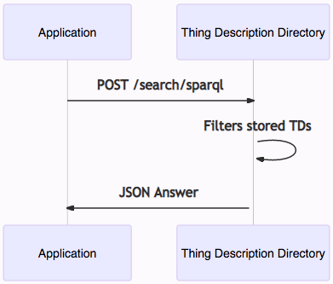
SPARQL semantic discovery API example
"searchSPARQL": {
"description": "SPARQL semantic search",
"uriVariables": {
"query": {
"title": "A valid SPARQL 1.1. query",
"type": "string",
"format": "iri-reference"
}
},
"forms": [
{
"href": "/search/sparql?query={query}",
"htv:methodName": "GET",
"response": {
"description": "Success response",
"htv:statusCodeValue": 200
},
"scopes": "search"
},
{
"href": "/search/sparql",
"htv:methodName": "POST",
"response": {
"description": "Success response",
"htv:statusCodeValue": 200
},
"scopes": "search"
}
]
}

Slide 10
SPARQL semantic discovery API example

Slide 11
SPARQL semantic discovery API example
{
"head": {
"vars": [ "href" ]
} ,
"results": {
"bindings": [
{ "href": { "type": "uri" , "value": "https://example-1.com/sensor1/status" } ,
{ "href": { "type": "uri" , "value": "https://example-2.com/sensor1/status" } ,
{ "href": { "type": "uri" , "value": "https://example-3.com/sensor1/status" } ,
….
]
}

Slide 12
SPARQL queries examples: SELECT
Useful for filtering TDs
filtering and exploratory queries
As result return a JSON
PREFIX wot: <https://www.w3.org/2019/wot/td#>
PREFIX sch: <https://www.w3.org/2019/wot/json-schema#>
PREFIX hyp: <https://www.w3.org/2019/wot/hypermedia#>
DESCRIBE DISTINCT ?href WHERE {
?device wot:hasPropertyAffordance ?property .
?property sch:propertyName "status” .
?property wot:hasForm ?form .
?form hyp:hasTarget ?href .
}

Slide 13
SPARQL queries examples: ASK
Useful to know if a TD with some restrictions exists
As result returns a boolean value inside a JSON
PREFIX wot: <https://www.w3.org/2019/wot/td#>
PREFIX sch: <https://www.w3.org/2019/wot/json-schema#>
PREFIX hyp: <https://www.w3.org/2019/wot/hypermedia#>
ASK {
?device wot:hasPropertyAffordance ?property .
?property sch:propertyName "status" .
?property wot:hasForm ?form .
?form hyp:hasTarget ?href .
}

Slide 14

Translating TDs (using JSON-LD 1.1 spec)
TD
@context
JSONPath
Xpath
JSON-LD
(framed)
TD
TD
framing rules
RDF
RDF
SPARQL
Turtle
JSON-LD
…
TD
RDF
Trix

Slide 15
SPARQL queries examples: DESCRIBE
Useful to retrieve TDs fulfilling some restrictions
As result returns RDF → JSON-LD (problem to translate to JSON-LD framed)
PREFIX wot: <https://www.w3.org/2019/wot/td#>
DESCRIBE ?thing {
?thing a wot:Thing .
}
PREFIX wot: <https://www.w3.org/2019/wot/td#>
PREFIX dc: <http://purl.org/dc/terms/>
DESCRIBE ?thing {
?thing a wot:Thing .
?thing dc:title "Smart-Coffee-Machine"@en .
}

Slide 16
SPARQL queries examples: CONSTRUCT
Not very useful for discovery
Generates RDF from a set of restrictions and allows to introduce new triples
Does not modifies the original stored TD
As result returns RDF → JSON-LD (problem to translate to JSON-LD framed)
PREFIX wot: <https://www.w3.org/2019/wot/td#>
PREFIX dc: <http://purl.org/dc/terms/>
CONSTRUCT {
?thing dc:title “new property”.
?thing ?p ?o .
} WHERE {
?thing a wot:Thing .
?thing ?p ?o .
}

Slide 17
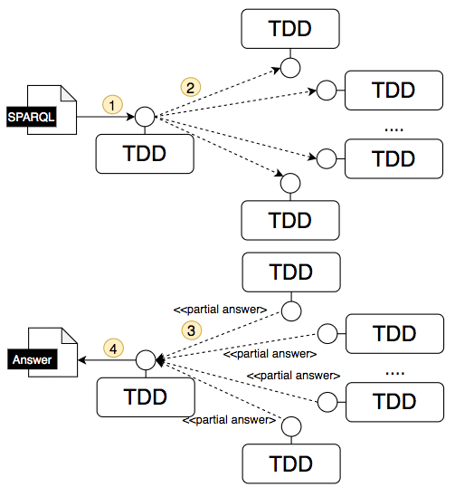
Advanced SPARQL queries
Query Federation
SPARQL allows query federation
TDD forwards the query to other TDDs
Former TDD Returns a unified query answer
Pros
Allows extending discovery criterion to other TDDs easily
Extends the discovery scope
Cons
TDDs addresses must be known beforehand
Previous service discovery
Brute force forwarding

Slide 18
Advanced SPARQL queries example
Assuming the following TDDs:
http://tdd-example-1.org,
http://tdd-example-2.org ,
http://tdd-example-3.org ,
…
http://tdd-example-100.org
PREFIX wot: <https://www.w3.org/2019/wot/td#>
PREFIX sch: <https://www.w3.org/2019/wot/json-schema#>
PREFIX hyp: <https://www.w3.org/2019/wot/hypermedia#>
SELECT DISTINCT ?href WHERE {
SERVICE ?tdd {
?device wot:hasPropertyAffordance ?property .
?property sch:propertyName "status” .
?property wot:hasForm ?form .
?form hyp:hasTarget ?href .
} VALUES ?tdd {
<http://tdd-example-1.org>,
….,
<http://tdd-example-100.org>
}
}

Slide 19
Pros and Cons of SPARQL
Pros
Expressive, takes advantages of ontology semantics and linked data
E.g., reasoning over data
E.g., linked Thing Descriptions → distributed TDs
SPARQL is a query language
Has functions, e.g., for aggregation or data cleaning
Allows complex queries
Query federation
SPARQL is a W3C standard
Federated queries
Including SPARQL endpoints from directories and URLs of LinkDescriptions
Cons
Simple queries are more verbose than those expressed in JSONPath or Xpath
Consumes more resources than XPath and JSONPath?
SPARQL can be complex and not easy to learn

Slide 20
Conclusion
Semantic discovery allows to filter registered TDs using:
(MAY) SPARQL queries
Semantic discovery (SPARQL) is very flexible:
Allows complex queries with functions
Exploits the semantics of ontologies, reasoning
Implementing SPARQL 1.1 enables query federation
Privacy & Security
Discovery is binded to security and privacy policies defined in a TDD

