Slide 1
Syntactic Discovery in Directories
Andrea Cimmino (Universidad Politécnica de Madrid)
17/03/21

Slide 2
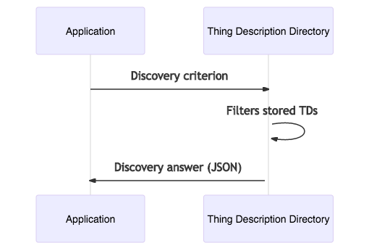
Discovery in a nutshell

Slide 3
Thing Description Directory (TDD) and discovery
TDD syntactic discovery criterion:
(Syntactic discovery) MUST support JSONPath as discovery criterion
(Syntactic discovery) SHOULD support XPath as discovery criterion
TDD semantic discovery criterion:
(Semantic discovery) May support SPARQL as discovery criterion
TDD discovery answer:
A set (array) of Thing Descriptions (TD) meeting the criterion are found
A set (array) of Thing Descriptions (TD) fragments fulfilling the criterion are found
Discovery results could be paginated (depending on the discovery criterion)

Slide 4
JSONPath syntactic discovery API
The discovery criterion is JSONPath
https://tools.ietf.org/id/draft-goessner-dispatch-jsonpath-00.html
Not standard, widely used
Response code:
200 (Ok) with application/json Content-Type header
Error codes:
400 (Bad Request): JSONPath expression not provided or contains syntax errors.
401 (Unauthorized): No authentication.
403 (Forbidden): Insufficient rights to the resource.

Slide 5
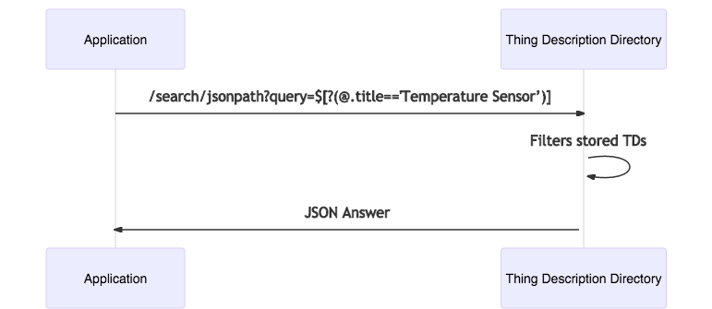
JSONPath syntactic discovery API example
...
"searchJSONPath": {
"description": "Json Path syntactic search",
"uriVariables": {
"query": {
"title": "A valid Json Path expression",
"type": "string",
"format": "iri-reference"
}
},
"forms": [
{
"href": "/search/jsonpath?query={query}",
"htv:methodName": "GET",
"response": {
"description": "Success response",
"htv:statusCodeValue": 200
},
"scopes": "search"
}
]
},
...

Slide 6
JSONPath syntactic discovery API example
...
"searchJSONPath": {
"description": "Json Path syntactic search",
"uriVariables": {
"query": {
"title": "A valid Json Path expression",
"type": "string",
"format": "iri-reference"
}
},
"forms": [
{
"href": "/search/jsonpath?query={query}",
"htv:methodName": "GET",
"response": {
"description": "Success response",
"htv:statusCodeValue": 200
},
"scopes": "search"
}
]
},
...
Find TDs with title Temperature Sensor

Slide 7
JSONPath syntactic discovery API example
...
"searchJSONPath": {
"description": "Json Path syntactic search",
"uriVariables": {
"query": {
"title": "A valid Json Path expression",
"type": "string",
"format": "iri-reference"
}
},
"forms": [
{
"href": "/search/jsonpath?query={query}",
"htv:methodName": "GET",
"response": {
"description": "Success response",
"htv:statusCodeValue": 200
},
"scopes": "search"
}
]
},
...
Find TDs with title Temperature Sensor
[
{ "@context":"https://www.w3.org/2019/wot/td/v1",
"id":"urn:example:1234",
"title": “Temperature Sensor" ...
}, { "@context":"https://www.w3.org/2019/wot/td/v1",
"id":"urn:example:9856",
"title": “Temperature Sensor" ...
}, ….
],
Discovery answer is an array of TDs

Slide 8
Syntactic discovery with XPath
The discovery criterion is XPath
https://www.w3.org/TR/xpath-31/
W3C standard
Response code:
200 (Ok) with application/json Content-Type header
Error codes:
400 (Bad Request): XPath expression not provided or contains syntax errors.
401 (Unauthorized): No authentication.
403 (Forbidden): Insufficient rights to the resource.
501 (Not Implemented): XPath API not supported.

Slide 9
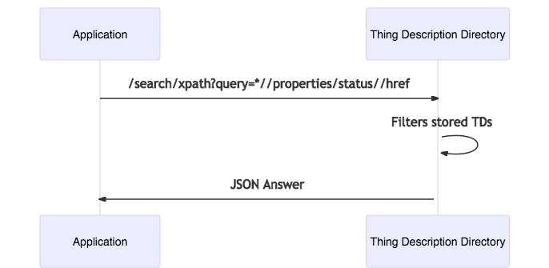
XPath syntactic discovery API example
…
"searchXPath": {
"description": "XPath syntactic search",
"uriVariables": {
"query": {
"title": "A valid XPath expression",
"type": "string",
"format": "iri-reference"
}
},
"forms": [
{
"href": "/search/xpath?query={query}",
"htv:methodName": "GET",
"response": {
"description": "Success response",
"htv:statusCodeValue": 200
},
"scopes": "search"
}
]
},
…

Slide 10
XPath syntactic discovery API example
…
"searchXPath": {
"description": "XPath syntactic search",
"uriVariables": {
"query": {
"title": "A valid XPath expression",
"type": "string",
"format": "iri-reference"
}
},
"forms": [
{
"href": "/search/xpath?query={query}",
"htv:methodName": "GET",
"response": {
"description": "Success response",
"htv:statusCodeValue": 200
},
"scopes": "search"
}
]
},
…
Find values of href in property named status from all TDs

Slide 11
XPath syntactic discovery API example
…
"searchXPath": {
"description": "XPath syntactic search",
"uriVariables": {
"query": {
"title": "A valid XPath expression",
"type": "string",
"format": "iri-reference"
}
},
"forms": [
{
"href": "/search/xpath?query={query}",
"htv:methodName": "GET",
"response": {
"description": "Success response",
"htv:statusCodeValue": 200
},
"scopes": "search"
}
]
},
…
Find values of href in property named status from all TDs
[
"https://example-1.com/sensor1/status",
"https://example-2.com/sensor1/status",
"https://example-3.com/sensor1/status",
"https://example-4.com/sensor1/status",
"https://example-5.com/sensor1/status",
]
Discovery answer is an array of TD fragments

Slide 12
Example syntactic discovery queries
Description | JSONPath query | XPath query
TDs with title Terrace Temperature Sensor | $[?(@.title=='Terrace Temperature Sensor')] | *[title='Terrace Temperature Sensor']
TDs with title ending with Temperature Sensor | $[?(@.title=~/.*Temperature Sensor/) | *[ends-with(title, 'Temperature Sensor')]
TDs with title ending with Temperature Sensor and created in March 2020 | $[?(@.title=~/.*Temperature Sensor/ && @.created=~/2020-03-10/)] | *[ends-with(title, 'Temperature Sensor') and starts-with(created, '2020-03-10')]
TDs with form href values starting with http | not supported by the library | *[*/*/forms/*[starts-with(href, 'http')]]
TDs with version.v:hardware (namespace: v) equal to "1.0" | $[?(@.version.'v:hardware'=='1.0') | ??
Second to fourth TD | $[2:4] | *[position()>=2 and position()<4]
More examples: https://github.com/linksmart/thing-directory/wiki/Query-Language

Slide 13
Pros and Cons of JSONPath and XPath
Pros
Short and expressive (XPath and JSONPath)
Passed as URL query parameters (XPath and JSONPath)
Value/object selection saves both client and server resources
(XPath and JSONPath)
XPath is a standard
Cons
TD fragments responses are not JSON-LD compliant (XPath and JSONPath)
Complex queries can get verbose and messy (XPath and JSONPath)
JSONPath not a standard
JSONPath may lead to security breaches on some queries

Slide 14
Conclusion
Syntactic discovery allows to filter registered TDs using:
(MUST) JSONPath
(SHOULD) XPath
Discovery answers are always a JSON:
Array of TDs
Array of TD fragments
Privacy & Security
Discovery is binded to security and privacy policies defined in a TDD

