Slide 1
WoT Virtual F2F Thing Description
Sebastian Kaebisch
24 March 2021

Slide 2
Agenda
Whats new in TD 1.1? (20m)
Aim for next TD publications
Discuss (10min)
Thing Model (1h30m, 10min break in between)
required feature
import feature
file extensions and media type
feedback from PlugFest about SDF-TM usage (Michael Koster)
TD Canonicalization (20m) (Michael Lagally / Michael McCool)
News from iotschema.org (Michael Koster/Darko Anicic)

Slide 3
What’s new in TD 1.1? Diff from REC 1.0 to FPWD 1.1 (vF2F Oct 2020)
Please check
https://github.com/w3c/wot/blob/main/PRESENTATIONS/2020-10-online-f2f/2020-10-21-TD-Topics-Kaebisch.pdf

Slide 4
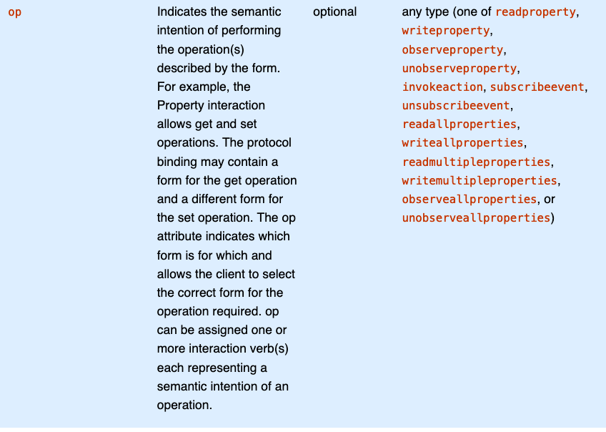
What’s new in TD 1.1? observeallproperties & unobserveallproperties
https://w3c.github.io/wot-thing-description/#form

Slide 5
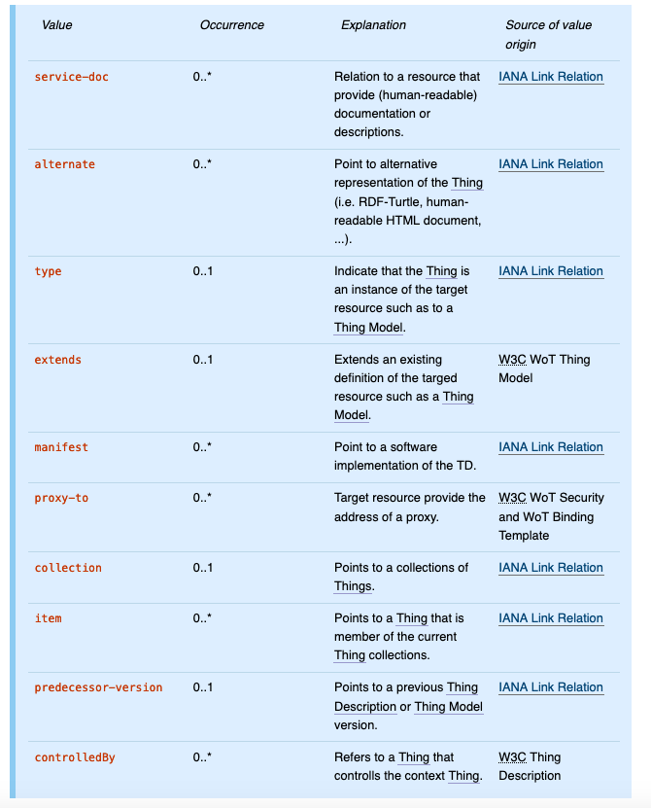
What’s new in TD 1.1? init rel types in links
https://w3c.github.io/wot-thing-description/#link

Slide 6
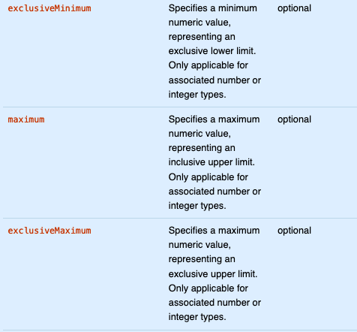
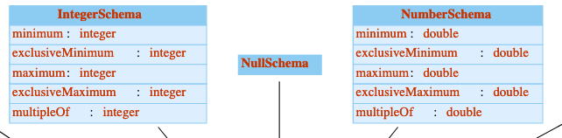
What’s new in TD 1.1? exclusiveMinimum & exclusiveMaximum
https://w3c.github.io/wot-thing-description/#numberschema
https://w3c.github.io/wot-thing-description/#integerschema

Slide 7
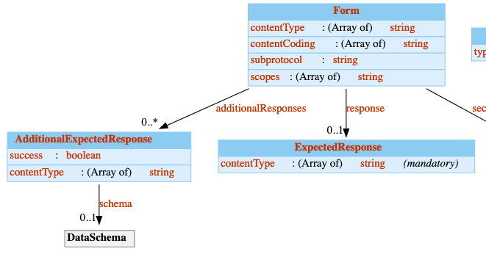
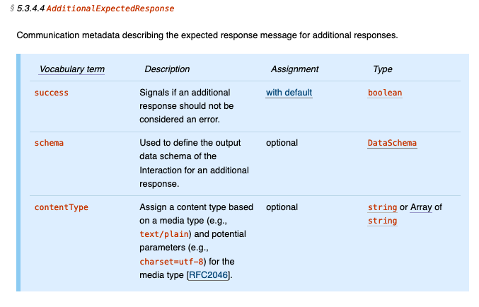
What’s new in TD 1.1? AdditionalExpectedResponse
https://w3c.github.io/wot-thing-description/#additionalexpectedresponse

Slide 8
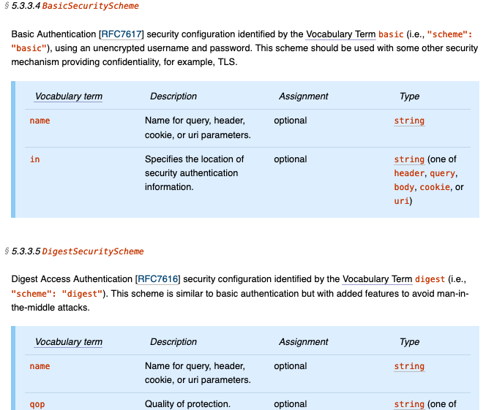
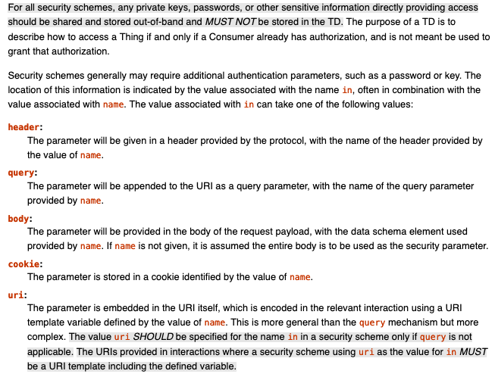
What’s new in TD 1.1? uri assignment for authentication location
…
https://w3c.github.io/wot-thing-description/#securityscheme

Slide 9
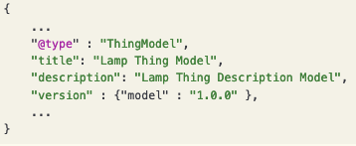
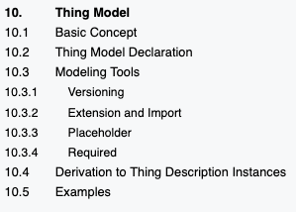
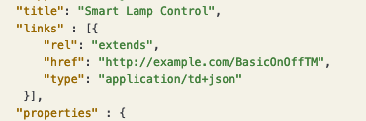

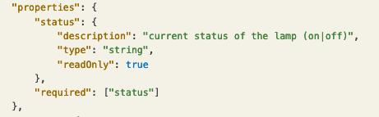
What’s new in TD 1.1? TM Features

Slide 10
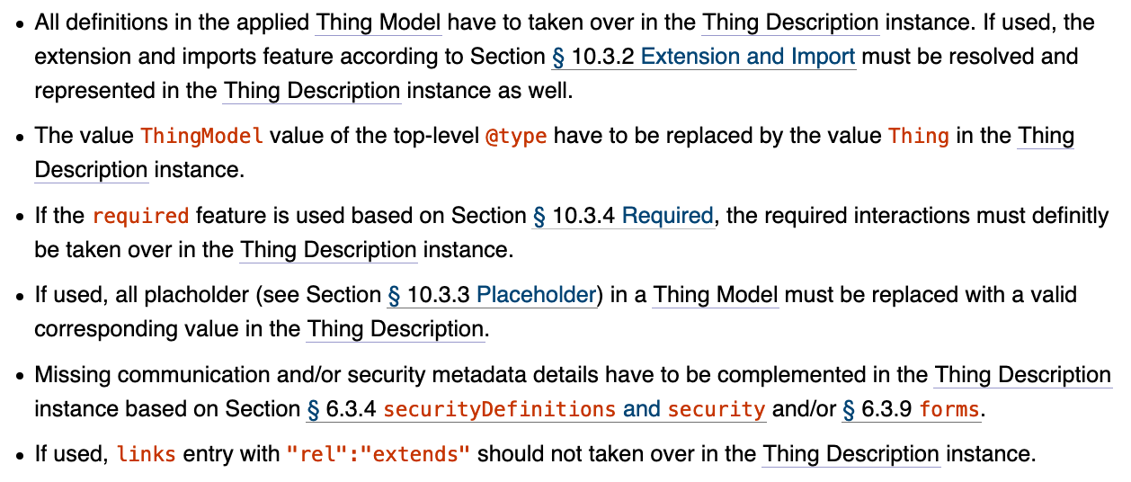
What’s new in TD 1.1? TM Features
https://w3c.github.io/wot-thing-description/#thing-model

Slide 11
Roadmap for next Publication
Next WD (until End of April / middle May) should cover
missing TM feature → @sebastiankb
multipleResponses alternative → @mmcool
Labeled “PR needed” (https://github.com/w3c/wot-thing-description/issues?q=is%3Aissue+is%3Aopen+label%3A%22PR+needed%22)
Profile identification
Validation & Canonization?
CR (June/July; depending on WoT Profile)
fix all semantic based issues (also discovery dependent) → @victor
Maybe some related issues regarding profile (e.g., operations in a top level form, History etc.)
Provide assertion risks (depends of the PlugFest)

Slide 12
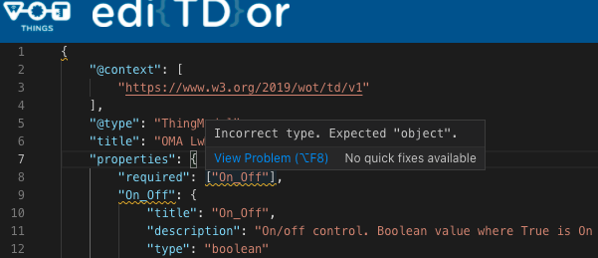
TM Issues - required at interaction level Problem Statement
Confusing for TD/TM processor that the required term is showing up at interaction level. Validator showing an error since it is not a normal interaction definition.

Slide 13
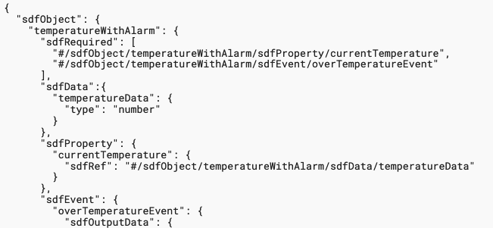
TM Issues - required at interaction level Solution Proposal
Current approach is adopted from JSON Schema concept
SDF defines sdfRequired https://ietf-wg-asdf.github.io/SDF/sdf.html#section-4.5 → “The value of "sdfRequired" is an array of name references, each pointing to one declaration the instantiation of which is declared mandatory.“ → is defined outside of the interaction

Slide 14
TM Issues - required at interaction level Solution Proposal
Follow same approach as sdfRequired
Name proposals: tdRequired / tmRequired / wotRequired…
define outside of the interactions:
… "security": ["nosec_sc"], "tmRequired" : ["#/properties/homeLoc"], "properties": { "homeLoc": { "title": "Home location", "description": "Home location, can be set to a new value. goHome action goes there", "type": "object",
…

Slide 15
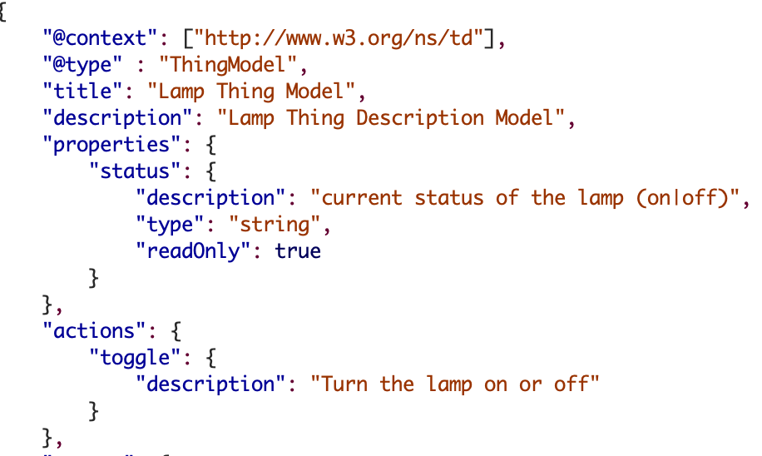
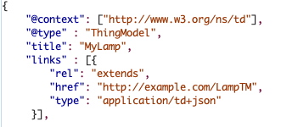
TM Issues – import mechanism Problem Statement
We can extend a TM which inherit all definitions.
However, we cannot import sub-definition of one or more TMs. E.g., we only interested in status property definition.

Slide 16
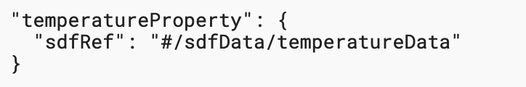
TM Issues - import mechanism Solution Proposal
JSON Schema concept has the $ref concept → mainly points to JSON Schema
SDF defines sdfRef https://ietf-wg-asdf.github.io/SDF/sdf.html#section-4.4 → “Copy all of the qualities of the referenced definition, indicated by the included name reference, into the newly formed definition..“

Slide 17
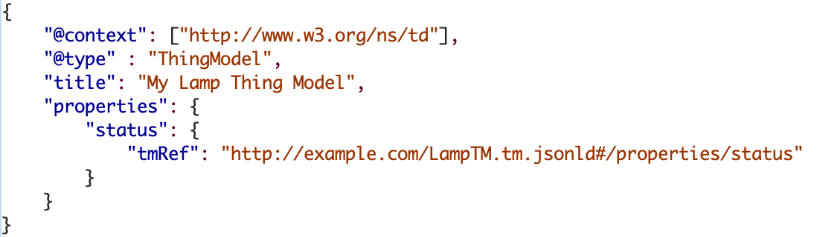
TM Issues - required at interaction level Solution Proposal
Follow same approach as sdfRef
Name proposals: tdRef / tmRef / wotRef…

Slide 18
File Extension / Media Type Open Questions
we have no media type definition for TM → question is this needed or shall we use application/td+json or application/jsonld
we need also clarification about a common file extension (e.g., td.jsonld and tm.jsonld)

