Slide 1
Thing Description
Sebastian Kaebisch
7 October 2021

Slide 2
Outline
TD Editor's Draft Review
What's New
TD 1.1 vs TD 2.0
impact on the TD versioning
check the labeled "defer 2.0" issues
New feature „Collections for TMs“
Reducing verbosity in TDs (Cris)
Latest about Binding Templates? (Ege)

Slide 3
What's New
Editor's Draft Review
Many minor editorial changes & bug fixes, e.g.,
fix: maxItems,minItems are xsd:nonNegativeInteger
Fix definition of multipleOf in TD schema
fix example 37 and its canonical form
Security reorder
…
New features
Add queryaction and cancelaction operations - closes #302
Add queryallactions operation
TD Signature will be not included in the TD spec
WIP: TD Signatures
Instead, a new W3C Note is being drafted as an alternative solution until JSON-LD Signature is available
Latest draft: https://w3c.github.io/wot-ejs/

Slide 4
TD 1.1 vs TD 2.0 (I/III)
The intention of TD 1.1 was to be backward compatible with TD 1.0.
TD processor based on TD 1.0 implementation shall also work for TD 1.1 versions
Many of the new features in the latest TD 1.1 draft could fulfill the promise so far
However, some very useful features, however, would break backward compatibility, e.g
define forms optional and introducing global endpoint definitions for optimization

Slide 5
TD 1.1 vs TD 2.0 (II/III)
Example:
WebSockets
typically, WS are announced once which IP and Port address is used
subprotocol would give the context about a specific protocol behavior for the interaction affordances (e.g., webthing, coap)
To be compliant with TD 1.0, forms in the interaction affordances would be always have identical, redundant information
each form entry would signalize, that I have open the connection again and agin
Solution: Global definition of an “endpoint” that announce WS usage + address information + contentType + subprotocol
Other protocols would also benefit of a global “endpoint” definition to point what is the “initialization” of the connection to the Thing which is then used to interact with Thing’s affordances e.g., to MQTT Broker, Modbus device, …) and to provide basic communication paradigm (contentType, byteSeq (e.g., big or little endian))

Slide 6
TD 1.1 vs TD 2.0 (III/III)
Questions:
Shall we stay with TD 1.1, however, keep backwards compatibility as much as possible with exceptions? E.g.,
Provide developer note that says like “If you want it to be backward compatible, you should provide forms with the mandatory content at the interaction level.”
Or should we be clear and go for TD 2.0?
Or should have both, TD 1.1 and TD 2.0 in same charter?
If so, we should evaluate all “defer to TD 2.0” labeled issues
Adding term to indicate a stream of data
JSON Schema breaking changes in Drafts 2019 and newer
Undefined behavior for writeOnly and readOnly
Single 'base' field but multiple 'forms' elements
Reconsider security & securityDefinitions being mandatory
Is the use of "$ref" and "definitions" allowed in TD ?
Add overridable global default value(s) for mediaType
..

Slide 7
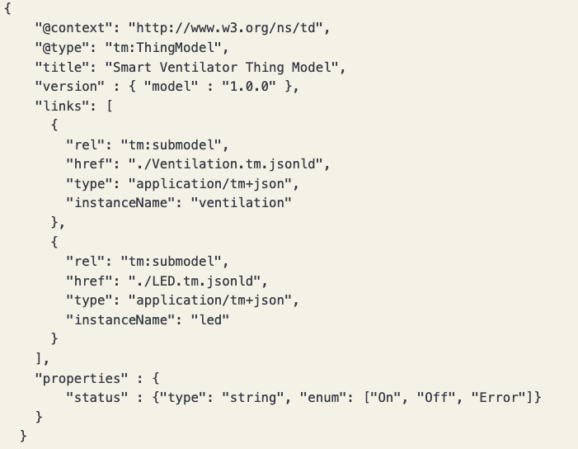
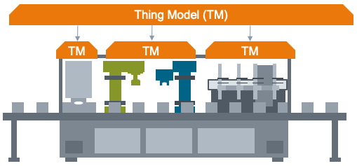
Thing Model Update
New update is provided in WIP: Updates for TM Chapter
New feature: TM Composition with two TD generation strategies
New relation typ in links “tm:submodel”
provide “instanceName” for distinguishing same TM compositions
Evaluated in PlugFest

