Slide 1
WoT Japanese CG
Tomoaki Mizushima
Internet Research Institute, Inc.
26 October 2021

Slide 2





Web of Things (WoT)
Problem of “IoT silos”
Developers have hard time to integrate various subsystems
W3C WoT is standardization for interconnecting various IoT platforms using Web technologies.
App
App
App
App
App
App
WoT API
WoT API
WoT API
{ properties, actions, events }
MQTT
KNX
TLV
ECHONET
Bearer
EXI
HTTP
OAUTH2
CBOR
WS
XML
MQTT
KNX
TLV
ECHONET
Bearer
EXI
JSON
Modbus
BACnet
OPC-UA
API Key
AMQP
HTTP
JSON
OAUTH2
CBOR
WS
XML
API Key
Modbus
BACnet
OPC-UA
AMQP

Slide 3
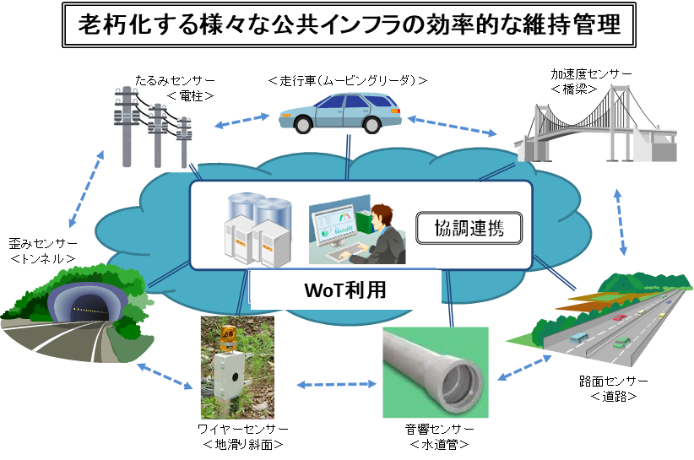
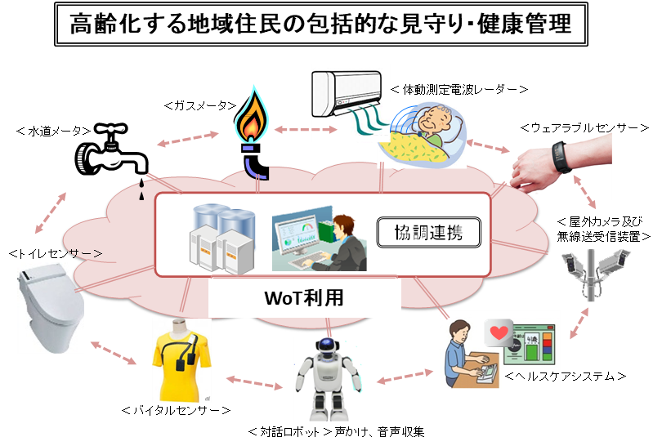
Our expectation for the future society using WoT
WoT as a solution to improve the situation
Social services, e.g., public infrastructure and health care
Efficient maintenance of various deteriorated public infrastructure
Comprehensive monitoring and health care of an aging community
Cooperation
Cooperation
with WoT
with WoT

Slide 4
WoT-JP CG – Accelerate WoT Deployment
W3C WoT-JP CG
https://www.w3.org/community/wot-jp/
Chairs
Tomoaki Mizushima (Internet Research Institute, Inc.)
Kunihiko Toumura (Hitachi, Ltd.)
Use Cases Task Force
Moderator:
Tomoaki Mizushima
(Internet Research Institute)
Objectives:
Discover industrial Use Cases
https://github.com/w3c/wot-jp-cg/tree/main/TF/Usecases
Outreach Task Force
Moderator:
Daisuke Ajitomi
(Toshiba)
Objectives:
To promote WoT deployment with SDOs, Companies, Communities, etc.
https://github.com/w3c/wot-jp-cg/tree/main/TF/Outreach
Deployment Task Force
Moderator:
Kunihiko Toumura
(Hitachi)
Objectives:
To Create Libraries, Tools, Documentations for development.
https://github.com/w3c/wot-jp-cg/tree/main/TF/Deployment
Translation Task Force
Moderator:
Kazuyuki Ashimura
(W3C/Keio)
Objectives:
English to Japanese
Japanese to English
https://github.com/w3c/wot-jp-cg/tree/main/TF/Translation

Slide 5
Relationship with WoT-WG/IG
[W3C WoT-JP CG]
Accelerate WoT deployment in Japan
[W3C WoT WG/IG]
Standardization of WoT Technology
Cooperation
- Information Exchanges
- Various proposals
- Communication Supports
Use Cases
Discover industry Use Cases
- Creating W3C specifications
- Task Force
- Thing Description
- Architecture
- Use Cases
- Scripting
- etc.
Publication and Update
W3C Specifications
- PlugFest and Testing
Outreach
Promote WoT deployment with
SDOs, Companies, Communities, etc.
Deployment
Support for developers, e.g.,
documentations, tools, libraries
Translation
English to Japanese
Japanese to English

Slide 6
Thank you!
W3C WoT Japanese CG
https://www.w3.org/community/wot-jp/
Chairs
Tomoaki Mizushima
(Internet Research Institute, Inc.)
Kunihiko Toumura
(Hitachi, Ltd.)
group-wot-jp-chairs@w3.org

