Slide 1
WoT Virtual F2F Architecture + Profiles
Michael Lagally
26 Oct 2021

Slide 2
Architecture + Profiles
Agenda:
Architecture Task Force
People and Deliverables
Current work
Next steps
Publication schedule
Profiles
Introduction to WoT profiles
Use Cases and Core Requirements
Current work
Open issues
Proposal for a “Push” event model
Next steps
Publication schedule

Slide 3
WoT Architecture Task Force People
The WoT Architecture task force is responsible for the abstract architecture and interoperability profiles for the Web of Things.
People:
WoT Architecture Co-Editors:
Michael Lagally (Oracle Corp.), Ryuichi Matsukura (Fujitsu Ltd.), Toru Kawaguchi (Panasonic Corp.), and Kunihiko Toumura (Hitachi, Ltd.)
WoT Profile Co-Editors:
Michael Lagally (Oracle Corp.), Michael McCool (Intel Corp.), Ryuichi Matsukura (Fujitsu Ltd.), Sebastian Kaebisch (Siemens AG), and Tomoaki Mizushima (Internet Research Institute, Inc.)

Slide 4
WoT Architecture Task Force Deliverables
WoT Architecture (W3C Recommendation)
The WoT Architecture specification describes the abstract architecture for the W3C Web of Things. It defines terminology that is used by all other WoT building blocks
Conceptual framework that can be mapped onto a variety of concrete deployment scenarios.
WoT Profile (W3C Recommendation)
Profiling Mechanism and a WoT Core Profile which enables out of the box interoperability among things and devices.
Out of the box interoperability implies that devices can be integrated into various application scenarios without deep level adaptations. Integration can be done by anyone without specific training.

Slide 5
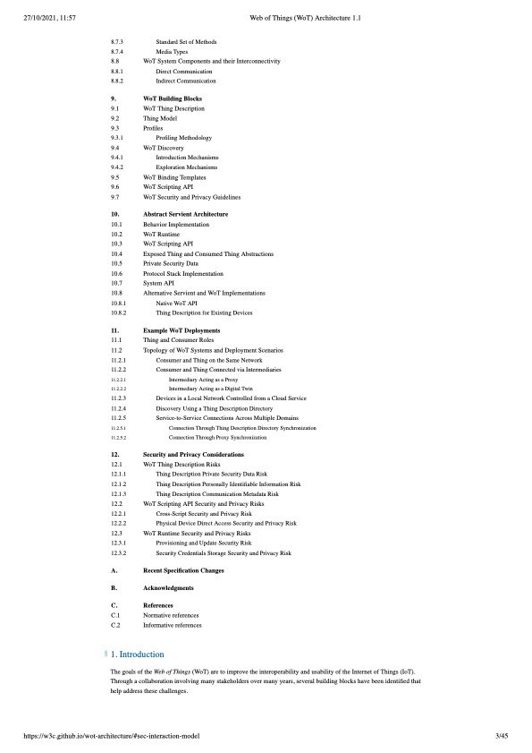
WoT Architecture 1.1

Slide 6
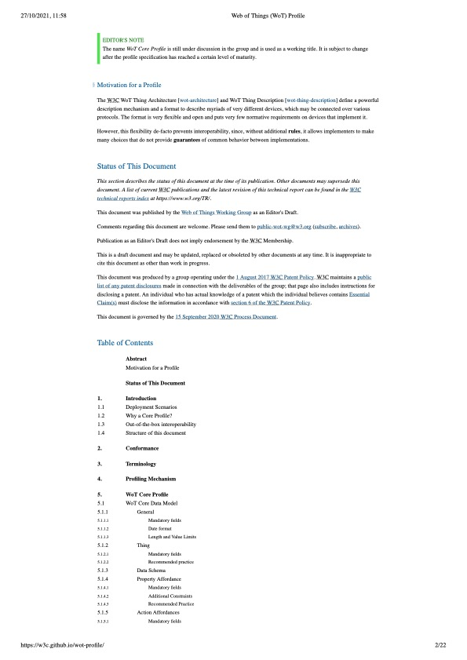
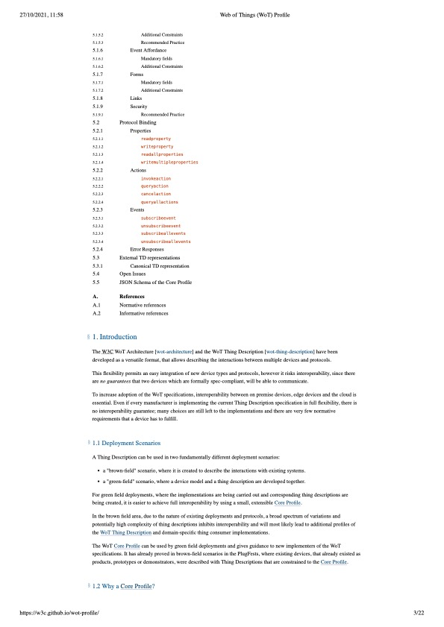
WoT Profile

Slide 7
WoT Architecture

Slide 8

Current work: Terminology Alignment
The WoT Architecture REC defines the common terminology for all WoT specifications.
Other WoT specifications should contain a reference this terminology.
Some specifications have their own terminology section, need to align and move common definitions to architecture.
https://github.com/w3c/wot-architecture/labels/spec%20alignment
# 614 - Additional terminology entries for binding spec
# 613 - Move terminology section from discovery to architecture spec
# 612 - Move terminology from TD to architecture spec
# 611 - Update Terminology regarding Binding Templates
To avoid confusion and potential ambiguities, the terminology section should be normative.

Slide 9
Current work: Protocol bindings
Recent restructuring of the WoT Binding Templates requires updates of the corresponding introduction section to this guideline.
Restructuring of the binding document goes on, some synchronisation is needed.
Initial discussions have started in the WoT editors call, will be continued in the Architecture call.

Slide 10
Next Steps
Implementation Report
Explainer Document
Help and contributions are very welcome.

Slide 11
Publication schedule
Tentative, based on the planned 6 months charter extension.
Architecture Feature Freeze: Jan 31, 2022
CR transition: mid-March
PR transition: mid-April
REC transition: before end of extended charter end of July

Slide 12
WoT Profiles

Slide 13
What is a WoT profile?
A WoT Profile is a normative subset of a WoT Thing Description with a normative binding to a selected protocol.
Profiles guarantee interoperability between compliant implementations, multiple profiles are possible.
The WoT Profile Specification defines a normative set of constraints and rules on the data model, representation format and protocol binding.
These constraints and rules set limitations and make decisions that reduce the complexity for implementers of the WoT standard.
The rules are prescriptive, to ensure that compliant implementations satisfy the semantic guarantees implied by them.

Slide 14
Core Profile for HTTP
Properties
Actions
Events
Links
Security
Core Data Model
Clarifications, Constraints, Recommended Practice
HTTP(S)
Binding
MQTT
Binding
Echonet
Binding
other
Bindings

Slide 15
Use Cases for Profiles
Agriculture
Smart Cities
Building Technologies
Manufacturing
Retail
Retail
Health
Energy
Transportation
Automotive
Smart Home
Education
Require-ments
Liaisons
Security
Discovery
Multi-Vendor System Integration
Out of the box interoperability
Digital Twins
Cross Protocol Interworking
Multimodal System Integration
Accessibility

Slide 16
Use Case Cross protocol interworking
In smart city, home and industrial scenarios various devices are connected to a common network. These devices implement different protocols.
To enable interoperability, an "agent" needs to communicate across different protocols. Platforms for this agent can be edge devices, gateways or cloud services.
Interoperability across protocols is a must for all user scenarios that integrate devices from more than one protocol.
Core requirements: Common data model across protocols,

Slide 17
Use Case Out of the box interoperability
As a device owner, I want to know whether a device will work with my system before I purchase it to avoid wasting money.
As a developer, I want to be able to validate that a Thing will be compatible with a Consumer without having to test against every possible consumer.
As a cloud provider I want to onboard, manage and communicate with as many devices as possible out of the box. This should be possible without device specific customization.

Slide 18
Core requirements
Data Model:
common metadata
common unit/metrics system
Common time formats
Constrained data model across protocols
Naming conventions
Protocol binding:
Unambiguous protocol binding
Clarifications and constraints
Fully specified interaction semantics for properties, actions and events
Fully specified error behaviour

Slide 19
Current work
Defining a core/baseline profile with a HTTP binding.
Identifying constraints and rules on the data model.
Unambiguous interaction semantics for properties, actions and events.
Constraints on payload formats.
Protocol binding semantics, e.g. headers, response codes.
Best practice security requirements.
Compliance - TD Validation

Slide 20
Open issues
Core data model section
Ongoing discussion in several PRs
Current constraints need to be reworked
One TF member proposed removal of the entire section, this would break cross-protocol interoperability use cases and impact OOTB interoperability
Event model limitations
Current model is a “Consumer Pull model” using SSE
Requires an open socket connection for each subscription
Does not support firewalls
Does not scale to cloud scenarios
Works only in closed networks

Slide 21
Proposal for a “Push” event model (1)
In typical cloud scenarios devices are not reachable from the internet
Devices send messages and events via firewalls
Only on-demand network traffic, no open connection if no messages
Pull model wastes significant resources
open connections to thousands of devices even if no traffic
Network traffic overhead due to timeouts and reconnects
Webhooks over HTTP are industry standard for scalable event systems, see for example:
Github: https://docs.github.com/en/developers/webhooks-and-events
Paypal: https://developer.paypal.com/docs/api-basics/notifications/webhooks/
Atlassian: https://developer.atlassian.com/server/jira/platform/webhooks/
Wordpress: https://wordpress.com/support/webhooks/

Slide 22
Proposal for a “Push” event model (2)
In typical cloud scenarios devices are not reachable from the internet
Devices send messages and events via firewalls
Only on-demand network traffic, no open connection if no messages
Pull model wastes significant resources
open connections to thousands of devices even if no traffic
Network traffic overhead due to timeouts and reconnects
Webhooks over HTTP(S) are commonly used for scalable event systems, see for example:
Github: https://docs.github.com/en/developers/webhooks-and-events
Paypal: https://developer.paypal.com/docs/api-basics/notifications/webhooks/
Atlassian: https://developer.atlassian.com/server/jira/platform/webhooks/
Wordpress: https://wordpress.com/support/webhooks/

Slide 23
Push event model
Follow Industry best practice:
Use Webhooks over HTTP(S) for push events
Use cloud events as message payload format (https://github.com/cloudevents/spec/blob/v1.0.1/spec.md)
Provide additional clarifications:
Retry and reconnect behaviour
Error behavior
Standard attributes

Slide 24
What are Cloud Events?
A specification for describing event data in a common way.
Spec has been developed by several companies, including Alibaba, Amazon, Google, Huawei, IBM, Intel, Microsoft, Oracle, PayPal, Red Hat, SAP, Serverless Inc, SolarWinds, VMWare.
It defines a type system, context attributes and a payload format.
Open source implementations for various languages, including Java, go, C#, javascript, python are available.
https://cloudevents.io

Slide 25
Cloud Event example (JSON)
{
"specversion" : "1.0",
"type" : "com.github.pull_request.opened",
"source" : "https://github.com/cloudevents/spec/pull",
"subject" : "123",
"id" : "A234-1234-1234",
"time" : "2018-04-05T17:31:00Z",
"comexampleextension1" : "value",
"comexampleothervalue" : 5,
"datacontenttype" : "text/xml",
"data" : "<much wow=\"xml\"/>"
}

Slide 26
Next steps
“Push” event mechanism
Rework data model section
Implementation Report
Compliance Section – JSON Schema for profile
Authentication, Security
Incorporate Plug Fest findings

Slide 27
Future Work – next charter period
Support for other protocol bindings
Candidates include:
MQTT
Echonet Lite
OPC-UA
Include TD 1.1 features
E.g. Thing Models
Include TD 2.0 features

Slide 28
Publication schedule
Tentative, based on the planned 6 months charter extension.
Profile Feature Freeze: Jan 31, 2022
CR transition: mid-March
PR transition: mid-April
REC transition: before end of extended charter end of July

Slide 29
References
WoT Architecture task force
https://www.w3.org/WoT/activities/tf-architecture/
WoT Architecture repository / working draft
https://github.com/w3c/wot-architecture
WoT Profile repository / working draft
https://github.com/w3c/wot-profile
Wot Use Cases – editors draft:
http://w3c.github.io/wot-usecases

Slide 30
Backup

Slide 31
PRs

Slide 32
PRs
RFC 2119 markup: add css mark <span> into index.html
https://github.com/w3c/wot-profile/pull/79
Discussion:
We noticed that some span markups are in editors notes – these need to be cleaned up in a further iteration.
We merged the PR, Mizushima-san will provide additional comments.
McCool will do another pass using the test tooling.

Slide 33
References
WoT Use Cases repository
https://github.com/w3c/wot-usecases

