Slide 1
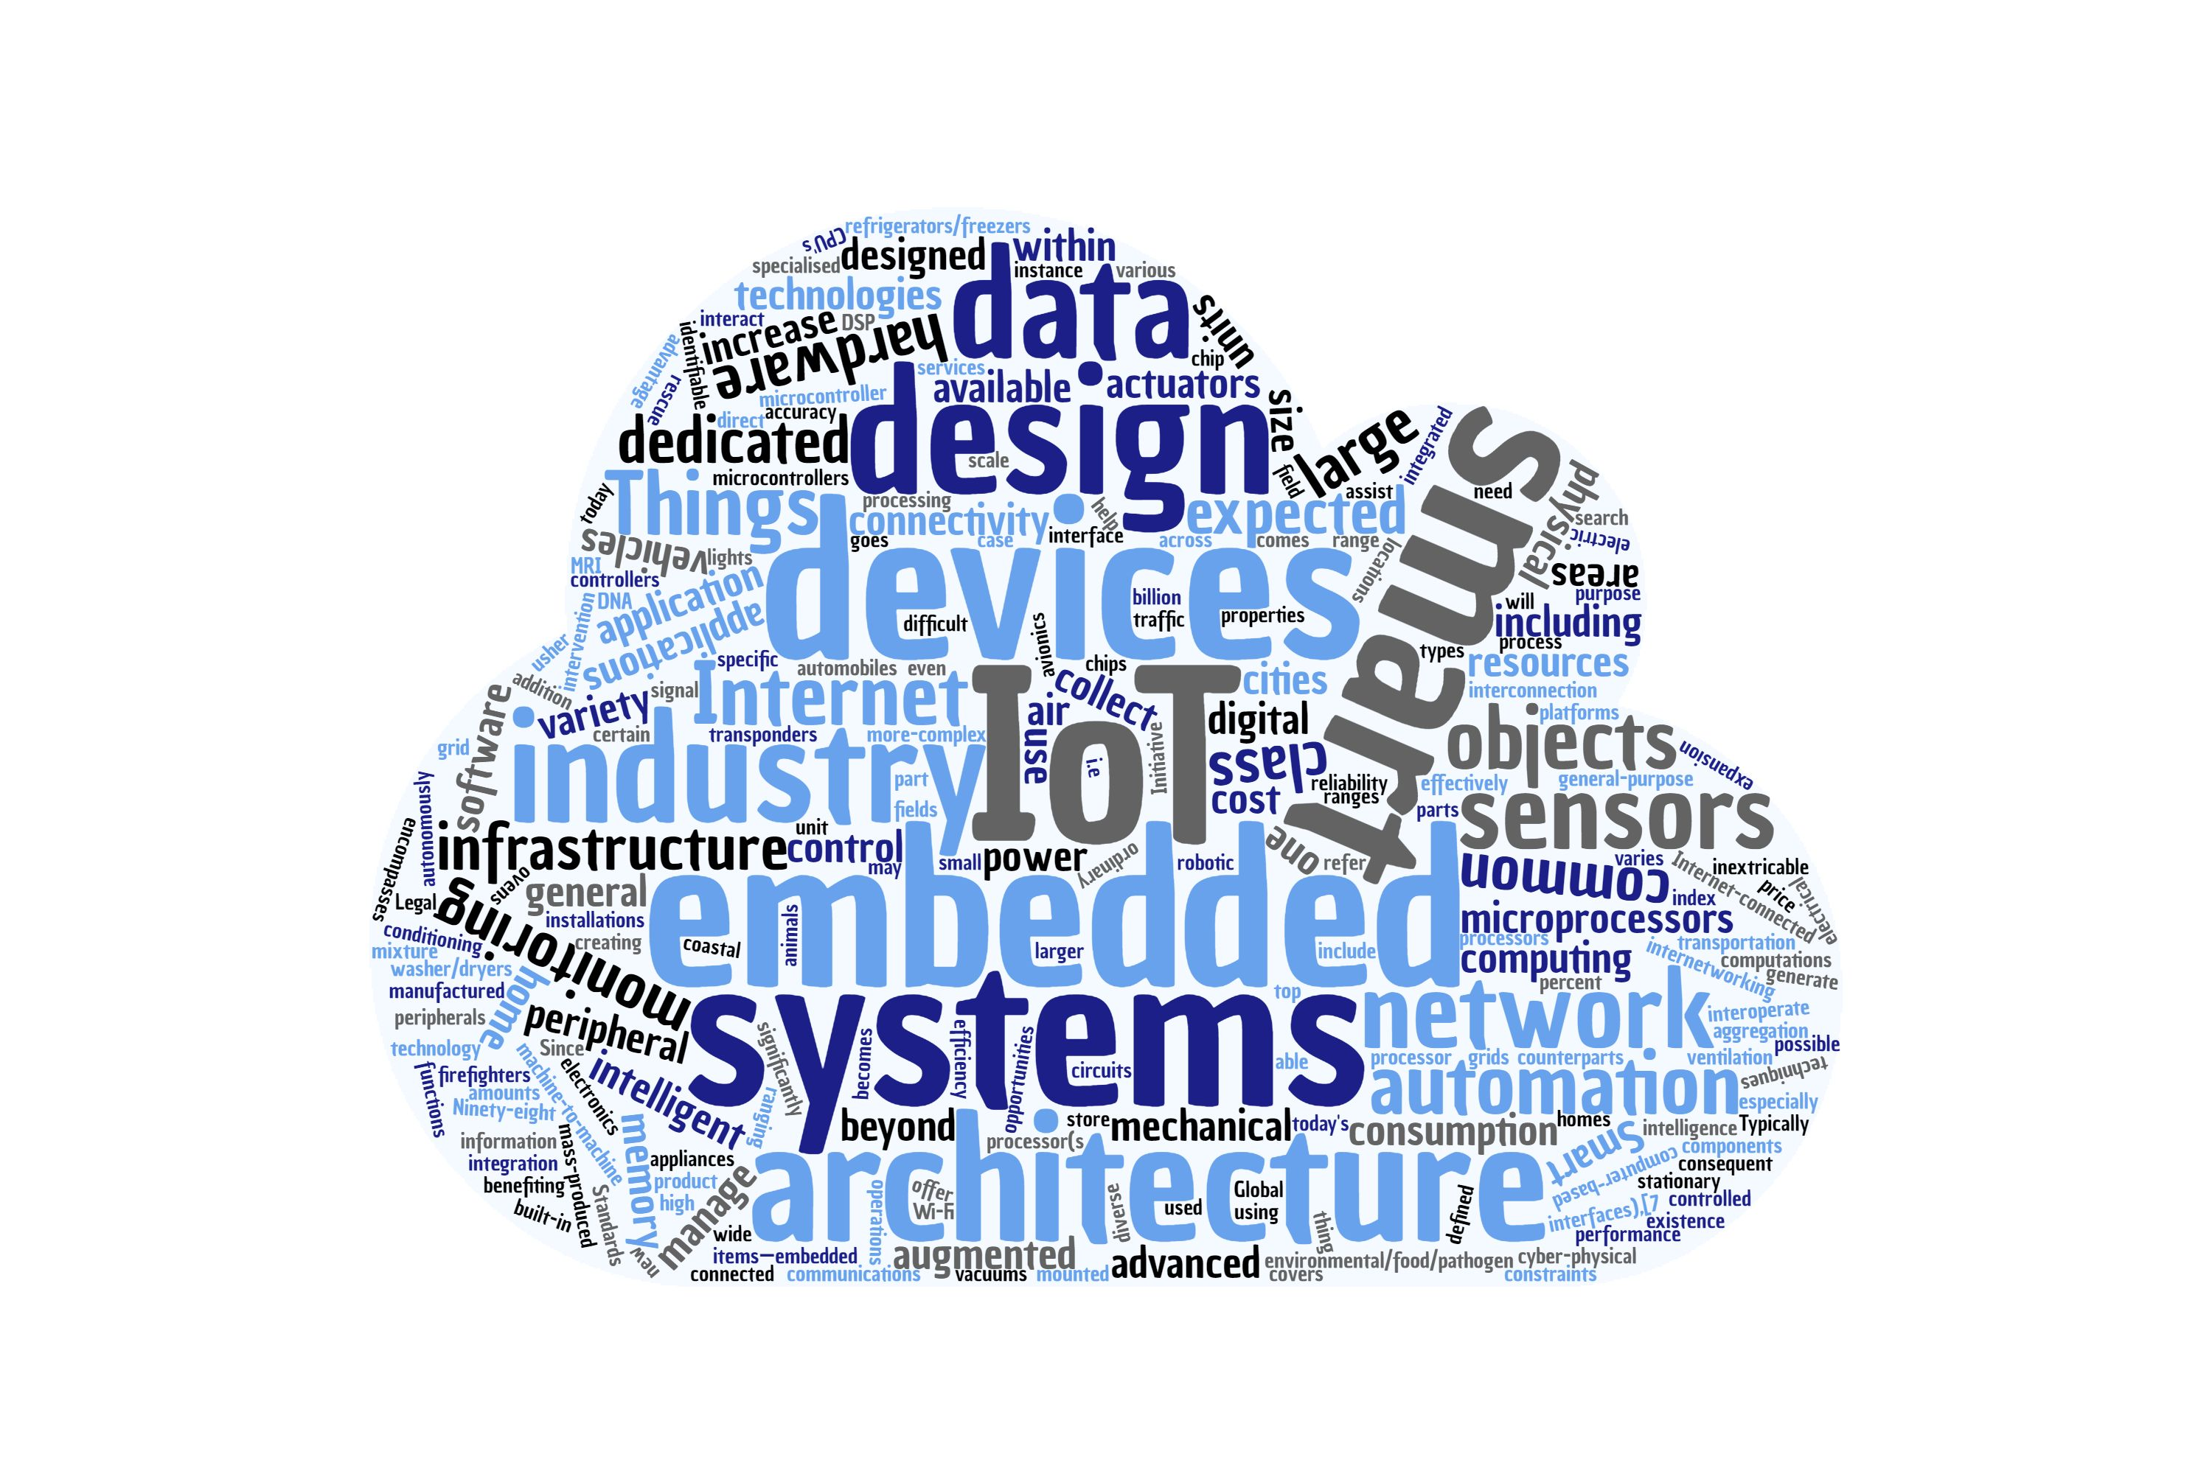
W3C WoT Plugfest - Testbench by Marcus Wolf Schmidt & Ege Korkan October 11th, 2021 Associate Professorship of Embedded Systems and Internet of Things

Slide 2

The Testbench: Main Goals
Request Generation
Testcase Generation
Payload Generation
Automate Thing Testing/„Probing“
TD
Evaluation

Slide 3
Testbench
TD
Operation
Input
Parameter
Output
Testing
Evaluation

Slide 4
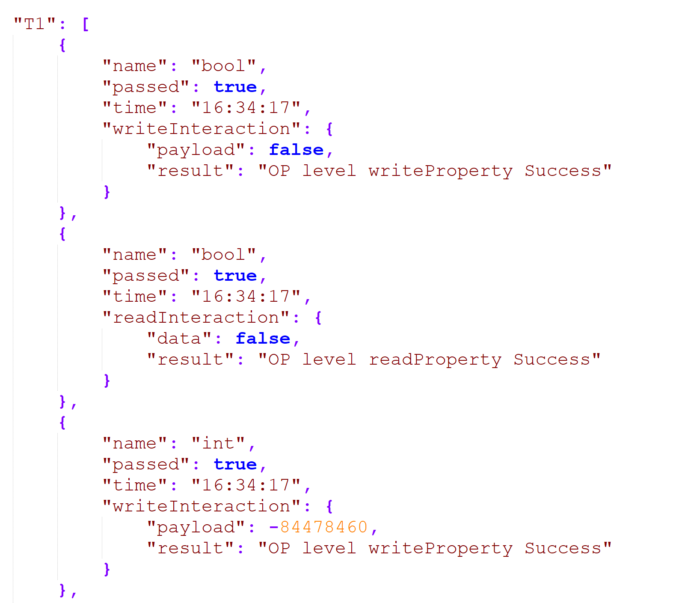
Test Report
T1: Operation Coverage
T2: Parameter Coverage
T3: Input Coverage
T4: Output Coverage

Slide 5
Things I have interacted with during the Plugfest
Things | Reachable | Tested
Siemens | True | True
NHK | True | True
Intel | False | False
Hitachi | True | True
Unibo Farm | True | True
TUM | True | True
ECHONET | True | True
Fujitsu | False | False

Slide 6
Siemens
Things | Reachable | Tested | Passed | Reason
counter | True | True | 95% | Image data could not be generated (T3)
eCar | False | False | 0% | IP was not IPv6 or VPN (T1)
SmartCoffee | True | True | 85% | Discrepance between written value and read value of property Affordances (T3)
SolarPower | True | True | 100% | ----
TestThing | True | True | 100% | ----

Slide 7
NHK
Things | Reachable | Tested | Passed | Reason
DisplayEmu | True | True | 95% | power Affordance writeproperty did not get accepted (T1 & T2 & T3)
SpeakerEmu | True | True | 95% | power Affordance writeproperty did not get accepted. (T1 & T2 & T3)

Slide 8
Hitachi
Things | Reachable | Tested | Passed | Reason
accelerometer | True | True | 100% | ----
LED | True | True | 30% | Thing did not respond in most testcases (T3)

Slide 9
Unibo Farm
Things | Reachable | Tested | Passed | Reason
Sprinkler | True | True | 50% | CoAP testcases did not execute correctly. The Thing did not respond to CoAP requests. (T1)
SoilSensor | True | True | 50% | Same as above.

Slide 10
ECHONET
Things | Reachable | Tested | Passed | Reason
Lighting | True | True | 100% | --
Airconditioner | True | True | 100% | --
Lightsensor | True | True | 100% | --
Temperature sensor | True | True | 100% | --

Slide 11
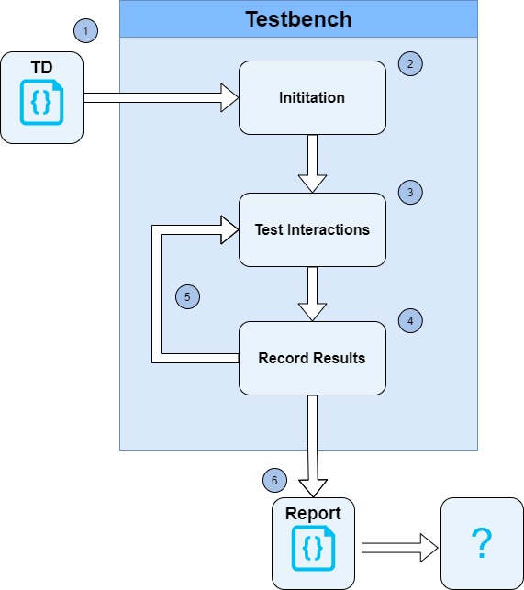
What is next ?
What next ?

Slide 12
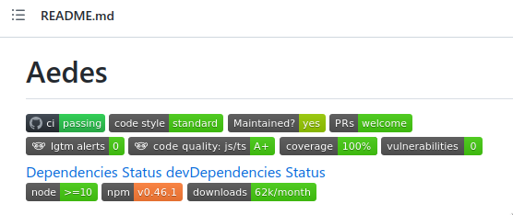
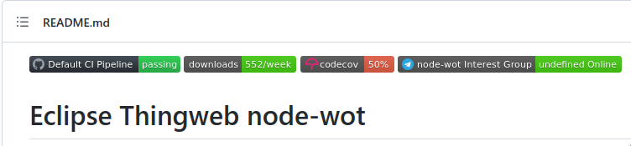
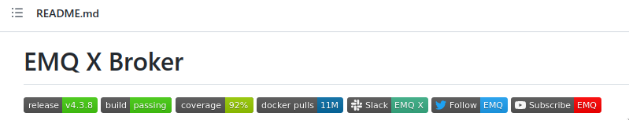
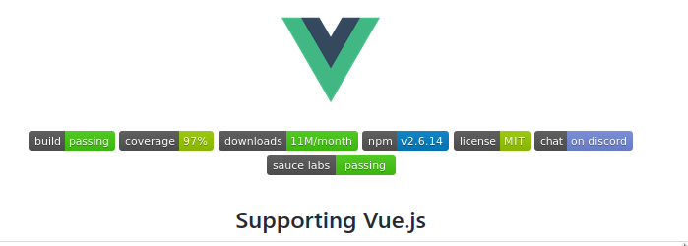
Motivation
Many code repositories contain badges about the build status or test coverage:

Slide 13
TD “Badges”
Can we have such information in TDs? Why?
- Gives confidence to Consumers that every affordance can be used
- Motivates Thing implementors to do better and compliant implementations
How is it done for repositories?
- Badges give a quick image/result
- Link to a provider of the feature (code coverage, build)
- Can be external
- Has full information

Slide 14
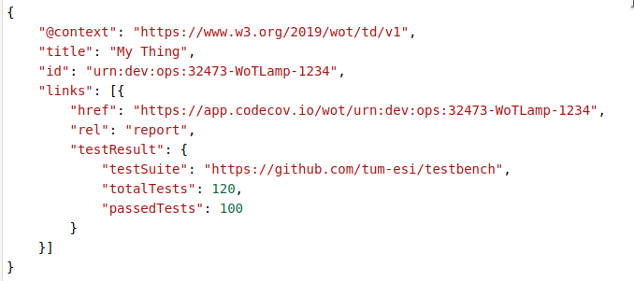
TD “Badges”: Example
Just an initial thought

Slide 15
{
"@context": "https://www.w3.org/2019/wot/td/v1",
"title": "My Thing",
"id": "urn:dev:ops:32473-WoTLamp-1234",
"links": [{
"href": "https://app.codecov.io/wot/urn:dev:ops:32473-WoTLamp-1234",
"rel": "report",
"testResult": {
"testSuite": "https://github.com/tum-esi/testbench",
"totalTests": 120,
"passedTests": 100
}
}]
}

Slide 16
Discussion
What to do with Report ?
Share over E-Mail
Database
Github
Local

Slide 17
WoT-Testbench
https://github.com/tum-esi/testbench

Slide 18
Results
All the results are on GitHub https://github.com/w3c/wot-testing/pull/193
and can be sent to the owners.

