Slide 1

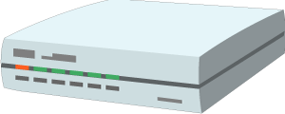

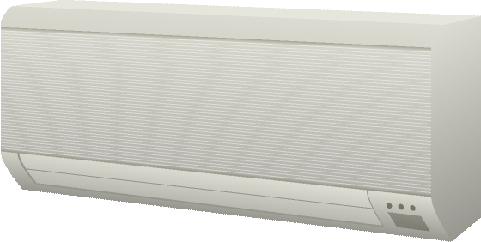


Cloud Mirror / Device Shadow
Integration Hubs
Thing
App Script with Software Objects
Thing
Resource Model
App Script with Software Objects
Protocol Bindings
Thing
Description
Resource Model
Protocol Bindings
Standardized Scripting APIs for portable Apps
Semantic Models
Web Integration
Web Browser
Thing
App Script with Software Objects
App Script with Software Objects
Resource Model
Complementing
Existing Devices
and Platforms
Thing
Description
Resource Model
Protocol Bindings
Protocol Bindings
Thing-to-Thing Interaction

Slide 2

Local Hubs
Cloud Mirrors
Device Shadow
Remote access
Virtual Thing
Standardized APIs for portable application logic
(Scripting API)
Semantic metadata
(Thing Description)
Application with Software Objects
Application with Software Objects
Scripting API
Scripting API
Protocol Bindings
Protocol Bindings
Web integration
Direct Thing-to-Thing interaction
Complementing
existing devices
and platforms
Web Browser
Existing Device
Thing
Application with Software Objects
Application with Software Objects
+
Scripting API
(Protocol Bindings, Thing Description)
Scripting API
Protocol Bindings
Thing
Protocol Bindings
$$⇒$$

Slide 3
Semantic
Metadata
Platform A
Platform B
Applications
Applications
API
API

Slide 4
Semantic
Metadata
Platform A
Platform B
Applications
Applications
API
API

Slide 5
Thing
Application Script
Scripting API
Protocol Bindings

