Slide 1
On “EVRYTHNG Web Thing Model”
…
4. Web Things Integration Patterns
5. Web Things Requirements
6. Web Things Model
…
How does it compare to the WoT Current Practices?

Slide 2
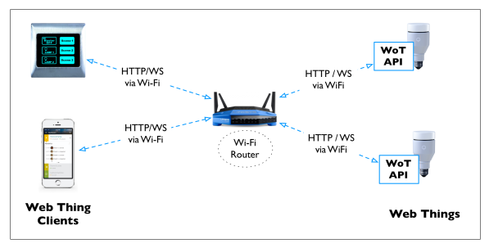
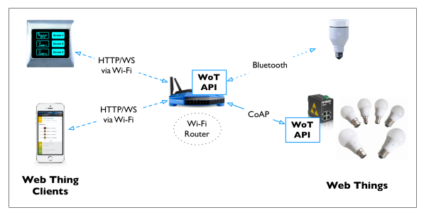
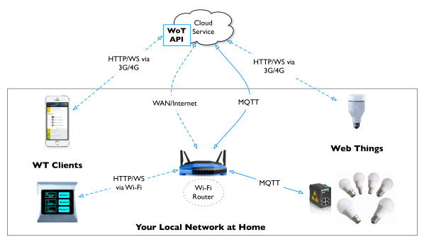
4. Web Things Integration Patterns
Direct Connectivity
WoT API on Things
Gateway-based Connectivity
WoT API on gateways
Cloud-based Connectivity
WoT API in cloud

Slide 3
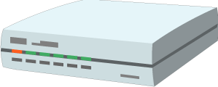


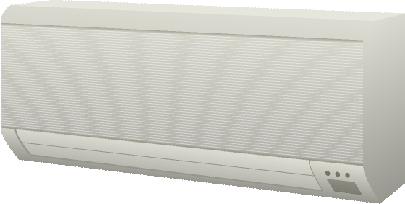
On 4.: W3C WoT Architecture
Local Hubs
Cloud Mirrors
Cloud
Gateway
Device Shadow
Remote access
Virtual Thing
Standardized APIs for portable application logic
(Scripting API)
Semantic metadata
(Thing Description)
Application with Software Objects
Application with Software Objects
Scripting API
Scripting API
Protocol Bindings
Protocol Bindings
Web integration
Direct Thing-to-Thing interaction
Complementing
existing devices
and platforms
Web Browser
Existing Device
Thing
Direct
Application with Software Objects
Application with Software Objects
+
Scripting API
(Protocol Bindings, Thing Description)
Scripting API
Protocol Bindings
Thing
Protocol Bindings

Slide 4
5.1 Web Things Requirements
R0.1: MUST use HTTP
Too restrictive for IoT, but a good default
R0.1: MUST have Entry point URI (“root resource”)
Yes
R0.3: MUST support GET, POST, PUT, DELETE
Yes, uniform interface, and make it multi-protocol
R0.4: MUST utilize HTTP status codes
Yes, and even better multi-protocol REST status codes
R0.5: MUST support JSON
Too restrictive for IoT, but a good default
R0.6 == R0.1 (MUST support GET on it)
Yes

Slide 5
5.2 Web Things Requirements
R1.1: SHOULD use secure protocol (“HTTPS”)
Yes
R1.2: SHOULD use WebSockets
Yes, there is need for more protocols than just HTTP
R1.3: SHOULD support [6.] Web Thing Model
Yes, we should agree on an interaction model
R1.4: SHOULD use status codes properly
Yes
R1.5: SHOULD provide human-readable doc.
Yes, and MUST provide machine-readable doc. (TD)

Slide 6
5.3 Web Things Requirements
R2.1: MAY support more to optimize (“OPTIONS verb”)
Yes
R2.2: MAY support more representation formats
Yes
R2.3: MAY offer HTML-based UI
Yes
R2.4: MAY provide semantic metadata
Yes , and MUST for machines

Slide 7
6. Web Things Model
6.0: Standardized relative URI paths
No, use hypermedia controls (Web Linking and Forms)
6.1: Common Constructs (~semantic core)
Yes, best as Linked Data vocabulary
6.2: Link to related resources
Yes
6.3: Values
Yes, and provide semantically annotated schemas
6.4: Typed resources (allowed verbs and responses)
No, use hypermedia controls (Web Linking and Forms)
6.5: Semantic Extensions
Yes, TD extensible @context

Slide 8
Delta to EVRYTHNG Web Thing Model
R0.1: MUST use HTTP
Too restrictive for IoT, but a good default
R0.5: MUST support JSON
Too restrictive for IoT, but a good default
6.0: Standardized relative URI paths
No, use hypermedia controls (Web Linking and Forms)
6.4: Typed resources (allowed verbs and responses)
No, use hypermedia controls (Web Linking and Forms)

