Slide 1


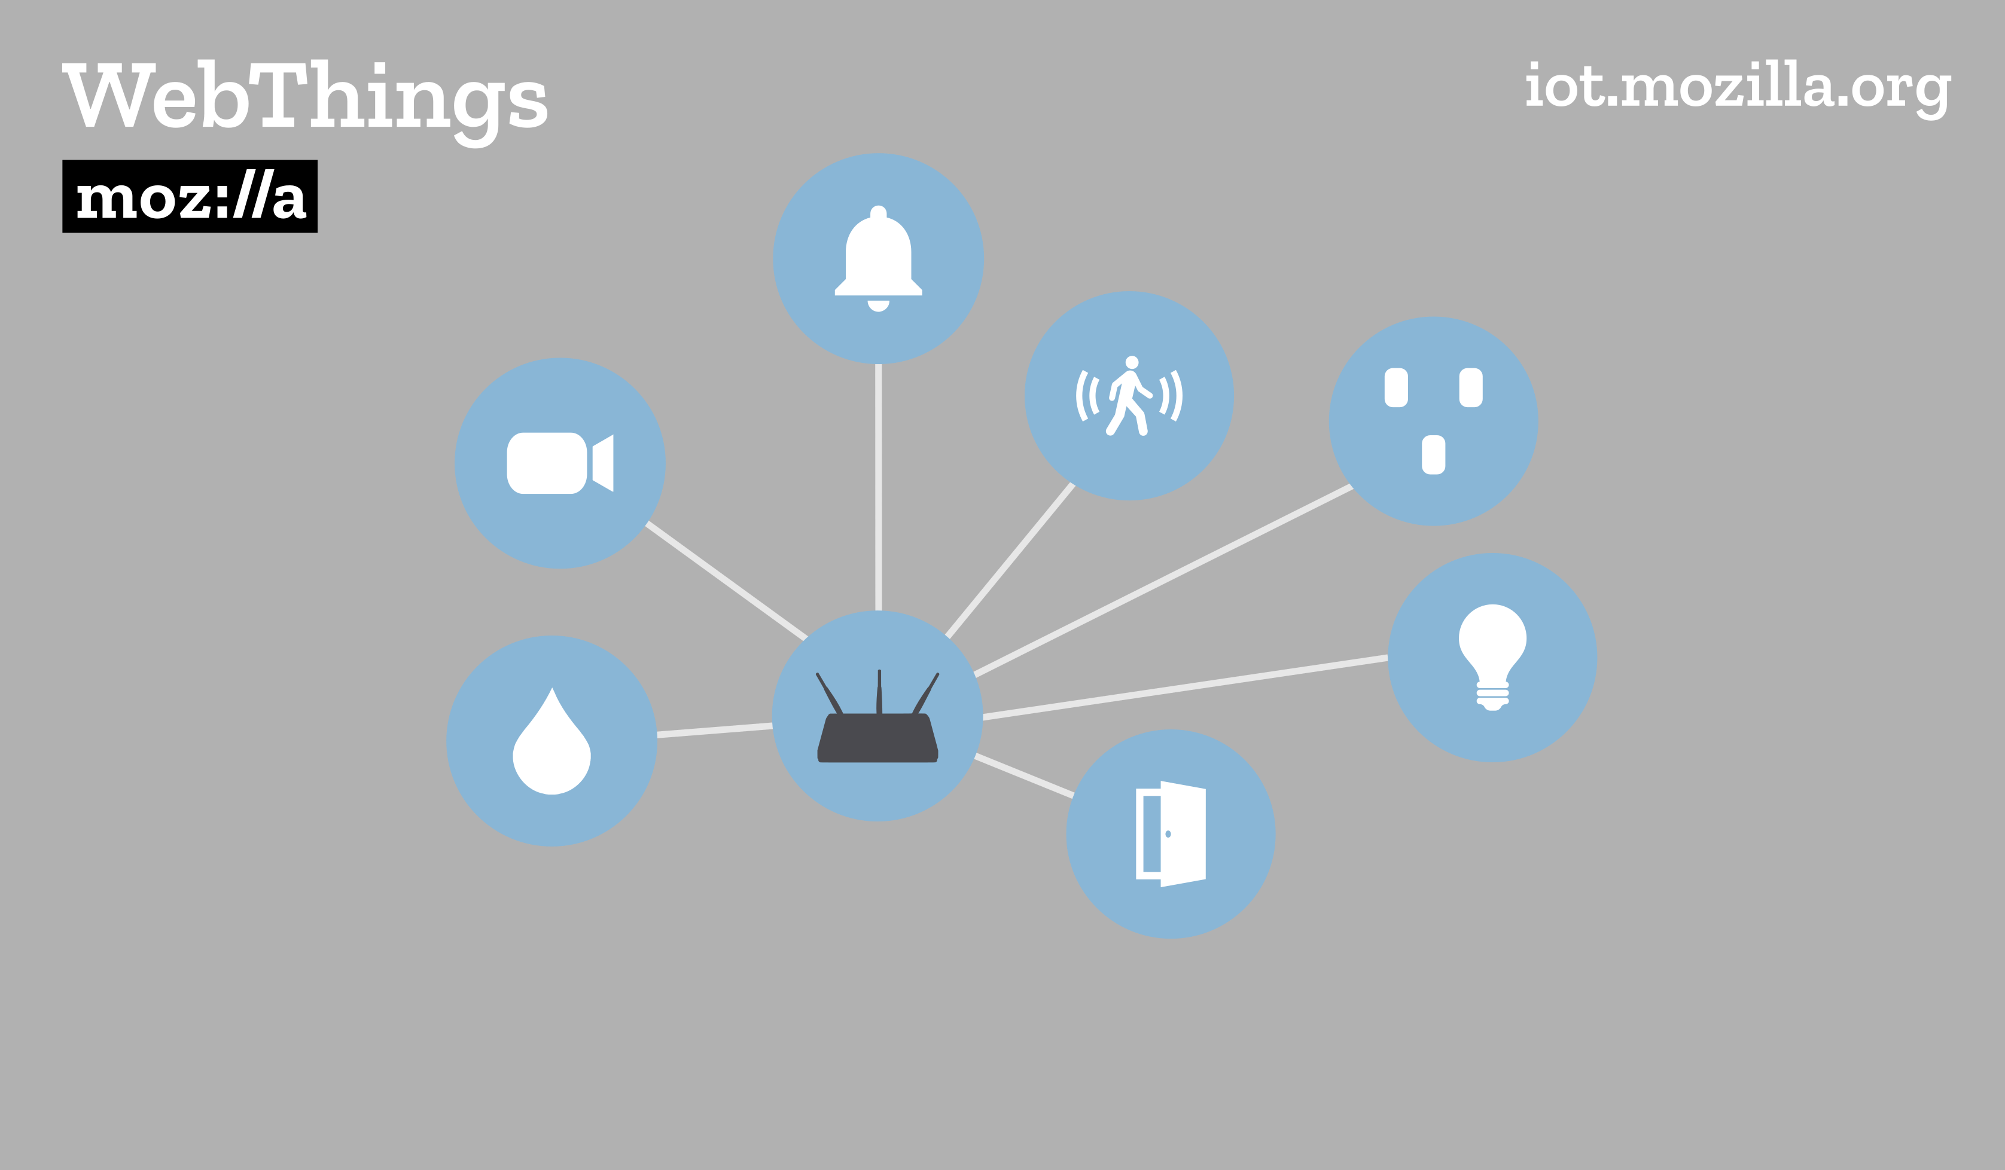
W3C WoT Open Day Mozilla WebThings
Local HTTPS
Web thing authentication
HTTP on constrained devices
<< Insert picture (optional)>>
A unified application layer which bridges together multiple underlying smart home protocols
Directly monitor and control your home over the web, without a middleman.
E-Mail: bfrancis@mozilla.com kgiori@mozilla.com

