Slide 1

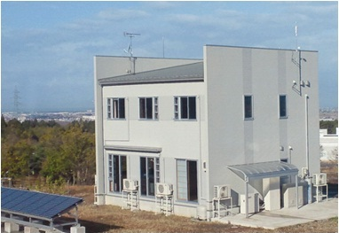
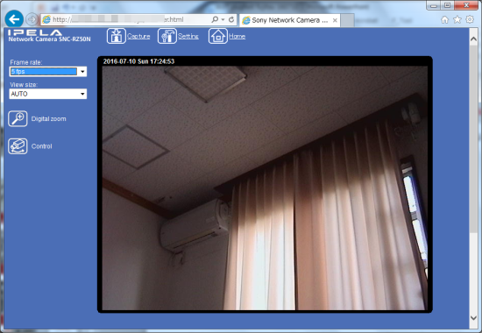
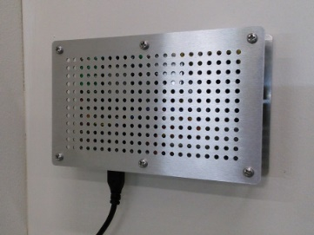
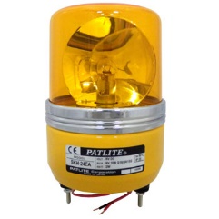
W3C WoT Open Day WoT gateway with device virtualization
Insert your logo here
Application
Many kinds of devices are connected to the field.
An integrated API is required for developers to establish the digital transformation.
Fujitsu WoT gateway can expose virtual devices with integrated API
to applications instead of actual devices.
Virtual A
Virtual B
Virtual C
WoT Gateway
Smart factory: environment sensors, rotary beacon light
Adapter
Adapter
Ease of Use
Ease of Maintenance
Device A
Device B
Device C
Device A & B : non-WoT devices connected with adapter
Device C : WoT device connected directly
Smart home: home appliances, window blind, etc.
E-Mail: r.matsukura@fujitsu.com, suzuki.takahisa@fujitsu.com

