Slide 1
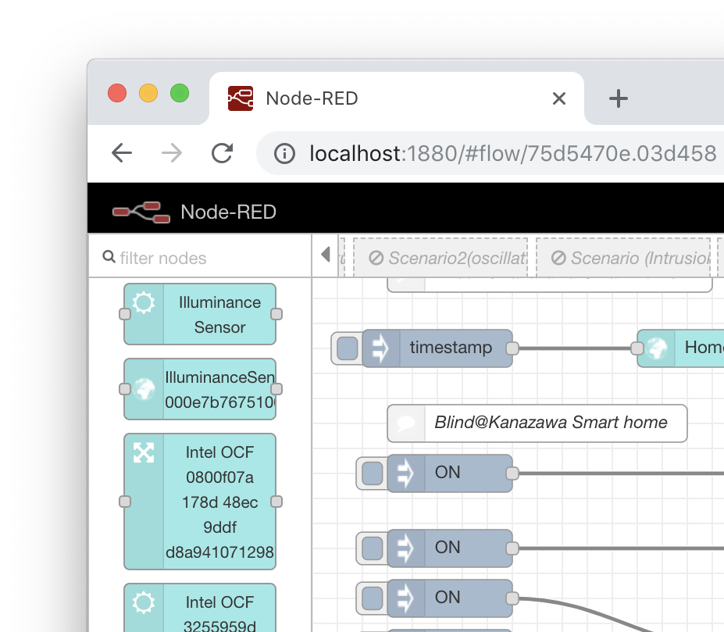
W3C WoT Open Day Rapid IoT application development using the Web of Things
IoT application development:
Node Generator: A tool for generating a Node-RED node module from a WoT Thing Description (TD).
Using this tool, developer can handle a node on the Flow Editor as an avatar of the Thing.
Since each IoT platform uses different transport protocol and data format, developer have to implement protocol handling logic or build an application on an IoT platform-specific environment.
Node
Generator
TD provides a formal specification of how to interact with the Thing. Moreover, the tool can utilize semantic information in the TD, such as type of Thing and links for other related Things.
WoT Thing
Description
GitHub repository: https://github.com/k-toumura/node-red-nodegen/tree/webofthings
E-Mail: kunihiko.toumura.yv@hitachi.com

