Slide 1

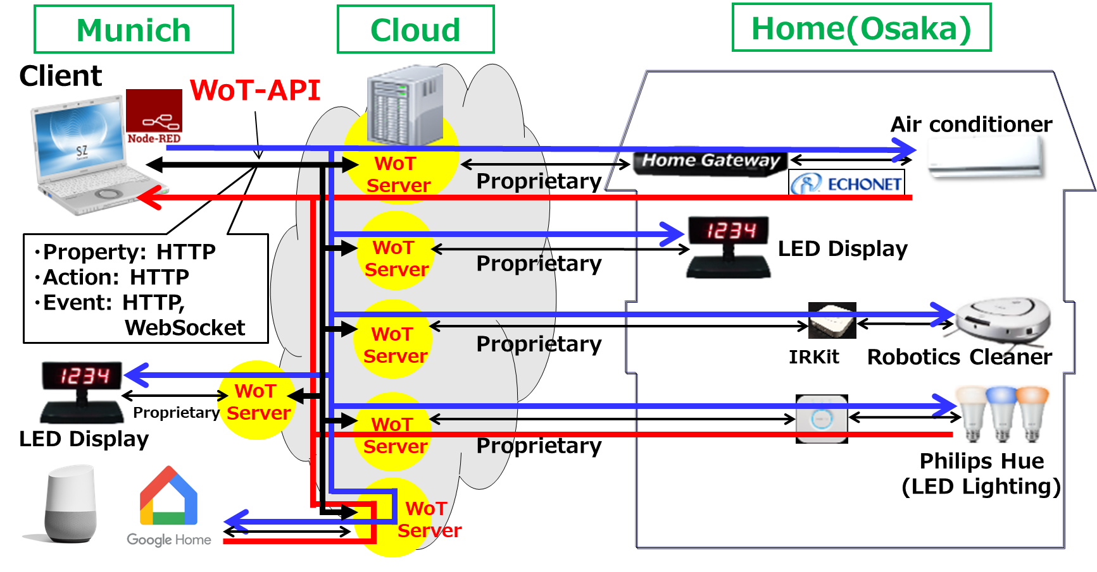
W3C WoT Open Day Smart Home Demo
Home appliances communicate with the gateway using existing home protocol such as ECHONET Lite, and provide functions through the WoT server API on the cloud.
Panasonic aims to realize "Lifestyle Update", which continuously provide new value to customers by connecting with any devices.
By defining common interaction models and metadata formats, WoT can eliminate the barriers between platforms and to connect devices across fields.
E-Mail: kawaguchi.toru@jp.panasonic.com, yamada.takesi@jp.panasonic.com

