Slide 1
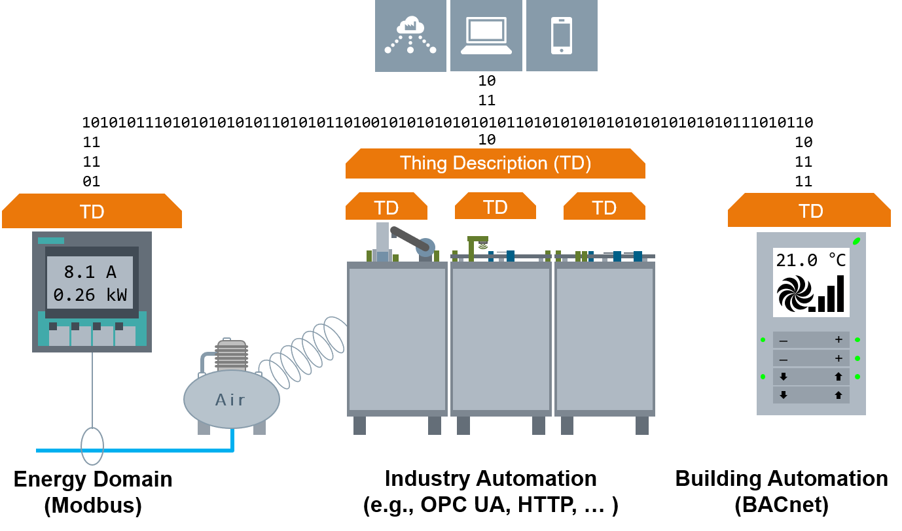
Create Smarter Industrial Environment by Integrating Domains with Web of Things Approach
Plug and Play of energy monitoring device into industrial plant
Control plant operation based on HVAC monitoring
Simplified onboarding of HVAC controller to Cloud
Retrieving data from heterogenous sources
Integration of data from Modbus, HTTP, BACnet, CoAP and OPC UA protocols
Simplified Brown-field integration
Plug and Play of devices made easy
Bigger developer community
Web tools, e.g., Node-RED can be used for WoT application development
Authors: Michele Blank, Aparna Saisree Thuluva, Hassib Belhaj Hassine, Thomas Stockner, Haifa Lahbaiel, Sebastian Kaebisch
E-Mail: michele.blank@siemens.com, aparna.thuluva@siemens.com, hassib.belhaj_hassine@siemens.com, sebastian.kaebisch@siemens.com

