Slide 1
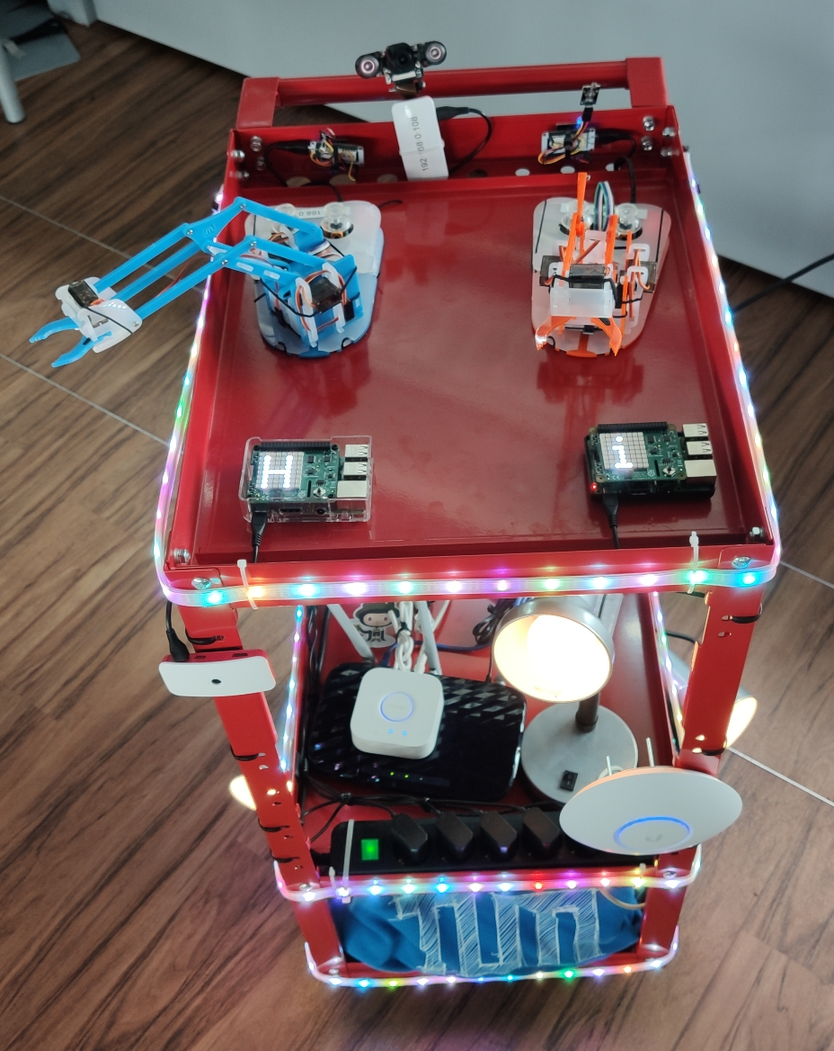
W3C WoT Open Day Technical University of Munich Demo Platform
Research:
Hardware evaluation platform for new research ideas
Teaching:
Mobile platform for showcasing IoT technologies and hands on tutorials
Describing systems composed of WoT devices:
System Commissioning
System Verification
Ease of composing complex systems
Application independence from protocol and network
Tel.: +49 176 3012 69 42
E-Mail: ege.korkan@tum.de

