Slide 1
Hardware-based secure services past and future
Olivier POTONNIEE, Aurélien COUVERT, Virginie GALINDO
April 2016

Slide 2
What we did around Secure Element ….
Sys APP WG proposal
Opening a communication channel with Secure Element
Does not fit
Web Crypto API for hardware token
Too early
Web Crypto . Next workshop in Sept 2014
Promoting secure element and FIDO authentication
Web Authentication WG
Up and running

Slide 3
Why is not there yet an API to access Secure Element ?
Education matters
Web dev don’t want to speak APDU
Browser makers neither
Power industry matters
We are only few security vendors in W3C
More device and security players are joining : Banks, Visa, Tyfone, Chipset makers, …
SE value are not straightforward for browser makers
They live in a on-line, real time, risk management world
They know how to deal with secure browser, secure enough storage…
Concern with privacy and security
Services in SE made accessible to everyone is a privacy concern
No security solution for access control has been convincing enough up to now

Slide 4
What we see for the open web platform….
There are some standard services that web app could benefit
Cryptography operation and storage
Citizen identity
Payment services
Abstraction : what ever is the hardware-based token flavor
The W3C should not worry about integration aspects
TEE and secure element are used in transparent way in platforms
See iOSSecure Enclave, android hardware-key, android Trusty framework, android fingerprint API, and some mobile payment solutions

Slide 5
Example of Web Authentication API….
The level of service is
Enroll authenticator
Authenticate
W3C defines attestation, signature and service parameters
The implementers manage the FIDO Client and enumeration/communication with the authenticators
Security model is
HTTPS
SOP
Centralized server checking device attestation, behing the web app domain

Slide 6
Our suggestion for having some hardware-based secure services happening
Pick one or two use cases
Design the basic services we need
Prototype integration with UA vendor
And improve

Slide 7
Sharing with you some technical thoughts….

Slide 8










Low level Secure Element APIs
PC/SC
Open Mobile API
(OMAPI)
8.1: 
10: 
Notes:
Existing standards for native applications:
- PS/SC v1 in 1997
- OMAPI: v1 in 2011, v3.1 in 2015
Win10
API fragmentation across platforms

Slide 9
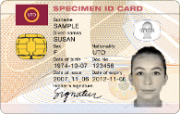

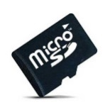


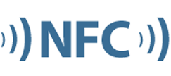


Cross-Platform Secure Element (SE) API
Web Applications
Web Runtime
Secure Element API
Access Control
PC/SC
(MSWindows, MacOS, Linux)
OMAPI
(Android)
NFC
…
OS
Desktop
Mobile
Notes:
The Open Web Platform proposes uniform cross-platform APIs
Across platforms and communication interfaces
Due to secure nature of secure elements, we need to define a proper access control mechanism
Why Access Control?
Web is open, while secure element is closed, usually very restricted. 1-to-1.
We don’t want anybody access to SE, because it contains secrets

Slide 10


Secure Element API
Standardization
Proposed to W3C (SysApps & WebCrypto WGs)
http://opoto.github.io/secure-element/
Transferred to a GlobalPlatform WG
https://github.com/globalplatform
Under public review here http://globalplatform.github.io/WebApis-for-SE/doc/.
Implementation
Included in Firefox OS 2.2 (June 2015)

Slide 11
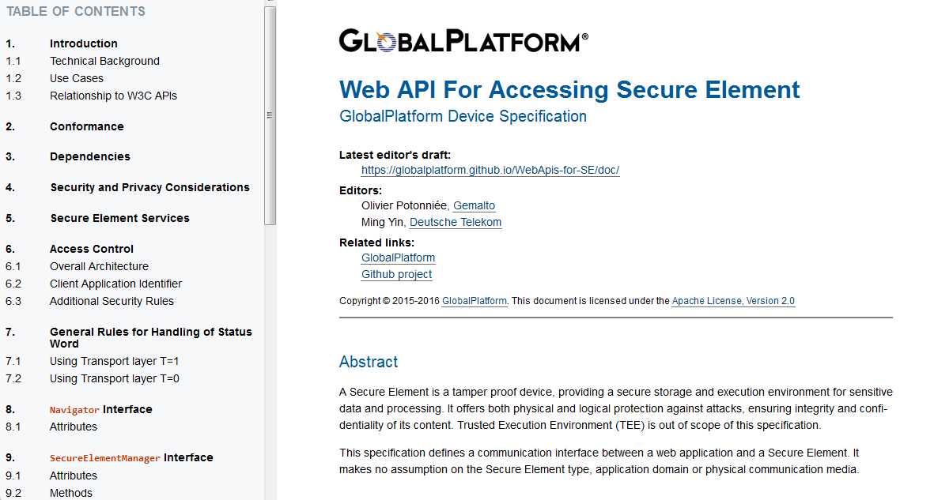
Web API for accessing Secure Element

Slide 12

Secure Element API
Transport-level API (similar to SIM Alliance’s OMAPI)
Secure Element Manager
Enumerate readers
SE insertion / removal events
Is SE present?
Connect to SE
SE ATR
Connect to Applet
Basic / Logical
Transmit APDUs
Reader
Session
Channel

Slide 13
Access Control Toolbox
Web Security Model
Secure Element Security Model
Permissions: Access to device/resources (GPS, storage, etc…)
Same Origin Policy (SOP): Data isolation per domain
PIN
Secure Messaging Mutual AuthentN
GlobalPlatform Access Control
Notes:
The two models that do not fit immediately.
We’ll look at both of them

Slide 14
Access Control (1/2): The Web
Web Security Model
Secure Element Security Model
Permissions: Access to device/resources (GPS, storage, etc…)
Same Origin Policy (SOP): Data isolation per domain
PIN
Secure Messaging Mutual AuthentN
GlobalPlatform Access Control
Notes:
Permission: delegates control to user, for local resources only. Not enough for value added services.
SOP: One could consider eID domain-less, they can be presented to many parties to prove one’s identity. Cross-origin per nature.

Slide 15




Domain-binded SE apps (SOP compliant)
An SE app with one credential per domain
An SE app is tied to a single domain, which hosts a centralized service
Other apps use a delegation protocol to use the centralized service
Service
Provider
(Relying Party)
SAML/OpenID Connect
Identity
Provider
Login
Authenticate
Notes:
FIDO: SOP compliant by design. Hardcoded in the protocol.
the fido authenticator belongs to the user, not the main model for secure elements
Usually: the secure element belongs to the emitter, and usage of the credentials it stores my be restricted to this emitter only
Delegation: eg for eGov, but could also be used in payment, or ticketing

Slide 16
Access Control (2/2): Secure Elements
Web Security Model
Secure Element Security Model
Permissions: Access to device/resources (GPS, storage, etc…)
Same Origin Policy (SOP): Data isolation per domain
PIN
Secure Messaging Mutual AuthentN
GlobalPlatform Access Control
Notes:
PIN: delegates control to user
Secure Messaging: only authorized parties can access card content. 1 or N security domains/keys
GP AC: for larger numbers of 3rd parties (well adapted for the web), white list of authorized applications

Slide 17
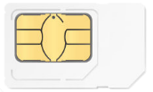
GlobalPlatform Access Control
Access Rule: Authorizes a specific app on device to access a specific app on SE [and send specific commands]
User Device Application
Access Control Enforcer
SE
Application
Cached
Access Rules
Access Rules
http://www.globalplatform.org/specificationsdevice.asp
Notes:
V1 in May 2012
Today (sept 2015): v1.1

Slide 18
Secure Element API to build Trusted Services
Web Applications
Public APIs
AuthentN
Signature
Payment
Reload
Privilege apps, e.g. Extensions
…
Web Runtime
Restricted APIs
Secure Element API
Access Control
Notes:
Each privilege app may be white listed in GP AC rules

Slide 19

The security palette
Secure Element Built-ins
GlobalPlatform Access Control
Trusted Services
Domain Binding

Slide 20
Or something completely different !
a REST API provided by those privileged apps
No need to comply with SOP but authentication could be managed by well deplowed techno like OAUTH
Permission, privileged context, SRI, CSP, CORS …

