Slide 1



Committing To Learning Git
Presented by the BGSU Linux Club

Slide 2
Presentation materials at:
https://github.com/BGSU-Linux-Club/BGSU-Git-Tutorial

Slide 3
Our IRC Server!
What is IRC?
IRC stands for Internet Relay Chat, it is an application layer protocol that enables many people to talk on a client/server networking model.
We own a server that is (partially) dedicated to hosting IRC chat for this organization.

Slide 4
Our IRC Server!
How do I join in?
There are many clients available to use IRC:
  HexChat is a cross-platform client program that features a user-friendly interface and will be the one we provide instructions for
  https://hexchat.github.io/
  Alternative clients include WeeChat, mIRC, Pidgin, and some web clients

Slide 5
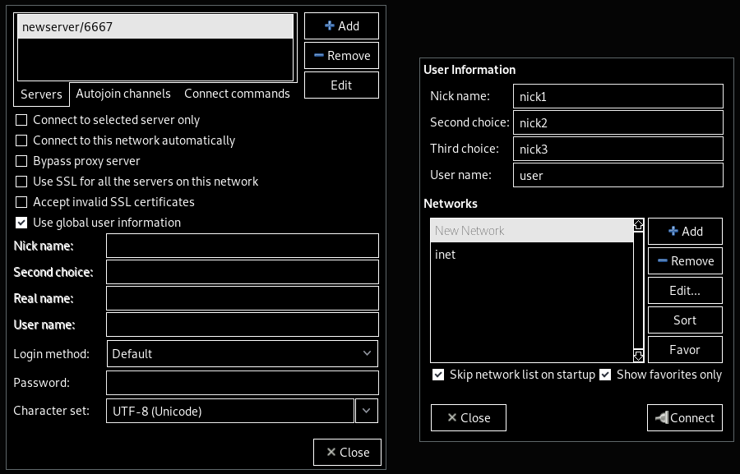
Our IRC Server!
The HexChat Interface

Slide 6
Download Git from
git-scm.com/download/win
$git config --global user.name "<Your Name>"
$git config --global user.email "<Your Email>"

Slide 7
Git Terminology
Repository – (or repo) how Git keeps track of a project, data stored in .git directory
Remote Repository – a repository stored on a server, such as GitHub
Master Branch – the main branch in any git repository
README.md – a standard file used to give any additional information to the user
  $less README.md

Slide 8
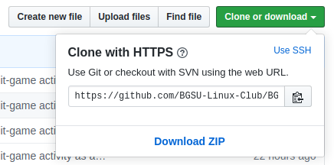
Create a Git Repository
Navigate to the directory you want to use
$git init | Initializes an empty Git repository in the current directory.
$git clone <HTTPS Link> | Downloads the contents of a Git repository into a sub-directory.

Slide 9
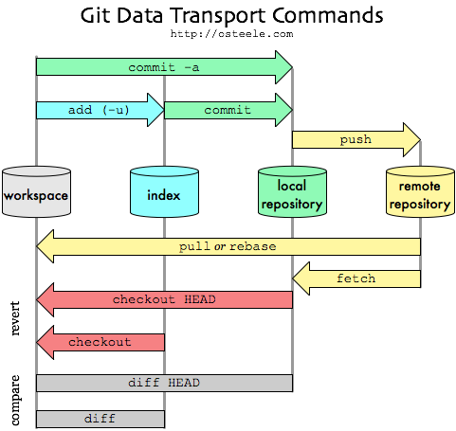
Git Commands
https://medium.com/@talgoldfus/better-understanding-gits-work-flow-in-order-to-properly-deal-with-merge-conflicts-part-i-760a366fc997

Slide 10
Where’s My Code?
workspace
This is where you work on code
index
This is where you stage groups of changes
local
repository
This is where Git keeps data on your code
remote
repository
This is the server your code and data is on (i.e. GitHub, GitLab)

Slide 11
Let’s change some code
workspace
index
local
repository
remote
repository
$git add
$git commit
$git push
$git add <file> | Tells Git to track the given files. Use . to add all files in the directory
$git commit -m “<message>” | Saves the current version of the tracked files. The message is used to keep track of what you did.
$git push | Sends your files to the remote repository. May require your login info.

Slide 12
Tracking your code
Hash: 1
Hash: 2
Hash: 3
commit
commit
HEAD
HEAD | The current version of the code you are working on
Hash | A unique string generated for each commit, this will be very long
$git checkout <hash> | Moves the head to the commit with the given hash, allowing you to access that code.

Slide 13
Branching Out
$git branch <branch name> | Creates a new branch, or parallel “line” of development
$git checkout <existing branch> | Allows you to switch between branch, changing the HEAD
$git merge <branch name> | Joins the code in the last commit of the given branch name with that of the current branch

Slide 14
Oops!
Hash: 1
Hash: 2
Hash: 3
Hash: 4
commit
commit
HEAD
$git revert 3
$git revert <hash or HEAD> | Creates a commit with the same contents as the commit before the one reverted.

Slide 15
GitHub Time Machine
Hash: 1
Hash: 2
Hash: 5
Hash: 6
Hash: 7
commit
commit
commit
MASTER BRANCH
HEAD
HEAD
HEAD
HEAD
HEAD
branch
merge
commit
NEW BRANCH
HEAD
HEAD
Hash: 3
Hash: 4

Slide 16
Let’s download some code
workspace
index
local
repository
remote
repository
$git pull or $git rebase
$git fetch
$ git pull | Update your local code to match the remote repository.
$ git fetch | Download code from the remote repository, but don’t overwrite your local code.

Slide 17
Professional Scapegoating
Each tracked file knows who made what changes
$git blame <file name> will show each line of a file and who modified it last

Slide 18
Brain Teaser
github.com/git-game/git-game
Hints:
$git
$man git <git command>

Slide 19
Thank you for coming!
Connect with us!
Meetings | Thursdays 6:30 – 8 PM BTSU 314 or 307
GitHub | github.com/bgsu-linux-club
IRC | 74.133.14.243/6697

