Slide 1
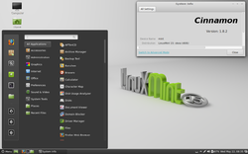
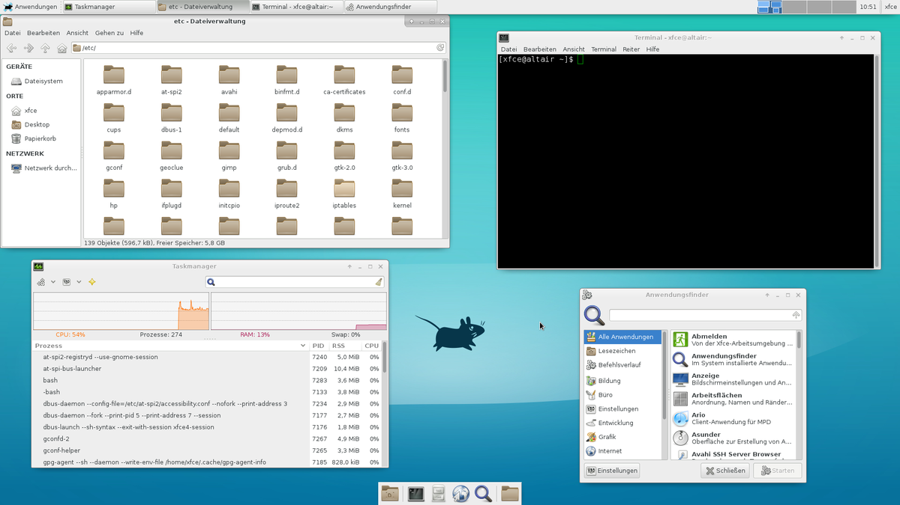
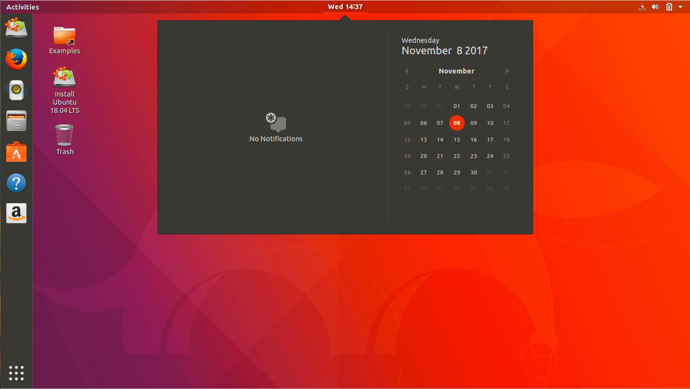
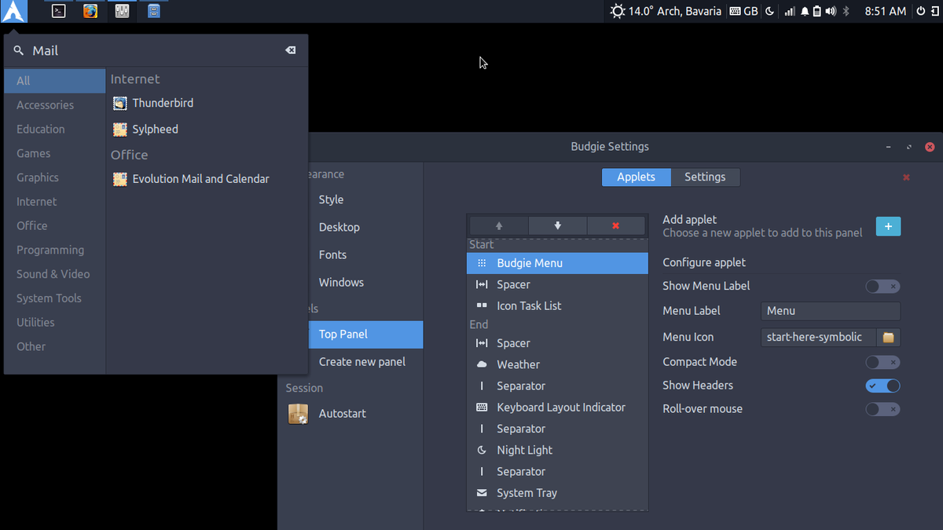


BGSU Linux Club
What’s in a Desktop?
February 2020

Slide 2
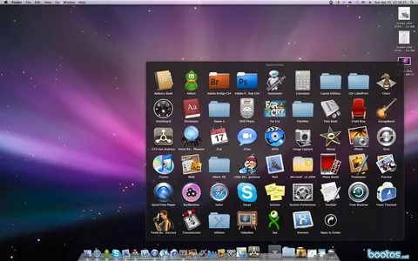
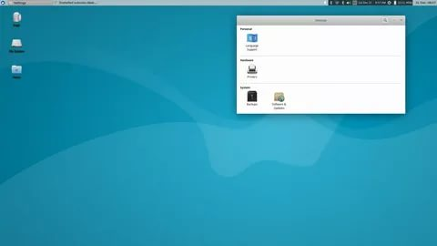
What’s in a Desktop?
In nearly every operating system, a user’s conventional desktop contains the a similar scheme of elements

Slide 3
“Desktop Environment”
Window Manager
Daemons,
Configuration Files
Status Bar/
Program Launcher
Drivers / Xorg
Settings
Frontend
Independent Software
DE Features /
Helper Programs
Package Manager
GNU Coreutils / base system
Kernel Configuration
Distribution

Slide 4
Things can be mixed...
XFWM
Window Manager
Package Manager
Daemons,
Configuration Files
KDE Status Bar/
Program Launcher
Drivers / Xorg
Independent Software
Settings
Frontend
DE Features /
Helper Programs
GNU Coreutils / base system
Kernel Configuration
Distribution

Slide 5
Or omitted...
Window Manager
Package Manager
Daemons,
Configuration Files
Drivers / Xorg
Independent Software
Settings
Frontend
GNU Coreutils / base system
Kernel Configuration
Distribution
Distribution

Slide 6
This is how a system can be configured for several use cases
Apache Daemon
sshd
System administration
tools
Xorg / Graphics
Web browser
System administration
Tools
Video games
Office suite
Program launcher
Low footprint software
Modified kernel
Configuration
Dedicated Web Server
Desktop
Embedded system

Slide 7
What’s in it for me?
Knowing the elements of a desktop allows you to build a system that specifically works for you and your workflow.
You are able to choose all of what you want, and none of what you don’t want.

Slide 8
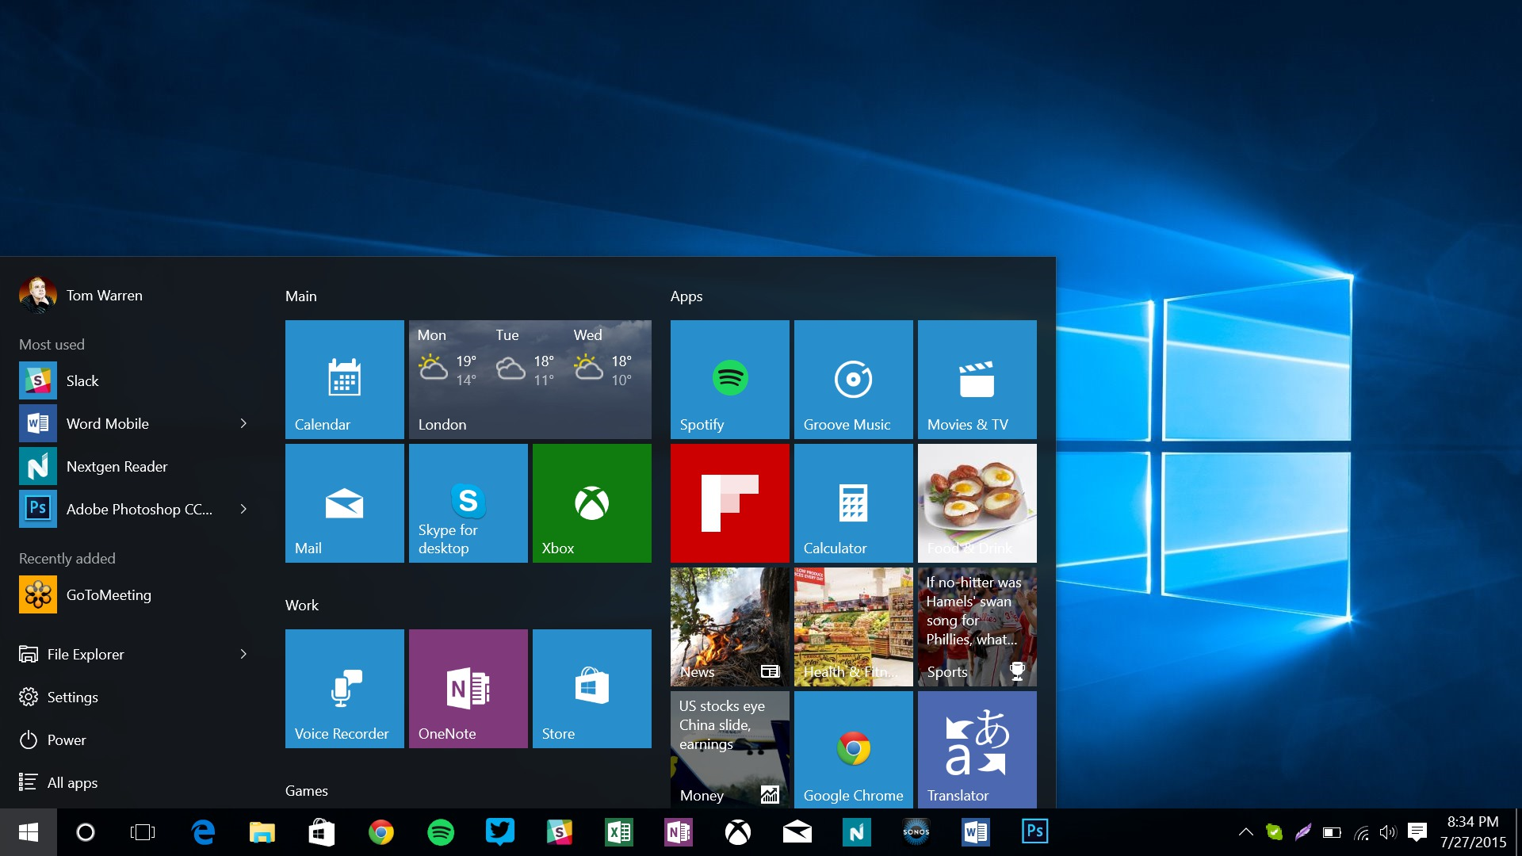

Slide 9
Choosing What You Want
  Distribution
    A distribution is a medium that GNU/Linux is presented to an end user, with different pre-installed programs, configurations, package managing systems etc.
    Ubuntu, Fedora, Arch, KDE Neon, Manjaro
      Some can be derivative of others
      https://distrowatch.com https://en.wikipedia.org/wiki/List_of_Linux_distributions
    At the end of the day, distribution choice is inconsequential unless you have specific wants.

Slide 10
Choosing What You Want
Most distributions come shipped with things pre-installed
  Filesystem
    You can even choose how to partition your disk!
  Bash / “Terminal”
    A terminal interprets Bash as instruction, other GNU coreutils
  Xorg
    Display server, provides a layer for GUI and nothing else
  Bootloader
    You can even choose what bootloader to install!
    A bootloader is the first thing that executes on your hard drive
    GNU GRUB, LILO

Slide 11
Choosing What You Want
  Desktop Environment (DE)
    A collection of software that forms a complete desktop experience
  Window Manager (WM)
    Manages the placement and appearance of windows via the display server – controls your window decorations and window behavior
      gnome-wm, xfwm, i3, dwm, openbox, etc. etc.

Slide 12
Choosing What You Want
  Package management
    The primary/easy way to download and install software on GNU/Linux is via a package manager. A package manager is a program that keeps track of what software “packages” you have installed.
    A package manager calls from a list called a repository, basically a list of all of the packages available, fetched from a maintainer site or mirror.
    This way, a package from the list can tell the package manager what software it relies on, and the package manager can act accordingly.

Slide 13
Choosing What You Want
  Package management
    Usually, your package manager is dictated by your distribution at install
      Think apt, pacman, yum, portage.
    Different package managers install software in different ways, and have different features.
      Portage downloads the source code and compiles it based on user-set compiler flags and build options, while apt downloads a binary based on your architecture and other factors.

Slide 14
Choosing What You Want
  Important daemons / services / tools
    Depending on what you have, you might want to choose your own services:
  Network / DHCP / Wifi Daemon
    NetworkManager, wpa, netctl
  Sound Server
    Pulseaudio, ALSA
  Init system
    Systemd, openrc, sysVinit
  System administration
    Sudo, polkit

Slide 15
Choosing What You Want
  Supplementary desktop programs
    Program launchers, file managers, etc. can be installed in bulk from a DE
  File managers
    Dolphin, PCManFm, Thunar (XFCE), Konqueror (KDE), Midnight Commander
  Status bar
    xfce4-panel, KDE panel, GNOME panel, i3-bar, polybar
  Terminal emulator
    xfce4-terminal, Konsole, LXTerminal, st, Gnome-Terminal

