Slide 1



A GNU for You
Presented by the BGSU Linux Club

Slide 2
Presentation materials at:
github.com/BGSU-Linux-Club/installing-linux

Slide 3
Agenda
Introduction
What’s in a Distribution?
Guide to Installing / Partitioning
Software Talk
Testing it Out

Slide 4
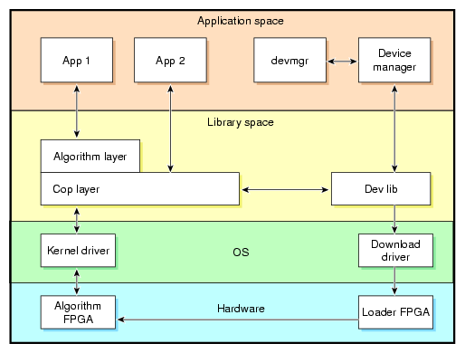
Introduction
What is GNU?
  GNU is an operating system and software collection that makes use of the Linux kernel.
    Less, cat, bash are all part of GNU

Slide 5
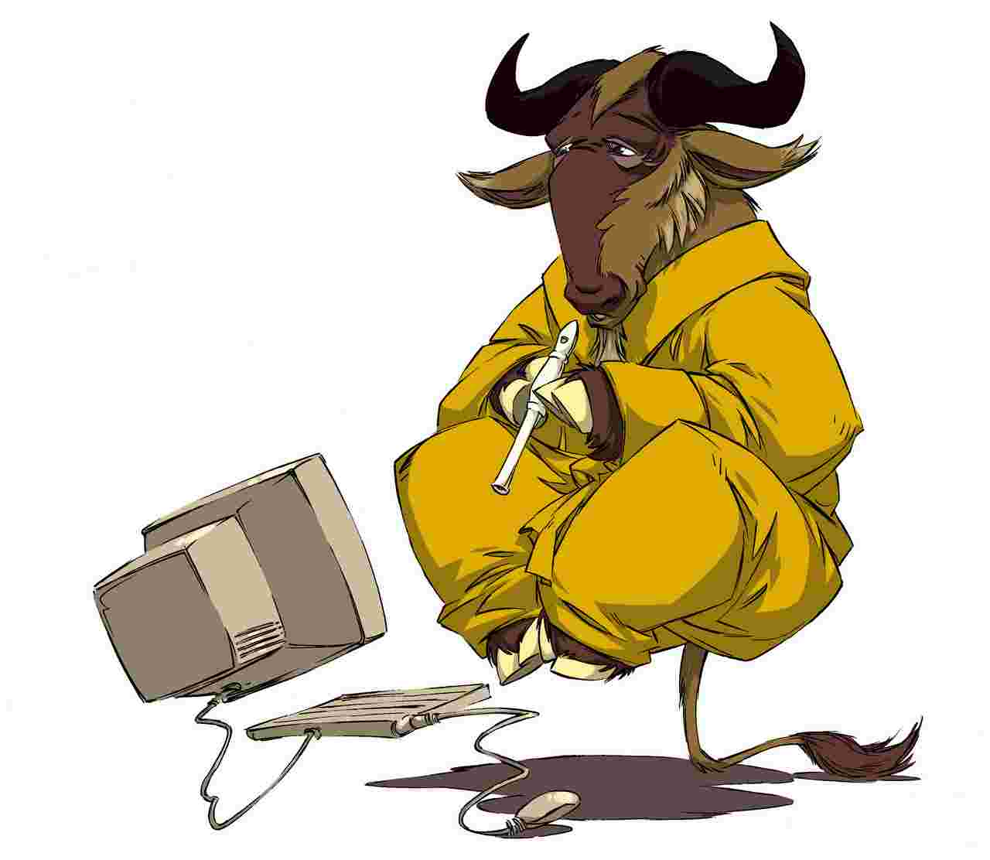
Introduction
Why should I use GNU?
  GNU/Linux is:
    Extremely customizable – every single aspect of your operating system is free and modifiable, you may mix/match your own system
    Lightweight – a system can be configured to handle the limitations of old computers and also to take advantage of the capabilities of powerful computers.
    Free – a GNU system can be made to be completely libre.
    Fun! - A Linux system can teach one lots about how some computer functions work.

Slide 6




What’s in a Distribution?
What is a distribution?
  Since GNU/Linux is so modular and customizable, it can be packaged in many different ways
  A distribution is a medium of dispersing GNU for users.
  Ubuntu, Arch Linux, RHEL, CentOS Are examples

Slide 7
What’s in a Distribution?
What’s the difference?
  Distributions are all GNU/Linux, but have differences such as:
    Licensing
    Kernel configuration
    Pre-installed software
    Update patterns (with their pre-installed package manager)
    Out-of-box experience
    Software Combination

Slide 8
What’s in a Distribution?
What do I choose?
  Try what looks best! Do your research on what types of software you want (minimal install, desktop environments, package managing)
    https://www.distrowatch.com/
  Remember, when you use GNU/Linux, you are allowed to customize your computing experience in any way you wish

Slide 9
Guide to Installing
I’ve picked a distribution. Now what?
  The most likely case for installation is that you need to get an image of the system burned onto a CD or thumb drive.
  The image can usually be downloaded at the distribution maintainer’s site or a mirror.
  Make sure to check the image’s checksum before you install to make sure that the image is not tampered
    You can do this with sha256sum and gpg

Slide 10
Guide to Installing
How to verify an image
  Most downloads should also have instructions to verify the .iso file with their signature
    You will most likely download a checksum file and then another file named something like checksum.gpg
    You should compare the output of
      $sha256sum image.iso
    With the contents of the checksum file. ($cat checksum)
    You can run
      $gpg –-verify checksum.gpg checksum
    to verify the checksum. If this doesn’t work, then you will have to obtain public keys from an address disclosed by your distribution of choice.
      $gpg --keyserver <keyserver-name> --recv-keys <publickeys>

Slide 11
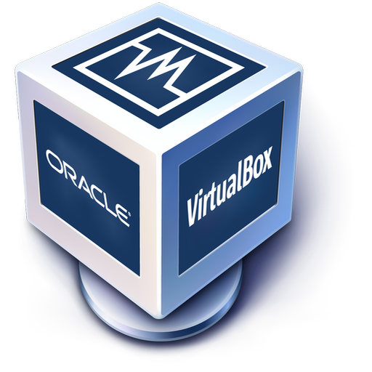
Guide to Installing
Bare Metal / Virtual Machine
  At this point, with your image, you can either use this to install a Linux system alongside a Windows/MacOS installation, or you can install Linux on a virtual machine
  Most VM programs should
  provide decent partitioning
  schemes

Slide 12
Guide to Installing
To install on bare metal, you have to prepare boot media. In this case, a live USB.
To burn a .iso disc image to a flash drive, first ensure that you are willing to erase everything on it.
Format the flash drive to one blank FAT32 partition using either parted (GNU) or the Windows Partition Manager
(This is a good time to take space out of your C drive to reserve for your Linux install)

Slide 13
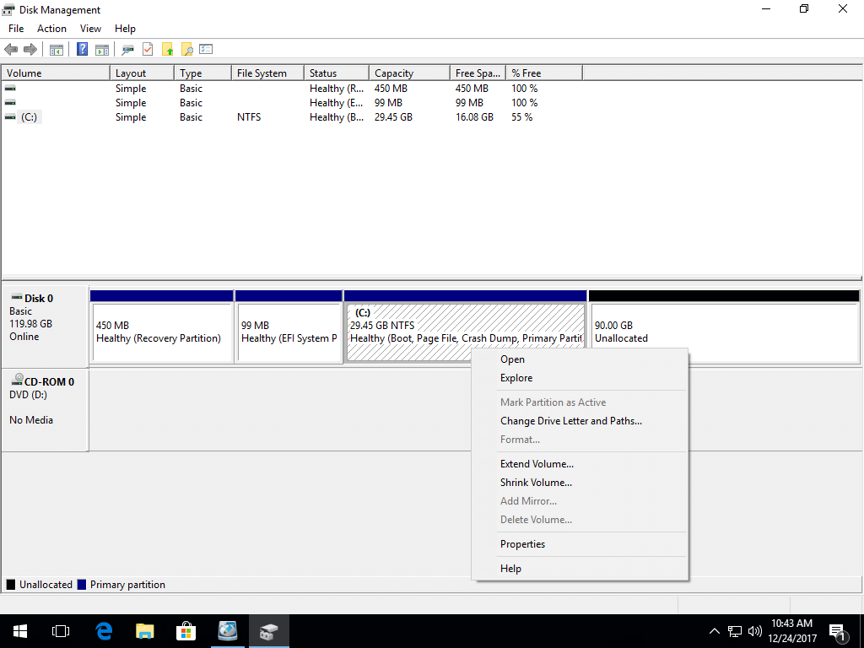
Guide to Installing
The Windows Partition Manager

Slide 14


Guide to Installing
In order to burn the image onto a flash drive, you can use a program like Etcher or Unetbootin or dd (UNIX)

Slide 15
Guide to Installing
With proper boot media, the next step is to reboot with the boot media inserted in the computer.
  Boot in to the BIOS, usually done by spamming F2 / F1 / Del during boot.
  Settings like “Secure Boot” can keep the machine from booting from alternative boot media, turn these off.
  You should be able to select a USB device to boot off of in the BIOS, or be able to set the USB device to top priority in the boot sequence.

Slide 16
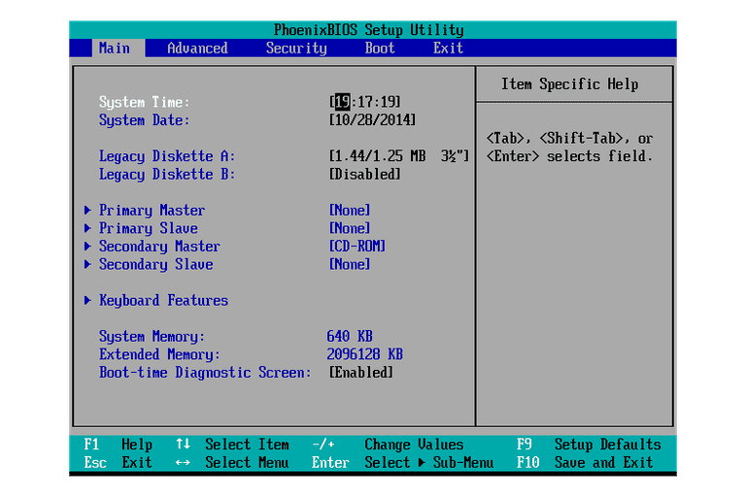
Guide to Installing
A typical BIOS menu

Slide 17
Guide to Installing
Once you boot off of the thumb drive, the install process can vary. We will go over partitioning as it is an important part of any system.
The partitioning process might be slightly automated by an installer, but every user will have their own needs depending on what they want.

Slide 18
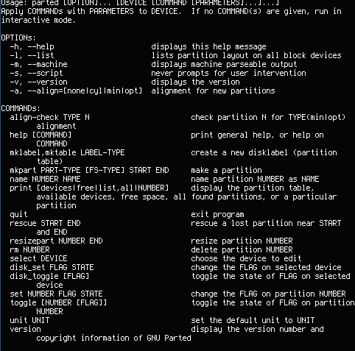
Anatomy of parted

Slide 19
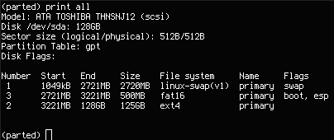
Anatomy of parted
Commands/Syntax
mkpart PART-TYPE FS-TYPE START END select DEVICE
rm NUMBER mklabel LABEL-TYPE
resizepart NUMBER END
name NUMBER NAME
set NUMBER FLAG STATE

Slide 20
Anatomy of parted
Make sure to save space for swap!
  Swap space is disc space dedicated for memory usage in the case of low RAM
Depending on your partition table / efi/BIOS combination, you may have to make an efi system partition (esp)
!!! If you are installing alongside Windows, you will see a lot of partitions that will break your Windows installation if altered. !!!

Slide 21
Software Talk
Some software terms:
Desktop Environment (DE)
  A prepackaged collection of software that serves a complete desktop experience to a user (GNOME, KDE, XFCE,)
Window Manager (WM)
  A program that is able to make and manage windows / workspaces on an X server (XFWM, i3, dwm, openbox)
Package Manager
  A program that allows you to automate the search for, installation, and removal of software via a single interface (apt, yum, pacman, emerge, Synaptic)

Slide 22
Testing it Out
Happy Computing!
Some simple commands to get you started on the CLI:
  $apt search <term>
  $man <program>
  $ls -la
  $<program> --help

Slide 23
Thank you for coming!
Connect with us!
Meetings | Thursdays 6:30 – 8 PM BTSU 314 or 307
GitHub | github.com/bgsu-linux-club
IRC | 74.133.14.243/6697 Password bglinux #linuxclub

