Slide 1




Linux for CS Classes and Beyond
Presented by the BGSU Linux Club

Slide 2
Presentation materials at:
github.com/BGSU-Linux-Club/intro-to-linux

Slide 3
Agenda
Introduction
Connecting To BGLinux
Anatomy Of A Command
Everyday Commands
Putting It To The Test

Slide 4
Introduction
What is BGLinux?
  A Red Hat server hosted for BGSU students and faculty to run programs on
What is Secure Shell (SSH)?
  Allows us to remotely access a command line for a server, usually over port 22
How do I connect to BGLinux?
  Create an account
  Connect via PuTTY

Slide 5
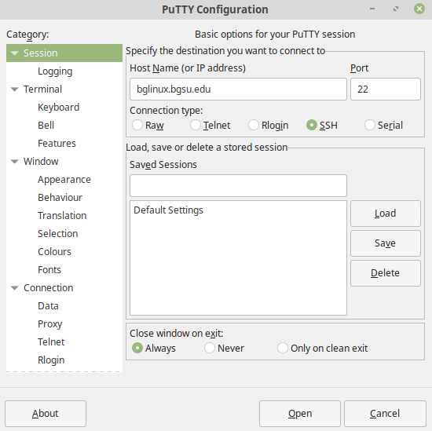
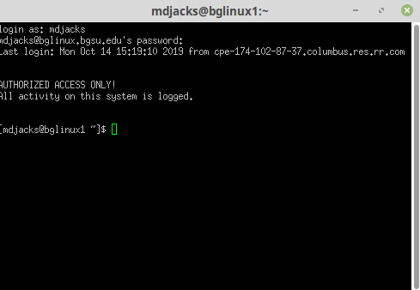
Connecting to BGLinux
After installing PuTTY and creating your account
Enter the Host Name bglinux.bgsu.edu
Use your BGSU username & password
Note: nothing will appear as you type your password

Slide 6
Anatomy of a command
$ command [-s --switch[=value]] <arguments>
$ | Denotes using the terminal DON’T TYPE
command | The most basic part of the command
[-s --switch[=value]] | Options for the command, one hyphen for one letter, two for multiple, can have multiple of these
<arguments> | Any additional information the command needs to run

Slide 7
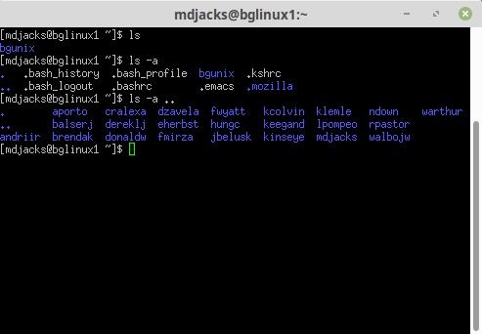
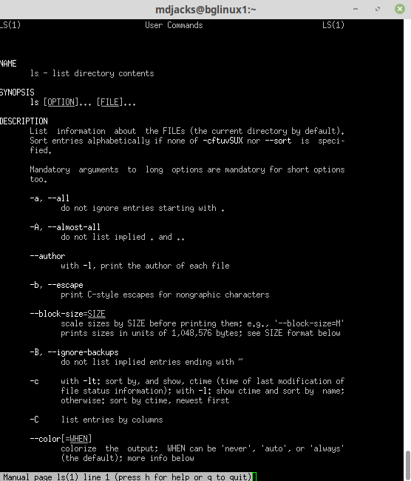
Our First Command
$ ls
$ ls -a
$ ls -a ..
$ man ls

Slide 8
Let’s Get Hands On!

Slide 9

Apply What We’ve Learned
Put your terminal skills to the test with
Terminus!
bit.ly/2SywXVb

Slide 10
Our IRC Server!
What is IRC?
IRC stands for Internet Relay Chat, it is an application layer protocol that enables many people to talk on a client/server networking model.
We own a server that is (partially) dedicated to hosting IRC chat for this organization.

Slide 11
Our IRC Server!
How do I join in?
There are many clients available to use IRC:
  HexChat is a cross-platform client program that features a user-friendly interface and will be the one we provide instructions for
  https://hexchat.github.io/
  Alternative clients include WeeChat, mIRC, Pidgin, and some web clients

Slide 12
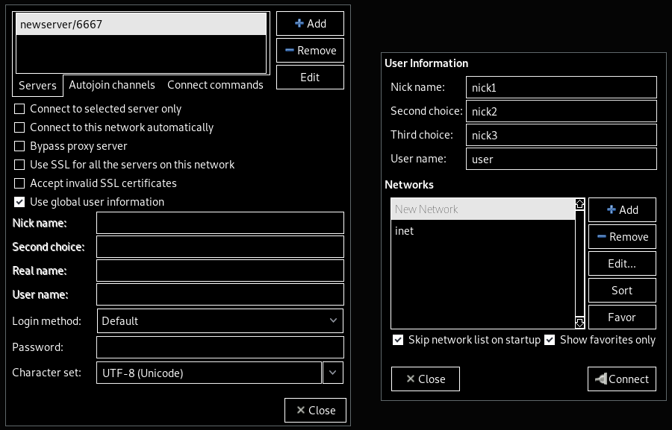
Our IRC Server!
The HexChat Interface

Slide 13
Thank you for coming!
Connect with us!
Meetings | Thursdays 6:30 – 8 PM BTSU 314 or 307
GitHub | github.com/bgsu-linux-club
IRC | TBD

