Slide 1

VACCINE DEVELOPERS: How do people feel about them?
SPICED Final Project
Brunno G. Soares
17/12/2021

Slide 2
Agenda
Motivation
Approach
Results
Potential Next Steps

Slide 3
Motivation
How can I gain Docker and ETL experience?
Does vaccination dev lead to reputation gain?
Applications:
Further motivate pharmas to tackle big health issues
Evaluate marketing campaign impact on social media

Slide 4
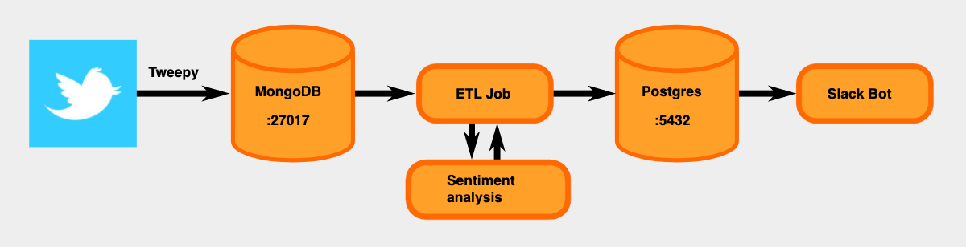
Approach
Pfizer, Moderna, AstraZeneca, and Johnson & Johnson
Twitter text data, English only, any location, all tweet forms
VaderSentiment
Dockerized live data pipeline
Mongo
ETL
Postgres
Web App
Sentiment

Slide 5
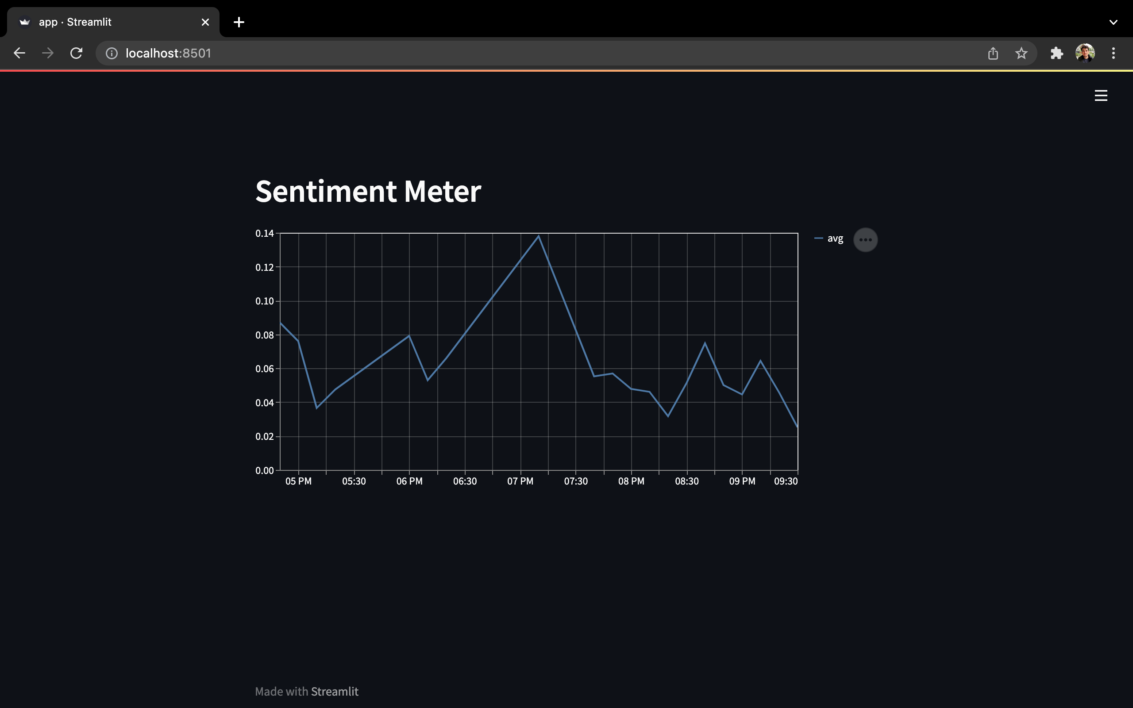
Results

Slide 6
Potential Next Steps
Longer Time Horizon
Deploy on the cloud
Deep learning to catch sarcasm
Thank you for listening. Questions?

