Slide 1

Voting Application
Architecture presentation
18.03.2016
Welcome!

Slide 2

Information architects
Boris Gligorijević
IT-Consultant / Software Architect

Slide 3
Architecture overview
Performance and scalability
Security
Quality
Release management
Next steps

Slide 4
Requirements - functional
User:
See all votes created
Add or delete own votes
Results visible only after voting
Votes cannot be changed once voted
Administrator:
Create, edit or delete any vote
Secure REST API

Slide 5
Requirements - non-functional
Horizontal scalability
High availability (99,5%)
Real-time monitoring
Source code in GIT
Single zip as end artifact
All business methods tested

Slide 6
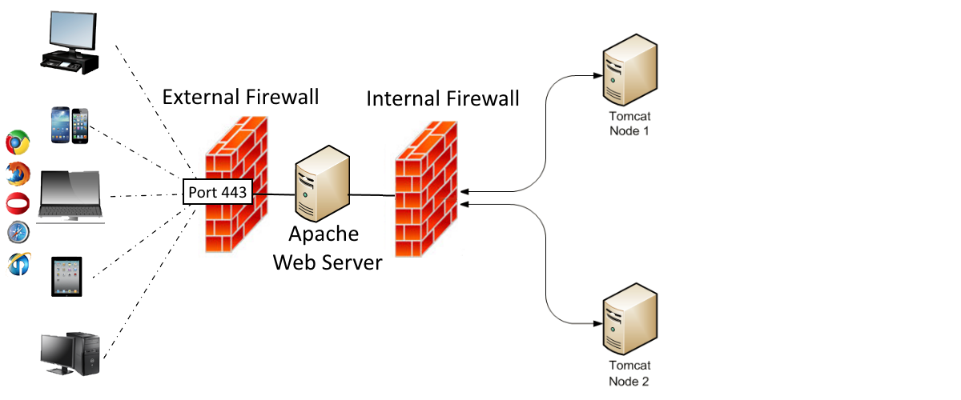
System architecture

Slide 7
Performance
Back-end / system / network:
Cluster of Tomcat nodes
Cluster of MongoDB databases
JDK8
GZIP and optional partial responses for REST API
Front-end application:
Minification of Javascript/CSS code

Slide 8
Measuring performance

