Slide 1
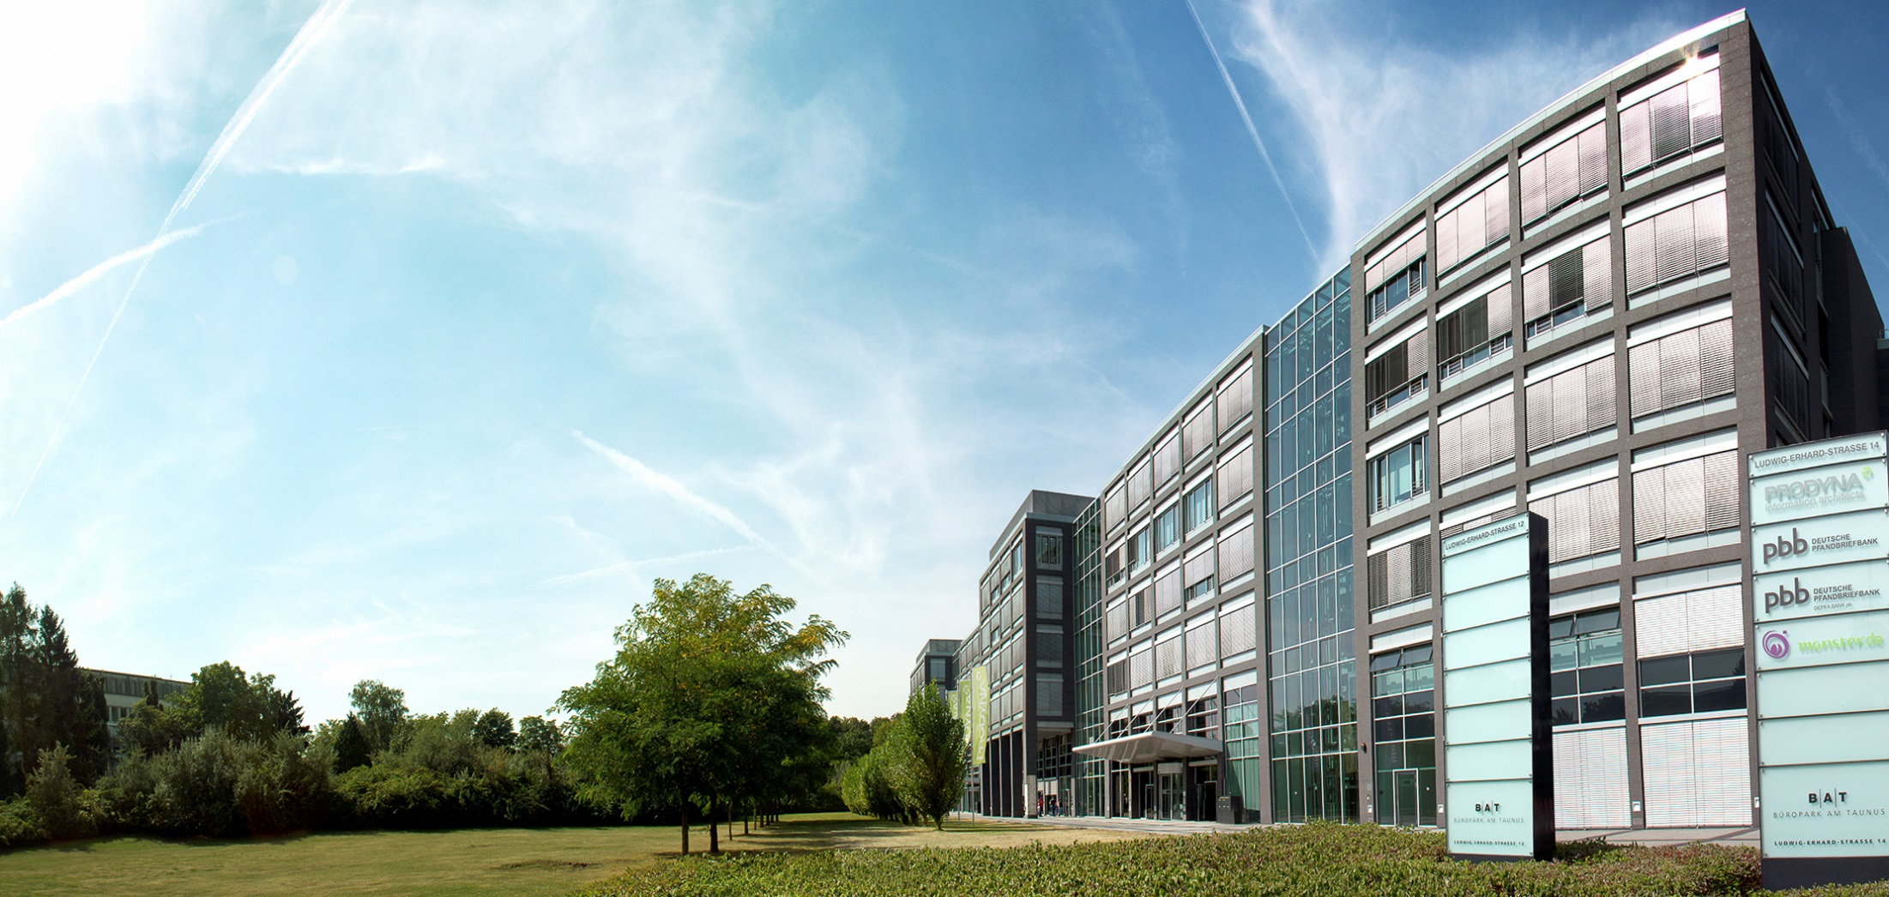
Voting Application
Architecture presentation
18.03.2016
Welcome!

Slide 2

Information architects
Boris Gligorijević
IT-Consultant / Software Architect

Slide 3
Information architects
Boris Gligorijević
IT-Consultant / Software Architect

Slide 4
Architecture overview
Performance and scalability
Security
Quality
Release management
Next steps

Slide 5
Requirements - functional
User:
See all votes created
Add or delete own votes
Results visible only after voting
Votes cannot be changed once voted
Administrator:
Create, edit or delete any vote

Slide 6
Requirements - functional
User:
See all votes created
Add or delete own votes
Results visible only after voting
Votes cannot be changed once voted
Administrator:
Create, edit or delete any vote

Slide 7
Requirements – non-functional
Must be horizontally scalable
Highly available – 99.5%
Real-time monitoring
REST API (secure)
Single artifact

Slide 8
System architecture

Slide 9
Architecture – back-end

Slide 10
Architecture – front-end

Slide 11
Performance and scalability

Slide 12
Security

Slide 13
Quality

Slide 14
Release management

Slide 15
Next steps – how to proceed

Slide 16
Thank you

