Slide 1

Voting - Architecture presentation
29.07.2016

Slide 2

PRO-fessional
DYNA-mic
Boris Gligorijević
IT-Consultant / Software Architect

Slide 3

Requirements - functional
User:
See all votes / Add or edit/delete own votes
Results visible only after voting
Votes cannot be changed once voted
Administrator:
Edit or delete any vote
Secure REST API - Authentication

Slide 4
Requirements - non-functional
Horizontal scalability → JSON Web Token / No Sessions, new nodes can easily be added to handle more load (cluster)
High availability (99,5%) → No single point of failure – 2 load balancers (Nginx), Tomcat farm, MongoDB Replica Set
Source code in GIT → 2 repositories, completely separated back-end and front-end code
Single zip as end artifact → everything needed to run the application, output of mvn clean install
All business methods tested → Easy to read integration tests
Real-time monitoring → New Relic tool provides real-time analysis of the application

Slide 5
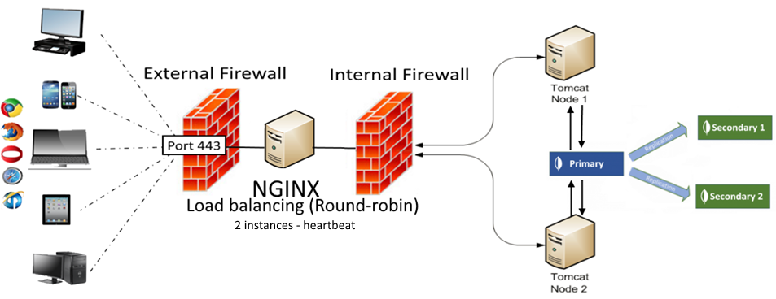
System architecture

Slide 6
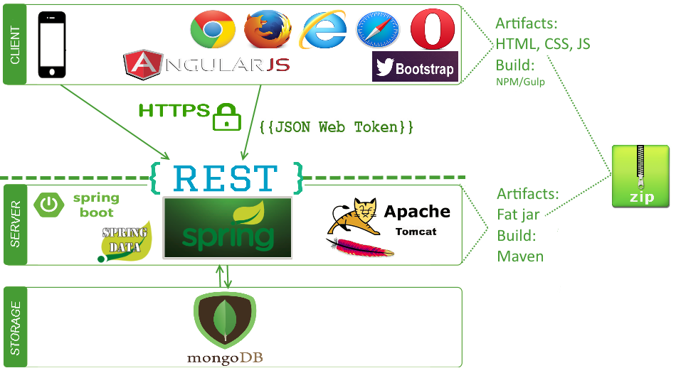
Technologies

Slide 7





Why these technologies exactly?
Modern
Lightweight
Mainstream
Developers love them ☺
Here to stay
No near future migration costs
Allow growth (scalable)
No reinventing the wheel

Slide 8
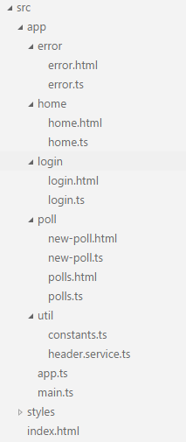
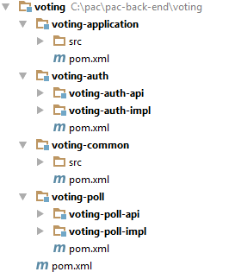
Project structure – back and front-end

Slide 9
Development
Agile / convention over configuration
Project tooling: Atlassian Stack (Jira, Confluence, Crucible)
Independent back-end and front-end projects
GIT Flow

Slide 10
Development – Back-end service
@Service @Log4j public class UserServiceImpl implements UserService { @Autowired private UserRepository userRepository; @Override public Optional<User> findUserByUserName(final String userName) { User user = userRepository.findByUserName(userName); return Optional.ofNullable(user); }
… }
0 XML lines
0 db queries

Slide 11
Development – Back-end model
@Getter @Setter @ToString public class User { private String email; private String userName; private String password; private Role role; }
Only domain relevant

Slide 12
Development – integration test
@RunWith(SpringJUnit4ClassRunner.class) @SpringApplicationConfiguration(classes = Application.class) @WebAppConfiguration @IntegrationTest({"server.port=8888"}) public class LoginIT implements VotingIntegrationTest { @Autowired private LoginITHelper $; @Test public void login_succeeds_for_existing_user() { $.given_existing_users(ALL_USERS); $.when_the_correct_login_credentials_are_sent(USER_1); $.then_the_access_token_is_returned(); } @Test public void login_fails_for_unknown_user() { $.given_existing_users(ALL_USERS); $.when_the_wrong_login_credentials_are_sent(); $.then_the_unauthorized_status_code_is_returned(); }
}
1. Tomcat is started with the test
2. Tests use the same db setup as in production / vagrant

Slide 13
Development - TypeScript
@Component({
selector: "login",
templateUrl: "login.html",
directives: [ROUTER_DIRECTIVES, ErrorComponent]
})
export class LoginComponent extends ErrorHandler {
private user: User = new User();
constructor(private http: Http, private router: Router, private headerService: HeaderService) {
super();
}
private isLoggedIn(): boolean {
return localStorage.getItem(Const.STORAGE_USER_PARAM) !== null;
} }
Declarative and reusable components
Live reload in browser!
Type safety
Dependency injection

Slide 14
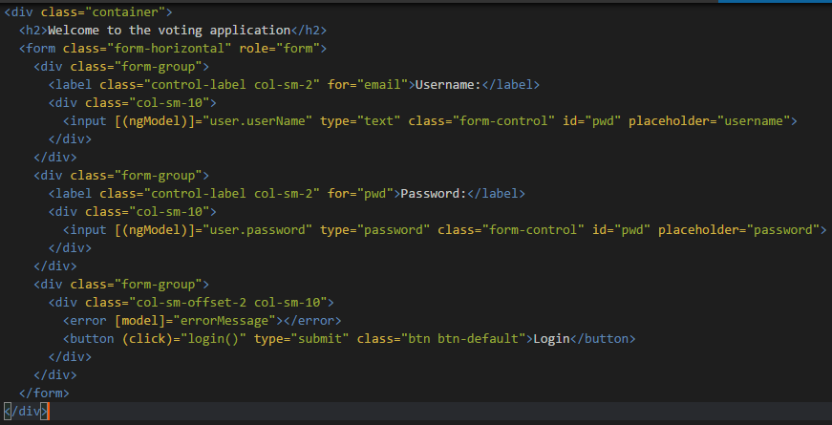
Development – login.html Template
Live reload in browser!

Slide 15
Development – Building/running app
Back-end:
mvn clean package – compiles Java code, runs all unit tests, produces OS-runnable jar file in the target folder
mvn clean install – as above + runs integration tests and packages the entire application as .zip
java –jar voting-application.jar from console or in IDE main class right click - run
Front-end:
npm run build – builds TypeScript code, produces browser-runnable JavaScript/HTML/CSS files in the build folder
npm start – launches application and watches for changes reloading the browser automatically if any change is detected

Slide 16
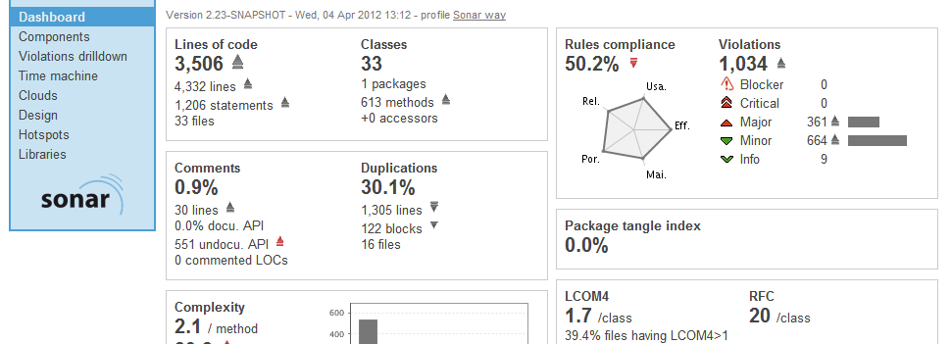

Quality
Compile type safety (Java/TypeScript)
Several testing layers (unit/integration tests/end-to-end tests)
Definition of done
Continuous integration / Sonar
Scrum – early feedback
Code reviews
Pair programming

Slide 17
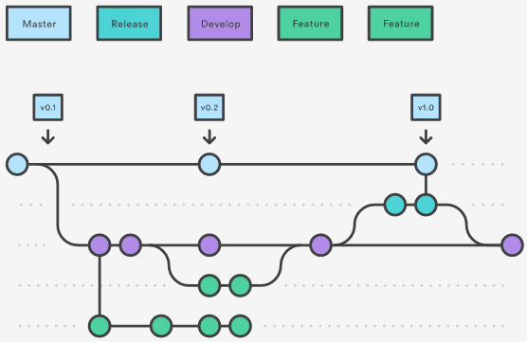
Making release
GIT Flow
versions.txt
maven release plugin / Jenkins / Nexus
Nexus holds the end artifact produced by the
release (zip file)

Slide 18
Deployment
Nexus keeps history of all released versions
DML – contract with system administrators - structure always stays the same
Configuration files for each stage (D, Q, P) kept on relative servers, respectively

Slide 19
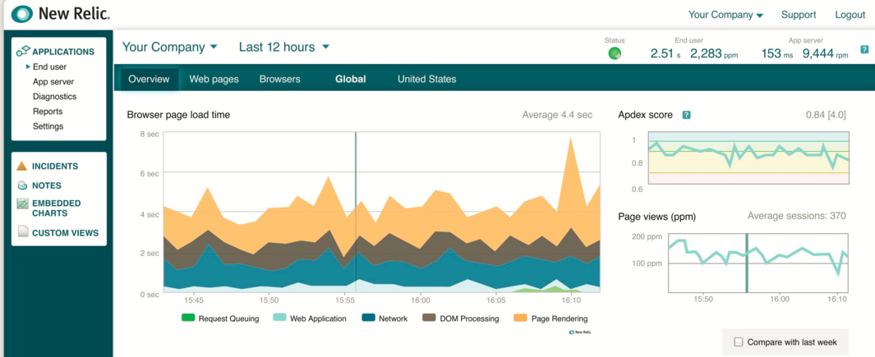
Application monitoring

Slide 20
How to continue from here?
Documentation
Well-defined and logical rules, just follow them
Super-easy project setup, easy to jump-in
Team coaching, know-how transfer, workshops
Keep it simple

Slide 21
Summary – why our architecture?
Works
Lightweight and simple
Designed specially to fit the application perfectly
Modern and mainstream technologies ensure skills can be found in the market
Saves money / no migrations, easy setup
No over-engineering – no reinventing the wheel
We think of everything for you, in advance

