Slide 1
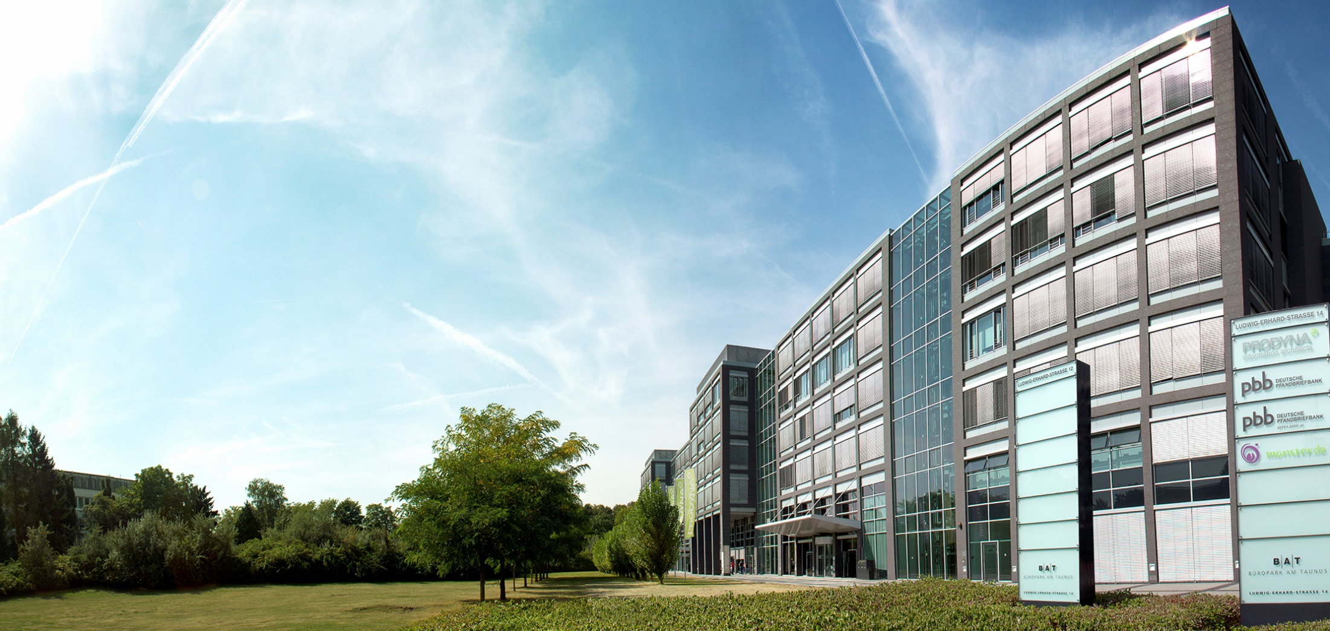
Voting - Architecture presentation
18.03.2016

Slide 2

PRO-fessional
DYNA-mic
Boris Gligorijević
IT-Consultant / Software Architect

Slide 3
Requirements - functional
User:
See all votes / Add or delete own votes
Results visible only after voting
Votes cannot be changed once voted
Administrator:
Create, edit or delete any vote
Secure REST API

Slide 4
Requirements - non-functional
Horizontal scalability
High availability (99,5%)
Real-time monitoring
Source code in GIT
Single zip as end artifact
All business methods tested

Slide 5
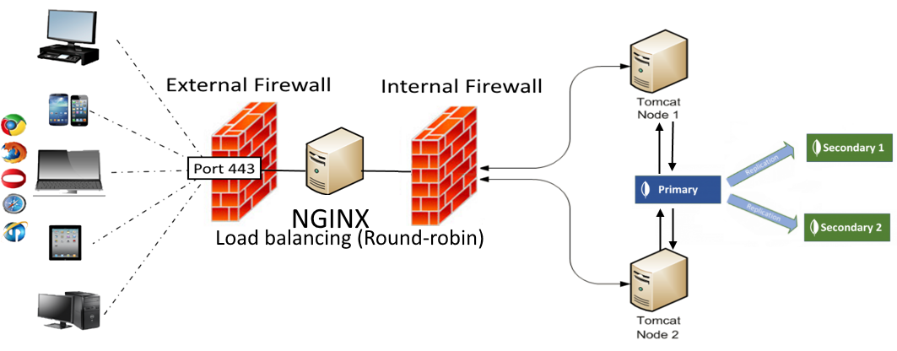
System architecture

Slide 6
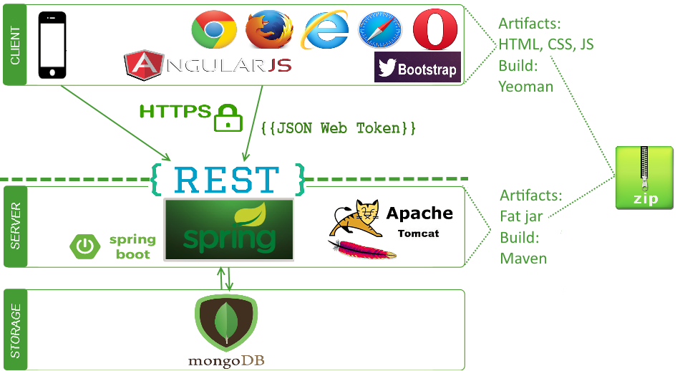
Technologies

Slide 7
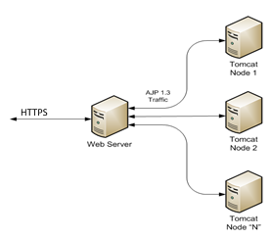
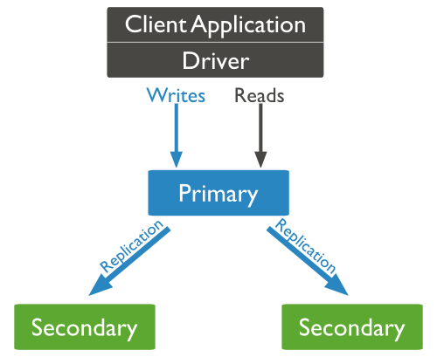
Availability and scalability
Tomcat cluster
MongoDB replication

Slide 8



Performance
PARTIAL API RESPONSES
/votes?fields=create_date,count

Slide 9
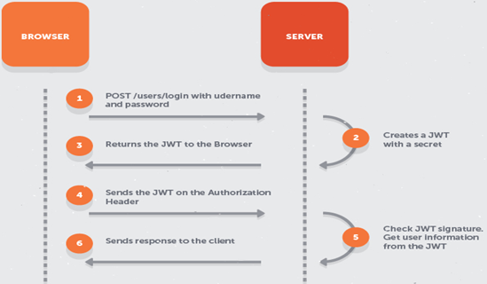
Security:
Secure REST API - JWT (RFC 7519 standard) over HTTPS
Roles

Slide 10
Quality:
High focus on Unit / Integration tests
Continuous integration
Issue tracking tools
Agile development process – recommendation: Scrum
SonarCube for quality metrics
Hallway usability testing

Slide 11
Development:
Coding and naming conventions
IDE formatters
Development setup via vagrant boxes = lower development costs
Recommendation: Pair-programming, TDD
Recommendation: Workshop 2-3 days with dev team on-site

