Slide 1

Voting - Architecture presentation
26.07.2016

Slide 2

PRO-fessional
DYNA-mic
Boris Gligorijević
IT-Consultant / Software Architect

Slide 3
Requirements - non-functional
Horizontal scalability
High availability (99,5%)
Source code in GIT
Single zip as end artifact
All business methods tested
Real-time monitoring

Slide 4
Horizontal scalability → Clustering, JSON Web Token / No Sessions, new nodes can easily be added to handle more load
High availability (99,5%) → Tomcat cluster, MongoDB Replica Set
Source code in GIT → 2 repositories, completely separated back-end and front-end code
Single zip as end artifact → everything needed to run the application
All business methods tested → Easy to read integration tests make sure the entire stack is well tested and stable, from REST to database layer
Real-time monitoring → New Relic tool provides real-time analysis of the application

Slide 5
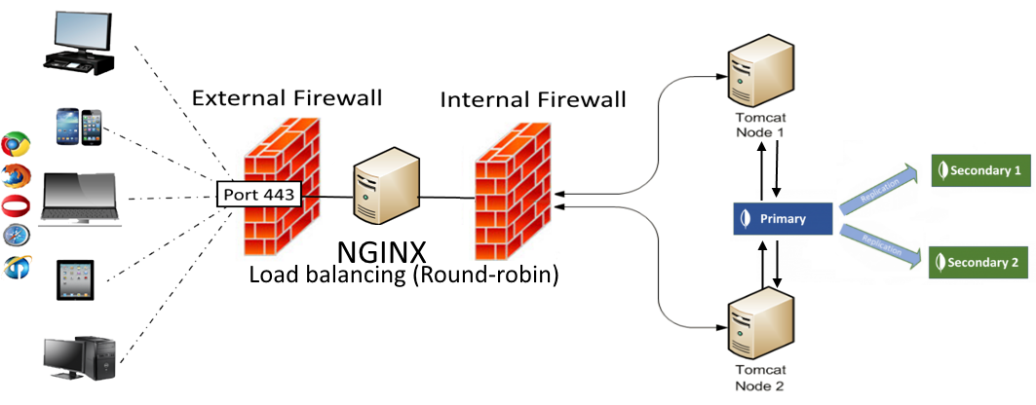
System architecture

Slide 6
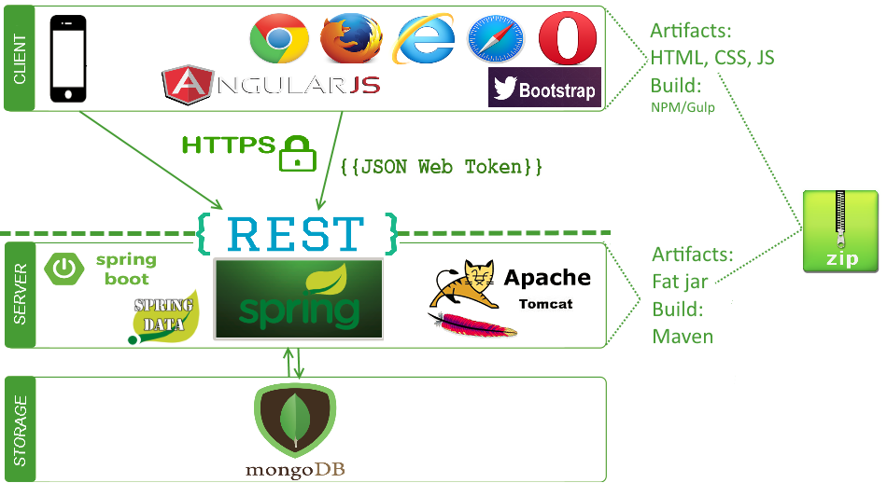
Technologies

Slide 7





Technologies – why?
Modern
Mainstream
Developers love them ☺
Here to stay
No near future migration costs
Allow growth (scalable)
No reinventing the wheel

Slide 8
Quality
Compile type safety (Java/TypeScript)
Several testing layers (unit/integration tests/end-to-end tests)
Continuous integration / Sonar
Scrum – early feedback
Rigorous code reviews
Pair programming

Slide 9
Development
Agile team, less is more
Tooling: Atlassian Stack (Jira, Confluence, Crucible)
Independent back-end and front-end projects
GIT Flow

Slide 10
Development – Java/Spring
@Service public class PollServiceImpl implements PollService { @Autowired private PollRepository pollRepository; @Override public Optional<Poll> getPoll(String id) { Poll poll = pollRepository.findOne(id); return Optional.ofNullable(poll); }
… }

Slide 11
Development – integration test
@RunWith(SpringJUnit4ClassRunner.class) @SpringApplicationConfiguration(classes = Application.class) @WebAppConfiguration @IntegrationTest({"server.port=8888"}) public class LoginIT implements VotingIntegrationTest { @Autowired private LoginITHelper $; @Test public void login_succeeds_for_existing_user() { $.given_existing_users(ALL_USERS); $.when_the_correct_login_credentials_are_sent(USER_1); $.then_the_access_token_is_returned(); } @Test public void login_fails_for_unknown_user() { $.given_existing_users(ALL_USERS); $.when_the_wrong_login_credentials_are_sent(); $.then_the_unauthorized_status_code_is_returned(); }
}
1. Tomcat is started with the test
2. Users are saved to the real database
3. REST call is made
4. REST API calls internal logic to process the call and returns data

Slide 12
Development - TypeScript
@Component({
selector: "login",
templateUrl: "login.html",
directives: [ROUTER_DIRECTIVES, ErrorComponent]
})
export class LoginComponent extends ErrorHandler {
private user: User = new User();
constructor(private http: Http, private router: Router, private headerService: HeaderService) {
super();
}
private isLoggedIn(): boolean {
return localStorage.getItem(Const.STORAGE_USER_PARAM) !== null;
} }
Declarative and reusable components
Live reload in browser!
Type safety
Dependency injection

Slide 13
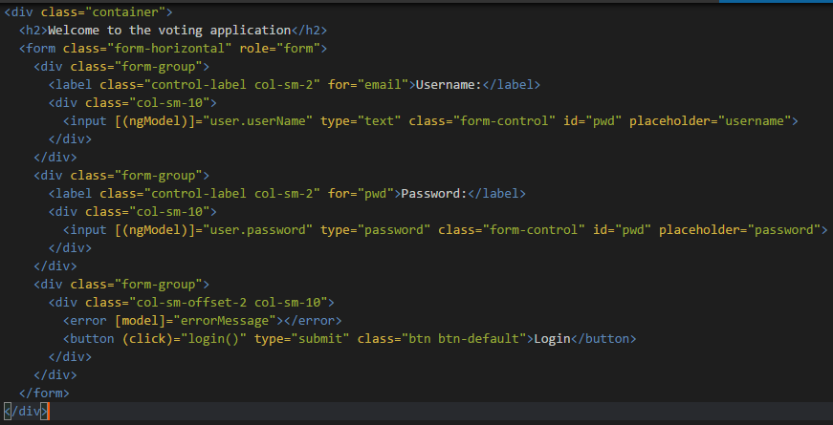
Development – login.html Template
Live reload in browser!

Slide 14
Development – Building/running app
Back-end:
mvn clean package – compiles Java code, runs all unit tests, produces OS-runnable jar file in target folder
mvn clean install – as above + runs integration tests and packages the entire application in .zip
java –jar voting-application.jar from console or IDE main class right click - run
Front-end:
npm run build – builds TypeScript code, produces browser-runnable JavaScript/HTML/CSS files in build folder
npm start – launches application and watches for changes reloading the browser automatically if any change is detected

Slide 15
How to continue from here?
Documentation
Well-defined and logical rules
Super-easy project setup
Team coaching, know-how transfer
Clean code without over-engineering – solid basis
Modern and mainstream technologies ensure skills can be found in the market

Slide 16

Requirements - functional
User:
See all votes / Add or delete own votes
Results visible only after voting
Votes cannot be changed once voted
Administrator:
Create, edit or delete any vote
Secure REST API

