Slide 1
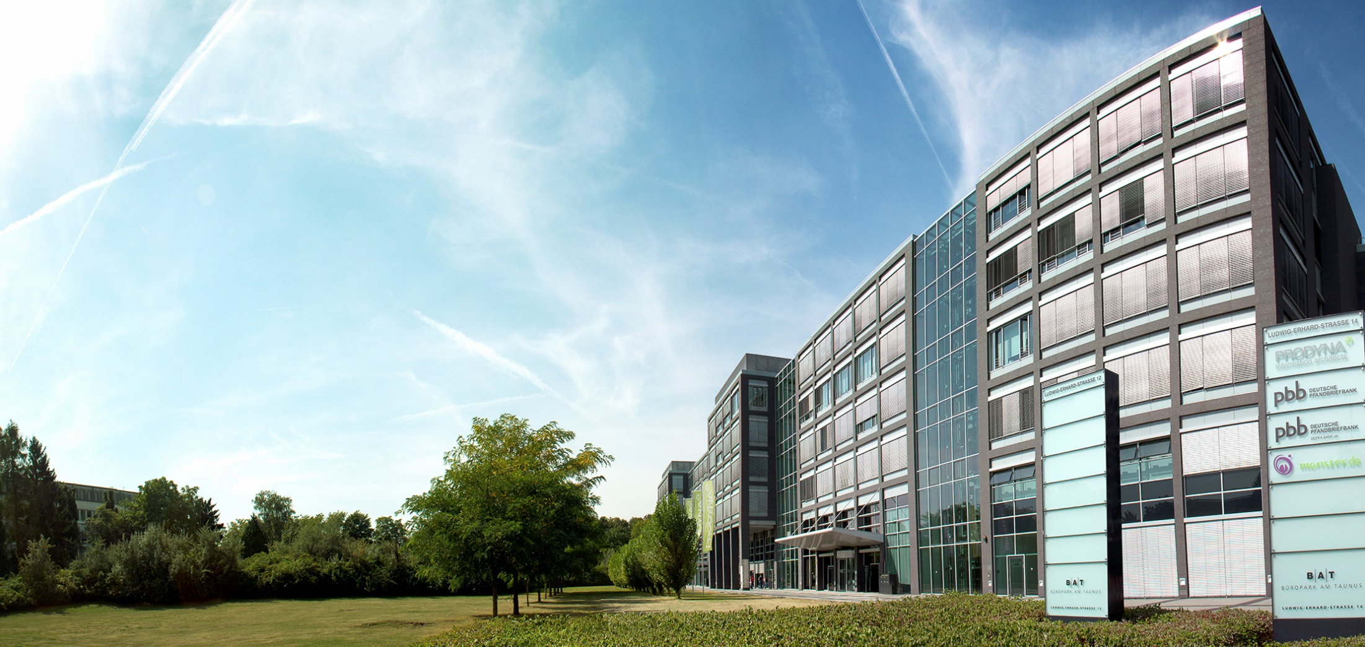
Voting - Architecture presentation
18.03.2016

Slide 2

PRO-fessional
DYNA-mic
Boris Gligorijević
IT-Consultant / Software Architect

Slide 3
Requirements - functional
User:
See all votes / Add or delete own votes
Results visible only after voting
Votes cannot be changed once voted
Administrator:
Create, edit or delete any vote
Secure REST API

Slide 4
Requirements - non-functional
Horizontal scalability
High availability (99,5%)
Source code in GIT
Single zip as end artifact
All business methods tested
Real-time monitoring

Slide 5
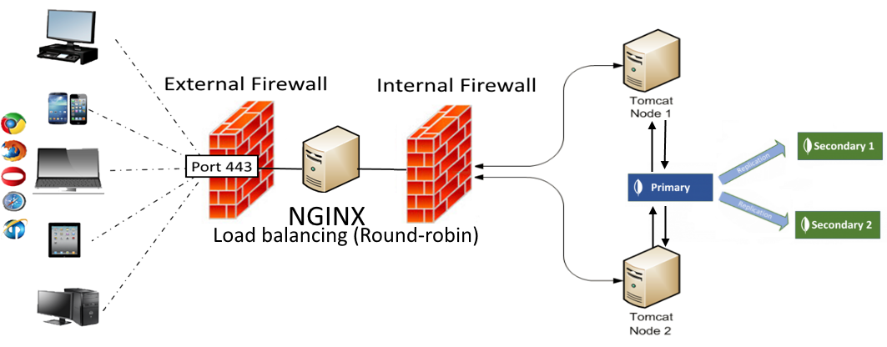
System architecture

Slide 6
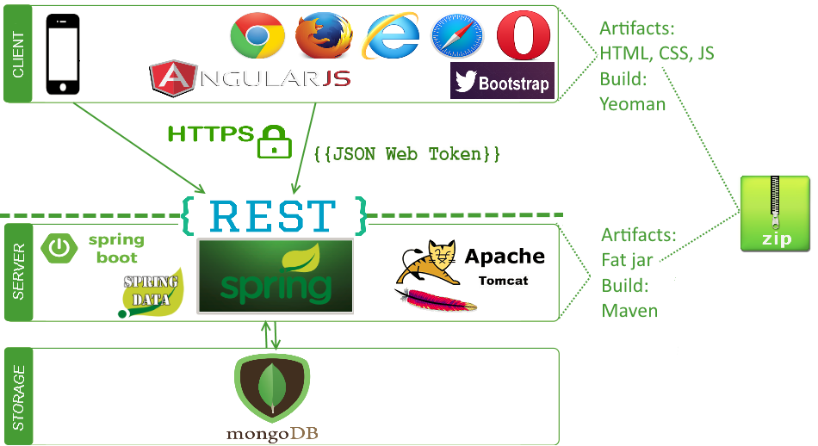
Technologies

Slide 7
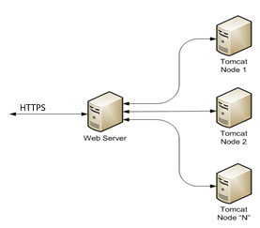
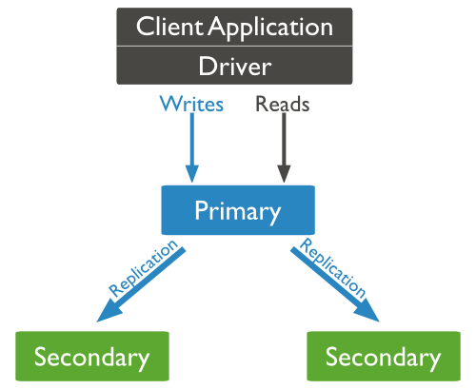
Availability and scalability
Tomcat cluster
MongoDB replication

Slide 8



Performance
PARTIAL API RESPONSES
/votes?fields=create_date,count

Slide 9
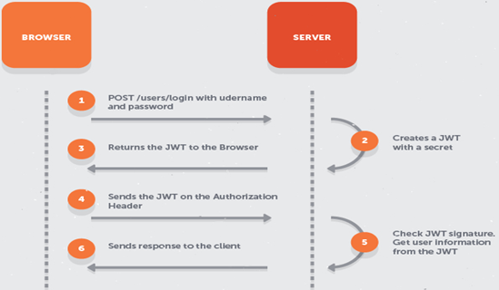
Security:
Secure REST API - JWT (RFC 7519 standard)
HTTPS
(TLS 1.2)
Roles

Slide 10
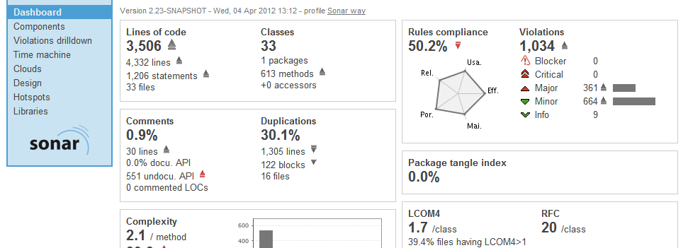

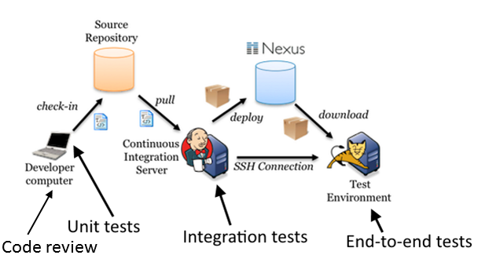
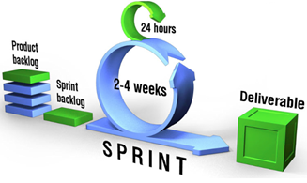

Quality:
Hallway usability testing

Slide 11
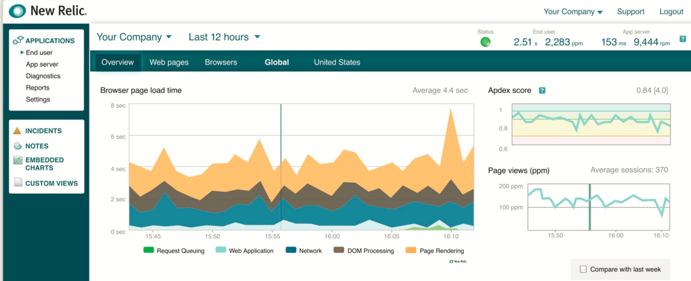
Application monitoring

Slide 12


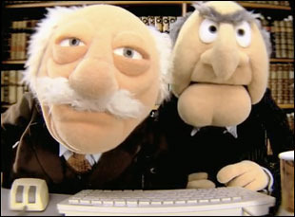
Development:
Coding conventions
Pair-programming
IDE formatters
On-site workshops
Naming conventions

