Slide 1
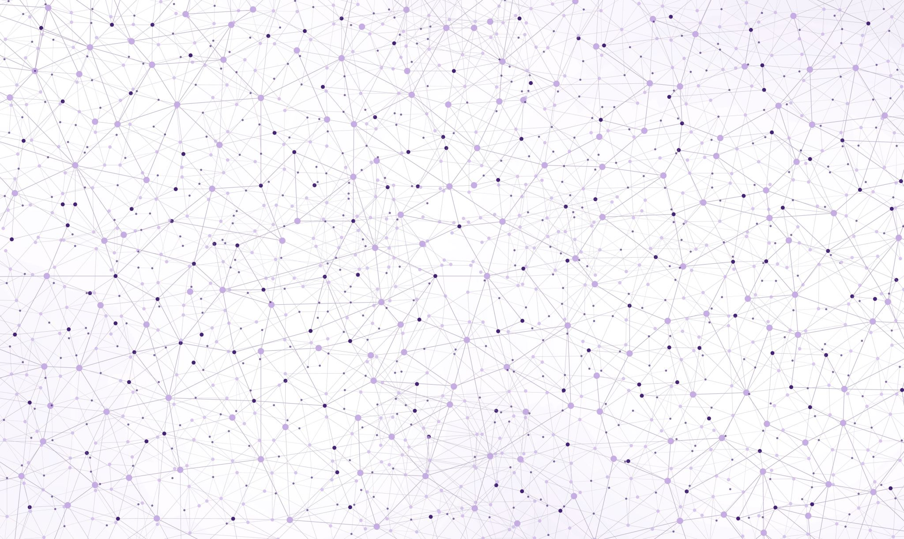
BiomeFUN-2025 Theoretical models in microbial ecology
Timmy Paez Watson
Djordje Bajić

Slide 2
Learning Objective Understand how simple ecological models can help explain microbial community dynamics.
To do that, we will need to:
Recognize key ecological concepts in microbial systems.
Use Lotka–Volterra models to explore how species interactions affect coexistence.
Apply consumer–resource models to see how resource use shapes community structure.

Slide 3
Unit structure
Basic concepts in microbial ecology.
Lotka-Volterra models.
Consumer-Resource models.
To do that, we will need to:
Recognize key ecological concepts in microbial systems.
Use Lotka–Volterra models to explore how species interactions affect coexistence.
Apply consumer–resource models to see how resource use shapes community structure.

Slide 4
Unit structure
Basic concepts in microbial ecology.
Lotka-Volterra models.
Consumer-Resource models.

Slide 5
Theoretical models in Microbial Ecology
1. Basic concepts

Slide 6
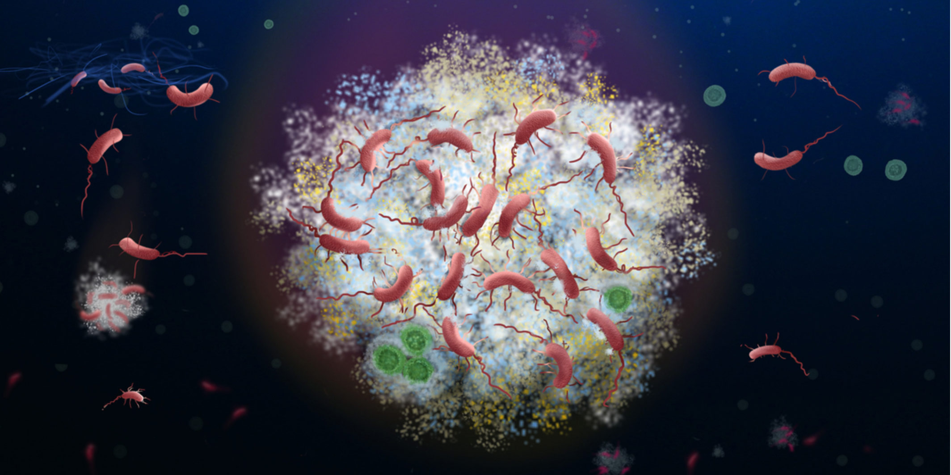
Basic principles in Ecology
What types of microbiomes do you know of?
Dominated by few species?
What determines interactions?

Slide 7
Basic principles in Ecology
How can you understand what is going on?
With what objective?

Slide 8
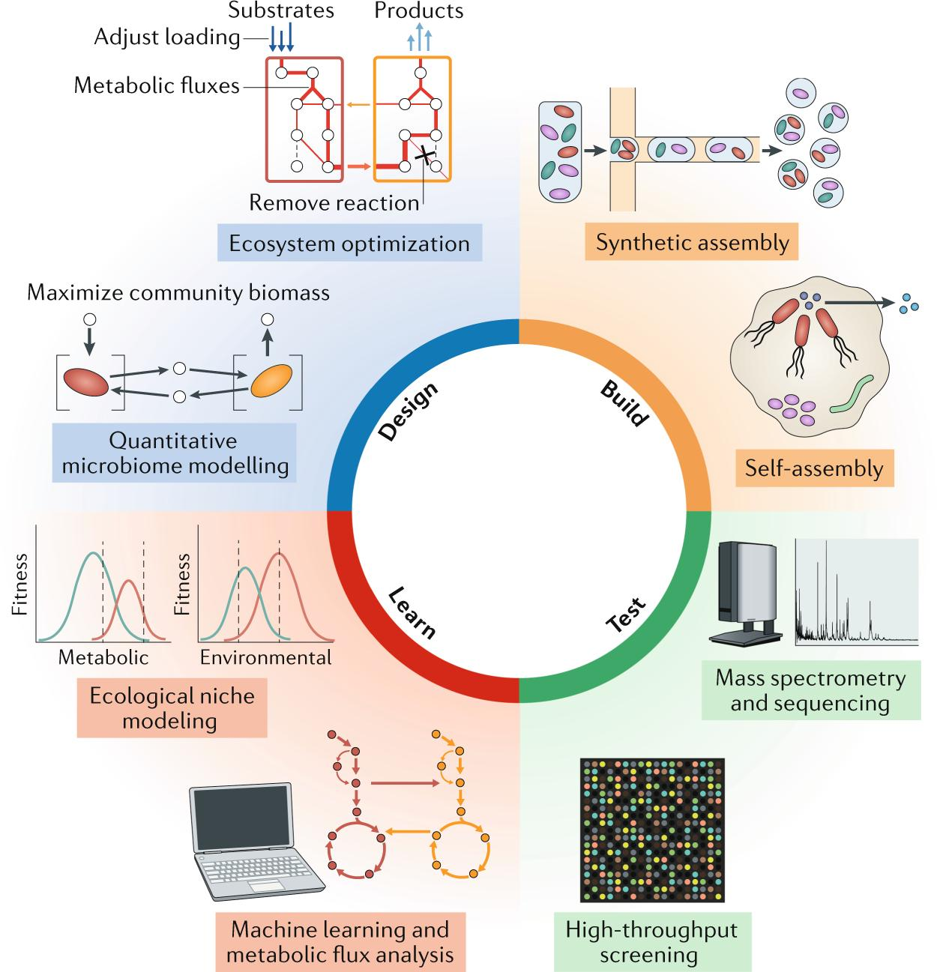
Basic principles in Ecology

Slide 9
But before, let’s understand some concepts
In groups, disucss:
Why do competing microbes often coexist?
Do predators stabilize or destabilize communities?
What limits growth of microbes in a community?

Slide 10

Basic concepts in Ecology
Population:
Carrying Capacity:
Niche:
Interaction:
Niche overlap:

Slide 11
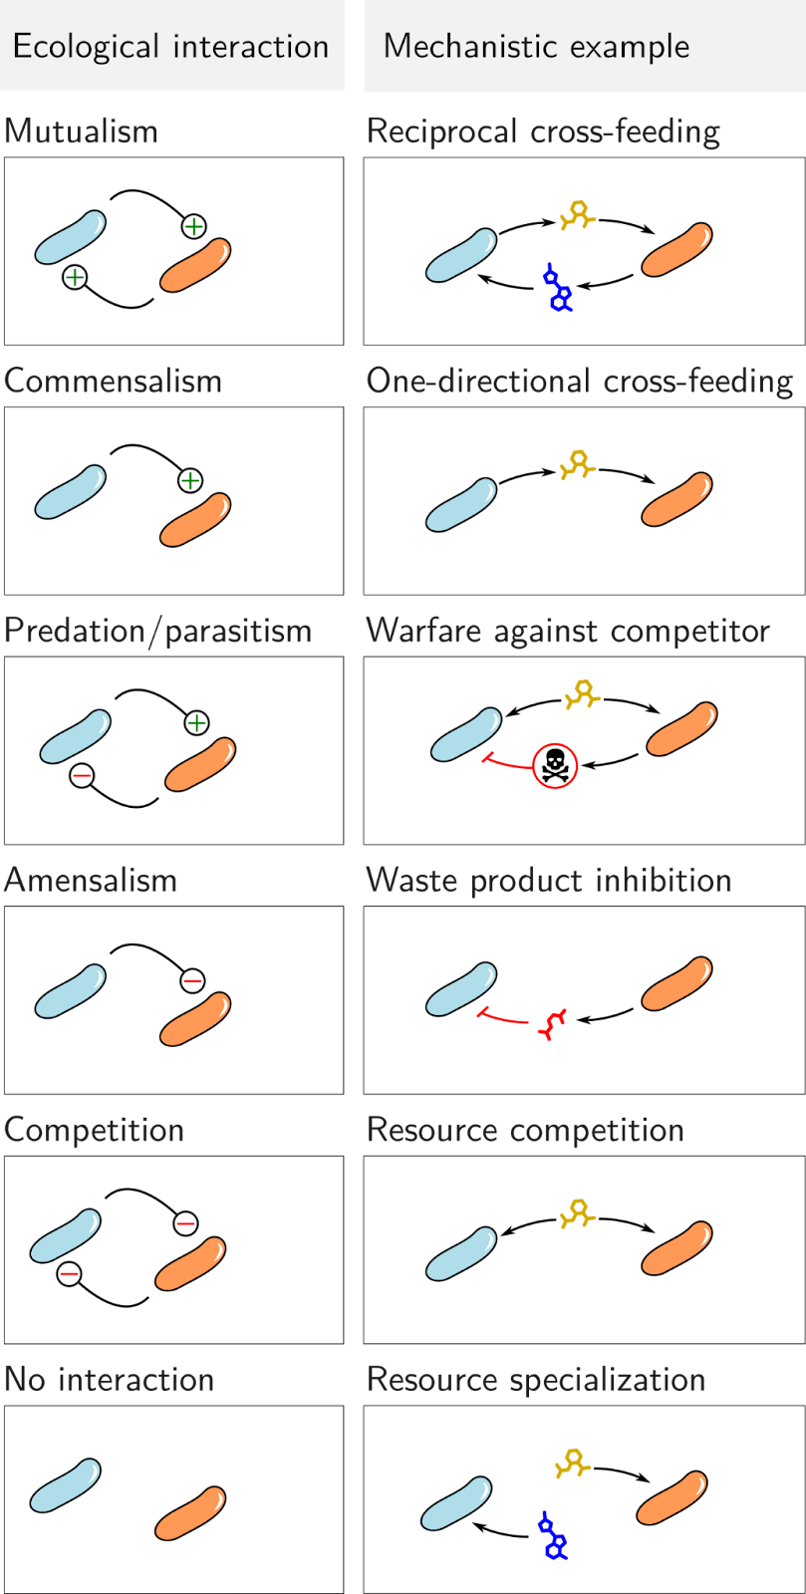
Types of interactions

Slide 12
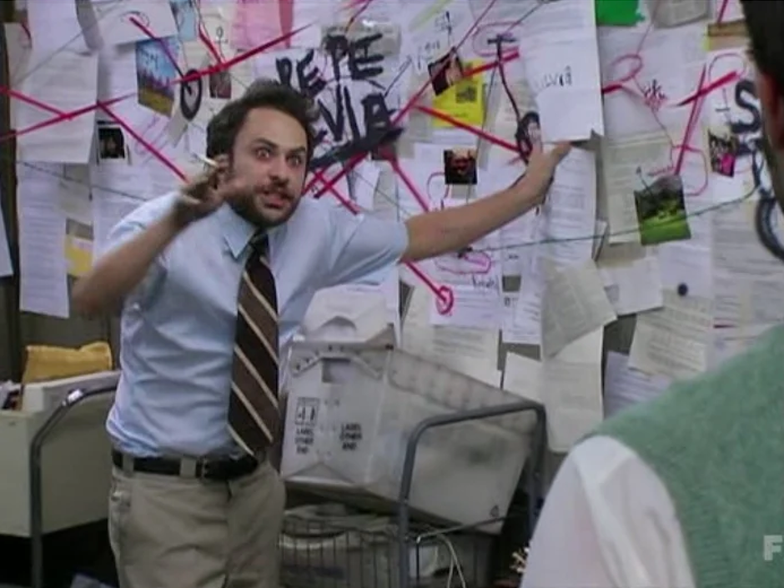







Types of interactions in a community
Mutualism
Competition
Commensalism
Predation
Parasitism
A
E
B
D
C

Slide 13
Theoretical models in Microbial Ecology
2. Lotka-Volterra models

Slide 14
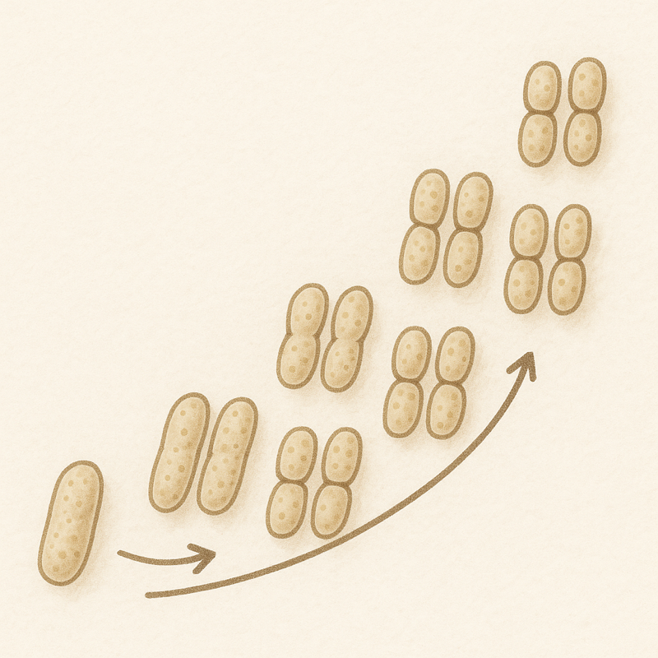

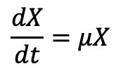
How can we keep track of an organism’s growth
$$\frac{dX}{dt}=μX$$
Solve with odeint
X grows in time as a function of X.
Let’s implement it in Python!

Slide 15
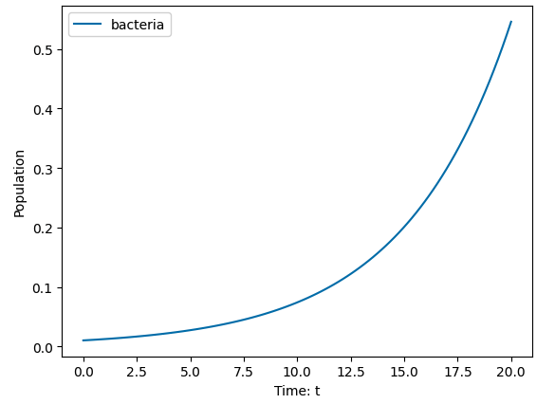
How can we keep track of an organism’s growth
$$\frac{dX}{dt}=μX$$
Realistic?

Slide 16
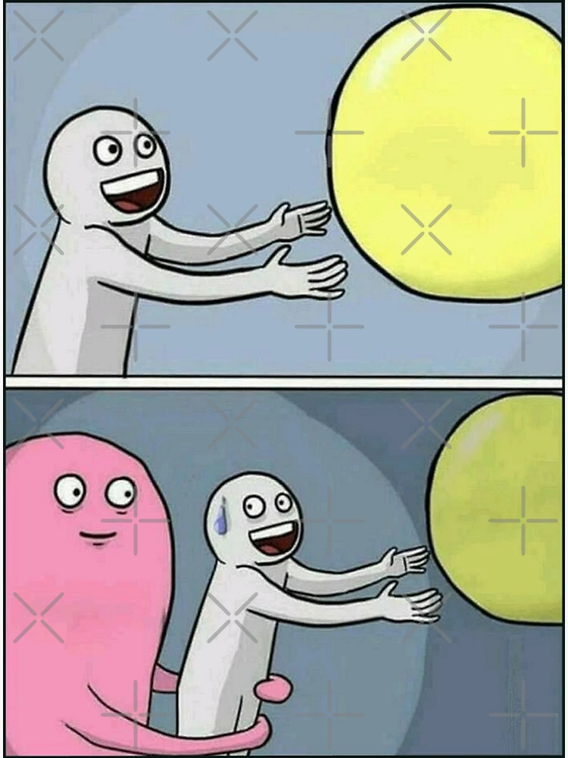
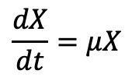
How can we keep track of an organism’s growth
$$\frac{dX}{dt}=μX$$
Grow to infinity
Realistic?
Limits?

Slide 17
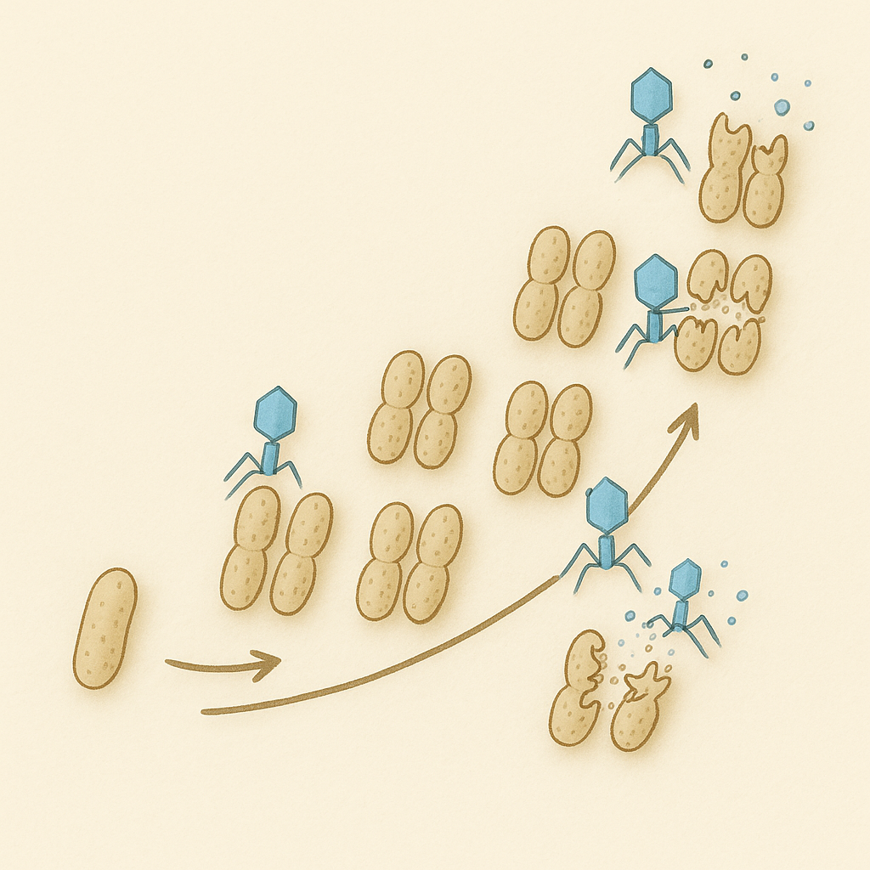
Let’s include a new player: phages
What will happen to the bacterial popullation?
Will phages take over?

Slide 18
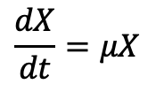
Let’s include a new player: phages
How can we model each popullation?
$$\frac{dX}{dt}=μX$$

Slide 19
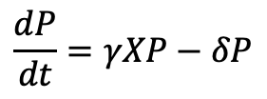
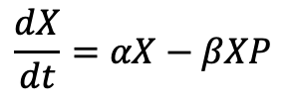
Let’s include a new player: phages
How can we model each popullation?
$$\frac{dX}{dt}=αX−βXP$$
X growth
X death by P infection
$$\frac{dP}{dt}=γXP−δP$$
P growth on X
P death

Slide 20
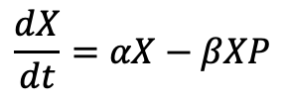
Let’s include a new player: phages
How can we model each popullation?
Predator-Pray LV model
$$\frac{dX}{dt}=αX−βXP$$
$$\frac{dP}{dt}=γXP−δP$$
Let’s implement it in Python!

Slide 21
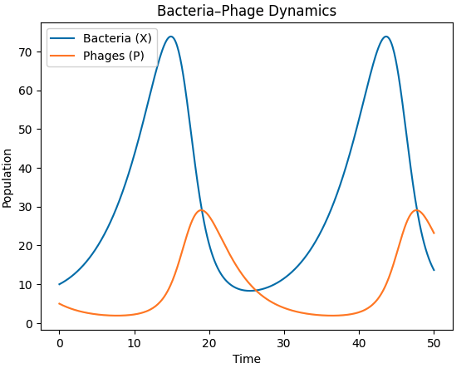
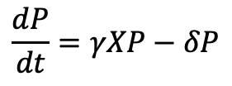
Let’s include a new player: phages
$$\frac{dX}{dt}=αX−βXP$$
$$\frac{dP}{dt}=γXP−δP$$

Slide 22
Let’s include a new player: phages
What will happen to the bacterial popullation?
Will phages take over?

Slide 23
Let’s include a new player: phages
$$\frac{dX}{dt}=αX−βXP$$
$$\frac{dP}{dt}=γXP−δP$$
We obtained dynamic oscilations.
In groups, disucss:
Will that always be the case?
Can this system achieve a steady state?

Slide 24
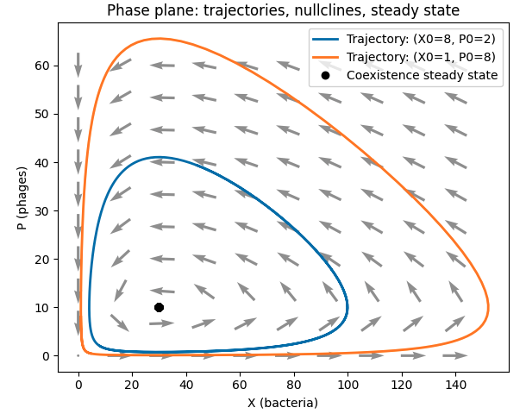
Let’s include a new player: phages
Let’s implement it in Python!

Slide 25


Lotka-Volterra models
N_{i} is the population size of species i.
r_{i} is the intrinsic growth rate of species i.
α_{ij}​ is the interaction coefficient between species i and species j.

Slide 26
Theoretical models in Microbial Ecology
1. Consumer-Resource models

Slide 27
Remember our simple model for growth?
$$\frac{dX}{dt}=μX$$
Realistic?

Slide 28
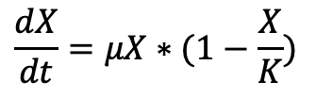
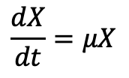
Let’s incorporate a limit on that exponentia growth
Carrying capacity:
$$\frac{dX}{dt}=μX$$
$$\frac{dX}{dt}=μX∗(1−\frac{X}{K})$$
Let’s implement it in Python!

Slide 29

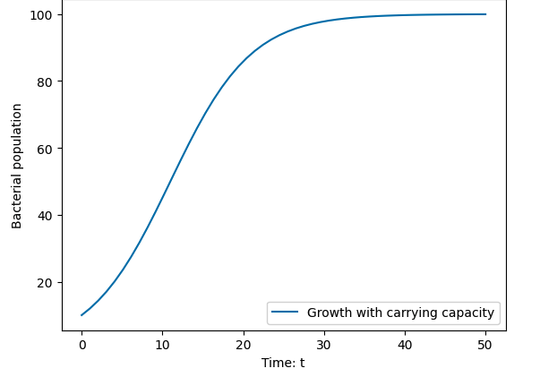
Let’s incorporate a limit on that exponentia growth
Carrying capacity:
$$\frac{dX}{dt}=μX$$
$$\frac{dX}{dt}=μX∗(1−\frac{X}{K})$$

Slide 30
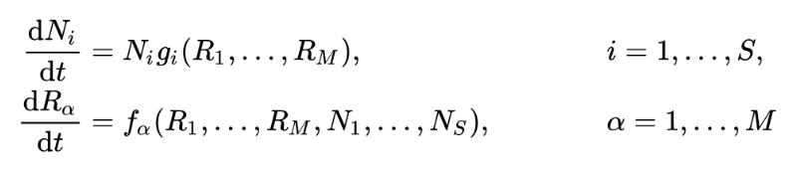
Let’s incorporate a limit on that exponentia growth
Carrying capacity:
$$\frac{dX}{dt}=μX$$
$$\frac{dX}{dt}=μX∗(1−\frac{X}{K})$$
Resources?

Slide 31
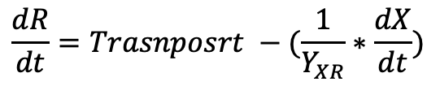
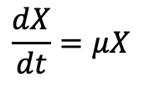
Let’s build a consumer resource model of growth
$$\frac{dX}{dt}=μX$$
$$\frac{dR}{dt}=Trasnposrt −(\frac{1}{Y_{XR}}∗\frac{dX}{dt})$$
In batch growth, no transport
How much ‘R’ is consumed to produce dX/dt
Let’s implement it in Python!

Slide 32
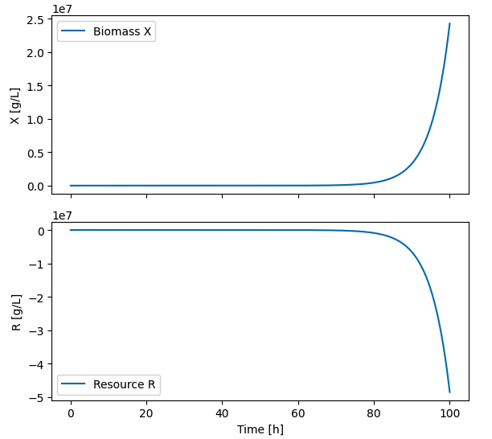
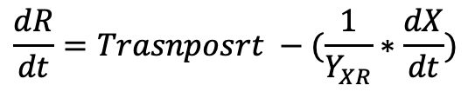
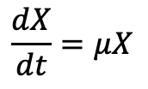
Let’s build a consumer resource model of growth
Growth rate is not dependent on resources.
Yet…
$$\frac{dX}{dt}=μX$$
$$\frac{dR}{dt}=Trasnposrt −(\frac{1}{Y_{XR}}∗\frac{dX}{dt})$$
In batch growth, no transport
How much ‘R’ is consumed to produce dX/dt

Slide 33
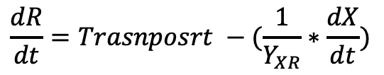
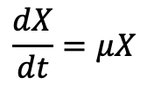
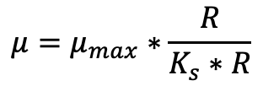
Let’s build a consumer resource model of growth
$$μ=μ_{max}∗\frac{R}{K_{s}∗R}$$
Monod-type
$$\frac{dX}{dt}=μX$$
$$\frac{dR}{dt}=Trasnposrt −(\frac{1}{Y_{XR}}∗\frac{dX}{dt})$$
In batch growth, no transport
How much ‘R’ is consumed to produce dX/dt

Slide 34
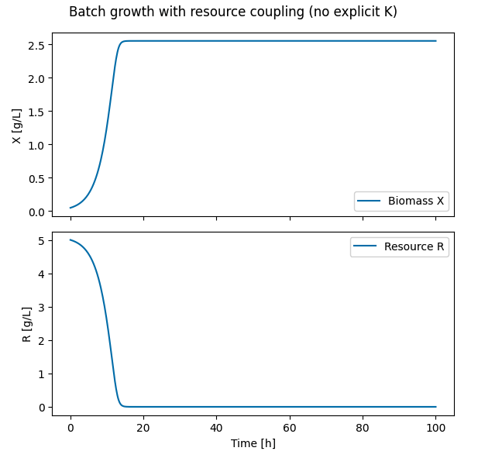
Let’s build a consumer resource model of growth

Slide 35

Consumer Resource mode: MacArthur
N_{i} is the population size of species i (i=1, …, S)
𝑤_{iα} represents the amount of biomass of species i produced per unit of resource α, i.e. its yield
c_{iα} is the matrix containing the rates of uptake of resource α by species i
m_{i} is the mortality rate of species i

Slide 36

Consumer Resource mode: MacArthur
R_{β} is the abundance of resource β in the environment (β = 1, …, M)
K_{β} is the (constant) supply of resource β
ω is the resource dilution rate
c_{iα} is the matrix containing the rates of uptake of resource α by species i

Slide 37
Theoretical models in Microbial Ecology
1. Consumer-Resource models

