Slide 1
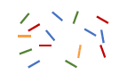

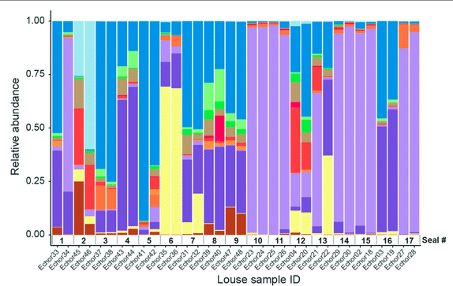

Functional Genomics: From assembled contigs to community function
Read quality check and trimming
Contig filtering, Binning of MAGs, Bin refinement, Quality check
Step 1
Step 3
Step 2
Step 4
Host contamination removal, assembly
MAG/ Contig functional profiling
Prateek Shetty, Ph.D.
JSMC Postdoctoral fellow,
Friedrich Schiller University
Matthias Schleiden Institute General Botany,
Jena, Germany

Slide 2
Key Challenges in Metagenomics
Partial gene fragments in assembled contigs (Completion/ Contamination)
Mixed communities with varying abundance (Normalization)
Gene length bias in sequencing (Normalization)
Computational Intensity and Data Volume (Money)

Slide 3
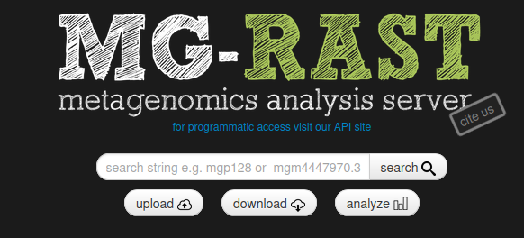
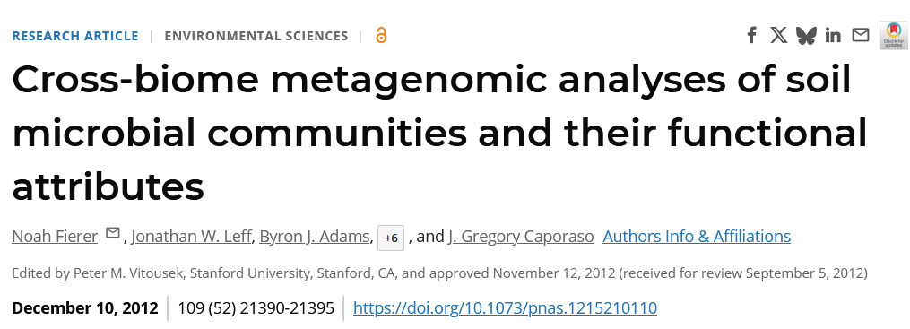
The central question
Moving beyond "who's there?" to "what are they doing?“
Linking microbial community composition to ecosystem function

Slide 4
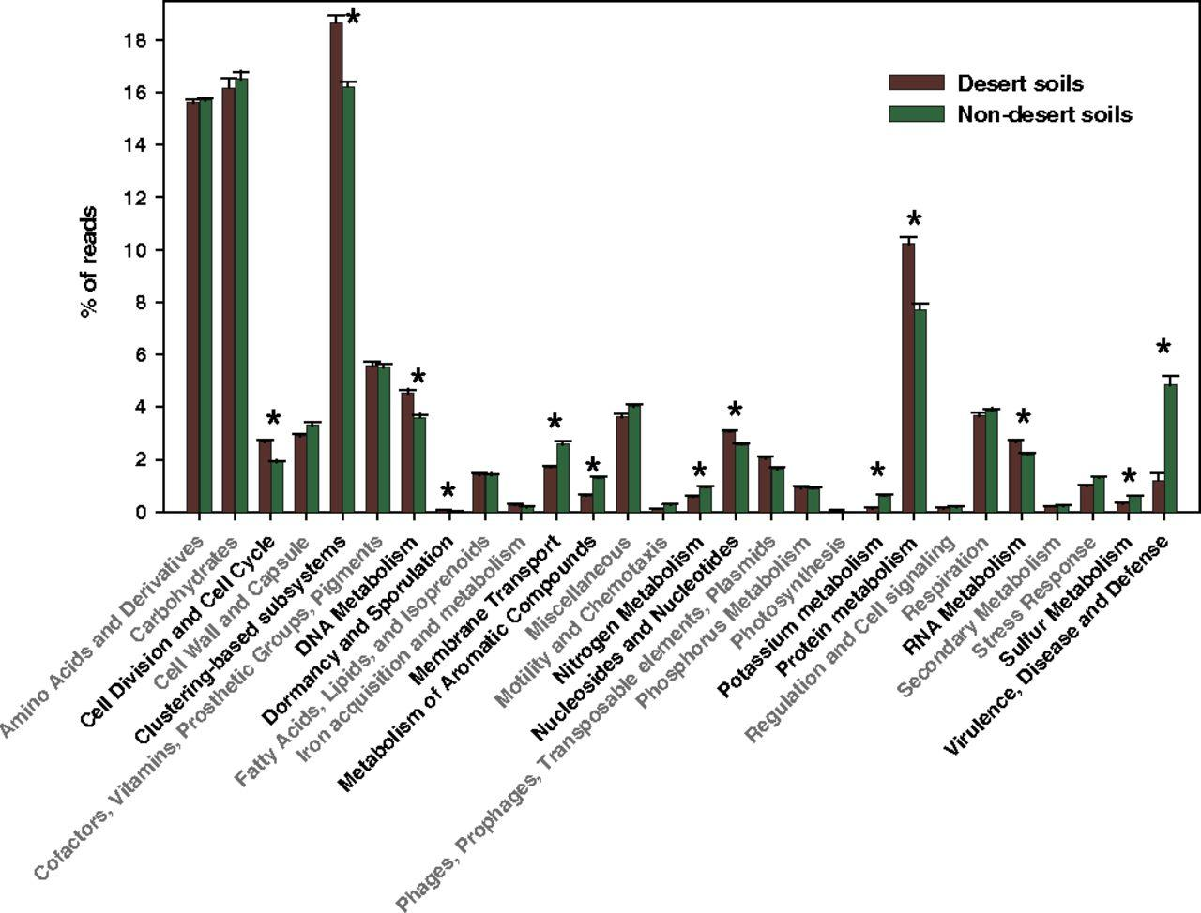
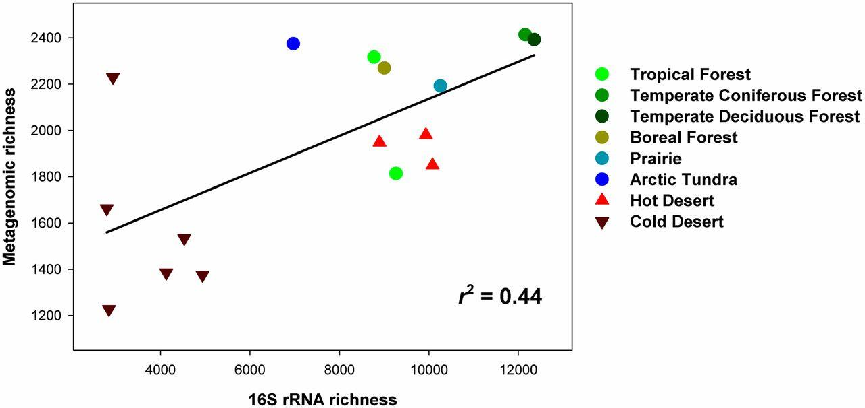

Slide 5
Contigs to Function: The Annotation Workflow
Structural Annotation (Gene Prediction)
What it does: Identifies where genes are located on contigs
Key tools: Prodigal, GeneMark, FragGeneScan
Output: Predicted protein-coding sequences (CDSs)/proteins
Functional Annotation (Gene Function Assignment)
What it does: Assigns biological functions to predicted genes
Key tools: Prokka, eggnog Mapper, Interproscan
Output: COG, GO, KO, product definitions
Gene A
Gene C
Gene E
Gene G
Gene B
Gene D
Gene F

Slide 6
Key steps in building a functional profile
Structural Annotation (Gene Prediction)
Functional Annotation (Gene Function Assignment)
Contig level
Map reads back to contigs using BWA-MEM or Bowtie2
Quantify the mapped reads0 using htseq-count.
Files required:
Read files,
contig index,
sam/ bam/ sorted bam
gtf file
CDS level
Dereplicate the MAGs, compile CDS from the different dereplicated MAGs
Pseudo align reads back to indexed CDS to quantify using Salmon
Files required:
Reads files,
CDS index
gtf file

Slide 7
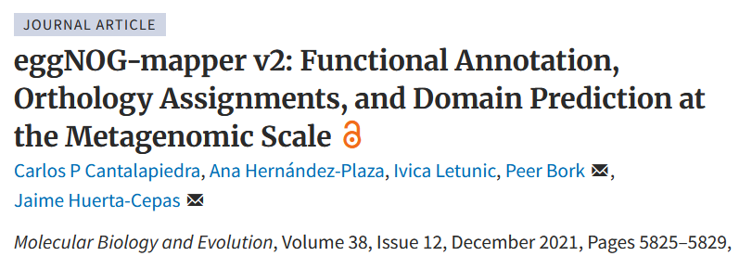
Tools for functional annotation
Method: Orthologous groups approach using precomputed clusters
Strengths: Fast, comprehensive, integrates multiple databases
Output: COG categories, GO terms, KEGG pathways

Slide 8
COG vs KO vs GO
Database | Key Purpose | Data Format/Structure | Best Use Case
Gene Ontology (GO) | High-level, hierarchical classification of gene functions. | Hierarchical directed acyclic graph. Functional categories in BP, CC and MF | Broad discovery, high-level summaries, and enrichment analysis.
Clusters of Orthologous Groups (COG) | Phylogenetic classification of proteins based on orthology. | Broad functional categories and subgroups. | Broad comparative surveys and functional classification.
KEGG Orthology (KO) | Mechanistic, pathway-centric mapping of gene functions. | Network of nodes (KOs) and edges (reactions). | Systems-level modeling, mechanistic inquiry, and hypothesis-testing.

Slide 9
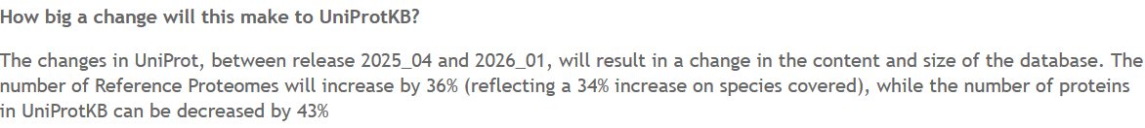
Functional databases
General databases
UniRef (100/90/50): Different levels of sequence clustering
Specialized databases
CAZy: Carbohydrate-active enzymes (plant biomass degradation)
CARD/ARG-ANNOT: Antimicrobial resistance genes
VFDB: Virulence factors
PHROGs: Phage functional categories

Slide 10



Normalization
Longer genes have higher probability to be sequenced compared to shorter genes.
RPKM (Reads per kilobase of transcript per million reads mapped)
TPM (Transcripts per million)
Zhao et al., 2020 “Misuse of RPKM or TPM normalization when comparing across samples and sequencing protocols”

Slide 11
Caveats!
Metagenomics will not give you information on expression of the gene.
It only suggests that there maybe the potential to perform these functions. Presence or absence of a gene does not always translate into biological activity.
DNA can also come from dead cells/ noise in environment.

Slide 12
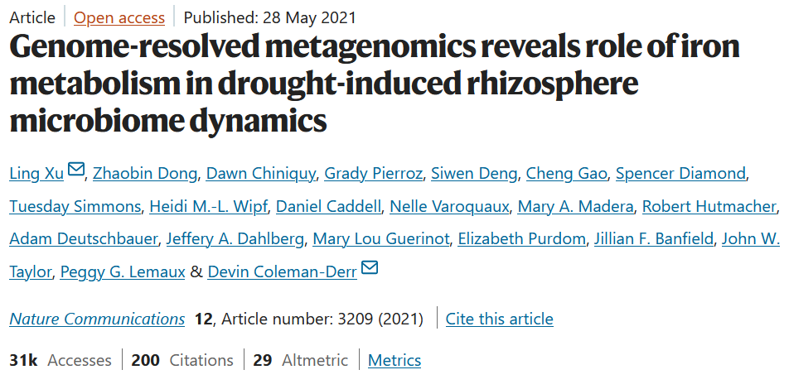
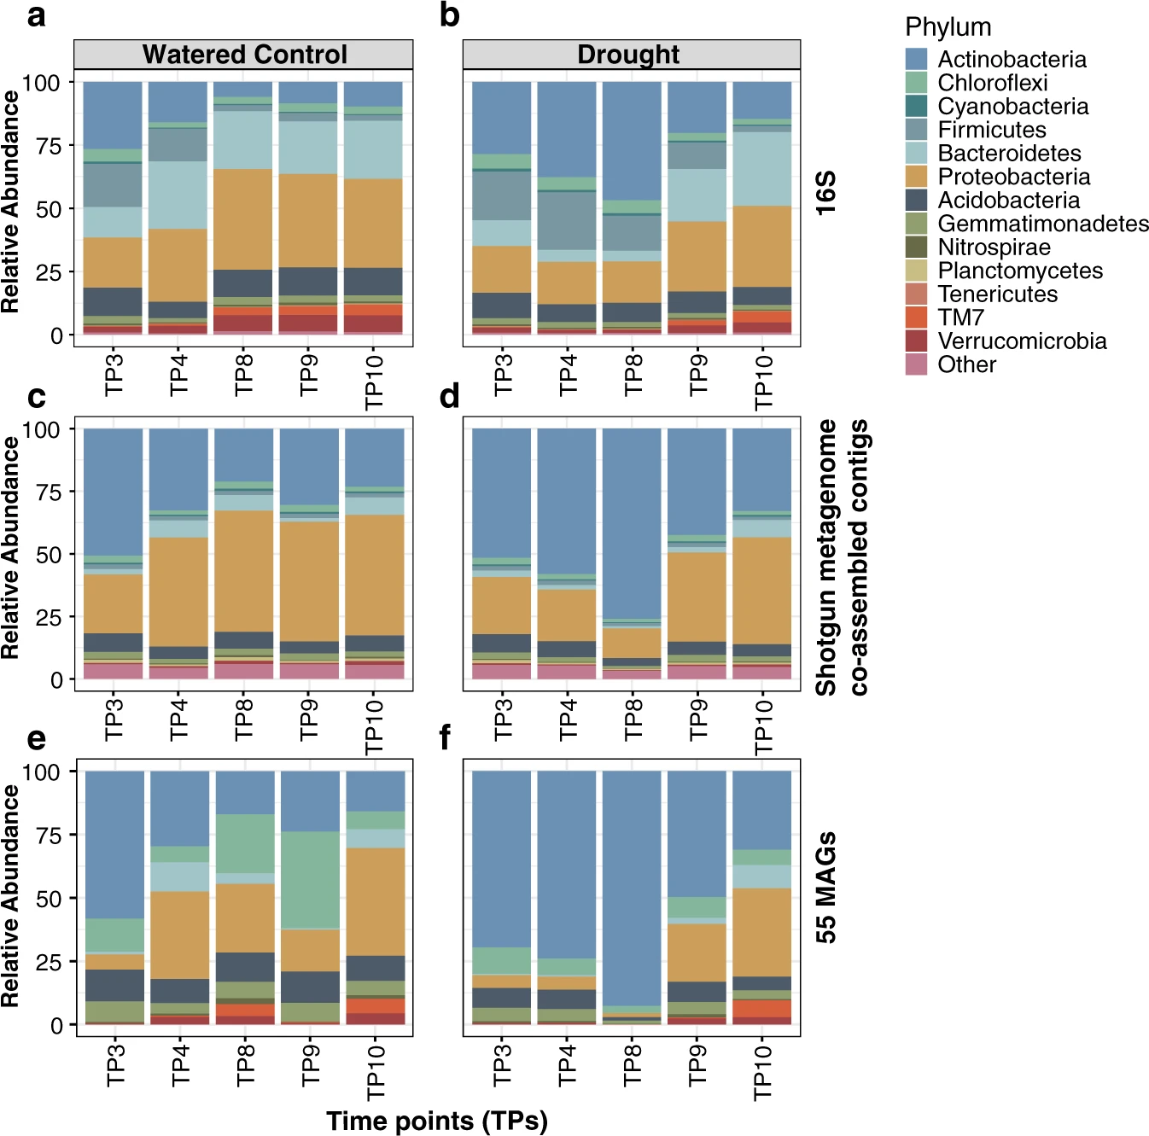
Case study 1: Genome-resolved metagenomics reveals role of iron metabolism in drought-induced rhizosphere microbiome dynamics

Slide 13
Case study 1: Genome-resolved metagenomics reveals role of iron metabolism in drought-induced rhizosphere microbiome dynamics
Raw Data Assessment - FastQC v0.11.5
Read Trimming and Filtering - cutadapt v1.6
Co-Assembly Approach - MEGAHIT v1.1.2
Coding Sequence Prediction - Prokka v1.13
COG Assignment – Prokka
Relative abundance quantification – Kallisto
Differential abundance of functions – Deseq2
NOTE: Prokka uses static COG database (often COG 2014 or earlier) while eggNOG database is updated(currently v5.0, updated 2019)

Slide 14
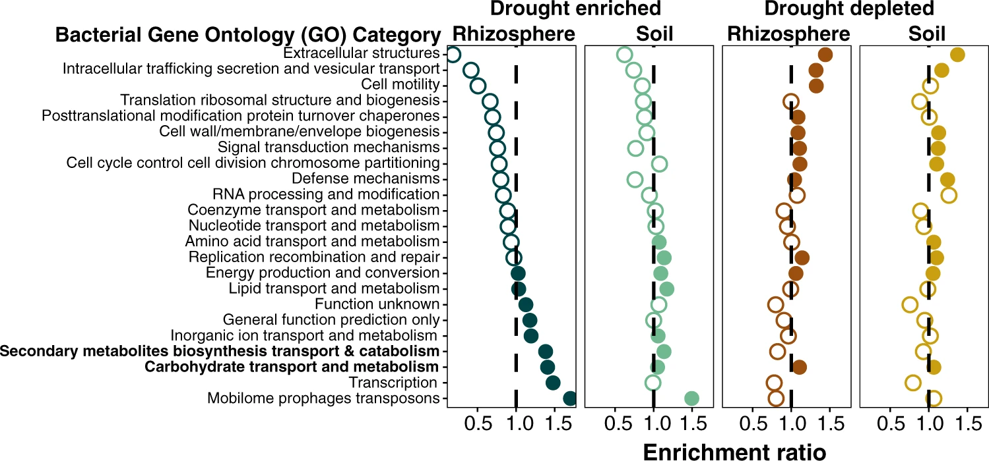
Case study 1: Genome-resolved metagenomics reveals role of iron metabolism in drought-induced rhizosphere microbiome dynamics

Slide 15
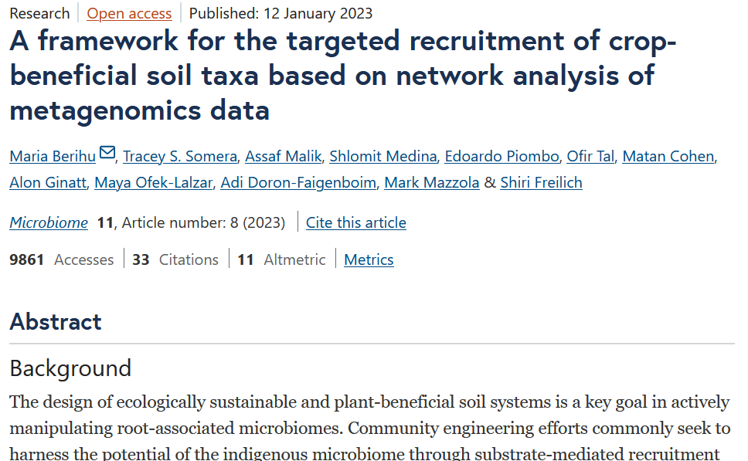
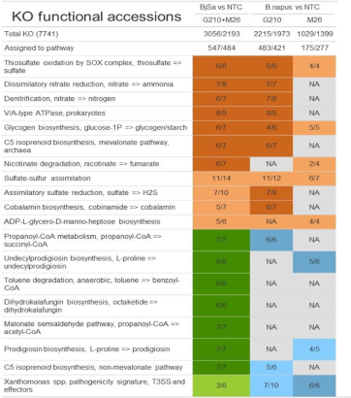
Case study 2: A framework for the targeted recruitment of crop-beneficial soil taxa based on network analysis of metagenomics data

Slide 16
Case study 2: A framework for the targeted recruitment of crop-beneficial soil taxa based on network analysis of metagenomics data
Raw Data Assessment - NA
Read Trimming and Filtering – Trimmomatic + Fastx toolkit
Individual Assembly Approach - MEGAHIT v1.1.3
Coding Sequence Prediction – Prodigal v2.6.2
Functional Assignment at Contig level – NR-NCBI database with Diamond + MEGAN
Relative abundance quantification – BWA + MEGAN
Differential abundance of functions – MEGAN
NOTE: Prokka uses static COG database (often COG 2014 or earlier) while eggNOG database is updated(currently v5.0, updated 2019)

Slide 17
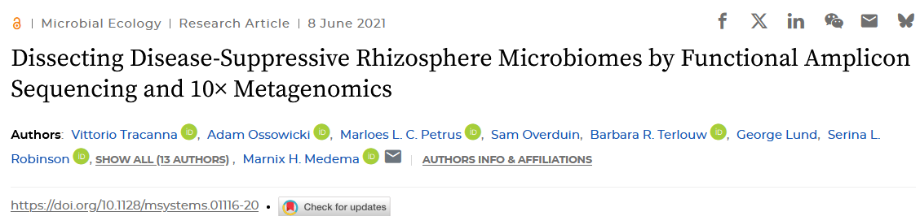
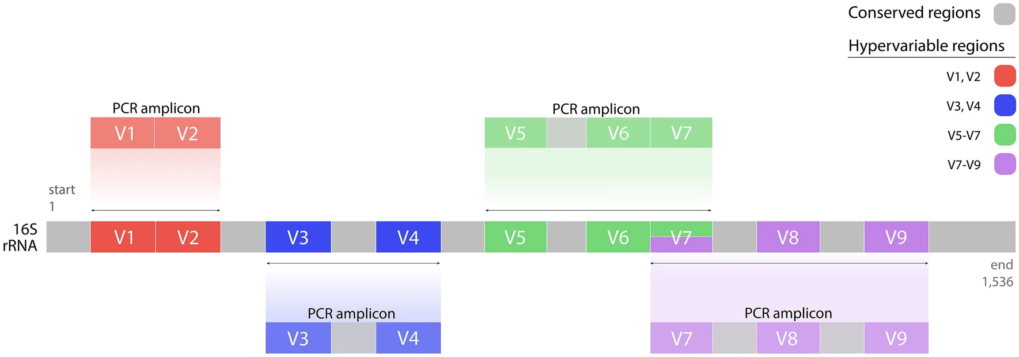
Case study 3: Dissecting Disease-Suppressive Rhizosphere Microbiomes by Functional Amplicon Sequencing and 10× Metagenomics
López-Aladid, Ruben, et al. "Determining the most accurate 16S rRNA hypervariable region for taxonomic identification from respiratory samples." Scientific reports 13.1 (2023): 3974.

Slide 18
Case study 3: Dissecting Disease-Suppressive Rhizosphere Microbiomes by Functional Amplicon Sequencing and 10× Metagenomics
Functional amplicon sequencing of NRPS
Targeting and amplifying A domain: Previously published primers were used to amplify the A domain of NRPS sequences [Similar to 16s universal primers]
Sequence and process: Resulting reads were natural amplicons (nAMPS/ OTUs/ ASVs)
Building a reference: Insilico reference database built using reference BGCs from MIBiG and antismash database [Similar to Silva/ Greengenes]
DADA2 used as in 16s pipeline. Just the database is different
Low similarity matches – Novel BGCs!
López-Aladid, Ruben, et al. "Determining the most accurate 16S rRNA hypervariable region for taxonomic identification from respiratory samples." Scientific reports 13.1 (2023): 3974.

Slide 19
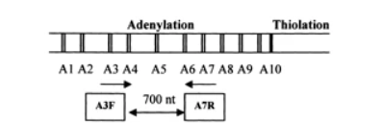
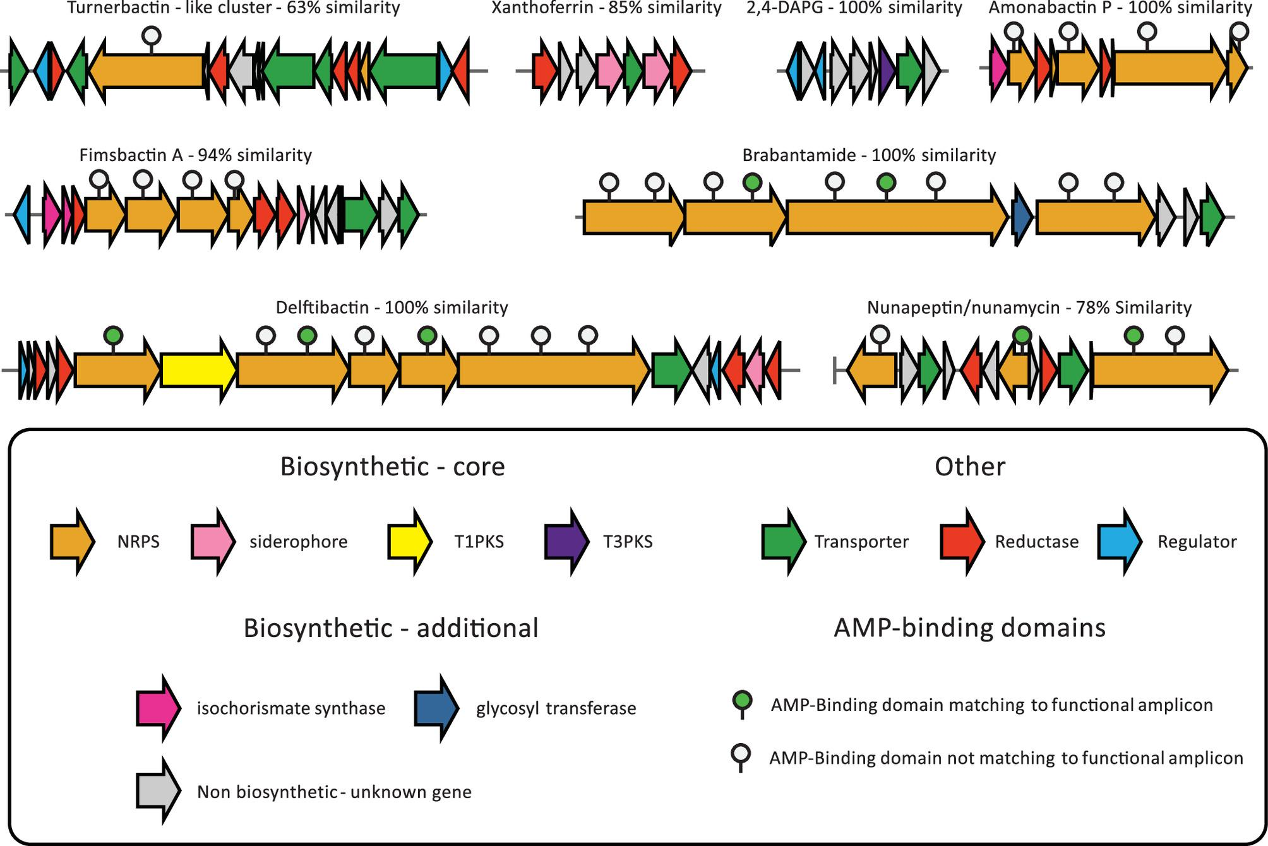
Case study 3: Dissecting Disease-Suppressive Rhizosphere Microbiomes by Functional Amplicon Sequencing and 10× Metagenomics
Identification of novel BGCs using functional amplicon metagenomics
Ayuso-Sacido, A., and O. Genilloud. "New PCR primers for the screening of NRPS and PKS-I systems in actinomycetes: detection and distribution of these biosynthetic gene sequences in major taxonomic groups." Microbial ecology 49.1 (2005): 10-24.

Slide 20
Protocol for MAG based functional annotation
Step 1: Dereplicate your MAGs
dRep dereplicate --S_ani 0.99 -comp 60 -con 15 -p 16 dRep_results -g BiomeFun_bins/*.fa
dereplicate – Tells dRep what to do
S_ani 0.99 – 2 genomes must have a similarity lower than 99% to be retained
comp 60 – Genomes must have completeness greater than 60% to be retained
con 15 – Genomes must have contamination lower 15% to be retained

Slide 21
Protocol for MAG based functional annotation
Step 2: Structural & Functional annotation
for mag in dRep_results/dereplicated_genomes/*.fa;
do
mag_name=$(basename "$mag" .fa)
# Run Prokka on the MAGs
prokka
--metagenome
--addgenes
--evalue 1e-9
--cpus 16
--rfam
--outdir BF_MAG_prokka_annotations/"prokka_"$mag_name --force --prefix "$mag_name" "$mag“;
done

Slide 22
Protocol for MAG based functional annotation
Step 2: Structural & Functional annotation
--metagenome -- Prokka will use metagenome specific gene prediction
--addgenes -- Makes a genes only fasta file along with standard annotation files
--evalue 1e-9 -- Matches lower than this threshold will not be retained
--cpus 16 -- No. of processors to use
--rfam -- Searches and annotates non-coding RNA with Rfam database

Slide 23
Protocol for MAG based functional annotation
Step 3: Functional annotation using eggnog mapper
for mag_name in `basename -s .fa dRep_results/dereplicated_genomes/*.fa`; do
input_faa="prokka_"$mag_name"/"$mag_name".faa"
output_name="eggnog_"$mag_name
emapper.py
-i BF_MAG_prokka_annotations/"$input_faa"
-o BF_eggnog_annotations/"$output_name"
--cpu 38 --data_dir /exports/watson/Prateek/dbs/eggnog
-m diamond --sensmode mid-sensitive --dmnd_ignore_warnings
--tax_scope auto
--go_evidence non-electronic
--pfam_realign realign
--decorate_gff yes
--override;
done

Slide 24
Protocol for MAG based functional annotation
Step 3: Functional annotation using eggnog mapper
-m diamond – algorithm used for matches [Diamond is default, slower but specific alternative is hmmsearch]
--sensmode mid-sensitive – Controls sensitivity. Modes are fast, mid-sensitive or sensitive
--dmnd_ignore_warnings – Diamond will throw out warnings/ halt the process if there are incomplete genes or non-critical issues
--tax_scope auto – Use this if you are interested in limiting your scope of search to certain taxonomic groups/ families
--go_evidence non-electronic – Uses annotation with experimental data.
--pfam_realign realign – Improves accuracy of Pfam domain assignment. More useful for improving low identity matches
--decorate_gff yes – adds functional info into gff files. Generally only co ordinates are provided.
--override – If you have an incomplete previous run, overwrites it.

Slide 25
Protocol for MAG based functional annotation
Step 4: Counting
for SAMPLE in Sample1 Sample2 Sample3; do
echo "Processing sample: $SAMPLE"
salmon quant -i $OUT_F/MAG_catalog_idx -l A
-1 $RF/${SAMPLE}_1.trim.fastq -2 $RF/${SAMPLE}_2.trim.fastq
--meta --validateMappings
--gcBias
--seqBias
--recoverOrphans
--threads ${THREADS} -o $OUT_F/${SAMPLE}_salmon_quant;
done

Slide 26
Protocol for MAG based functional annotation
Step 4: Counting
Salmon quant – Salmon can run index or Quant counting command
-l A – Library type, automatic detection
--meta – Counts based on metagenomic data
--validateMappings – More sensitive and accurate mapping using selective alignments
--gcBias – Enables GC bias correction
--seqBias – Corrects for sequence biases at the beginnings or endings of the reads
--recoverOrphans – Recovers mates of orphaned reads; i.e if only one pair has mapped to reference.

