Slide 1



Practical session on shotgun metagenomics assembly and binning
Alfonso Esposito, University of Verona (It)
Alfonso.esposito@univr.it
BiomeFun 2025, 16 September 2025

Slide 2
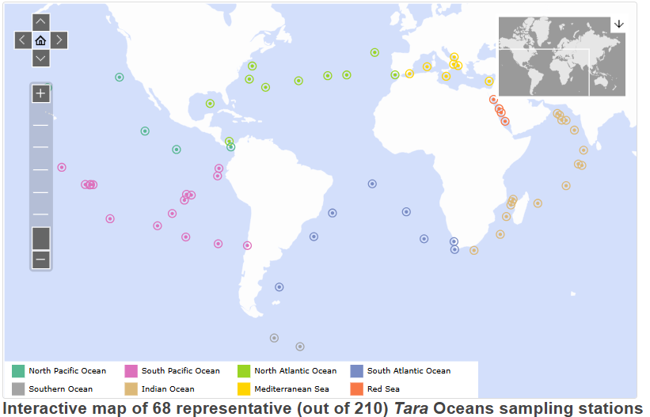
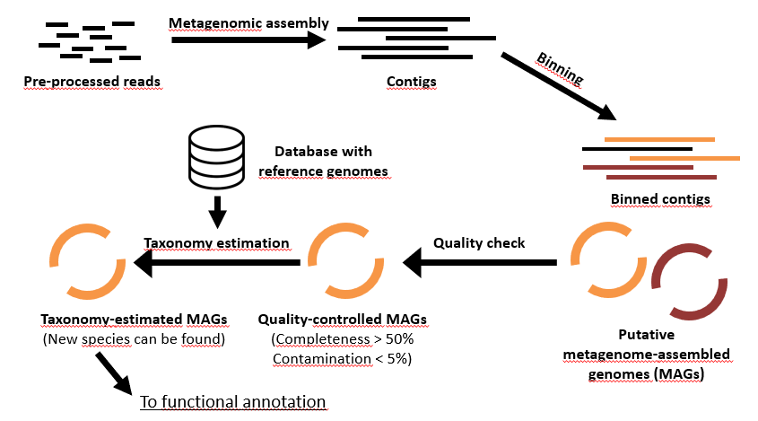

Introduction on the practicals and the dataset
This dataset was drawn from the data produced during the Tara Ocean Expedition (957 MAGs recovered!)
Three samples, each consisting of 500K Illumina reads in paired-end layout.
https://www.hadriengourle.com/tutorials/meta_assembly

Slide 3

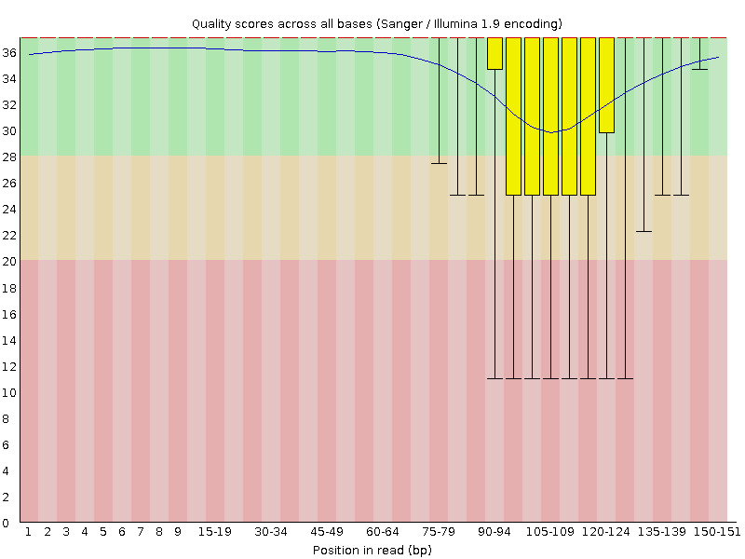
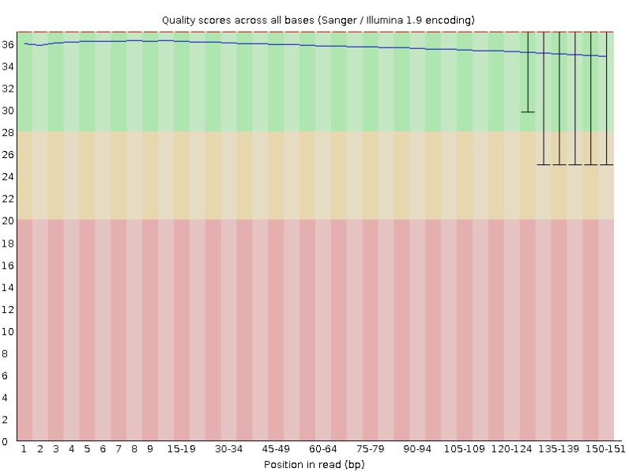
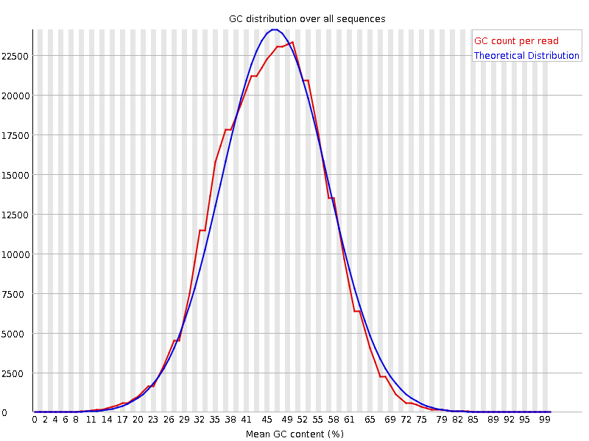
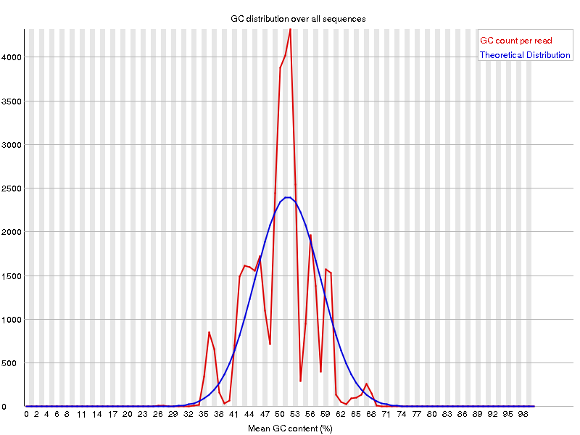

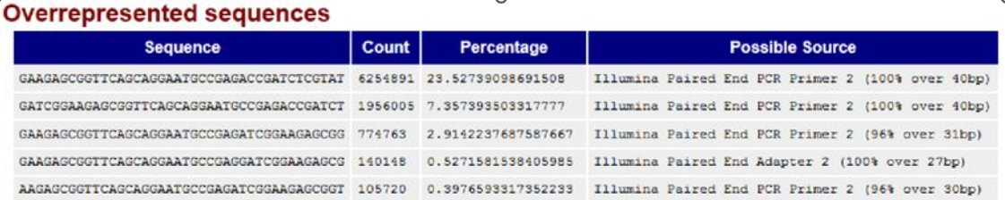
Checking data with fastqc
Before pre-processing
After pre-processing
FastQC: a java-based program to check the quality of .fastq data;
It provides summary and metrics that can be used to identify issues;
Simple, straightforward and user-friendly, with a nice point-and-click GUI;
Multiple fastQC reports can be simultaneously visualized using multiQC.

Slide 4

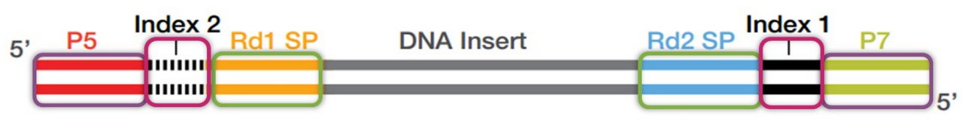
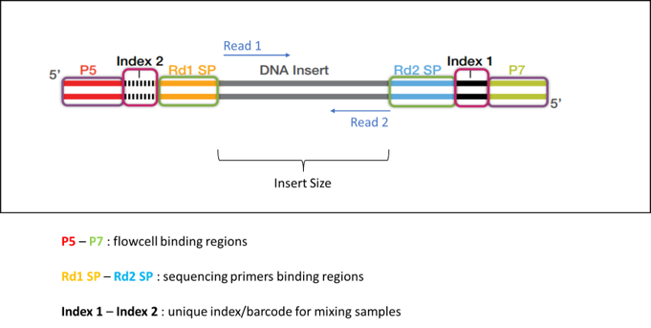
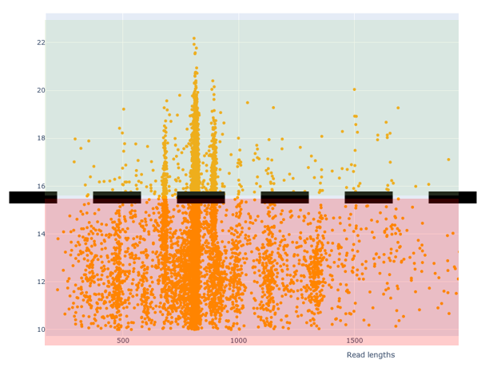
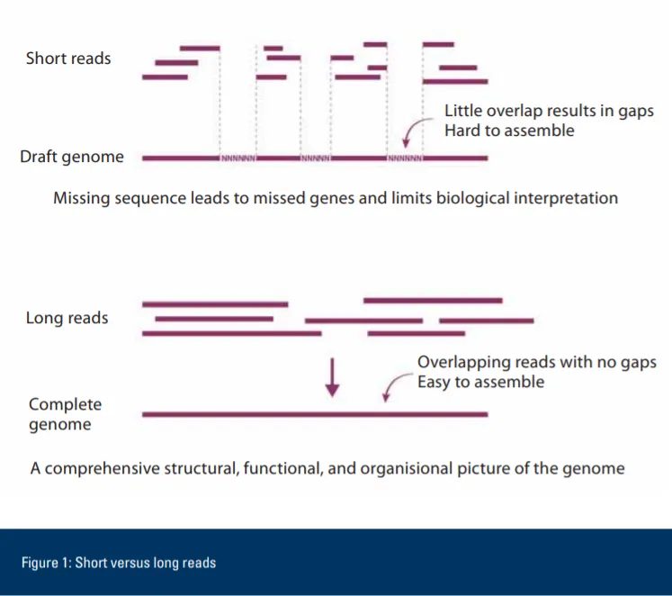

Reads pre-processing
Adapter trimming
Low-quality regions filtering
Quality
Length filtering

Slide 5
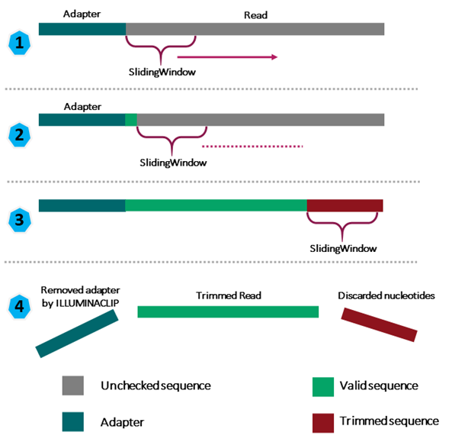
Trimmomatic
In Trimmomatic there are two strategies for adapter trimming:
Simple trimming (A and B): Adapter sequences are tested against the reads, if a match is detected, the read is clipped appropriately.
Palindrome trimming (C and D): designed for the case of 'read-through’ of short fragment into the adapter sequence on the other end.
F and R reads are aligned, if they align over their whole length, F read is clipped and the reverse read dropped (since it contains no new data).
Low quality regions removal is done using a sliding window approach.
SLIDINGWINDOW:<windowSize>:<requiredQuality>
windowSize: specifies the number of bases to average across
requiredQuality: specifies the average quality required.
Average quality over a user defined window is calculated. The window moves through the whole read length, cutting once the average quality within the window falls below a threshold. By considering multiple bases, a single poor quality base will not cause the removal of high quality data later in the read.

Slide 6
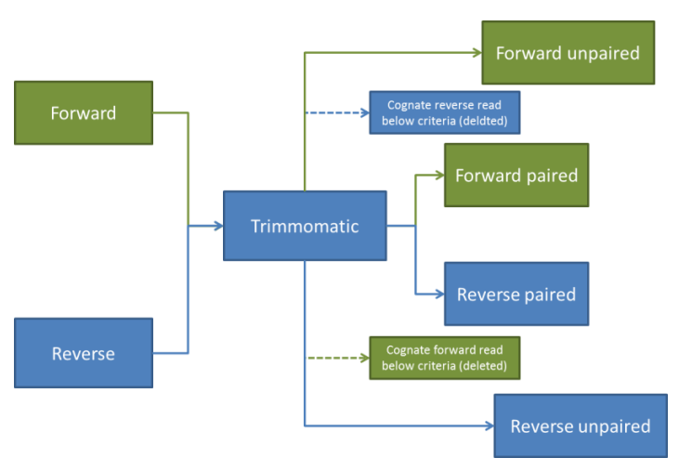
Trimmomatic – Inputs and outputs
2 Inputs -> 4 outputs
Adding “.gz” will automatically compress them (gzip)
If keepBothReads is set to true, all pairs are kept (also the cognate reverse reads).

Slide 7
Trimming and quality check
Before assembly, raw data must be trimmed to remove adapters and low-quality regions.
$ trimmomatic PE -phred33 PATH/TO/Sample-R1.fastq.gz PATH/TO/Sample-R2.fastq.gz \
PATH/TO/Sample_trim_R1.fastq.gz PATH/TO/Sample _trim_surv_R1.fastq.gz \
PATH/TO/Sample _trim_R2.fastq.gz PATH/TO/Sample_trim_surv_R2.fastq.gz \
ILLUMINACLIP:/home/user/Support_files/illumina_adapters.fa:2:30:10 \
SLIDINGWINDOW:4:15 \
MINLEN:36
ILLUMINACLIP:<fastaWithAdaptersEtc>:<seed mismatches>:<palindrome clip threshold>:<simple clip threshold>
fastaWithAdaptersEtc: specifies the path to a fasta file containing all the adapters, PCR sequences etc.
seedMismatches: specifies the maximum mismatch count which will still allow a full match to be performed
palindromeClipThreshold: specifies the match between two adapter reads must be for PE palindrome read alignment.
simpleClipThreshold: specifies how accurate the match between any adapter sequence must be against a read.
SLIDINGWINDOW:<windowSize>:<requiredQuality>
windowSize: specifies the number of bases to average across
requiredQuality: specifies the average quality required.
Notes:
Estimated time to go through this phase: approx. 20 minutes

Slide 8
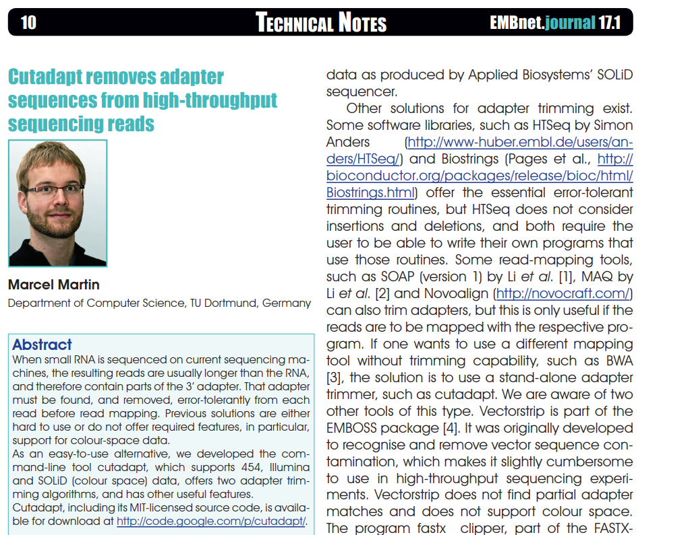
Other algorithms for trimming
Cutadapt — Cutadapt 4.10 documentation
Initially developed for smallRNA-seq (2011)
Written in python (alignment algorithm in C)
For each read, the following algorithm is:
Subtract the given cutoff (default=33) from all qualities
Compute partial sums from all indices to the end of the sequence
Cut the sequence at the index at which the sum is minimal
If both ends are to be trimmed, repeat this for the other end.
Read R1 (Q scores)
42 | 40 | 26 | 27 | 8 | 7 | 11 | 4 | 2 | 3
Example:
Assume you use a threshold of 10 and have these quality values
Subtracting the threshold gives
Then sum up the numbers, starting from the end (partial sums).
Stop early if the sum is greater than zero
Bases are trimmed till the first 4 one, where the sum is minimal
32 | 30 | 16 | 17 | -2 | -3 | 1 | -6 | -8 | -7
min
70 | 38 | 8 | -8 | -25 | -23 | -20 | -21 | -15 | -7
X
X
X
X
X
X
42 | 40 | 26 | 27 | 8 | 7 | 11 | 4 | 2 | 3

Slide 9
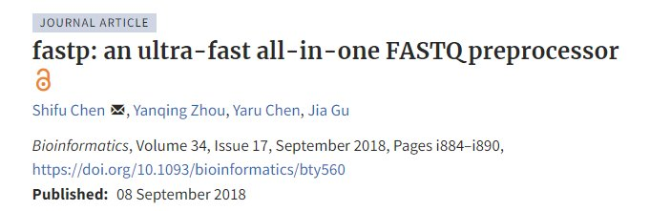
Other algorithms for trimming
The most recent, it was designed with speed in mind.
It works with a running average for quality check
it has several other interesting features (such as the polyX- or the polyG-trimming).
It also reports a user-friendly html report.
It will likely become a gold-standard in the next future.

Slide 10
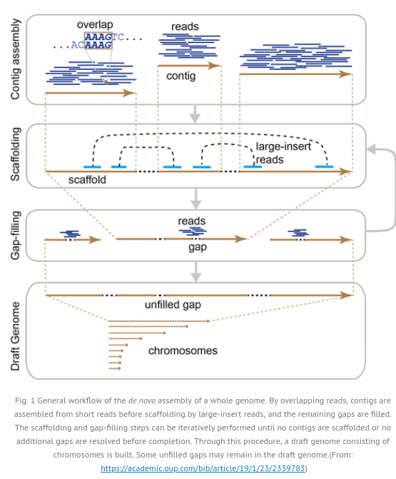
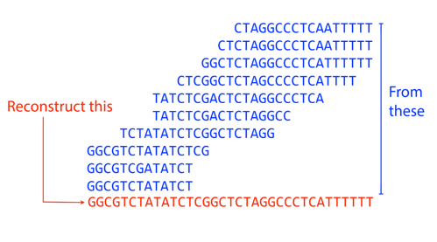
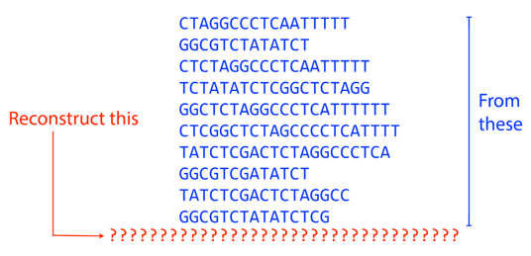
Genomic assembly
https://github.com/BenLangmead/ads1-slides/blob/master/0510_asm__overlaps.pdf

Slide 11
Assembly
The trimmed data were concatenated (i.e. “cat *R1* > All_R1.fastq.gz”) to do the co-assembly, which was done with the following command:
$ megahit -1 All_trimmed_R1.fastq.gz -2 All_trimmed_R2.fastq.gz -t 2 -o ./assembled_data
The co-assembly resulted in 6066 contigs, total 22,991,097 bp, min 212 bp, max 2,448,145 bp, avg 3790 bp, N50 20,596 bp
Notes:
Estimated time to go through this phase: approx. 30 minutes

Slide 12
Assemblers
Softwares developed for assembly of short reads rely mostly on the De Brujin graph.
Examples of assemblers are:
SPAdes (https://ablab.github.io/spades/): A DBG-based assembler optimized for short-read data (e.g., Illumina), widely used for bacterial genomes and metagenomics, with support for hybrid assemblies (short + long reads).
MegaHIT (https://github.com/voutcn/megahit): An ultra-fast, memory-efficient assembler tailored for large-scale metagenomic short-read datasets using succinct De Bruijn graphs.
De Brujn graphs assemblers are not very efficient for assembly of long (noisy) reads, most of the softwares use OLC:
Nextdenovo (https://github.com/Nextomics/NextDenovo): A long-read assembler designed for noisy single-molecule reads (e.g., ONT, PacBio CLR), using a correct-then-assemble approach for high accuracy.
HIFIASM (https://github.com/chhylp123/hifiasm): Long-reads assembler specialized for PacBio HiFi reads, producing haplotype-resolved assemblies using a graph-based approach for exceptional contiguity and accuracy.

Slide 13
Break

Slide 14
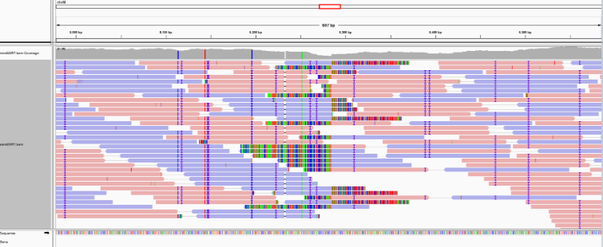
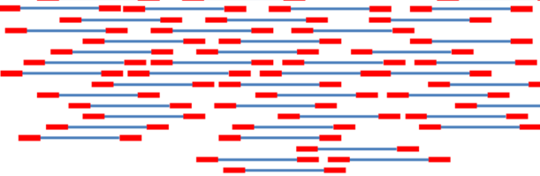

Mapping reads to a reference genome
The alignment algorithms can be used for few (tens, hundreds or even thousands of) sequences assumed to be homologues. However, it is not suitable for finding the best alignment between many (i.e. millions) reads to a large genome.
Querying a large genome using short reads can be done efficiently by building a sort of index (exactly like books), indeed the first step for mapping is creating the index for a genome. There are several ways to index, among the others:
Burrows-Wheeler Transformation
Es. BWA, Bowtie2
Hash tables (that is creating a unique numeric fingerprinting of a sequence through a specific function, allowing for fast indexing)
Es. STAR, SOAP and SOAP2, Novoalign
K-mer mapping (indexing the genome by extracting and sorting all k-mers)
Es. BBmap
+
Notes:
An index for the sequence ATTCCTTCATTC would be:
ATT 1,9
TTC 2,6
TCC 3
CCT 4
Etc.

Slide 15
Mapping
Trimmed paired-end reads from each sample were mapped on the co-assembled reads (indexed in <1 min) with the following command:
$ bwa index final.contigs.fa final.contigs
$ bwa mem -t 2 -o SAMPLE.sam BWA_idx/final.contigs.fa \
Sample_trim_R1.fastq.gz Sample_trim_R2.fastq.gz
Take a look to the output, in SAM format, and run samtools flagstat to get the alignment statistics.
Notes:
Estimated time to go through this phase: approx. 30 minutes

Slide 16
.sam/.bam conversion, sorting and indexing
The sam format, despite being human readable, is large and heavy, it is a good practice in bioinformatics to convert it into the lighter .bam format using samtools
$ samtools view -bS $SAMPLE.sam | samtools sort - > $SAMPLE.bam
$ samtools index $SAMPLE.bam
The .sam files can be safely deleted, the sam format can be easily re-created using samtools view.

Slide 17


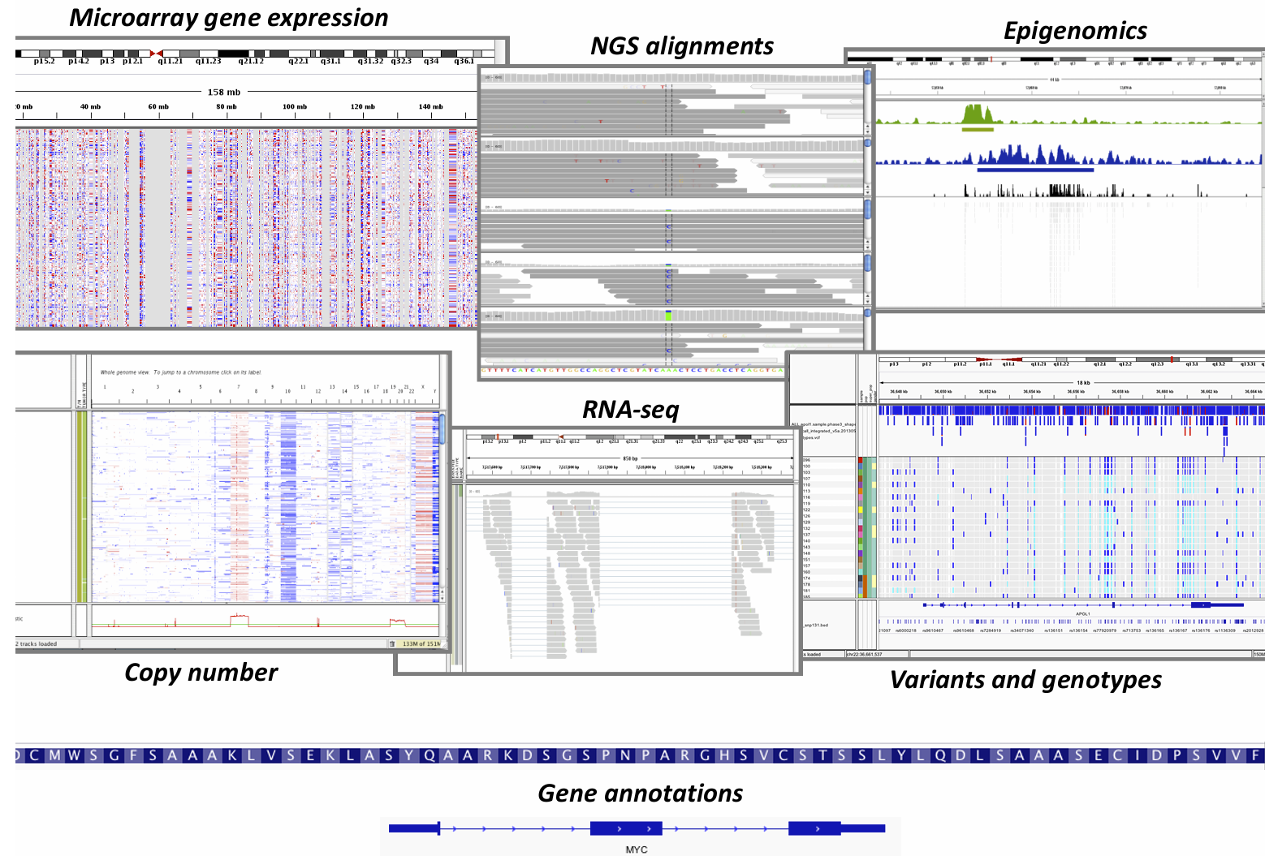
Look at the alignments using IGV
The Integrative Genomics Viewer is a visualization tool, developed by the BROAD institute, to simultaneously integrate and analyze multiple types of genomic data.

Slide 18
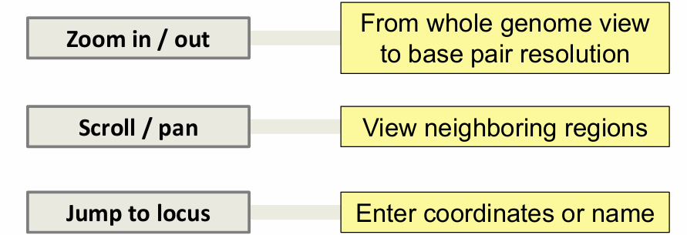
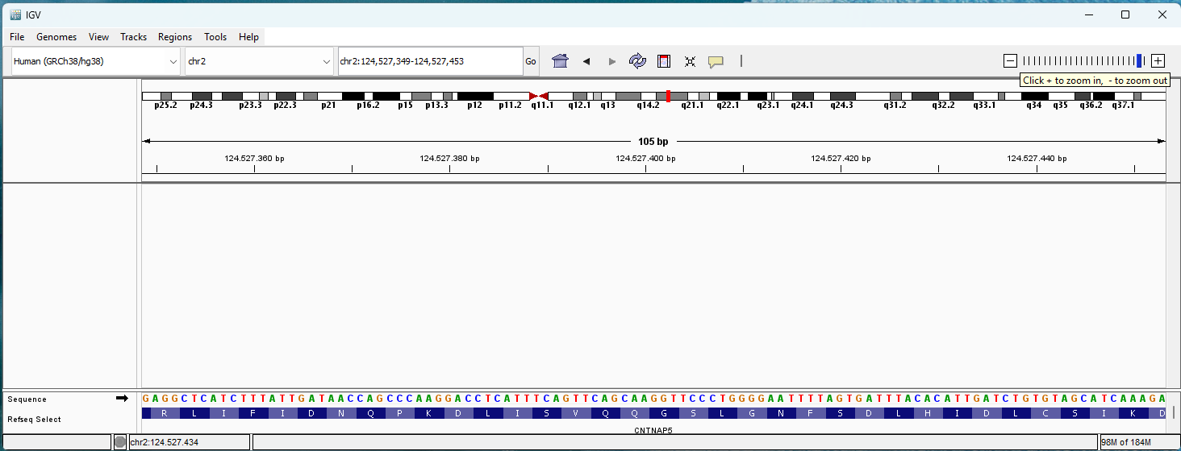
Look at the alignments using IGV
It is possible to interactively explore the sequencing data, e.g.:
• Select reference genome
• Load many different kinds of data
• Navigate the genomic regions
Base pair resolution

Slide 19
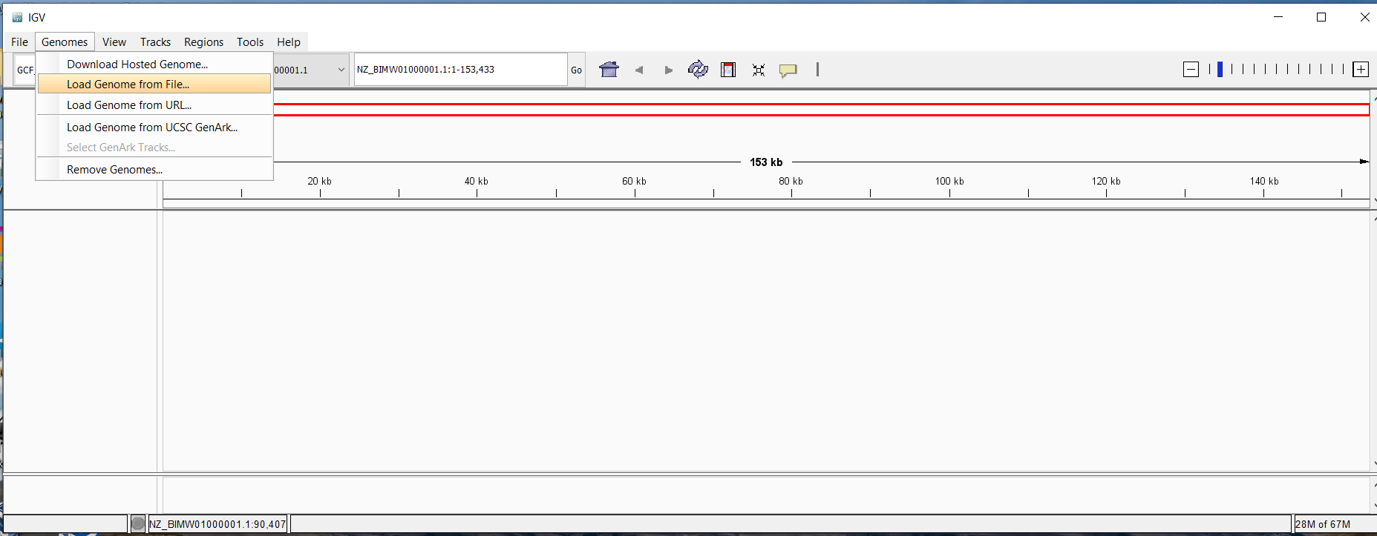
Look at the alignments using IGV
Loading the reference genome (or metagenomic assembly)

Slide 20
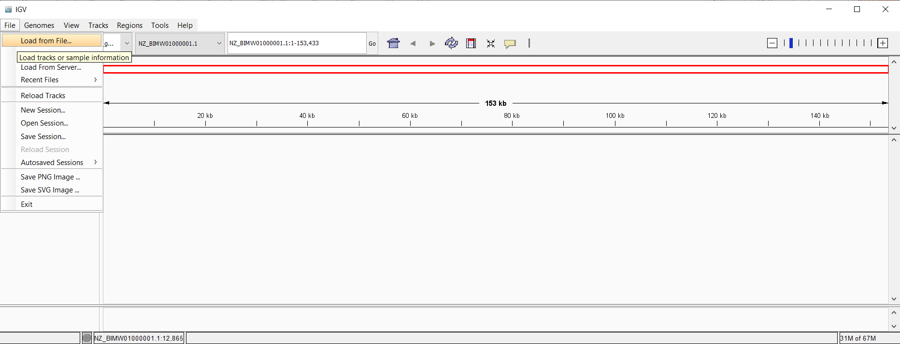
Look at the alignments using IGV
Loading the bam file(s), they should be sorted and indexed!

Slide 21
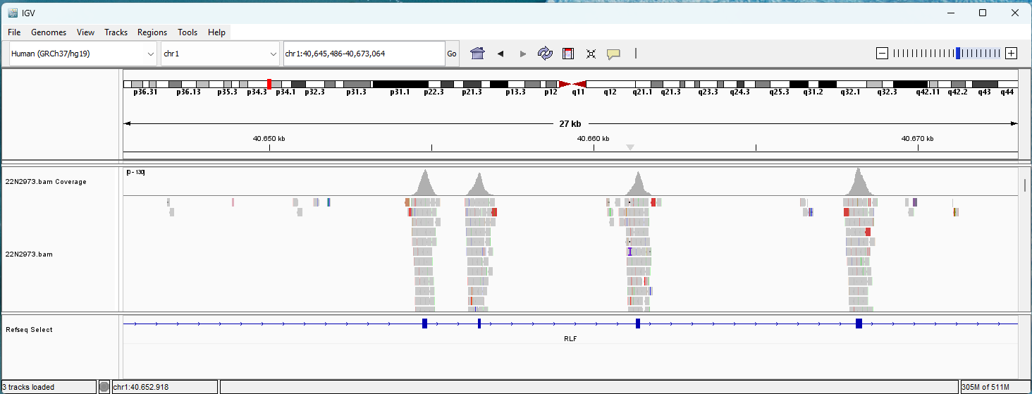
Look at the alignments using IGV

Slide 22
Binning using metabat
Binning means to group contigs on the basis of their composition and/or coverage. The software metabat can be run in its “naïve” form or with the wrapper runMetaBat.sh (included in the metagenomics conda environment).
$ runMetaBat.sh -m 1500 -s 10000 /PATH/TO/final.contigs.fa Sample1.bam Sample2.bam Sample3.bam
Take a look to the bins with assembly stats to get an idea of their size, N50 etc.
Notes:
Estimated time to go through this phase: approx. 15 minutes

Slide 23

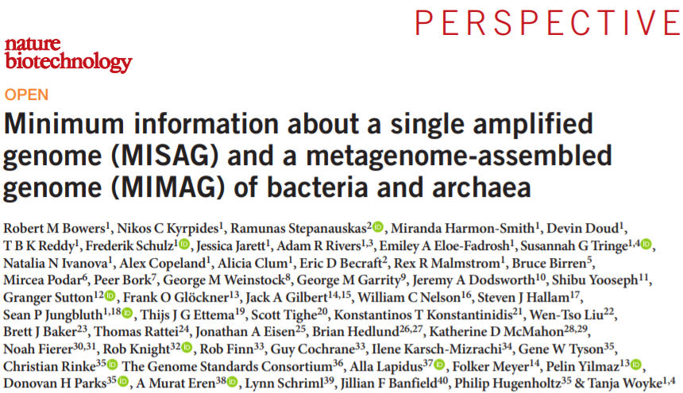
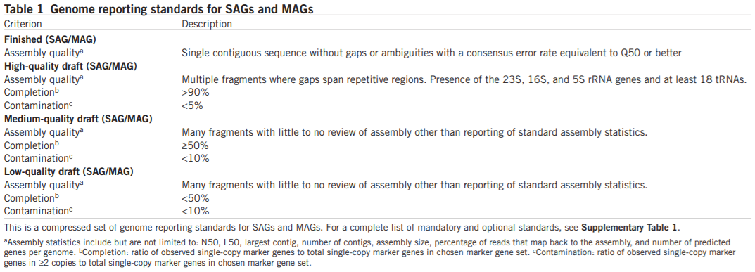
Evaluate genome completeness using checkM
Website: https://ecogenomics.github.io/CheckM/
Deposited genomes must reflect specific criteria of completion.

Slide 24
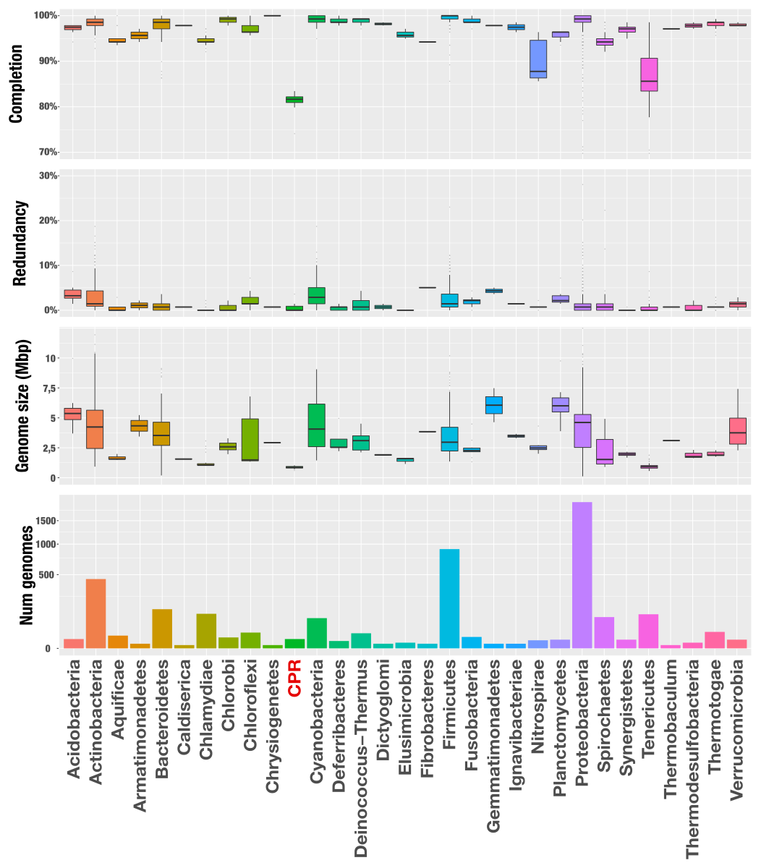
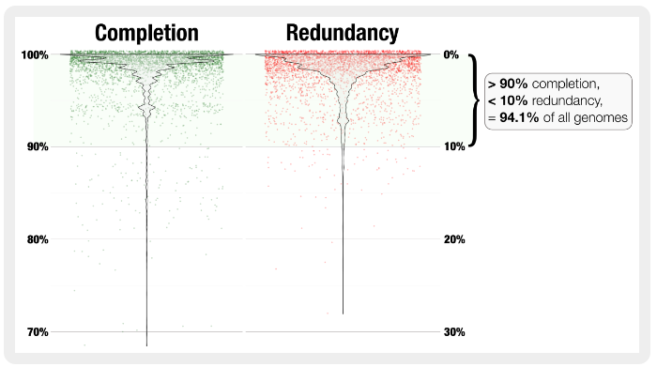
Completion and Redundancy in the public databases
Data derived from over 4000 deposited genomes (in 2016)
Source: (merenlab.org)

Slide 25
Evaluate genome completion and redundancy using checkM
CheckM2 uses machine-learning models to estimate genome completeness and contamination without relying solely on fixed lineage marker sets. However, before running the checkm2 predict command, it is important to download the diamond database.
$ checkm2 database –download
$ checkm2 predict -x fa --input bin.*.fa --output-directory checkm_out
Look at the output files for each genomic bin to identify the completion and redundancy.

