Slide 1





Introduction to Metagenomics – from samples to sequences and beyond
Dr. João Saraiva, Scientist @ Microbial Interaction Ecology group
Department of Applied Microbial Ecology
September 2025
Joao.saraiva@ufz.de
Notes:
Welcome everyone! Today we'll dive into shotgun metagenomics — what it is, how it works, and how we can analyze and visualize the data it generates.

Slide 2
Learning objectives
Define shotgun metagenomics vs. amplicon
Understand the bioinformatics pipeline.
Get familiar with key tools and methods.
Interpret taxonomic and diversity outputs.
Notes:
These are our goals. We’ll go step by step through the metagenomics workflow, focusing on shotgun sequencing, and look at practical tools and visualizations.

Slide 3
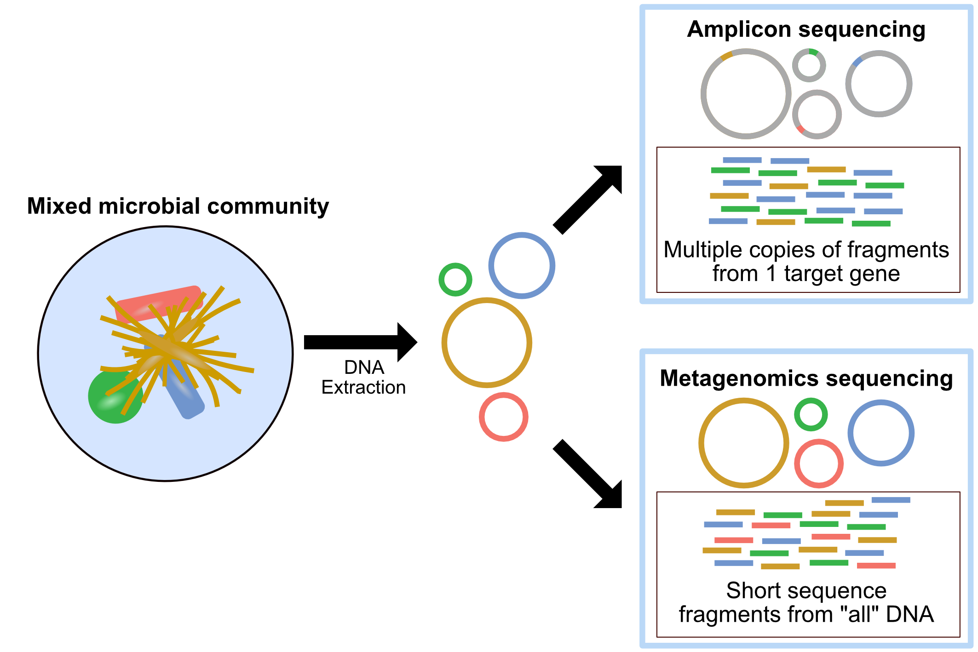
What is Metagenomics?
Study of genetic material from environmental samples.
Two approaches: Amplicon and Whole Genome Shotgun Metagenomics.
https://astrobiomike.github.io/misc/amplicon_and_metagen
Notes:
Metagenomics helps us understand microbial communities. Shotgun metagenomics is more comprehensive — we sequence everything, not just marker genes.
Shotgun Metagenomics –sequences from “all” DNA
Metabarcoding – amplicons of the 16S gene region

Slide 4



What can „Omics“ tell us?
Metatranscriptome/
Metaproteome
Flying
Driving
Bake
Eating
Sleeping
Metagenome
Pilot
Driver
Baker
Officer
Postman
Amplicon sequencing
Alejandra
Ricardo
Ben
Liliana
Jonathan
Notes:
Shotgun metagenomics lets us go beyond 'who’s there' to ask 'what are they doing?'

Slide 5
Metagenomics
Benefits
Limitations
Comprehensive analysis of ALL microbial DNA/RNA
Quantitative analysis
Novel and hard-to-culture species
Higher taxonomic resolution
Works low-volume samples
DNA purity
Complexity of the sample
Reference genomes

Slide 6
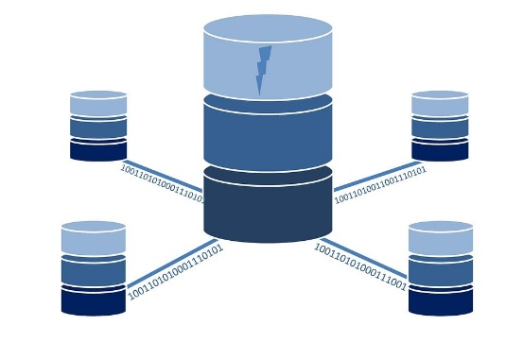
Applications
(Meta)genomics
Identification of novel metabolic pathways
Horizontal gene transfer
Community characterization / Diversity analysis
Identification of novel species
Pesticides
Gene sets
ARG
Secondary metabolites

Slide 7




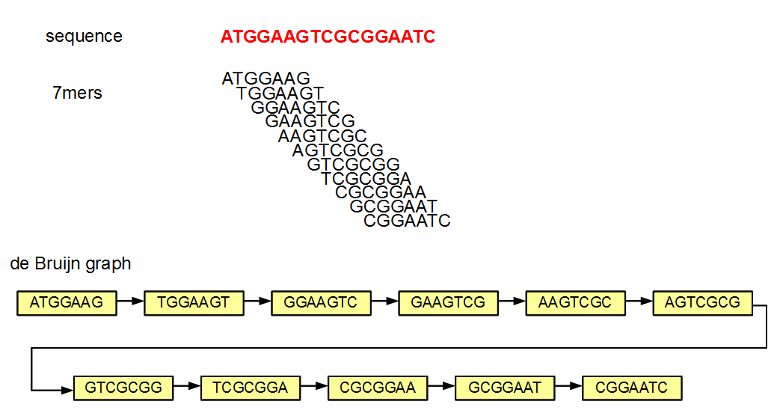



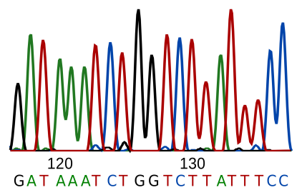
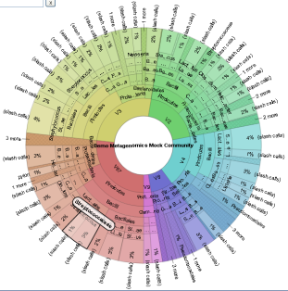
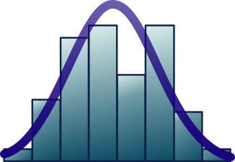
Workflow
DNA extraction
Sequencing
Fragmentation
Quality control
Annotation
Assembly/
Binning
Visualization Statistics
Syntropho-
bacter
METADATA is important for downstream analyses !
Notes:
Good data begins with good planning. Consistent sample collection and well-documented metadata are essential.

Slide 8
Wet Lab
Take care in sample handling → Contamination
DNA extraction
Sequencing
Fragmentation
Physical:
Sonication,
Hydrodynamic shearing
Enzymatic:
Transposase,
Dnase,
Restriction endonuclease
Notes:
Good data begins with good planning. Consistent sample collection and well-documented metadata are essential.

Slide 9
Sequencing
Pros
Widely available
High accuracy
Lower cost
Cons
Repetitive regions hamper gene sequencing
Mapping reads to specific regions of reference genomes might not be possible due to small size
Short reads (50 – 300 bases)
Illumina
Ion Torrent
Long reads (> 10 Kilo bases)
PacBio
Oxford Nanopore
Pros
Ability to read highly repetitive regions
Higher taxonomic resolution
High accuracy
Portability
Cons
DNA quantity
Cost
Depth: # times a specific base in the DNA is read during sequencing
The higher the depth the more confidence in the accuracy
Reduce errors and noise
Coverage: % of a genome that has been sequenced at a certain depth
at least once
The higher the coverage the more proportion of the genome
has been sequenced
Notes:
Sequencing Depth and Coverage:
Explanation of the importance of sequencing depth to capture the diversity and abundance of microbial communities
Eg depth -> nucleotide A sequenced 30 times means sequencing depth at that nucleotide position is 30x
Eg coverage -> If a genome of 3 billion bp is sequenced to an average depth of 30x, the coverage would be 30x. I.e. on average each base in the genome has been sequenced 30 times

Slide 10
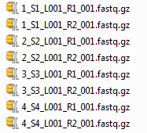
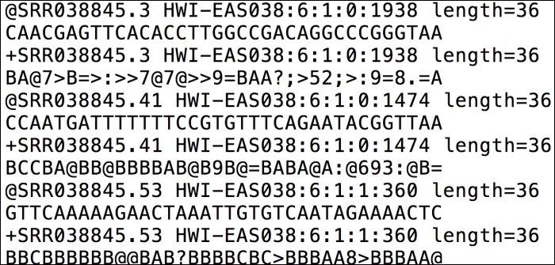
Sequencing Machine output
De-multiplexed fastq files (2 per sample)
FASTQ

Slide 11
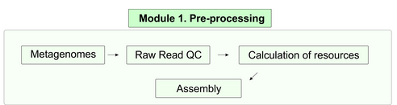
Pre-processing / library assembly
Read QC – metaWrap, FastQC, QUAST
Trimming – TrimGalore, Trimmomatic
Human contamination removal – bmtagger
Assembly – metaSpades, Megahit, Unicycler
Source: https://github.com/mdsufz/MuDoGeR
Notes:
Check raw read quality. FastQC gives a quick overview and highlights issues.
Key metrics: quality scores, GC content, duplication.

Slide 12
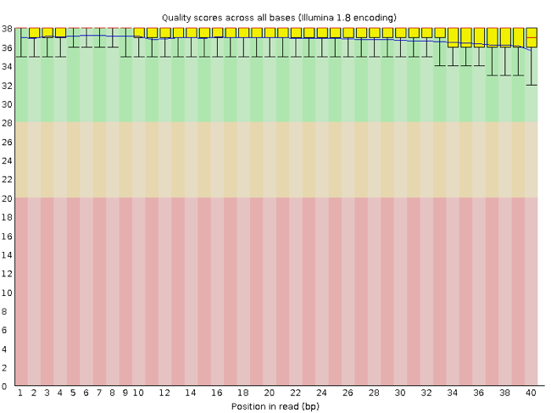
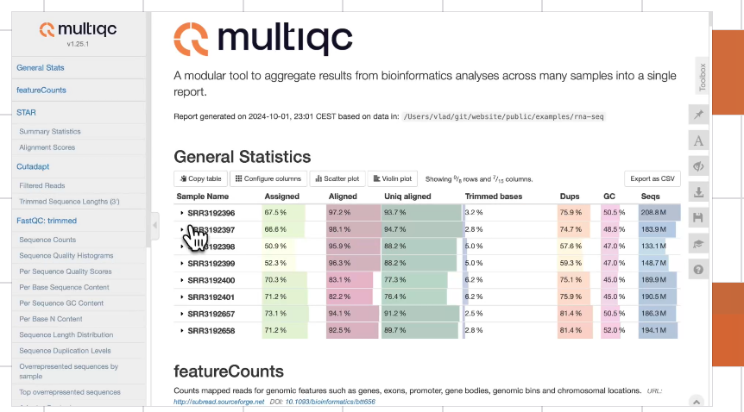
Quality control
Median QS
Read length
Notes:
Clean reads to avoid downstream errors.
FastQC looks at quality collectively across all reads within a sample.

Slide 13
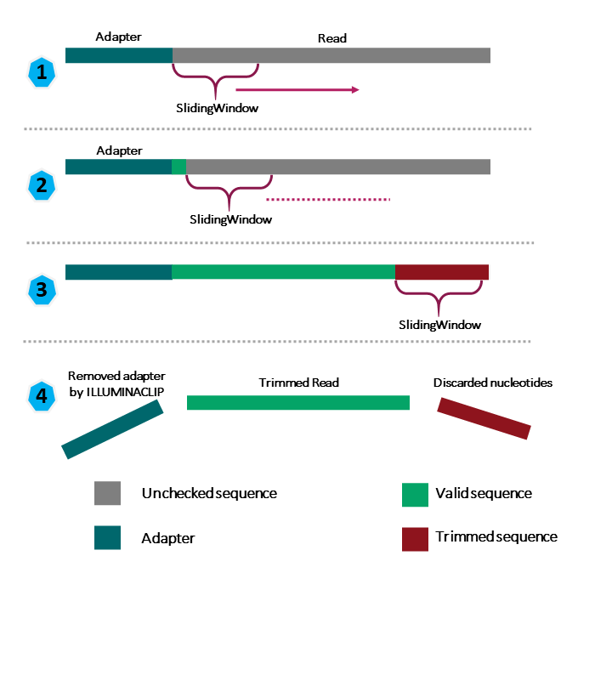
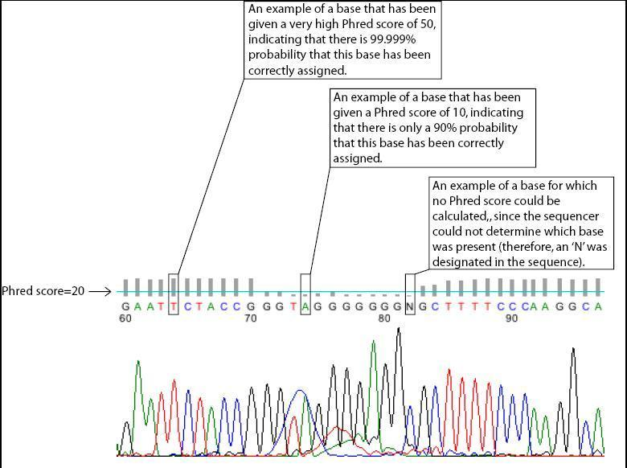
Trimming and Filtering
Phred Score is a measure of the quality of a base call in DNA sequencing
https://carpentries-lab.github.io
Notes:
Clean reads to avoid downstream errors.
Trimmomatic – removes adapters and low-quality bases or reads.

Slide 14
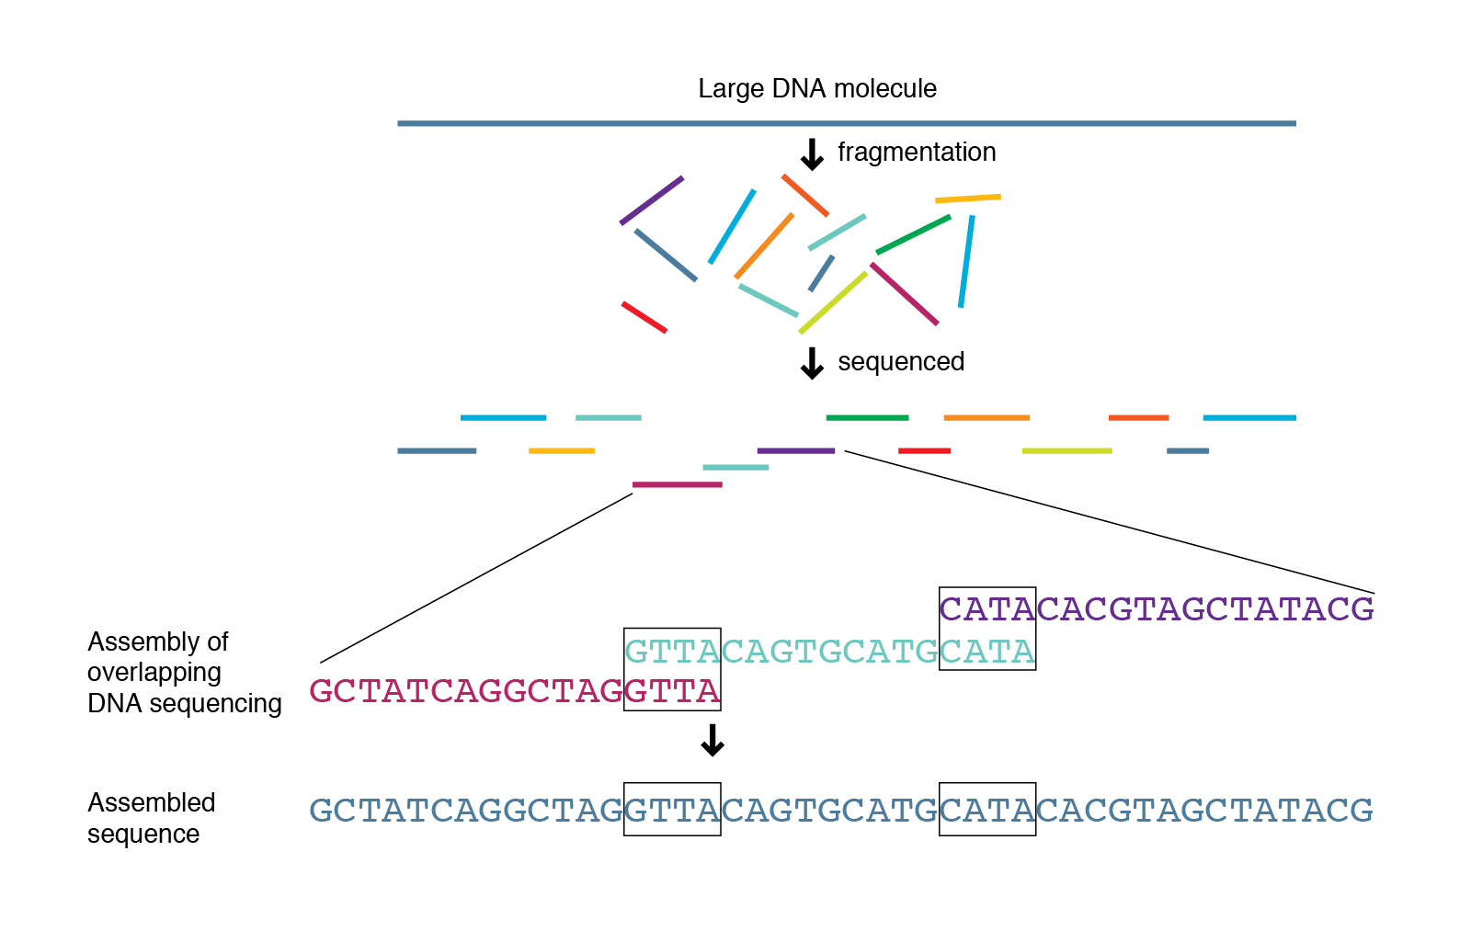
Assembly
https://avantonder.github.io
Notes:
Grouping of reads into contigs and then scaffolds to obtain sequence of whole chromosome.

Slide 15
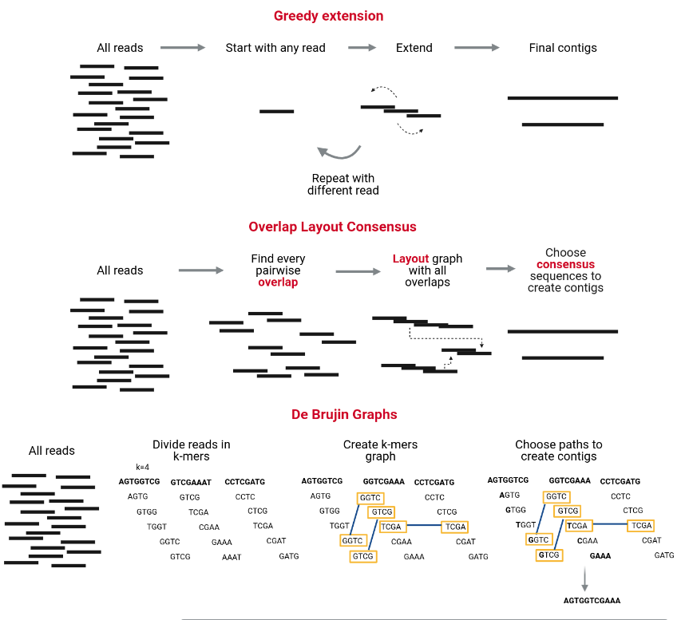

Assembly
https://carpentries-lab.github.io/metagenomics-analysis/fig/03-04-01.png
Notes:
Grouping of reads into contigs and then scaffolds to obtain sequence of whole chromosome.
MEGAHIT, MetaSPAdes.
Challenges:
Differences in coverage between the genomes due to the differences in abundance in the sample.
The fact that different species often share conserved regions.
The presence of several strains of a single species in the community.
MetaQUAST evaluates and compares metagenome assemblies based on alignments to close references.

Slide 16
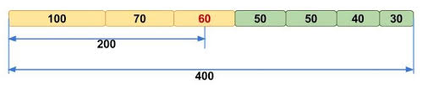
N50 value
The N50 value in genome assembly is the length of the shortest contig or scaffold at which 50% of the total assembly length is contained in contigs or scaffolds of that size or longer.
N50 length is calculated by:
1. sorting the contigs by length from longest to shortest;
2. starting from the longest contig, sum the lengths of each contig
3. when this running sum equals one-half of the total length of all contigs in the assembly…
The length of the shortest contig in this list is the N50.
High N50 values = contiguous and complete genome

Slide 17
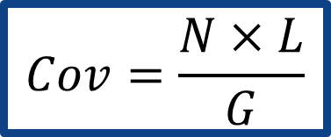
Depth of coverage
COVERAGE (a.k.a. read depth or depth): the average number of reads representing a given nucleotide in the reconstructed sequence
Genome
Coverage 5 3 2 0 1 4
G: Length of the genome
N: Number of reads
L: Average read length
$$Cov=\frac{N×L}{G}$$
Contigs with similar coverage profiles = same organism.

Slide 18
Mapping raw reads to contigs
Quality assessment of the assembly:
Assess how well the assembly represents the original data by checking the percentage of reads that align.
Identify regions that could indicate assembly errors.
Quantifying coverage:
Compute coverage per contig (how well-covered each contig is by the original reads).
Estimate relative abundance of organisms in the metagenomic sample, as contigs with higher coverage may represent more abundant organisms.
Downstream analysis:
Identify variants (e.g., SNPs) in the mapped reads

Slide 19
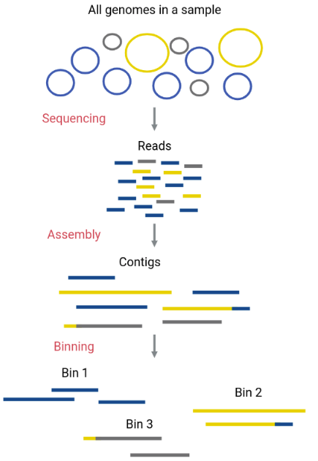

Binning
Possible:
Taxonomy
Advisable:
GC Content
Tetranucleotide freq.
Coverage
Completeness
Contamination
https://carpentries-lab.github.io/metagenomics-analysis/fig/03-05-01.png
Notes:
Grouping of reads into contigs and then scaffolds to obtain sequence of whole chromosome.
Maxbin, Metabat2, CONCOCT - Metawrap
GC content and genome size are like fingerprints of taxa.
Coverage - reads that originate from the same genome are expected to have similar coverage
GC content - genomes have distinct sequence composition patterns
CheckM – quality of bins
Factors that influence quality:
Genome size
Abundance
Sequencing depth

Slide 20
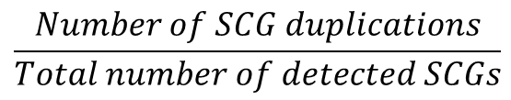
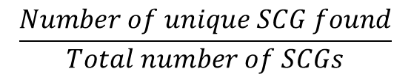
Bin QC
Marker Gene list
Bins
Contamination
Completeness
Infer lineage > list of SCG
Scan contigs against SCG
$$\frac{Number of unique SCG found}{Total number of SCGs}$$
$$\frac{Number of SCG duplications}{Total number of detected SCGs}$$

Slide 21
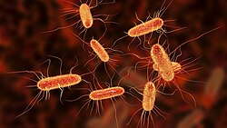
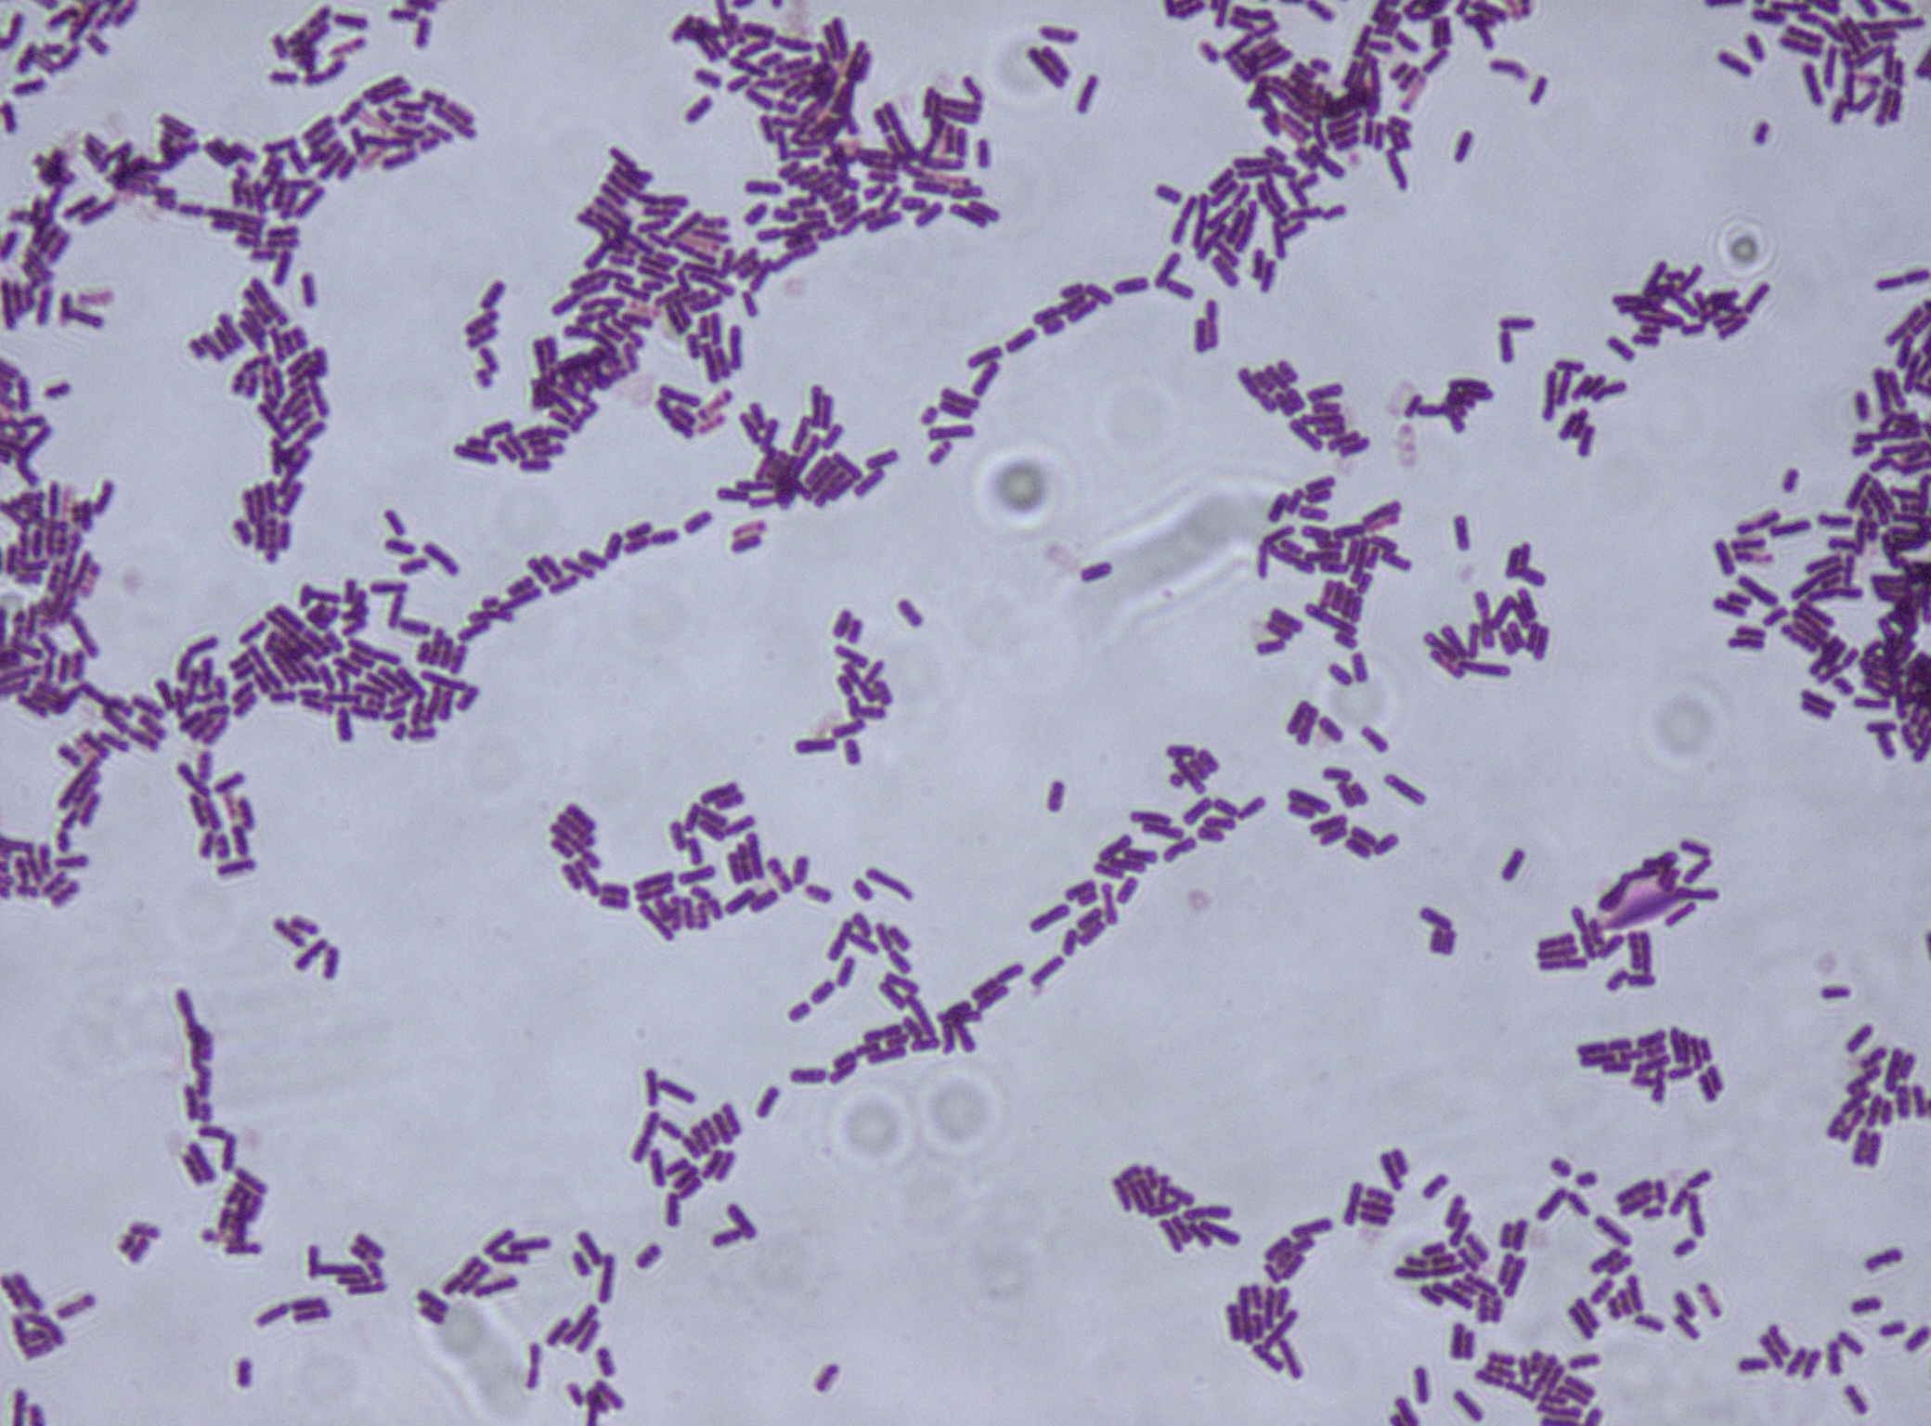
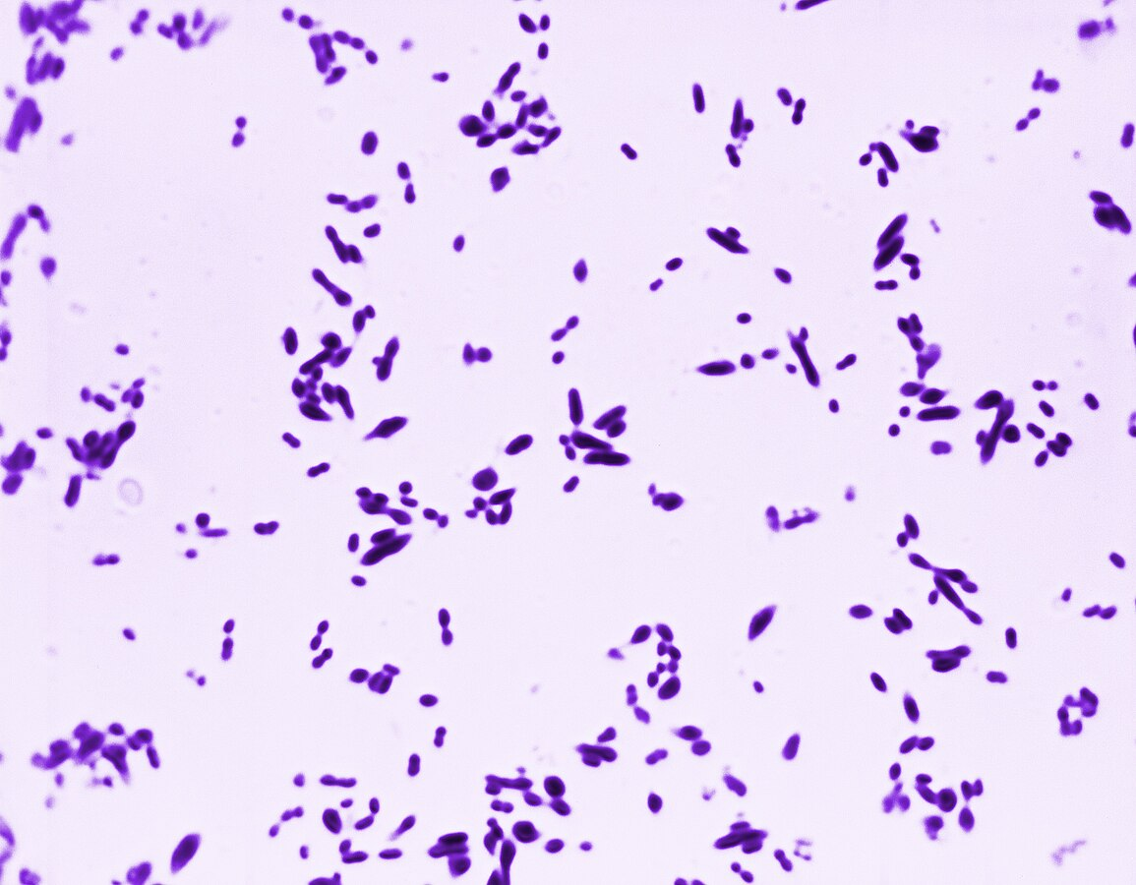
Taxonomic Assignment
https://commons.wikimedia.org/wiki
Notes:
Taxonomic classification links sequences to organisms.

Slide 22
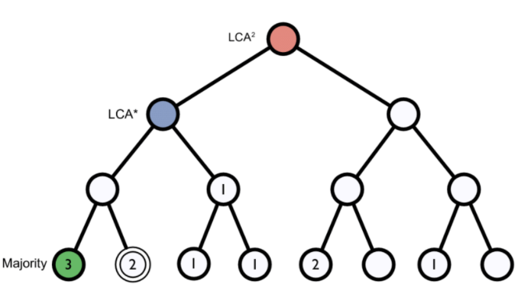
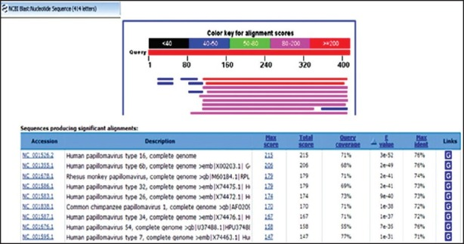
Taxonomic Assignment
K-mer
BLAST
https://blast.ncbi.nlm.nih.gov/
https://carpentries-lab.github.io/
Notes:
A genome database is broken into pieces of length k to be able to search for unique pieces by taxonomic group, from a lowest common ancestor (LCA), passing through phylum to species. Next, we break the query sequence (reads/contigs) into pieces of length k and look where these are placed within the tree.

Slide 23
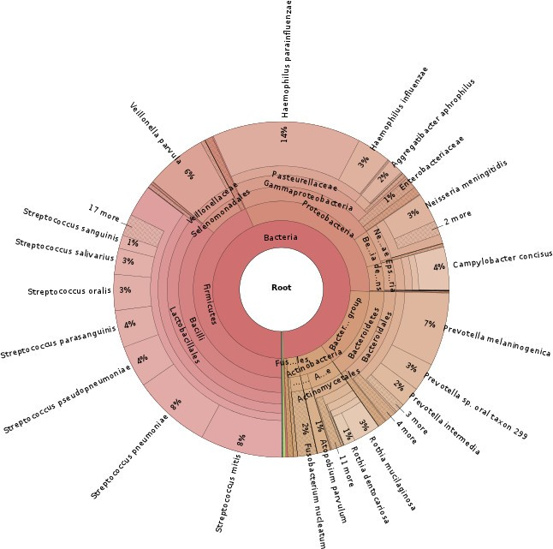
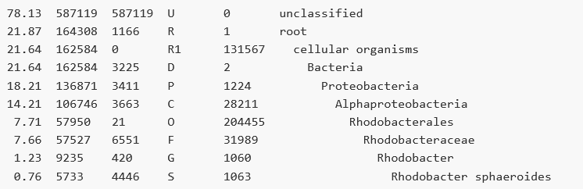
Taxonomic Assignment
Kraken2
Wood DE and Slazberg SL, 2014
Notes:
A genome database is broken into pieces of length k to be able to search for unique pieces by taxonomic group, from a lowest common ancestor (LCA), passing through phylum to species. Next, we break the query sequence (reads/contigs) into pieces of length k and look where these are placed within the tree.

Slide 24
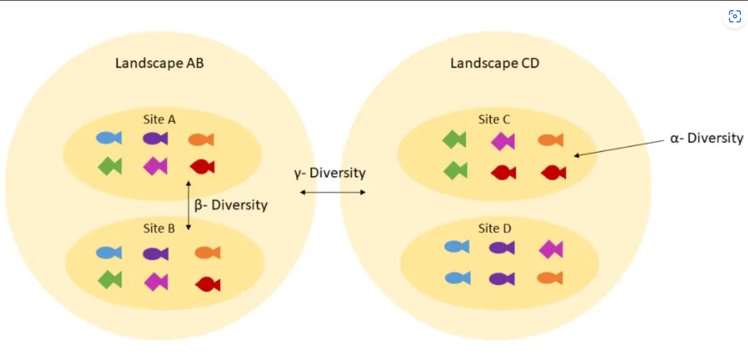
Downstream Analyses
https://training.galaxyproject.org
α - Species diversity (richness and/or evenness) within a particular area, community, or ecosystem.
β - The change in species composition between two or more habitats or communities; it reflects species turnover.
γ - Total species diversity across all ecosystems or samples in a landscape.
Notes:
(alpha)
Species richness: Number of species in a sample.
Shannon index: Accounts for both abundance and evenness of species.
Simpson's index: Emphasizes the dominance or evenness of species.
(beta)
Jaccard index: Based on presence/absence.
Bray–Curtis dissimilarity: Based on abundance data.
UniFrac (weighted/unweighted): Phylogenetic distance used in microbiome studies.
(gamma)
Pooling all samples together and calculating richness.
Summing/averaging alpha diversity and incorporating beta diversity.

Slide 25
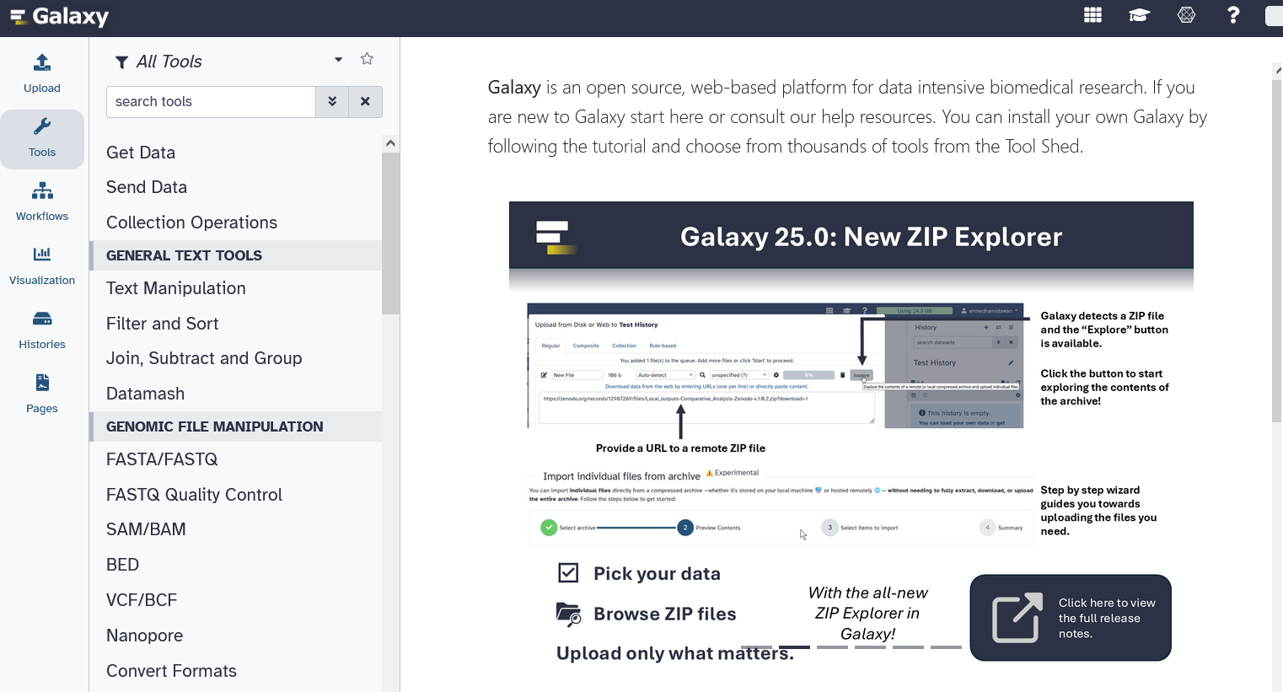
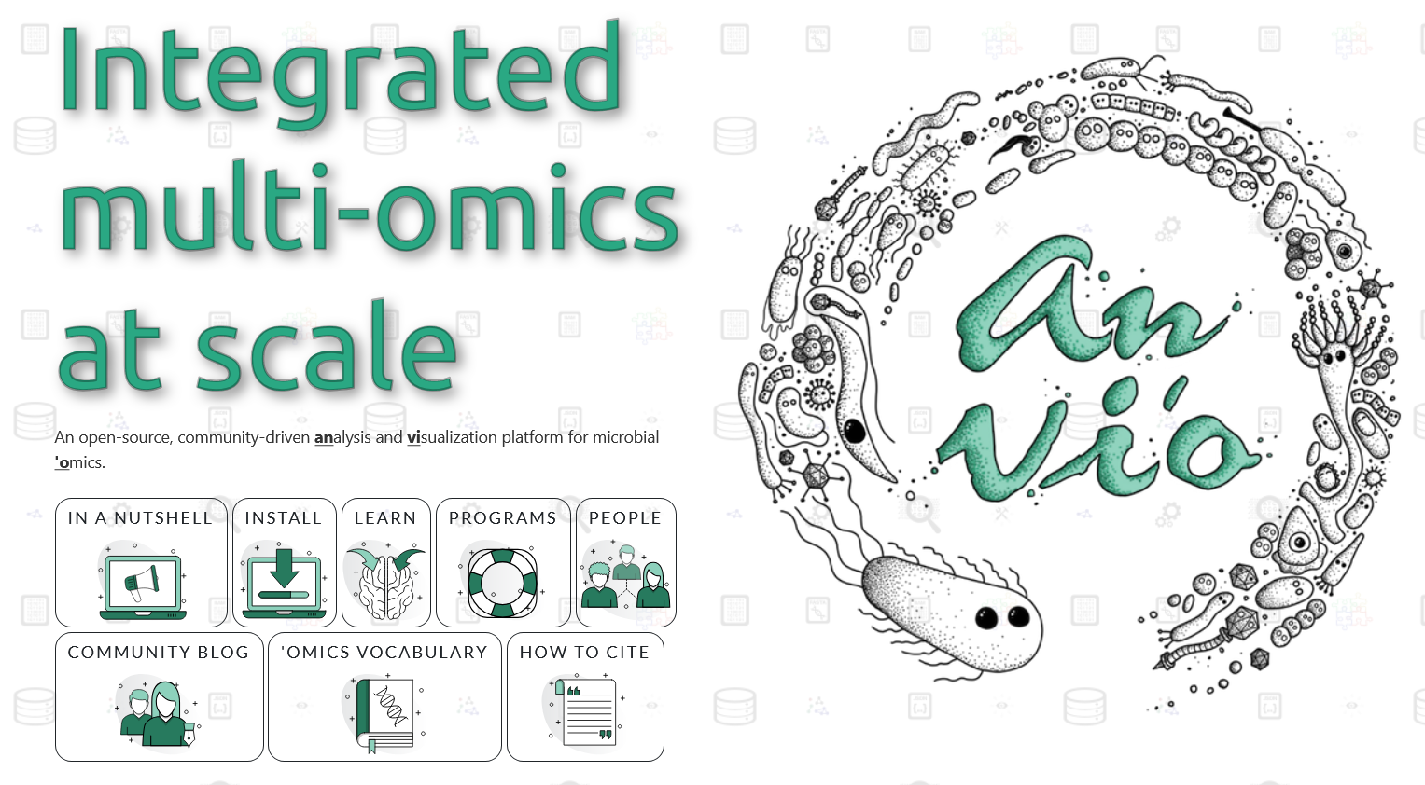
Web/Local platforms
Lack of computational resources
Limited computational skills
No need to install tools and supporting databases
https://usegalaxy.eu/
https://anvio.org/

Slide 26
Q&A?
Notes:
Thanks for participating! Explore the Carpentries Lab curriculum for hands-on practice.

