Slide 1
CST 499 Final Presentation
Brandon Gwaltney
University of Arizona Global Campus
CST 499: Capstone for Computer Software Technology
Instructor: Dr. Amjad Alkilani
April 17, 2021

Slide 2
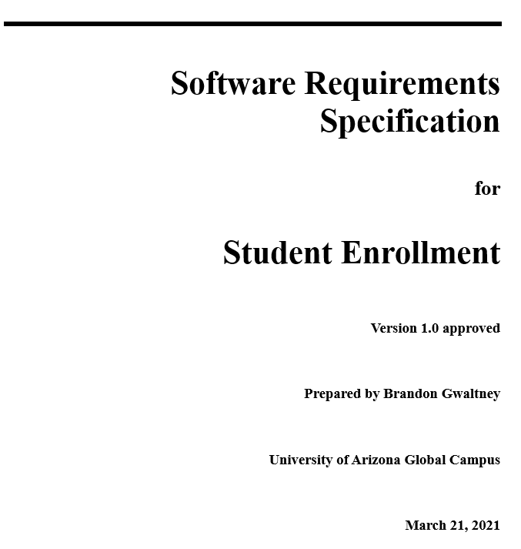
SRS Document
The SRS document is an important document used during system development. This document is important because it captures the high-level requirements of a software system. This includes both functional and non-functional; requirements and with be used a downstream artifact in creating other elements from the software design process, like UML diagrams. Because of this important nature of the information captured in the document must be a complete, concise, and quality depiction of all the software's behaviors (Kirner & Abib, 1997).

Slide 3
Core Requirements
New User Registration and Login
Adding Courses to the Enrollment list
Students' enrollments and cancellations
Systems features 1 and 2 in the SRS document created for this project.
Outputted 8 requirements for the project.
Included the ability to register a new user, validation of data, enforcement of a unique email, login ability, protected routes, and logout functionality.
System feature 3 in the SRS document created for this project.
Outputted 2 requirements for the project.
Included the ability to add a new course to the systems database, ensuring that the course contains the proper information, and adds the ability for students to waitlist courses.
Systems features 4 and 5 in the SRS document created for this project.
Outputted 6 requirements for the project.
Included the ability for a student to register or waitlist a course, alerts, view and cancel enrollments/waitlists, and when an enrollment is cancelled the first waitlisted student gets enrolled.

Slide 4


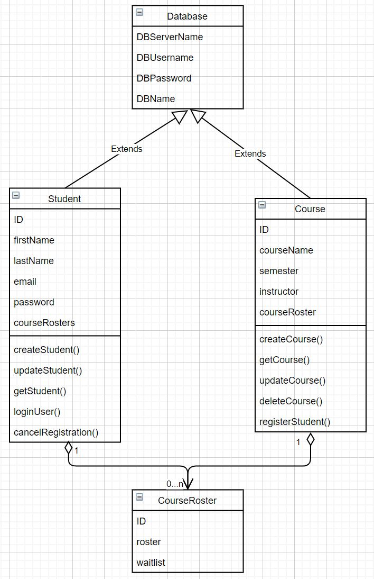
UML Design
Class Diagram
Four UML design diagrams were created for this project:
Class Diagram
Activity Diagram
Sequence Diagram
Use Case Diagram
Each of these diagrams depicts importanct information about the system, such as the class structure, how certain user actions will be sequenced, and how the system will interact with Users and external systems (Tsui et al., 2018).

Slide 5
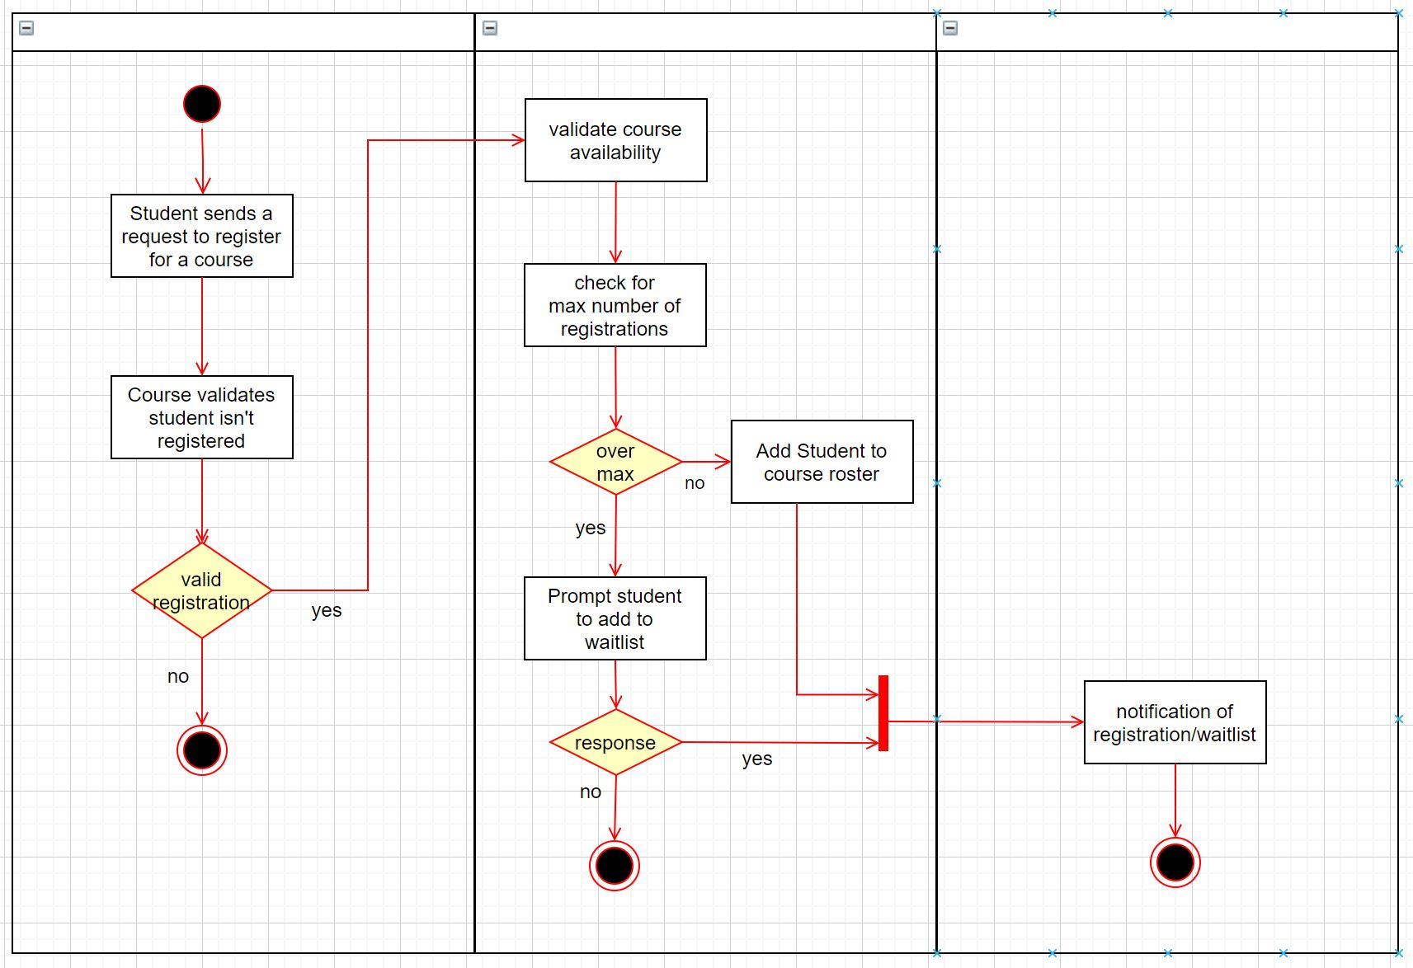
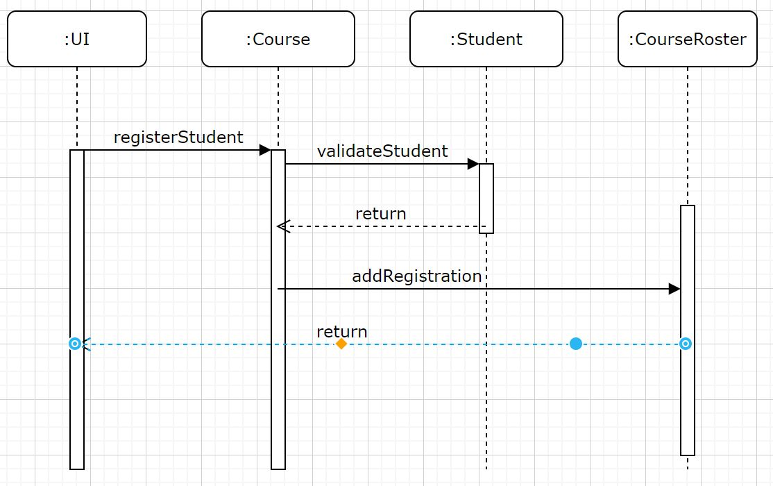
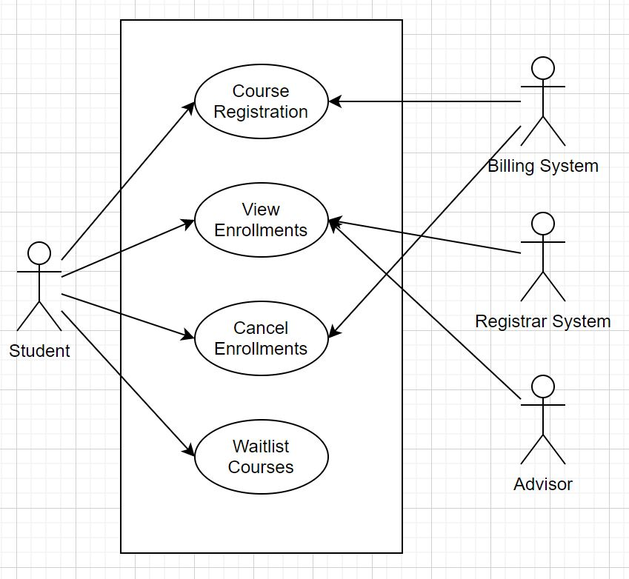
Additional UML Diagrams
Activity Diagram
Sequence Diagram
Use case diagram

Slide 6
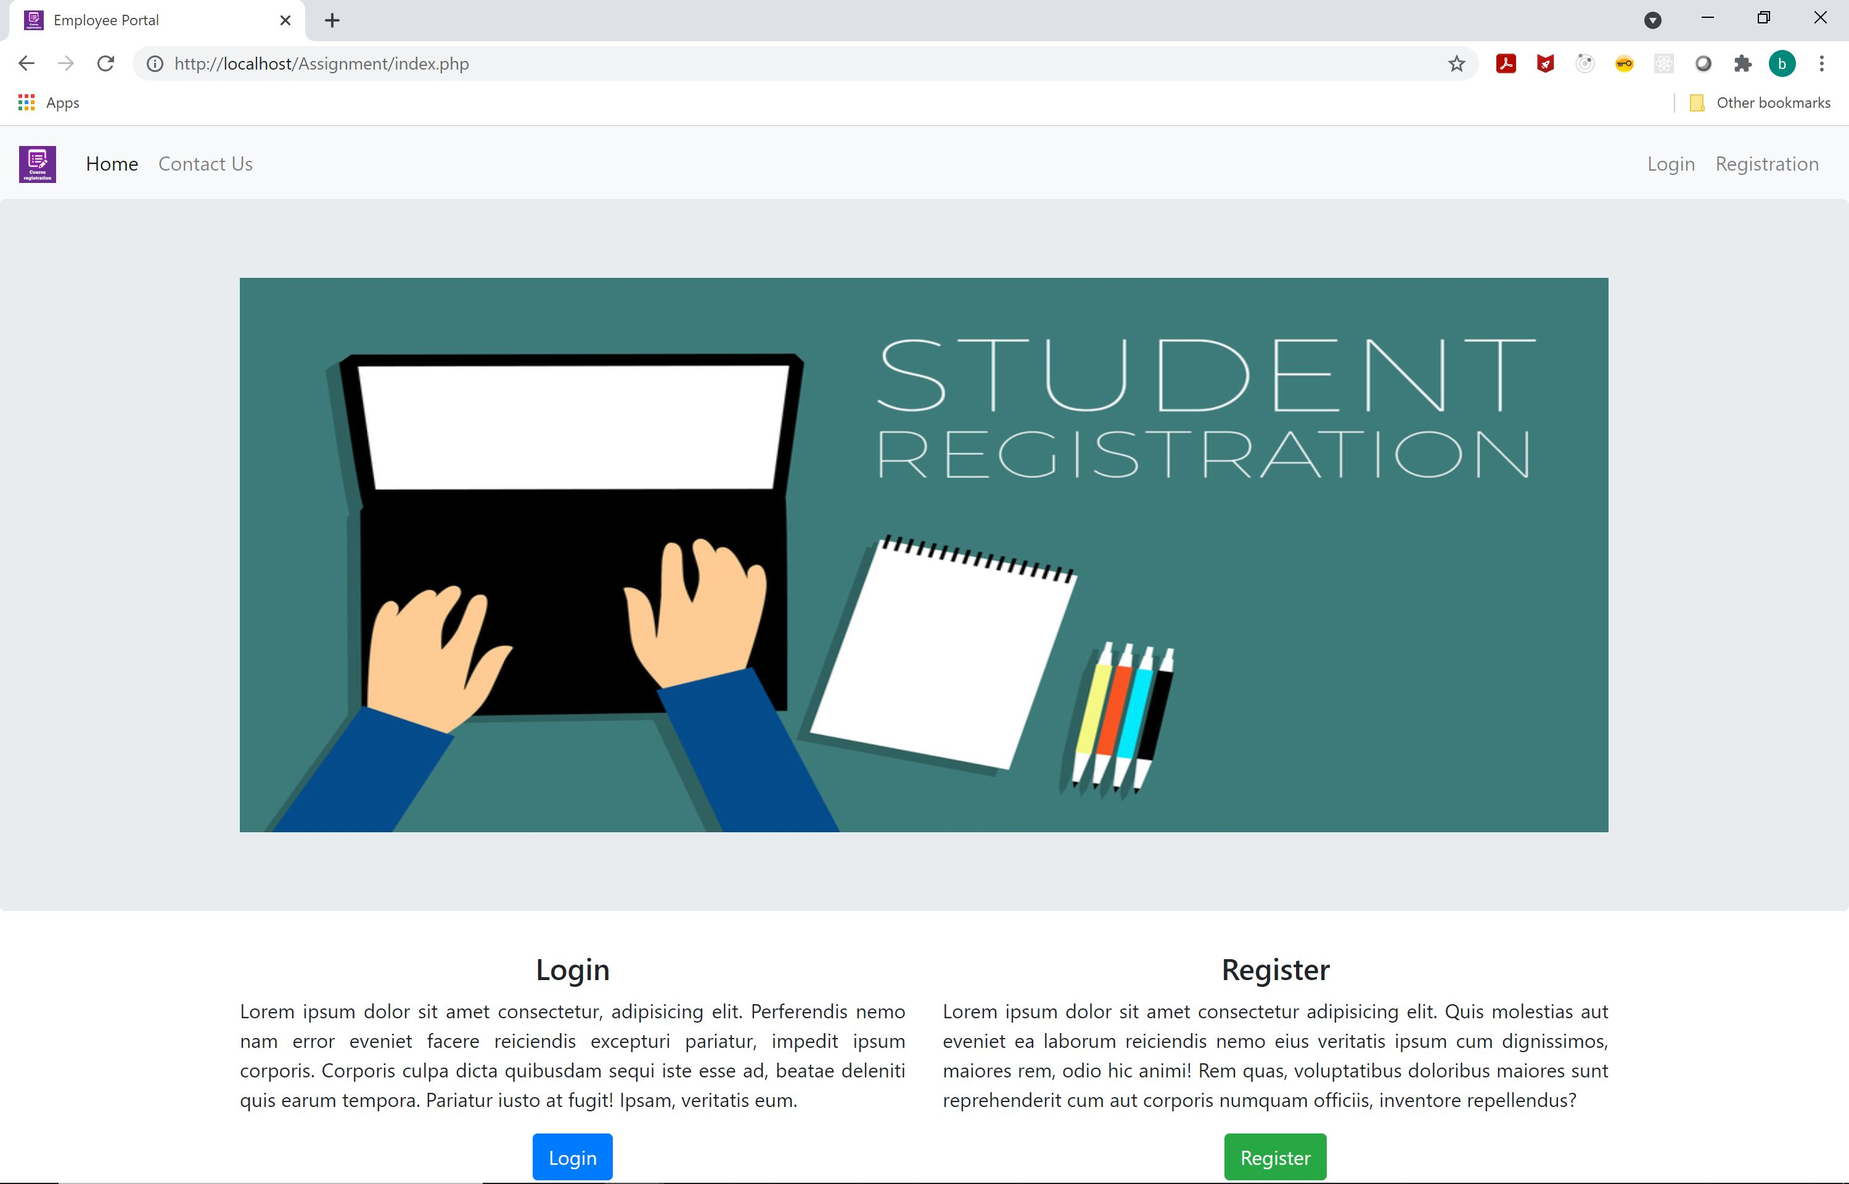
Landing page
The Landing, Login, and Enrollment/Registration pages were the first three pages created.
These pages are the only public pages in the system
For the landing page a simple design was used with clear direction about where to navigate.
The login and registration pages need clear forms with easy-to-follow instructions. There was also a focus on alerts and messaging with these pages.

Slide 7
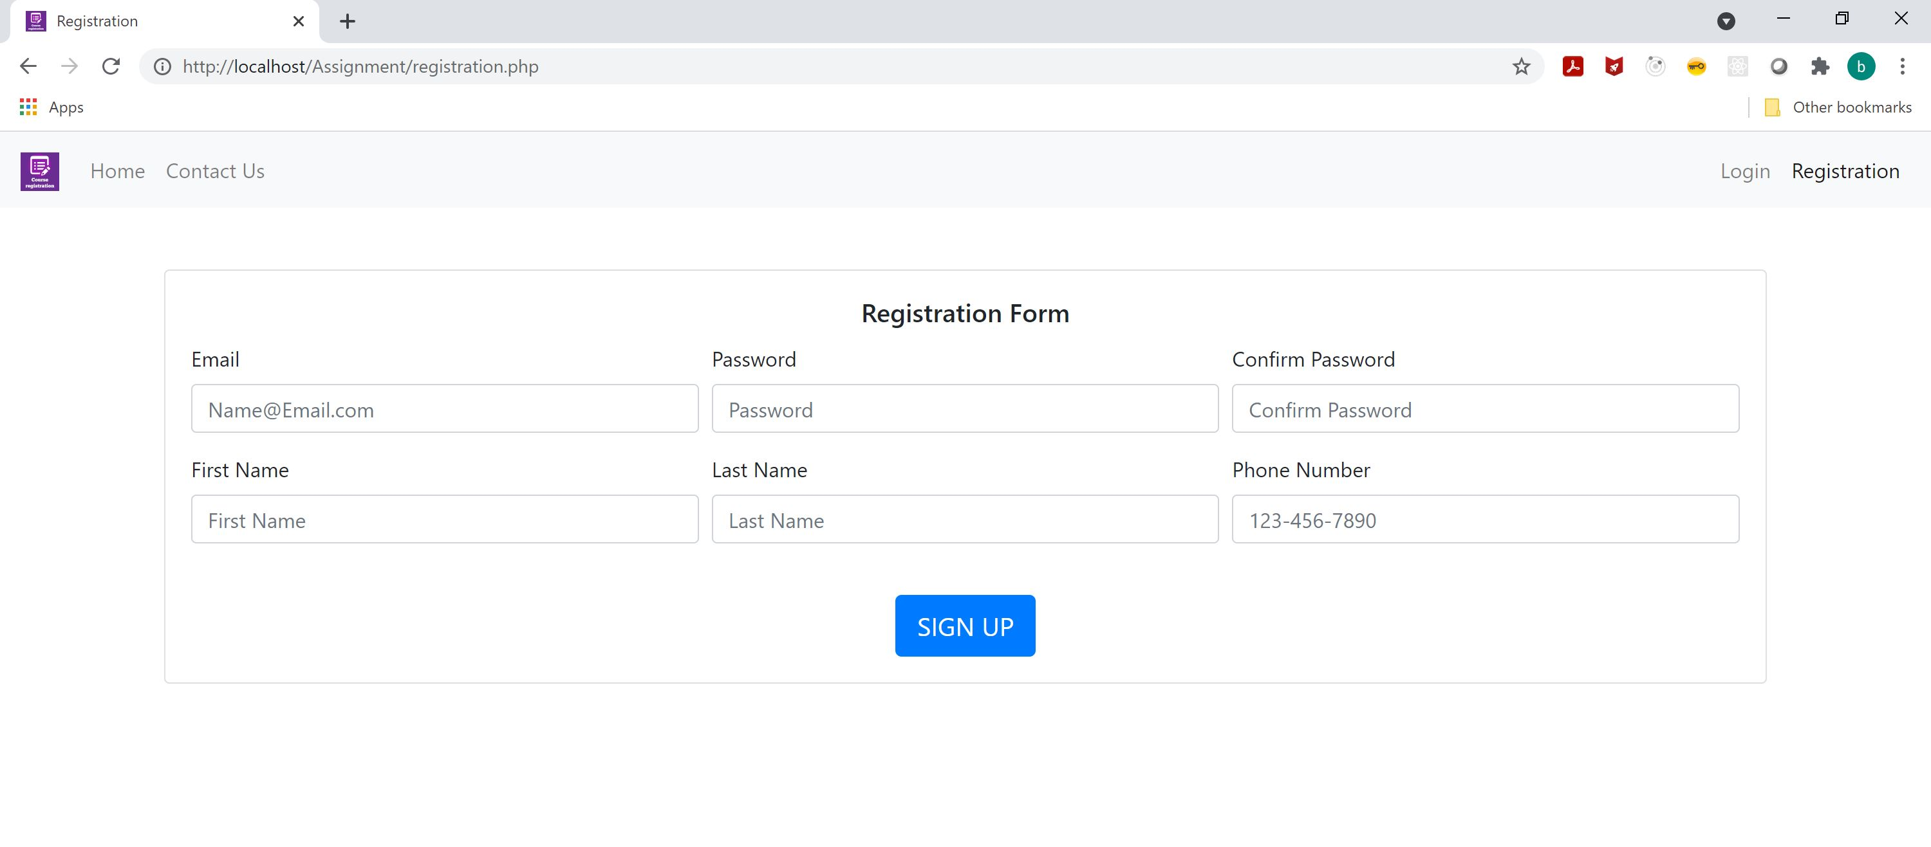
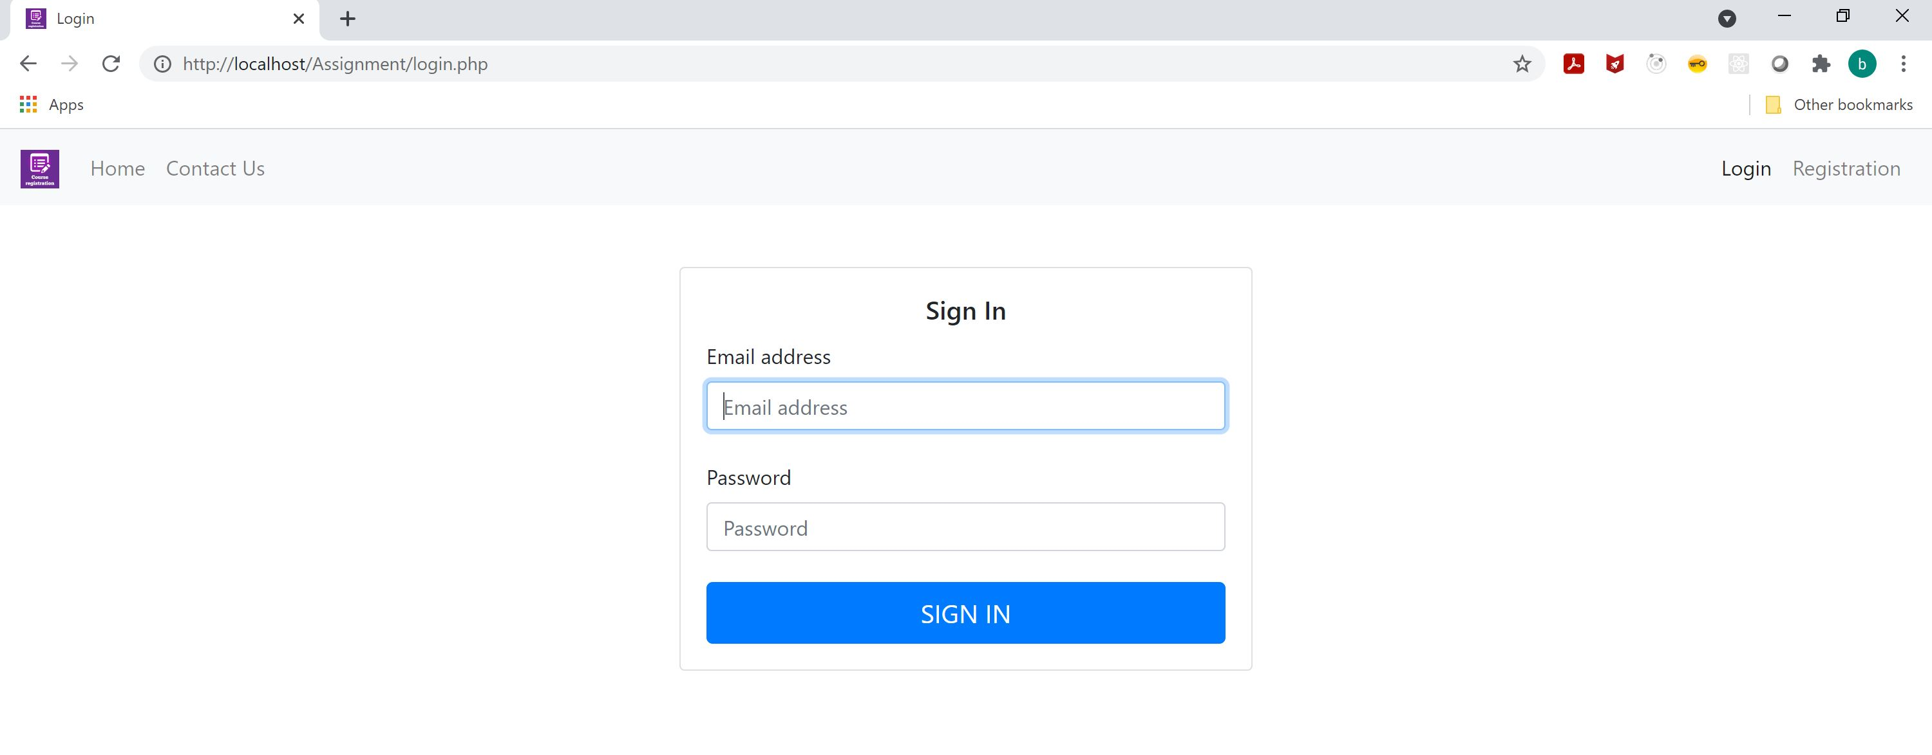
Login and Enrollment
The form fields have sample text to show examples of the format and information that should be in each field.
Once the form is completed an error or success message will show on the screen.
The error messages will contain information about the user has done wrong, like not all fields having data or duplicate emails.

Slide 8
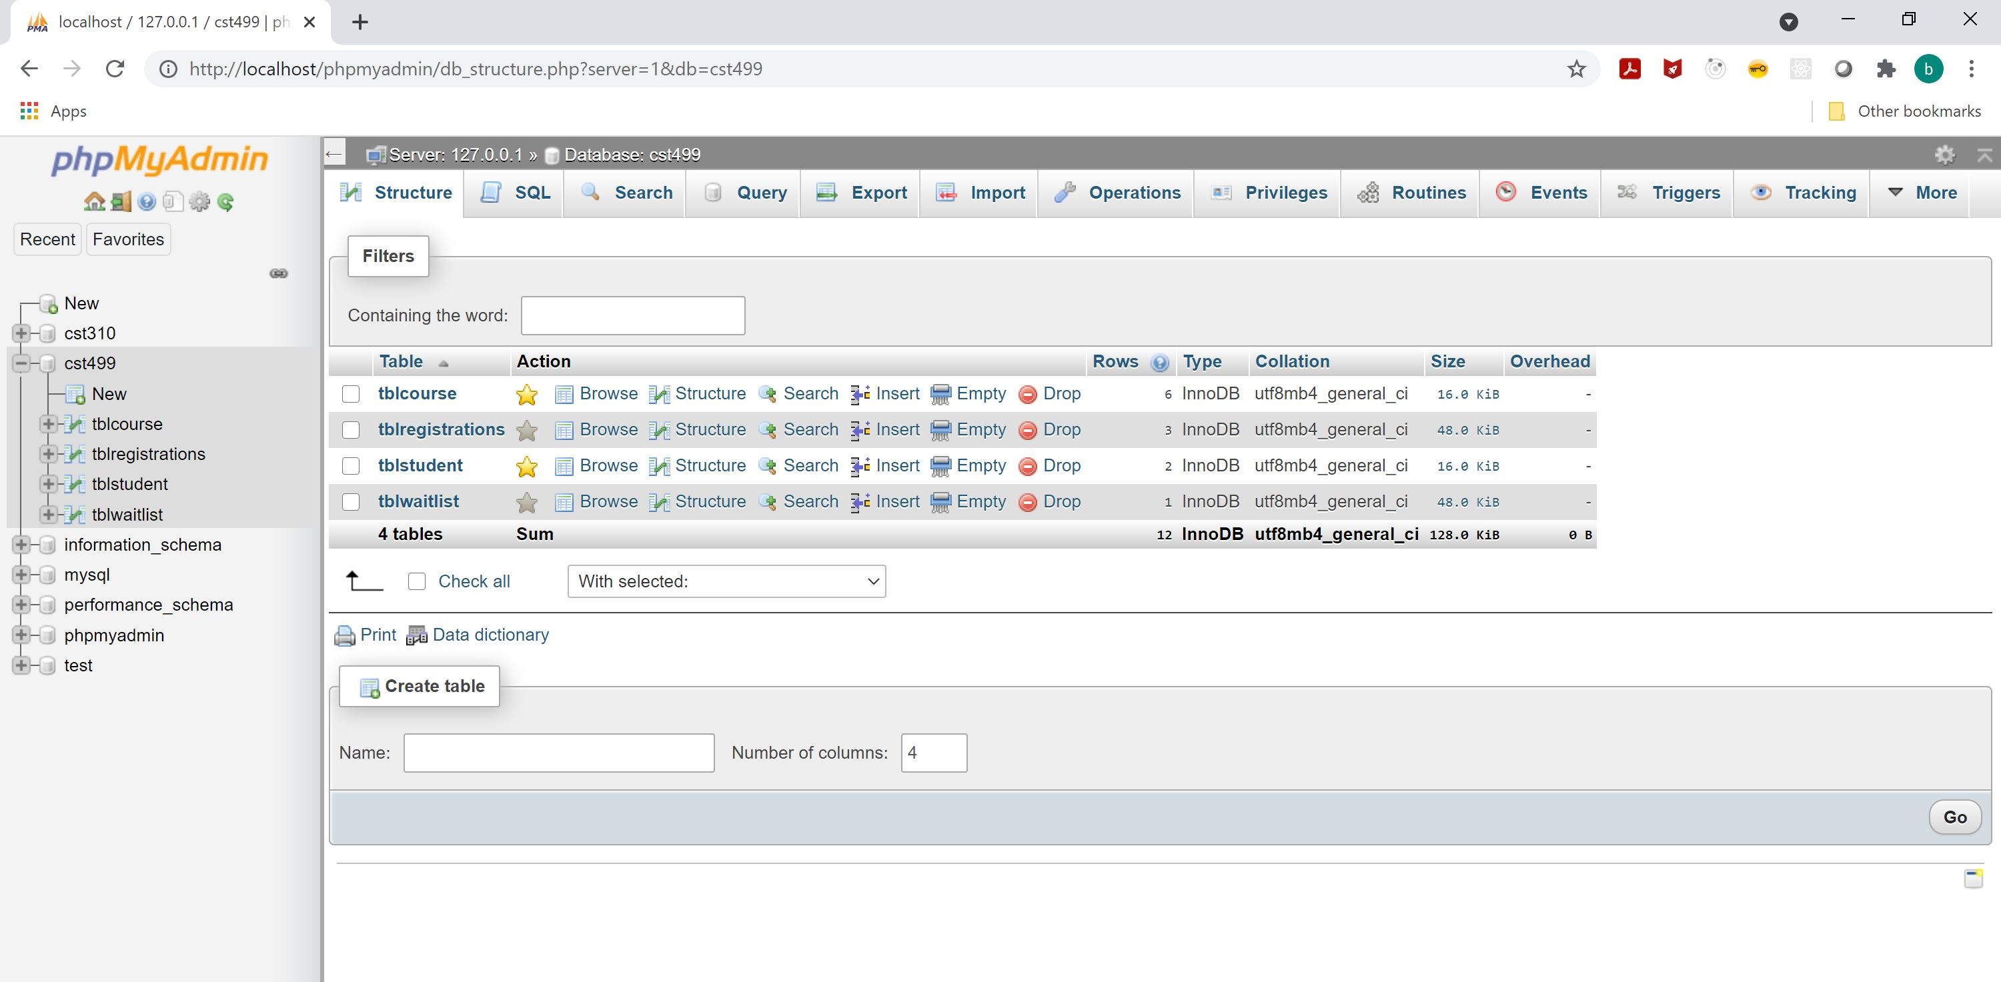
Mysql database
The database contains for tables that are used to facilitate all the functionality.
The course and student tables are where the information about the courses and students are stored.
The registration and waitlist tables are the bridging tables used to support the many to many relationship between students and courses.

Slide 9
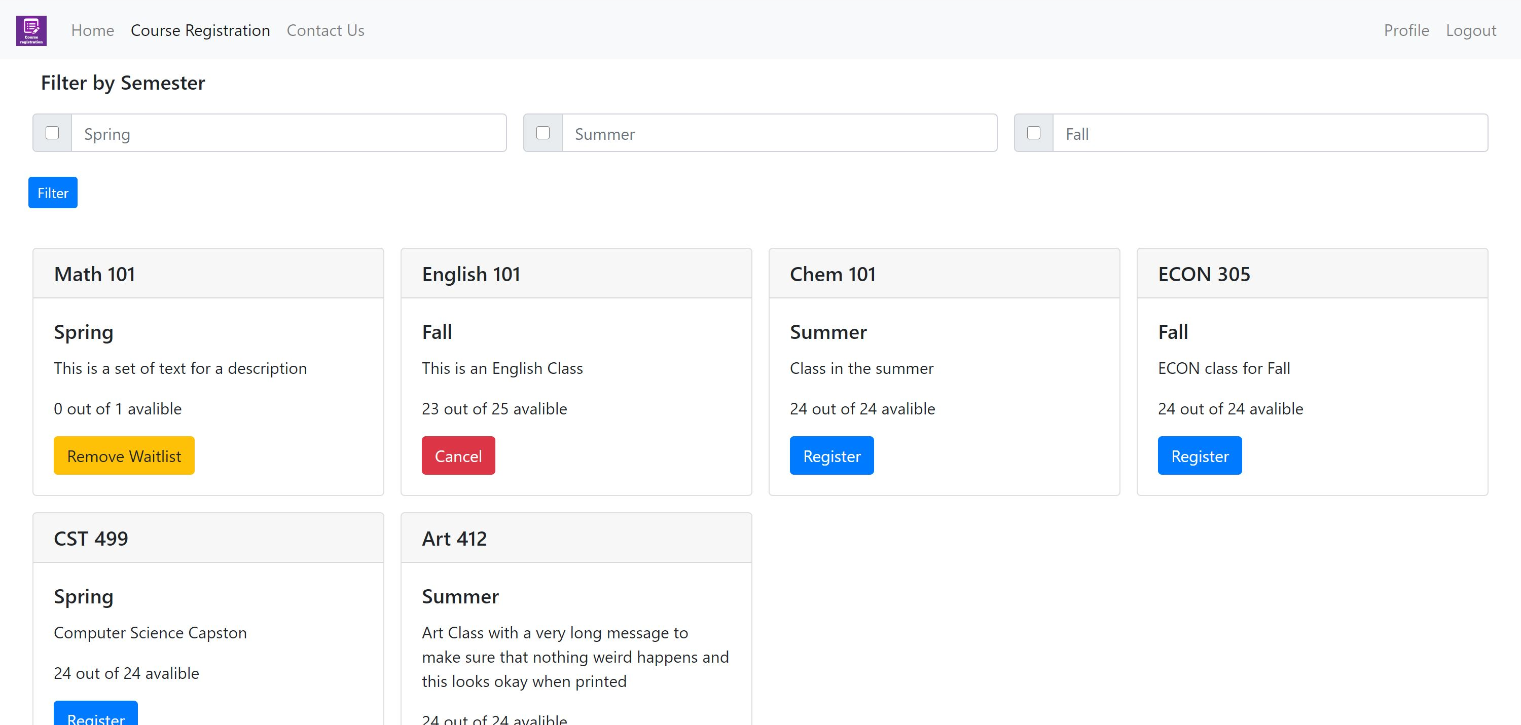
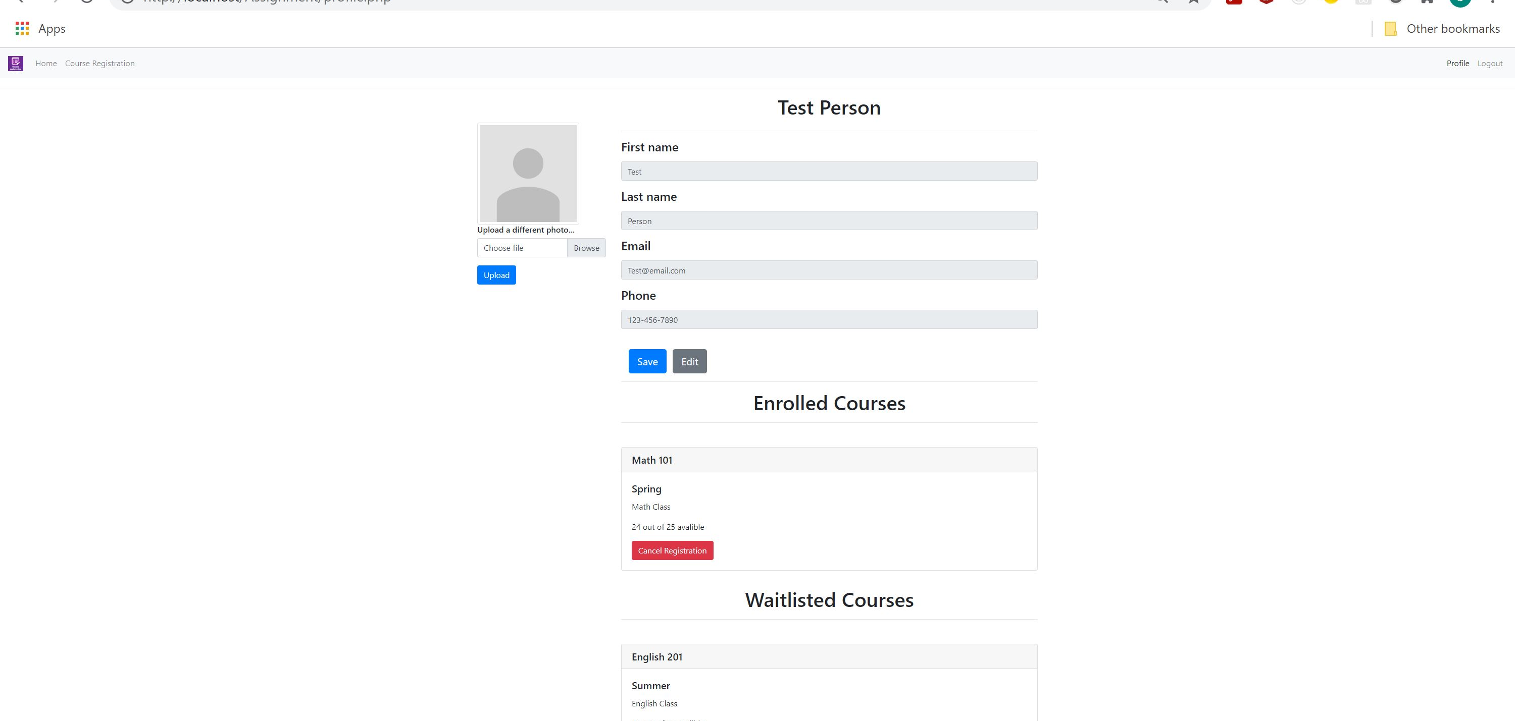
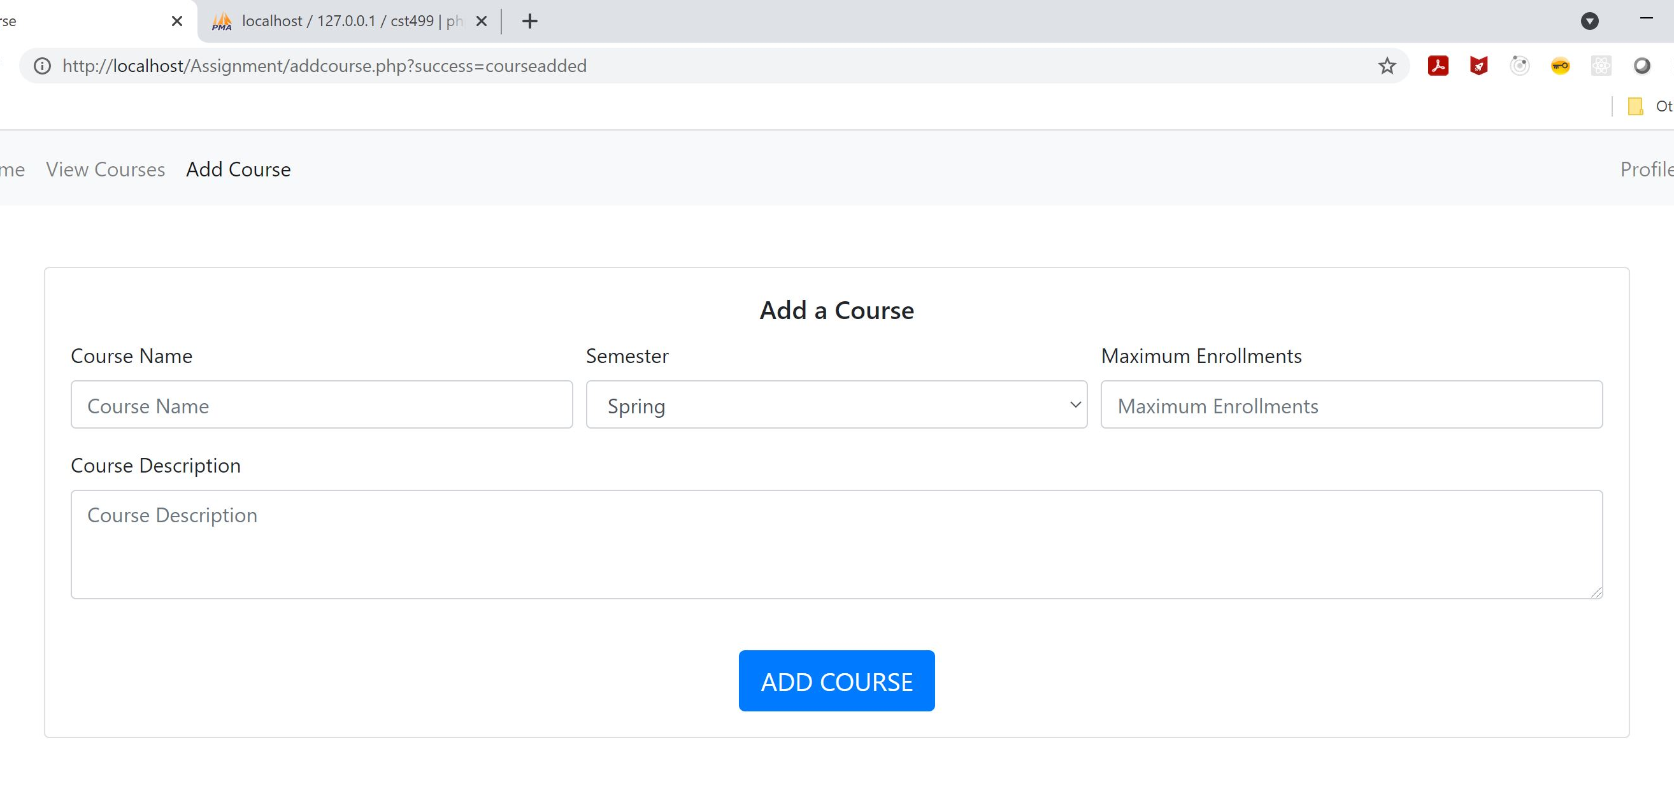
Course Registration, Profile, and add a course
Course Registration
Profile
Add a course
Used by students to enroll, waitlist, and remove enrolments and waitlist
Students can view and edit information about their account and view course they are enrolled or waitlisted for.
This is for the administrator account to be able to add courses to the system. This page is only accessible by the administrator account.

Slide 10
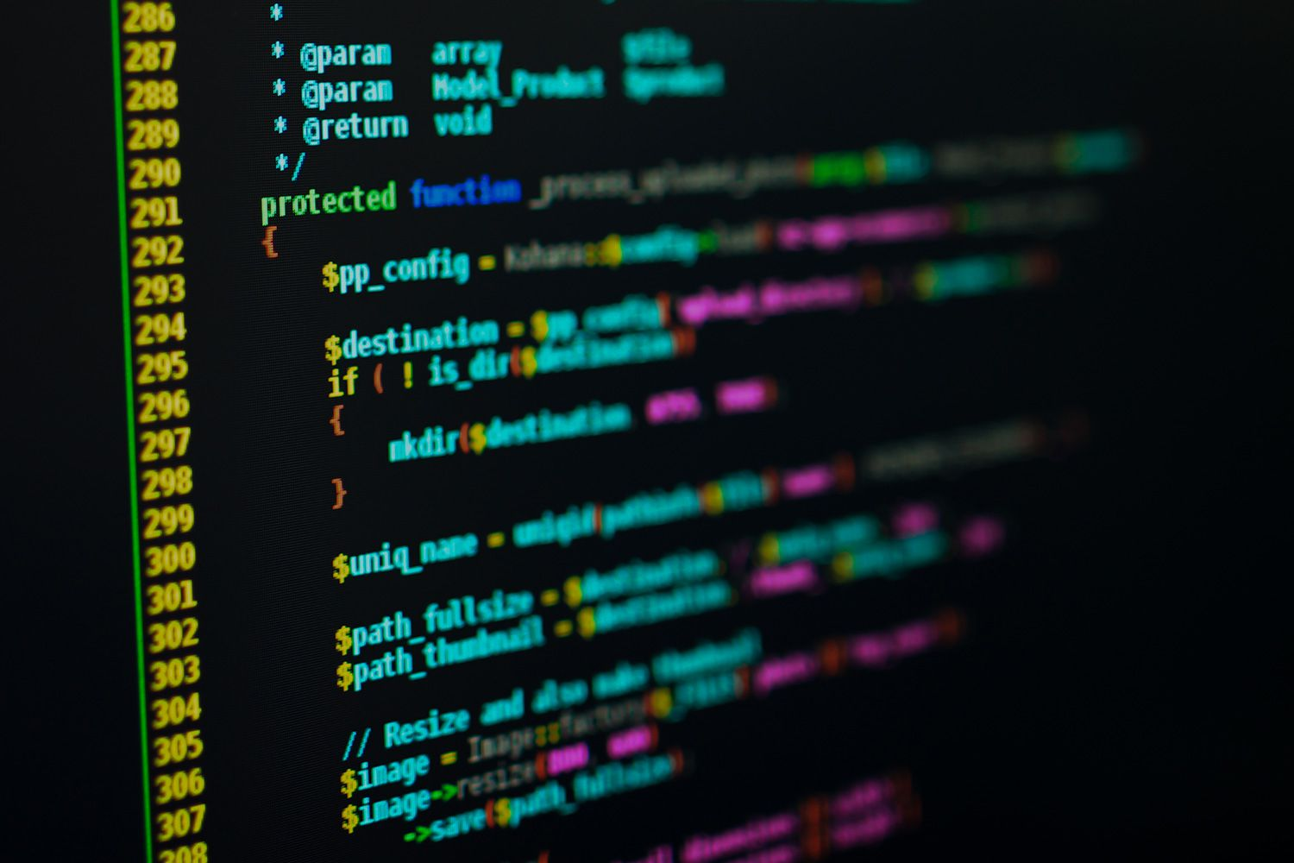
Lets look at some code.

Slide 11
References
Kirner, T. G., & Abib, J. C. (1997). Inspection of software requirements specification documents. Proceedings of the 15th annual international conference on Computer documentation - SIGDOC '97. https://dl-acm-org.proxy-library.ashford.edu/doi/10.1145/263367.263389
Tsui, F., Karam, O., & Bernal, B. (2018). Essentials of software engineering (4th ed.). Jones & Bartlett Learning.

