Slide 1

AWS IOT CORE
BY IOT GUY

Slide 2
OUR OBJECTIVE
Use MQTT and Restful Api of AWS IoT core to send/receive data.
Setting up our AWS IoT thing.
Write an Arduino Sketch to send & receive data from Nodemcu to AWS Cloud.
Write an Python Sketch using Paho Mqtt library.
Write JS code using AWS-SDK to communicate with AWS cloud
Integrate AWS SNS with the Thing.

Slide 3
REQUIREMENTS
NODEMCU/ ESP32
FREE AWS ACCOUNT
A PUSH BUTTON
BASIC UNDERSTANDING OF MQTT (It’s a +)

Slide 4
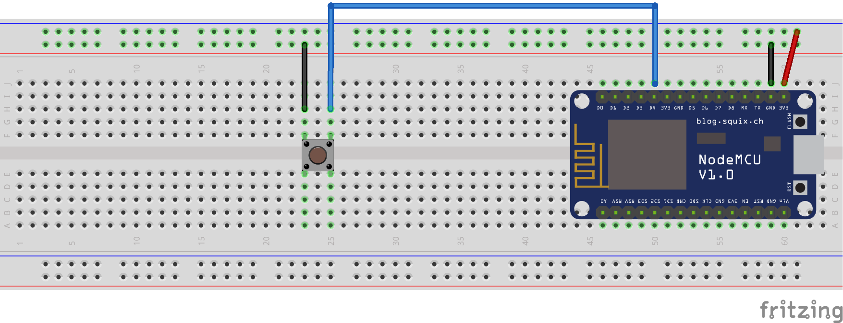
CIRCUIT
TO RECEIVE DATA
(BUILTIN LED)
TO SEND DATA TO AWS

Slide 5


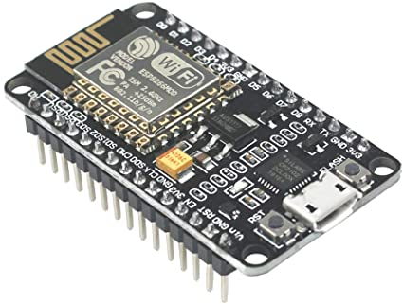
ARCHITECTURE
AWS IOT
MQTT BROKER
AWS TEST
(MQTT CLIENT 2)
button
led
SUBSCRIBES
TOPICS
PUBLISHES
PUBLISHES
PUSHBUTTON
BUILTIN LED
SUBSCRIBES
MQTT BOX
(MQTT CLIENT 3)
SUBSCRIBES
MQTT CLIENT 1

Slide 6
THINGSHADOW ARCHITECTURE
AWS IOT
MQTT BROKER
AWS TEST
(MQTT CLIENT 2)
TOPICS
PUBLISHES
PUBLISHES
$aws/things/testThing/shadow/update
SUBSCRIBES
PUSHBUTTON
$aws/things/testThing/shadow/update/accepted
BUILTIN LED
SUBSCRIBES
MQTT BOX
(MQTT CLIENT 3)
SUBSCRIBES
MQTT CLIENT 1

Slide 7
STEPS TO CONFIGURE AWS THING
Create a Thing
Create certificate
Create a Policy
Attach the Thing to the certificate
Attach the Policy to the certificate

