Slide 1
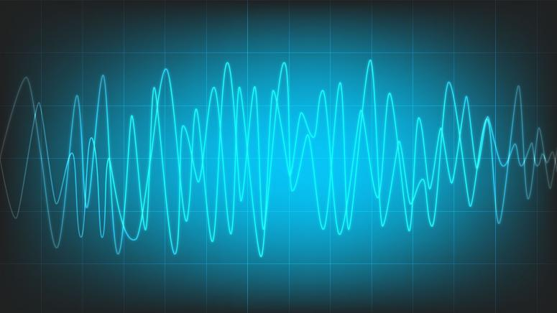
信号处理 Signal Processing Course No.8695001 2022-23秋季学期
School of Computer Engineering and Science
Shanghai University
Instructor: Shengyu DUAN（段圣宇）

Slide 2
Lecture 0
Syllabus
（课程概要）

Slide 3
Lecturers
Jianjia WANG（王健嘉） Ph.D | Shengyu DUAN（段圣宇） Ph.D
Class A Shanghai University School of CSE Ph.D degree from University of York, UK | Class B Shanghai University School of CSE Ph.D degree from University of Southampton, UK
Email: jianjiawang@shu.edu.cn Office：CS Room 409 | Email: sduan@shu.edu.cn Office：CS Room 407

Slide 4
Timetable
Lecture:
Every Monday 18:00-20:45,
Sept. 5th – Nov. 7th
Location: 东区材J201
Practical Section:
Every Wednesday 10:00-11:40,
Sept. 8th – Nov. 9th

Slide 5
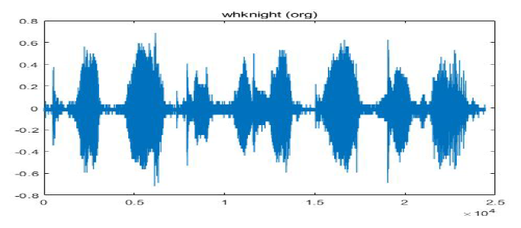
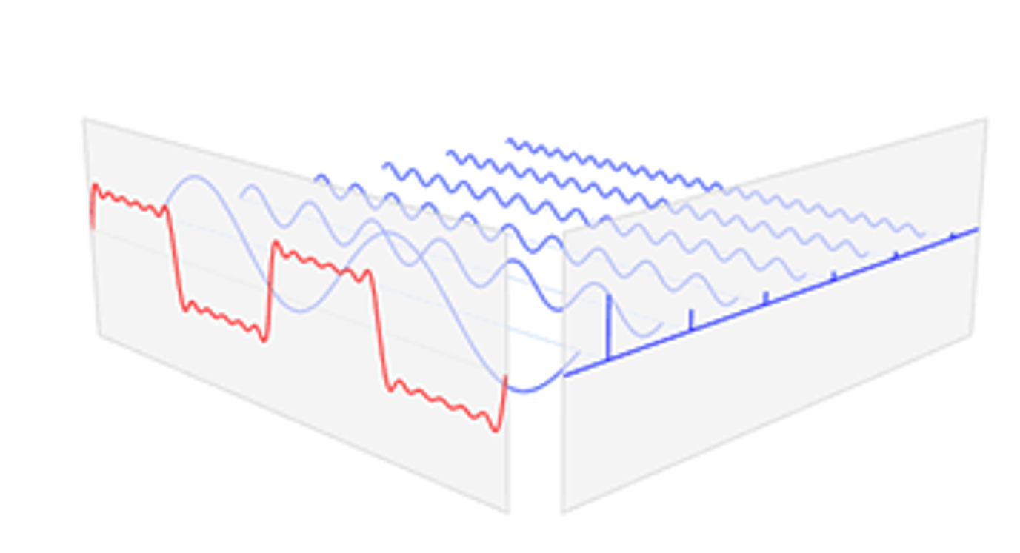
音频信号
Agenda
Section 1: Signals Processing in the Time Domain
Fundamental concepts in signal processing
Signals and systems
Types of Signals
Complex numbers
Convolution （卷积）
Section 2: Continuous Time Signals in the Frequency Domain
Fourier Series （傅里叶级数）
Fourier Transform （傅里叶变换）
Signal Sampling and Reconstruction
Section 3: Discrete Time Signals in the Frequency Domain
Discrete Time Fourier Series
Discrete Time Fourier Transform (DTFT)
幅度
时间
信号的频域表示

Slide 6
Agenda
Section 1: Signals Processing in the Time Domain
Fundamental concepts in signal processing
Signals and systems
Types of Signals
Complex numbers
Convolution （卷积）
Section 2: Continuous Time Signals in the Frequency Domain
Fourier Series （傅里叶级数）
Fourier Transform （傅里叶变换）
Signal Sampling and Reconstruction
Section 3: Discrete Time Signals in the Frequency Domain
Discrete Time Fourier Series
Discrete Time Fourier Transform (DTFT)
两种空间域
四种信号类型
Notes:
两种空间域：时域、频域
四种信号类型：
按周期性划分：周期信号与非周期信号
按连续性划分：连续信号与离散信号
学习目标：对上述四种信号类型，学会时域表示及频域表示的互相转换

Slide 7
Lecture
Lecture 0: Syllabus
Section 1: Signals Processing in the Time Domain
Lecture 1: Introduction Lecture 2: Complex Number Lecture 3: Linear Time-invariant Systems & Convolution
Section 2: Continuous Time Signals in the Frequency Domain Lecture 4: Fourier Series Lecture 5: Fourier Transform Lecture 6: Sampling
Section 3: Discrete Time Signals in the Frequency Domain Lecture 7: Discrete Time Fourier Series Lecture 8: Discrete Time Fourier Transform
Section 4: Overview and Conclusions
Lecture 9: Summary

Slide 8
Practical Section/Labs
Section 1: Basic in Matlab
Practice 1: Reorientation to Matlab
Practice 2: Representing Signals in Matlab
Section 2: Fundamental in Signal Processing Practice 3: Complex Signals Practice 4: Convolution, Correlation, and Finding Signals
Section 3: Applications using Frequency Domain Practice 5: Filters Practice 6: Discrete Fourier Transform (DFT) Practice 7: Development for a Shazam-like Music Identification Tool

Slide 9
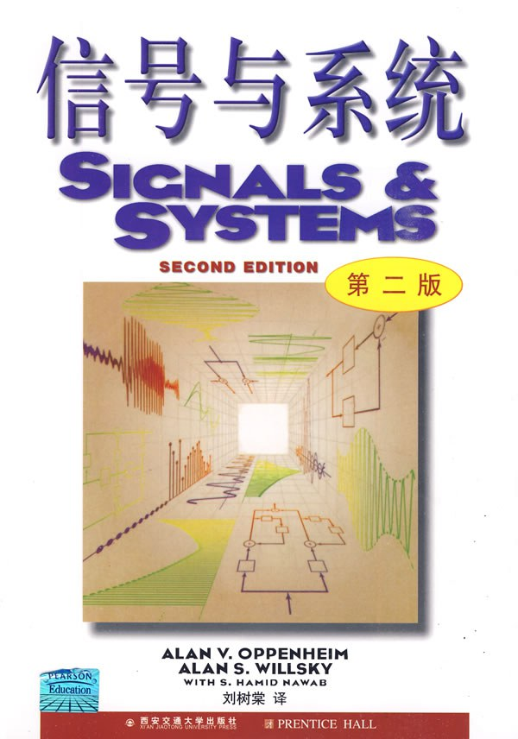
Textbook
《信号与系统》（第二版），Alan V. Oppenheim, Alan S. Willsky, with S. Hamid, 刘树棠（译），西安交通大学出版社

Slide 10
Textbook
《信号与系统》（第二版），Alan V. Oppenheim, Alan S. Willsky, with S. Hamid, 刘树棠（译），西安交通大学出版社
Assessment
Attendance + Homework (10%)
Labs (10%)
Project Report (10%)
Final Exam (70%)

Slide 11
Project Report and Demonstration
The project requires you to develop a practical application related to signal processing;
You can choose a specific application (e.g., image processing, acoustic recognition, broadcasting, etc.) that you are interested, as long as it is related to signal processing;
You can further develop a application, based on the labs that you finish during this course.
Each student will submit:
A written report (max. 6-pages, with bonus if written in English) – Nov. 13st (Week 10)
A 5-10min demonstration – Nov. 2nd and Nov. 9th (Week 9-10)

Slide 12
欢迎来到 信号处理的世界！
Welcome to Signal Processing！

