Slide 1

Lecture 1 Introduction
School of Computer Engineering and Science
Shanghai University
Instructor: Jianjia Wang, Shengyu Duan

Slide 2
Outline: Lecture 1: Introduction
Preliminary
What are the signals
What are the systems
Application of signals and systems
Fundamental concepts
Types of Signals

Slide 3
Outline: Lecture 1: Introduction
Preliminary
What are the signals
What are the systems
Application of signals and systems
Fundamental concepts
Types of Signals

Slide 4
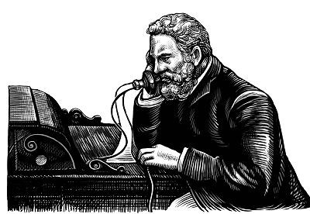
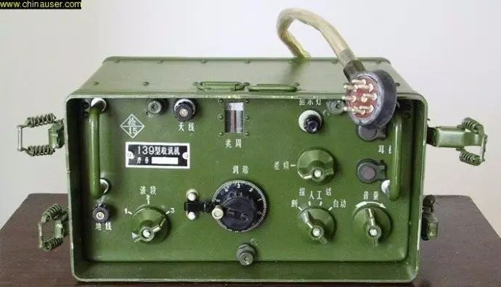


信号是什么？
电话
无线电
烽火狼烟
物联网

Slide 5
What is a Signal?
A signal is a pattern of variation of some form
Signals are variables that carry information
Any kind of physical variable subject to variations represents a signal
Examples of signal include:
Electrical signals
Voltages and currents in a circuit
Acoustic signals
Acoustic pressure (sound) over time
Mechanical signals
Velocity of a car over time
Video signals
Intensity level of a pixel (camera, video) over time
Notes:
信号=模式（信息）+变量（物理）

Slide 6
How is a Signal Represented?
Mathematically, signals are represented as a function of one or more independent variables.
For instance a black & white video signal intensity is dependent on x, y coordinates and time t f(x,y,t)
On this course, we shall be exclusively concerned with signals that are a function of a single variable: time
f(t)
t

Slide 7
How is a Signal Represented?
A signal is a set of information of data
Both the independent variable and the physical variable can be either scalars or vectors
Independent variable: time (t), space (x, x=[x₁,x₂], x=[x₁,x₂,x₃])
Signal:
Electrochardiography signal (EEG) 1D, voice 1D, music 1D
Images (2D), video sequences (2D+time), volumetric data (3D)

Slide 8
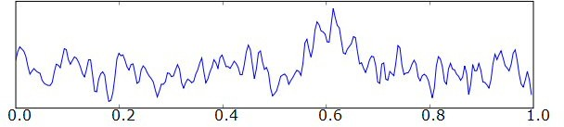
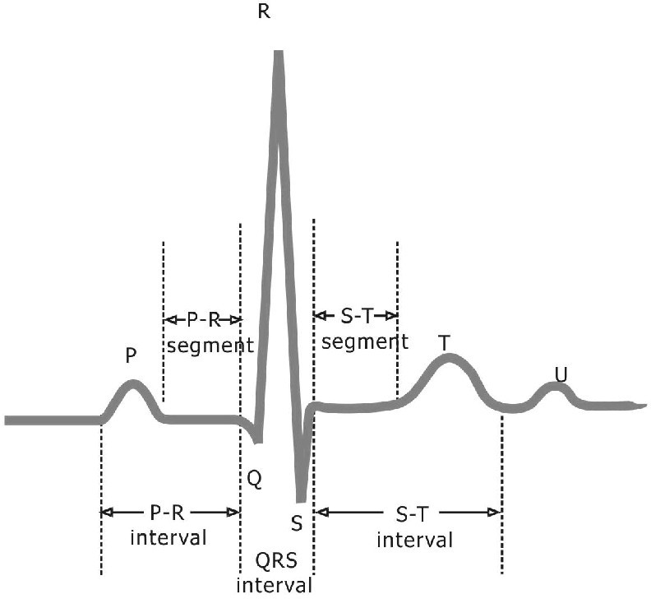
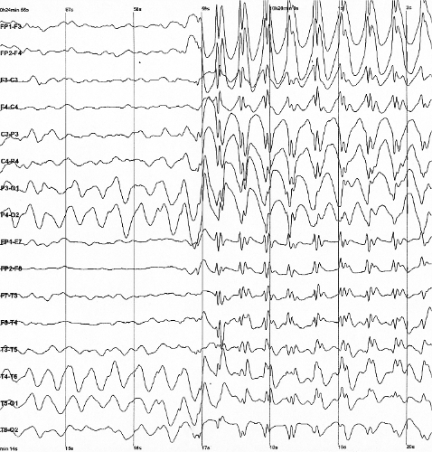
Example: 1D biological signals: ECG
amplitude
time

Slide 9
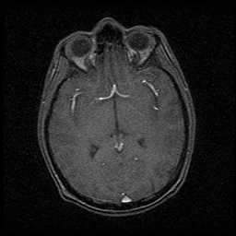
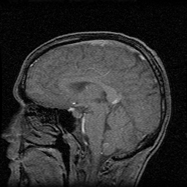
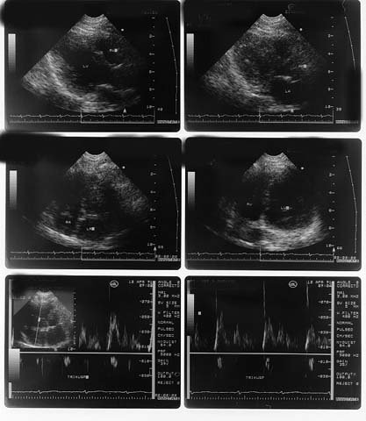
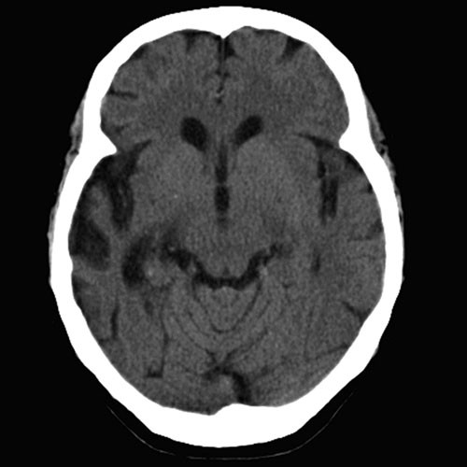
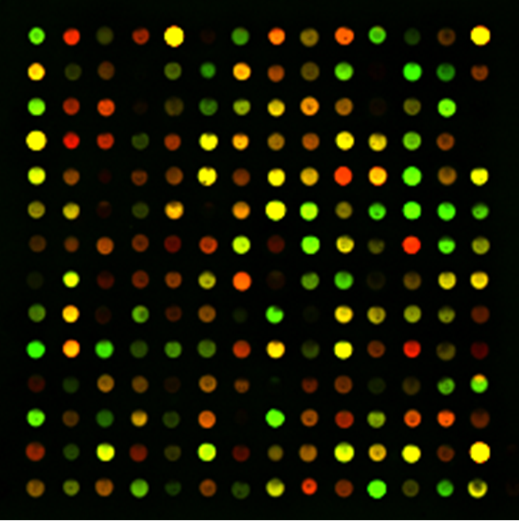
Example: 2D biological signals: MI
MRI
US
CT

Slide 10
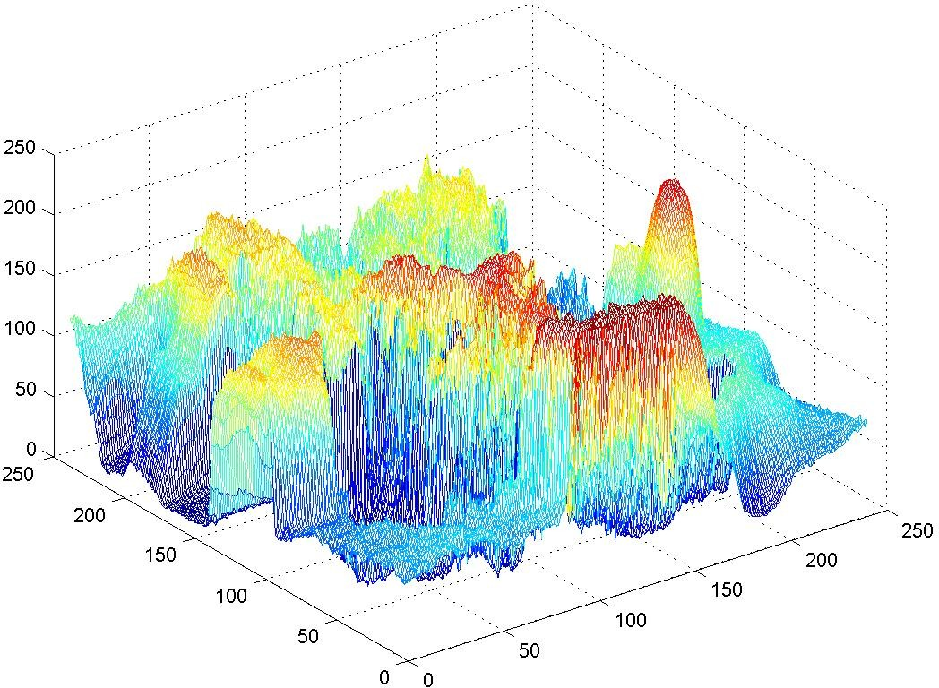

Example : Natural image

Slide 11
Signals as functions
Continuous functions of real independent variables
– 1D: f=f(x)
2D: f=f(x,y) x,y
Real world signals (audio, ECG, images)
Real valued functions of discrete variables
– 1D: f=f[k]
– 2D: f=f[i,j]
Sampled signals
Discrete functions of discrete variables
1D: f^{d}=f^{d}[k]
2D: f^{d}=f^{d}[i,j]
Sampled and quantized signals
Gray scale images: 2D functions
Domain of the functions: set of (x,y) values for which f(x,y) is defined : 2D lattice
[i,j] defining the pixel locations
Set of values taken by the function : gray levels
Digital images can be seen as functions defined over a discrete domain {i,j: 0<i<I, 0<j<J}
I,J: number of rows (columns) of the matrix corresponding to the image
f=f[i,j]: gray level in position [i,j]

Slide 12
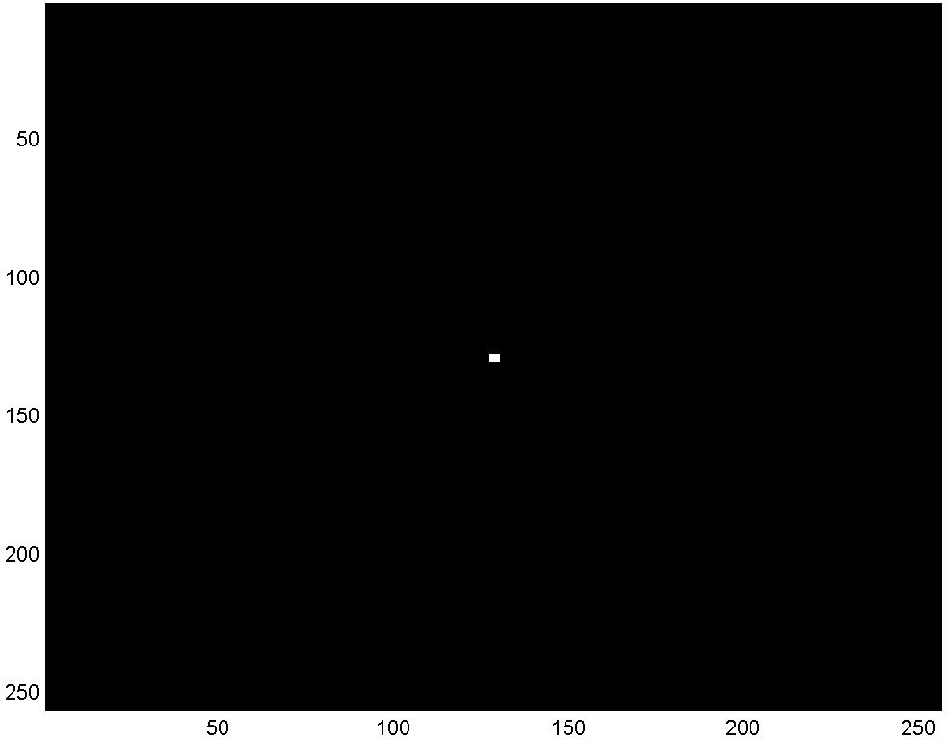

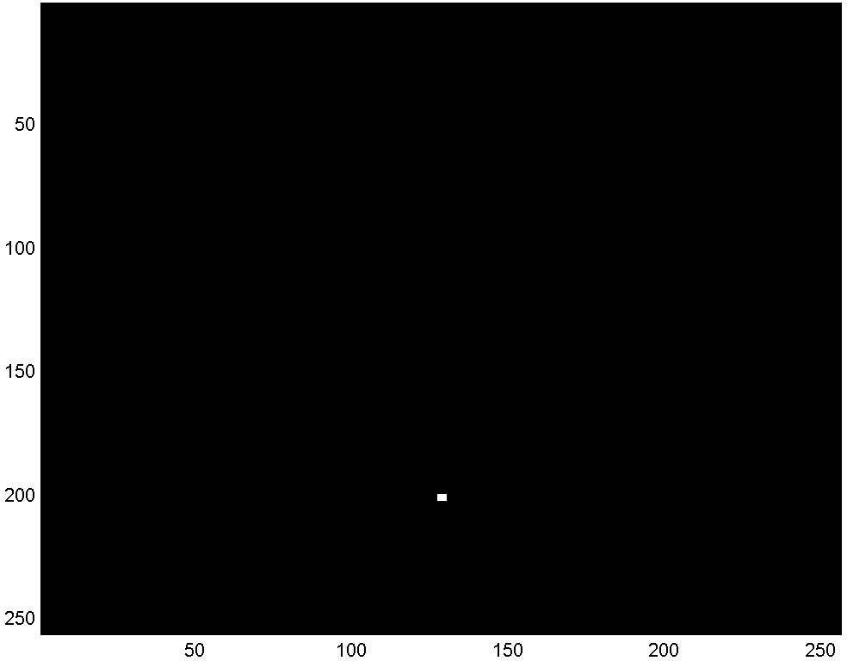
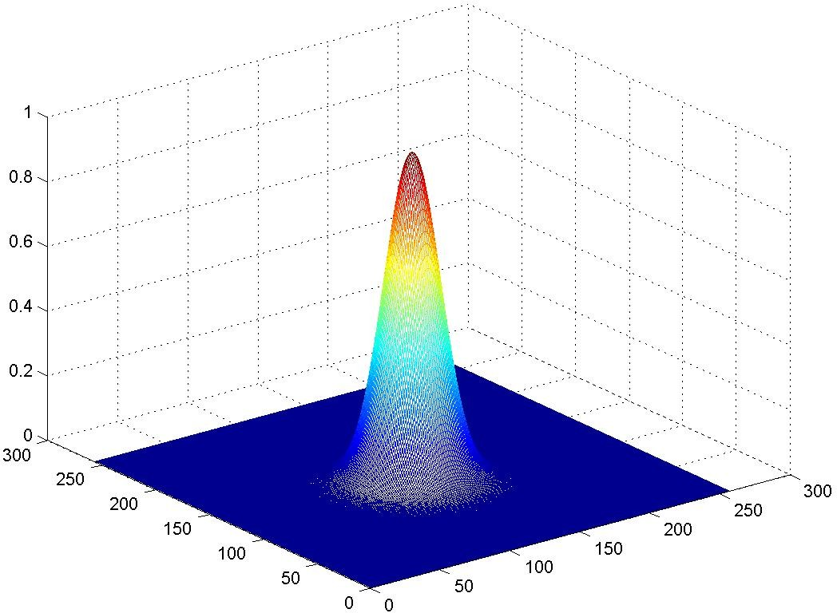
Example : function
i = j = 0
i, j ≠ 0;i ≠ j
Continuous function
δ [i, j]= ^{⎧1}
1
x² + y²
⎨₀
⎩
f (x, y) =
e
2σ ²
σ 2π
i = 0; j = J otherwise
Discrete version
δ [i, j − J ]= ^{⎧1}
⎨₀
⎩
1
i² + j ²
f [i, j] =
_{e} 2σ ²
σ 2π

Slide 13
Continuous & Discrete-Time Signals
Continuous-Time Signals
Most signals in the real world are continuous time, as the scale is infinitesimally fine.
E.g. voltage, velocity,
Denote by x(t), where the time interval may be bounded (finite) or infinite
Discrete-Time Signals
Some real world and many digital signals are discrete time, as they are sampled
E.g. pixels, daily stock price (anything that a digital computer processes)
Denote by x[n], where n is an integer value that varies discretely
Sampled continuous signal
x[n] =x(nk) – k is sample time
x(t)
t
x[n]
n

Slide 14
连续时间与离散时间信号
对连续时间信号x(t)， t可以是任意值（无限个数的值）；
对离散时间信号x[n]， n为有限个数的值；
x(t)
t
x[n]
n

Slide 15
连续时间与离散时间信号
对连续时间信号x(t)， t可以是任意值（无限个数的值）；
对离散时间信号x[n]， n为有限个数的值；
然而，连续与离散信号真的可以明确划分吗？
x(t)
t
x[n]
n

Slide 16
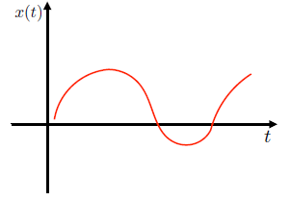
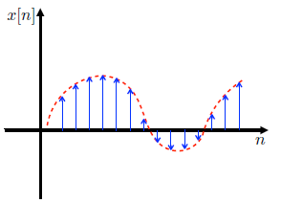
连续时间与离散时间信号
对以下连续时间信号x(t)，不断拉近
对以下离散时间信号x[n]，将n与n+1之间的间隔不断缩小
“连续”与“离散”存在主观性：连续信号是间隔无限接近于0的离散信号。
上述概念帮助理解不同信号类型的傅里叶变化及采样（连续/离散时间信号无法明确划分，但有必要去划分）。

Slide 17
Continuous & Discrete-Time Signals
Time signals:
Continuous time signals (analog signals): for example, audio signals (FMsignals), AC voltages and currents
Discrete time signals (digital signals): for example, daily temperature
Note that continuous time signals and discrete time signals can be converted to each other.

Slide 18
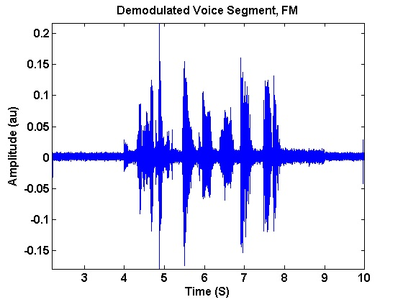
Continuous & Discrete-Time Signals
1D signal (e.g., voice, music): x(t) -> x[n]
2D signal (e.g., images): x(s₁,s₂) → x[n₁,n₂]
2D signal (e.g., videos: 2D spatial + time): x(s₁,s₂,t) → x[n₁,n₂,n]

Slide 19
Signal Properties
On this course, we shall be particularly interested in signals with certain properties:
Periodic signals: a signal is periodic if it repeats itself after a fixed period T, i.e. x(t) = x(t+T) for all t. A sin(t) signal is periodic.
Even and odd signals: a signal is even if x(-t) = x(t) (i.e. it can be reflected in the axis at zero). A signal is odd if x(-t) = -x(t). Examples are cos(t) and sin(t) signals, respectively.
Exponential and sinusoidal signals: a signal is (real) exponential if it can be represented as x(t) = Ce^{at}. A signal is (complex) exponential if it can be represented in the same form but C and a are complex numbers.
Step and pulse signals: A pulse signal is one which is nearly completely zero, apart from a short spike, d(t). A step signal is zero up to a certain time, and then a constant value after that time, u(t).
These properties define a large class of tractable, useful signals and will be further considered in the coming lectures
Notes:
Pulse signal: 冲激信号
Step signal：阶跃信号

Slide 20
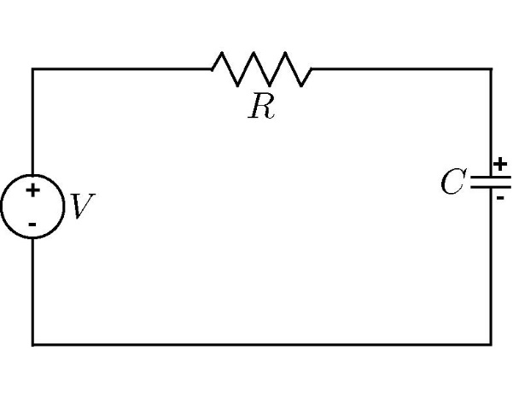
What is a System?
Systems process input signals to produce output signals
Examples:
A circuit involving a capacitor can be viewed as a system that transforms the
source voltage (signal) to the voltage (signal) across the capacitor
A CD player takes the signal on the CD and transforms it into a signal sent to
the loud speaker
The function linking the output of the system with the input signal is called transfer function and it is typically indicated with the symbol h(•)
input
output
System
Circuit:
Notes:
Transfer function：传递函数

Slide 21
What is a System?
Communication Systems
A communication system is generally composed of three sub-systems, the transmitter, the channel and the receiver. The channel typically attenuates and adds noise to the transmitted signal which must be processed by the receiver
s(t)
r(t)
Transmitter
Channel
Receiver
Message signal (information) data, text, audio, video
Transmitted signal
Received signal
Estimate of message signal (information)
noise, loss
distortion,
interference

Slide 22
How is a system Represented?
A system takes a signal as an input and transforms it into another signal
In a very broad sense, a system can be represented as the ratio of the output signal over the input signal
Input signal
x(t)
System
Output signal
y(t)
That way, when we “multiply” the system by the input signal, we get the output signal
This concept will be firmed up in the coming weeks

Slide 23
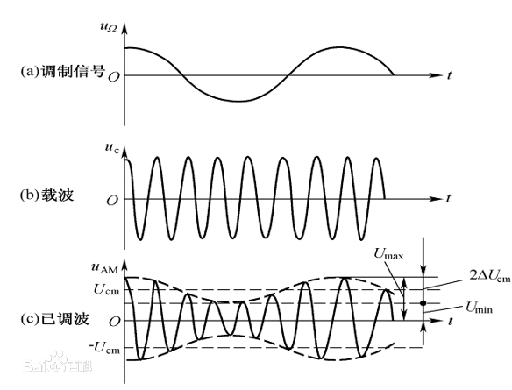
系统
Input signal
x(t)
System
Output signal
y(t)
系统往往是以一定比例（做乘法）放大、缩小输入信号
例如：幅度调制（Amplitude Modulation，AM）

Slide 24
Continuous & Discrete-Time Mathematical Models of Systems
Continuous-Time Systems
Most continuous time systems represent how continuous signals are transformed via differential equations.
E.g. circuit, car velocity
Discrete-Time Systems
Most discrete time systems represent how discrete signals are transformed via difference equations
E.g. bank account, discrete car velocity system
First order differential equations
First order difference equations

Slide 25
Properties of a System
On this course, we shall be particularly interested in signals with certain properties:
Causal: a system is causal if the output at a time, only depends on input values up to that time.
Linear: a system is linear if the output of the scaled sum of two input signals is the equivalent scaled sum of outputs
Time-invariant: a system is time invariant if the system’s output is the same, given the same input signal, regardless of time.
These properties define a large class of tractable, useful systems and will be further considered in the coming lectures
Notes:
Causal：具有因果性的

Slide 26
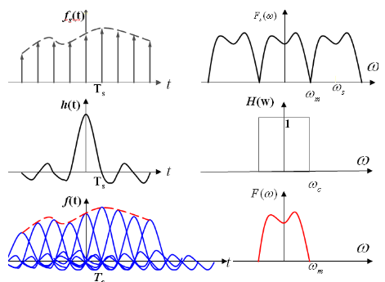
系统的因果性（Causality）
Causal: a system is causal if the output at a time, only depends on input values up to that time. （系统的输出只取决于现在的输入及过去的输入）
具有因果性的系统才是物理可实现的系统
因果性的意义：判断所设计的系统是否是可以被实现的
例：理想低通滤波器不具有因果性，是不可能被实现的

Slide 27
线性（Linear）系统
Linear: a system is linear if the output of the scaled sum of two input signals is the equivalent scaled sum of outputs （如果输入信号是两个信号的加权和，那么输出信号也是这两个输入信号对应输出的加权和）
例：如果系统对输入信号x(t)的输出是y(t)，则系统对输入信号ax₁(t)+bx₂(t)的输出为ay₁(t)+by₂(t)
线性系统对信号在频域表示下的处理具有重要意义。

Slide 28
时不变（Time-invariant）系统
Time-invariant: a system is time invariant if the system’s output is the same, given the same input signal, regardless of time. （系统特性不随时间发生变化）
例：如果系统对输入信号x(t)的输出是y(t)，则系统对输入信号x(t-t₀)的输出为y(t-t₀)
时不变系统对信号在频域表示下的处理具有重要意义。

Slide 29
Typical Examples of Signals/Systems Concerned
Computers
Signal Processing Systems
software systems processing the signal by computation/ memory
examples : audio enhancement systems, picture processing systems, video compression systems, voice recognition/ synthesis systems, array signal processors, equalizers, etc.

Slide 30
Typical Examples of Signals/Systems Concerned
Networks
user B
user A

Slide 31
Typical Examples of Signals/Systems Concerned
Information Retrieval Systems
Internet
Other Information Systems
examples : remote sensing systems, biomedical signal
processing systems, etc.
Internet
Search Engine
User

Slide 32
Internet
Internet
Digital
Libraries,
Virtual
Museums,
Electronic
Home,
Network
Entertainment
Google,
Facebook,
YouTube,
Amazon
Intelligent
Offices,
Distant
Learning,
Electronic
Commerce,
Network
Banking,
Electronic
Government
Services,
.
.
.
.
.
.
.
.
.
.
.
.
.
.
.
.
.
.

Slide 33
Internet
Network Technology Connects Everywhere Globally
Huge Volume of Information Disseminated across the Globe in Microseconds
Multi-media, Multi-lingual, Multi-functionality
Cross-cultures, Cross-domains, Cross-regions
Integrating All Knowledge Systems and Information related Activities Globally

Slide 34
Typical Examples of Signals/Systems Concerned
Control Systems
close-loop/feedback control systems
disturbance z(t)
error signal e(t)
control signal v(t)
input signal x(t)
controller
plant
output signal y(t)
feedback signal
sensor
example: aircraft landing systems, satellite stabilization systems, robot arm control systems, etc.

Slide 35
Typical Examples of Signals/Systems Concerned
Other Systems
manufacturing systems, computer-aided-design systems, mechanical systems, chemical process systems, etc.

Slide 36
信号处理与人工智能
例：实现一个简单的声音识别系统，对发声者的年龄、性别进行判断

Slide 37

信号处理与人工智能
例：实现一个简单的声音识别系统，对发声者的年龄、性别进行判断
以人工神经网络构建分类器：
每一层网络提取信号中的抽象特征

Slide 38
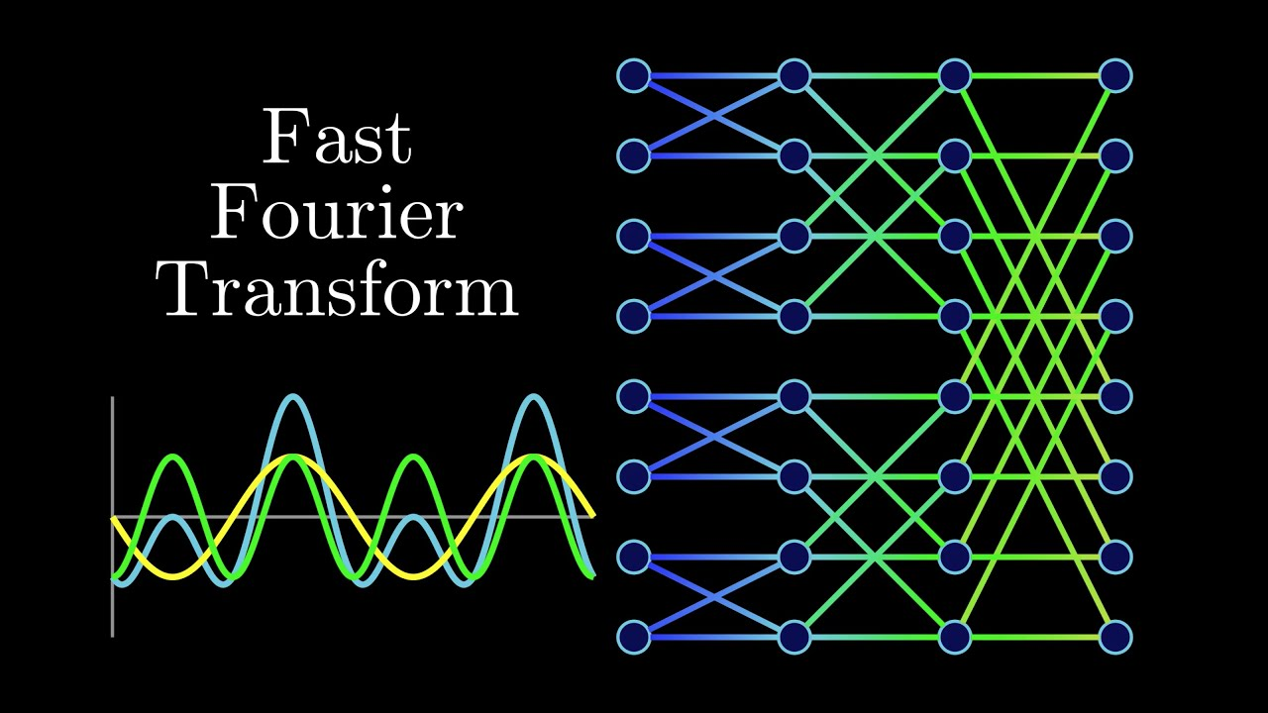
信号处理与人工智能
例：实现一个简单的声音识别系统，对发声者的年龄、性别进行判断
以人工神经网络构建分类器：
每一层网络提取信号中的抽象特征
以传统信号处理技术构建系统：
提取信号中频率特征

Slide 39
信号处理与人工智能
广义上来说，人工智能是抽象层面下的信号处理，以通过提取目前人类无法解释的特征来处理信号
信号处理可以是一种可解释的人工智能架构
信号处理与人工智能在未来的某一天是否会完全融合？
信号处理
人工智能

Slide 40
Outline: Lecture 1: Introduction
Preliminary
What are the signals
What are the systems
Application of signals and systems
Fundamental concepts
Types of Signals

Slide 41
Classification of signals
Continuous time – Discrete time
Analog – Digital (numerical)
Periodic – Aperiodic
Energy – Power
Deterministic – Random (probabilistic)
Note
Such classes are not disjoint, so there are digital signals that are periodic of power type and others that are aperiodic of power type etc.
Any combination of single features from the different classes is possible

Slide 42
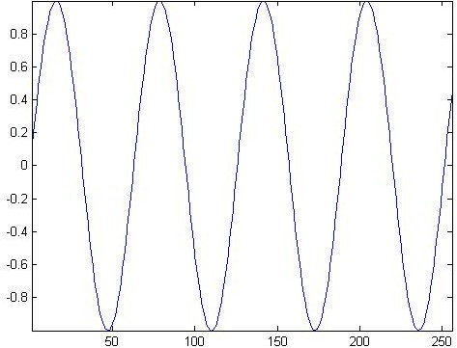
Continuous time – discrete time
Continuous time signal: a signal that is specified for every real value of the independent variable
The independent variable is continuous, that is it takes any value on the real axis
E.g. The domain of the function representing the signal has the cardinality of real numbers
Signal ↔ f=f(t)
Independent variable ↔ time (t), position (x)
For continuous-time signals:
t ∈ ℝ
amplitude
time

Slide 43
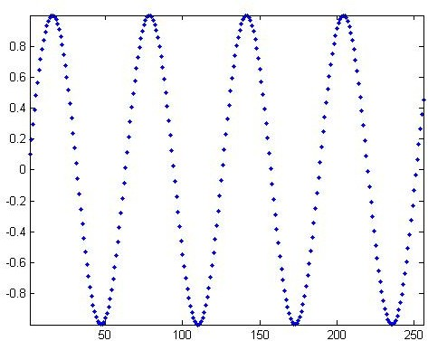
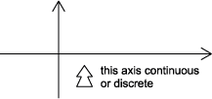
Continuous time – discrete time
Discrete time signal: a signal that is specified only for discrete values of the independent variable
It is usually generated by sampling so it will only have values at equally spaced
intervals along the time axis
E.g. The domain of the function representing the signal has the cardinality of integer numbers
Signal ↔ f=f[n], also called “sequence”
Independent variable ↔ n
For discrete-time functions: t ∈ Z
amplitude
time (discrete)

Slide 44
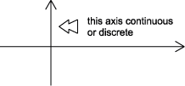
Analog - Digital
Analog signal: signal whose amplitude can take on any value in a continuous range
The amplitude of the function f(t) (or f(x)) has the cardinality of real numbers
The difference between analog and digital is similar to the difference between continuous-time and discrete-time. In this case, however, the difference is with respect to the value of the function (y-axis)
Analog corresponds to a continuous y-axis, while digital corresponds to a discrete y-axis
Here we call digital what we have called quantized in the EI class
An analog signal can be both continuous time and discrete time

Slide 45
Analog - Digital
Digital signal: a signal is one whose amplitude can take on only a finite number of values (thus it is quantized)
The amplitude of the function f() can take only a finite number of values
A digital signal whose amplitude can take only M different values is said to be Mary
Binary signals are a special case for M=2
amplitude
time

Slide 46
Example
– Continuous time analog
Discrete time analog
amplitude
amplitude
time
Continuous time digital (or quantized)
binary sequence, where the values of the function can only be one or zero.
time
Discrete time digital
binary sequence, where the values of the function can only be one or zero.
amplitude
amplitude
time
time

Slide 47
Summary
Signal amplitude/ Time or space | Real | Integer
Real | Analog Continuous-time | Digital Continuous-time
Integer | Analog Discrete-time | Digital Discrete time

Slide 48
Periodic - Aperiodic
A signal f(t) is periodic if there exists a positive constant T₀ such that
f (t + T₀ ) = f (t) ∀t
The smallest value of T₀ which satisfies such relation is said the period of the function f(t)
A periodic signal remains unchanged when time-shifted of integer multiples of the period
Therefore, by definition, it starts at minus infinity and lasts forever
−∞ ≤ t ≤ +∞ t ∈ °
−∞ ≤ n ≤ +∞ n ∈ Z
Periodic signals can be generated by periodical extension

Slide 49
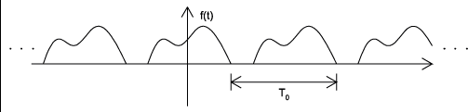
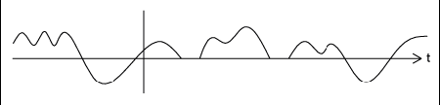
Examples
Periodic signal with period T₀
Aperiodic signal
Notes:
周期与非周期具有主观性

Slide 50
Examples
Periodic signal with period T₀
Still an aperiodic signal?
周期与非周期性同样具有主观性！
Notes:
周期与非周期具有主观性

Slide 51



Causal and non-Causal signals
Causal signals are signals that are zero for all negative time (or spatial positions), while
Anticausal are signals that are zero for all positive time (or spatial positions).
Noncausal signals are signals that have nonzero values in both positive and negative time
Notes:
区别系统的因果性与信号的因果性
因果系统：输出取决于当前及以前的输入
因果信号：时间原点之后才产生的信号

Slide 52
Causal and non-causal signals
Causal signals
f (t) = 0 t < 0
Anticausals signals
f (t) = 0 t ≥ 0
Non-causal signals
∃t₁ < 0:
f (t₁ ) = 0

Slide 53


Even and Odd signals
An even signal is any signal f such that f (t) = f (-t). Even signals can be easily spotted as they are symmetric around the vertical axis.
An odd signal, on the other hand, is a signal f such that f (t)= - (f (-t))

Slide 54
Decomposition in even and odd components
Any signal can be written as a combination of an even and an odd signals
– Even and odd components
重要！
f (t ) = ¹ ( f (t ) + f (−t )) + ¹ ( f (t ) − f (−t ))
2
t + f −t even component
2
1
2
1
2
( )
( )
f t =
f
( ) ( )
e
_{o} ( )
( )
f t =
f
( ) ( )
t − f −t odd component
f (t ) = f_{e} (t ) + f_{o} (t )

Slide 55

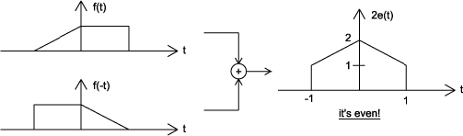
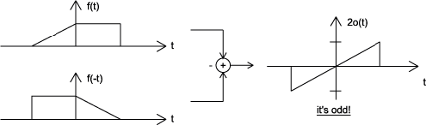
Example

Slide 56
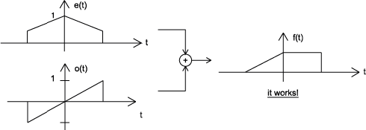
Example
Proof

Slide 57
Some properties of even and odd functions
even function x odd function = odd function
odd function x odd function = even function
even function x even function = even function
Area
a a
∫ f_{e} (t ) dt = 2∫ f_{e} (t )dt
− a 0
a
∫ f_{e} (t ) dt = 0
− a

Slide 58
Deterministic - Probabilistic
Deterministic signal: a signal whose physical description in known completely
A deterministic signal is a signal in which each value of the signal is fixed and can be determined by a mathematical expression, rule, or table.
Because of this the future values of the signal can be calculated from past values with complete confidence.
There is no uncertainty about its amplitude values
Examples: signals defined through a mathematical function or graph
Probabilistic (or random) signals: the amplitude values cannot be predicted precisely but are known only in terms of probabilistic descriptors
The future values of a random signal cannot be accurately predicted and can usually only be guessed based on the averages of sets of signals
They are realization of a stochastic process for which a model could be available
Examples: EEG, evocated potentials, noise in CCD capture devices for digital cameras

Slide 59


Example
Deterministic signal
amplitude
time
Random signal
amplitude
time

Slide 60
Finite and Infinite length signals
A finite length signal is non-zero over a finite set of values of the independent variable
f = f (t ), ∀t : t₁ ≤ t ≤ t₂ t₁ > −∞, t₂ < +∞
An infinite length signal is non zero over an infinite set of values of the independent variable
– For instance, a sinusoid f(t)=sin(ωt) is an infinite length signal

Slide 61
Size of a signal: Norms
"Size" indicates largeness or strength.
We will use the mathematical concept of the norm to quantify this notion for both continuous-time and discrete-time signals.
The energy is represented by the area under the curve (of the squared signal)
amplitude
0
T
time
Notes:
Norm：范数，空间中的长度

Slide 62
Energy
Signal energy
+∞
∫
−∞
+∞
∫
E =
f ² (t)dt
f
E =
f (t) ² dt
f
−∞
Generalized energy : L_{p} norm
– For p=2 we get the energy (L₂ norm)
( )
(
( )
p
)
1/ p
f t
=
∫
( )
f t
dt
1 ≤ p < +∞

Slide 63
Power
Power
– The power is the time average (mean) of the squared signal amplitude, that is the
mean-squared value of f(t)
1
+T /2
P = lim
∫
f ² (t)dt
f
T →∞ _{T}
−T /2
+T /2
1
∫
2
P_{f} = lim _{T}
f (t) dt
T →∞
−T /2

Slide 64
Power - Energy
The square root of the power is the root mean square (rms) value
This is a very important quantity as it is the most widespread measure of similarity/dissimilarity among signals
It is the basis for the definition of the Signal to Noise Ratio (SNR)
⎛⎛
^{P}signal ⎞
SNR = 20log
10 ⎮
⎮
P
⎛ ⎠
noise
– It is such that a constant signal whose amplitude is =rms holds the same power content of the signal itself
There exist signals for which neither the energy nor the power are finite
f
ramp
0
t
Notes:
RMSE：均方根误差

Slide 65
Energy and Power signals
A signal with finite energy is an energy signal
Necessary condition for a signal to be of energy type is that the amplitude goes to zero as the independent variable tends to infinity
A signal with finite and different from zero power is a power signal
The mean of an entity averaged over an infinite interval exists if either the entity is periodic or it has some statistical regularity
A power signal has infinite energy and an energy signal has zero power
There exist signals that are neither power nor energy, such as the ramp
All practical signals have finite energy and thus are energy signals
It is impossible to generate a real power signal because this would have infinite duration and infinite energy, which is not doable.
Notes:
有限能量的信号，其功率一定为0。因此，在无穷大的区间计算功率，意义不大。实际更多的是，在有限的时间区间内（如一个周期内），计算功率。

Slide 66
Useful signal operations: shifting, scaling, inversion
Shifting: consider a signal f(t) and the same signal delayed/anticipated by T
seconds
f(t)
T>0
t
f(t+T)
anticipated
T
f(t-T)
t
delayed
T
t

Slide 67
Useful signal operations: shifting, scaling, inversion
(Time) Scaling: compression or expansion of a signal in time
f(t)
f(2t)
t
ϕ (t ) = f (2t )
compression
f(t/2)
t
expansion ϕ (t ) = f (t / 2)
t

Slide 68
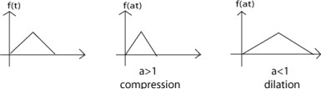
Useful signal operations: shifting, scaling, inversion
Scaling: generalization
a > 1
ϕ (t ) = f (at )
→ compressed version
ϕ (t ) = f ^{⎛⎛ t ⎞} → dilated (or expanded) version
⎮ _{a} ⎮
⎛ ⎠
Viceversa for a < 1

Slide 69
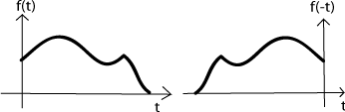
Useful signal operations: shifting, scaling, inversion
(Time) inversion: mirror image of f(t) about the vertical axis
ϕ (t ) = f (−t )
f(t)
0
f(-t)
0

Slide 70
Useful signal operations: shifting, scaling, inversion
Combined operations: f(t) → f(at-b)
Two possible sequences of operations
Time shift f(t) by to obtain f(t-b). Now time scale the shifted signal f(t-b) by a to obtain f(at-b).
Time scale f(t) by a to obtain f(at). Now time shift f(at) by b/a to obtain f(at-b).
Note that you have to replace t by (t-b/a) to obtain f(at-b) from f(at) when replacing t by the translated argument (namely t-b/a))

Slide 71
Outline: Lecture 1: Introduction
Preliminary
What are the signals
What are the systems
Application of signals and systems
Fundamental concepts
Types of Signals

Slide 72
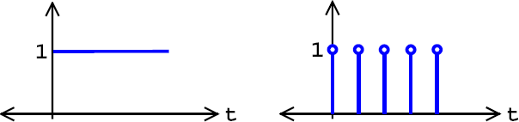
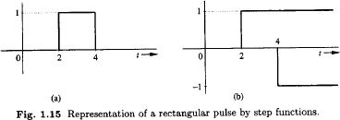
Useful functions
Unit step function （单位阶跃函数）
– Useful for representing causal signals
Continuous and discrete time unit step functions
t ≥ 0
t < 0
u(t)
u[k]
u (t ) = ^{⎧1}
⎨₀
⎩
f (t ) = u (t − 2) − u (t − 4)

Slide 73

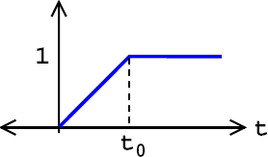
Useful functions
Ramp function (continuous time)
Notes:
Ramp signal：斜坡函数

Slide 74

Useful functions
Unit impulse function （单位冲激函数）
δ (t ) = 0
t ≠ 0
+∞
∫ δ (t ) dt = 1
−∞
δ (t )
 |  | ε→0
1/ ε
1
0
t
0
ε
t
Notes:
单位冲激函数面积为1

Slide 75
Properties of the unit impulse function
Multiplication of a function by impulse
φ (t )δ (t ) = φ (0)δ (t )
φ (t )δ (t − T ) = φ (T )δ (t − T )
Sampling property of the unit function
+∞ +∞
+∞
∫ φ (t )δ (t ) dt = ∫ φ (0)δ (t )dt = φ (0) ∫ δ (t )dt = φ (0)
−∞ −∞ −∞
+∞
∫ φ (t )δ (t − T ) dt = φ (T )
−∞
– The area under the curve obtained by the product of the unit impulse function shifted by T and ϕ(t) is the value of the function ϕ(t) for t=T

Slide 76
Properties of the unit impulse function
The unit step function is the integral of the unit impulse function
du
_{dt} = δ (t )
t
∫ δ (t )dt = u (t )
−∞
– Thus
t
⎧0 t < 0
t ≥ 0
∫ δ (t ) dt = u (t ) = ⎨₁
−∞
⎩

Slide 77

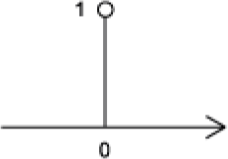
Properties of the unit impulse function
Discrete time impulse function

Slide 78

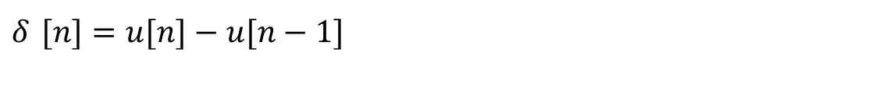
Unit Impulse and Unit Step Functions
Discrete-time
First difference
Running Sum
Sampling property
$$δ [n]=u[n]−u[n−1]$$
$$u\left[n\right]=\sum_{k=0}^{∞}{δ \left[n−k\right]}$$
$$u\left[n\right]=\sum_{m=−∞}^{n}{δ \left[m\right]}$$

Slide 79
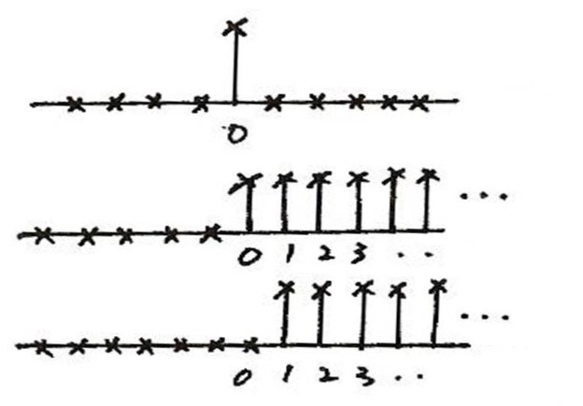
Unit Impulse & Unit Step
Discrete-time
δ [n]
n
u [n]
n
u [n – 1]
n
δ [n] = u[n] – u[n – 1]

Slide 80

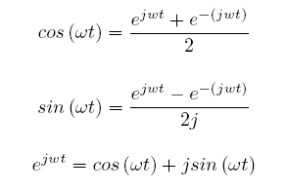

Useful functions
Continuous time complex exponential
f (t ) = Ae ^{jωt}
Euler’s relations
Discrete time complex exponential
– k=nT

Slide 81
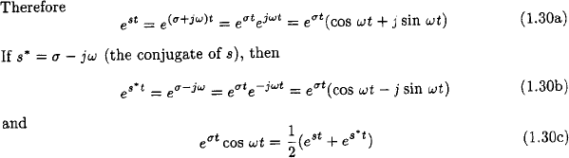
Useful functions
Exponential function e^{st}
– Generalization of the function e^{jωt}
s = σ + jω

Slide 82
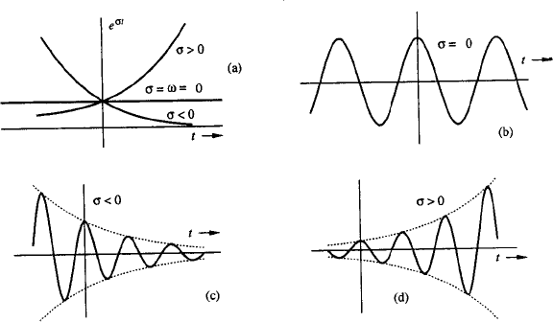
The exponential function
s=σ
s=jω
s = σ + jω
s = σ + jω

Slide 83
The exponential function
signals of constant amplitude
jω
s=σ
s=jω
left half plan exponentially decreasing signals
right half plan exponentially increasing signals
σ
s = σ + jω
s = σ + jω
monotonically increasing/decreasing exponentials

Slide 84
本章部分关键词汇中英文对照表
离散时间信号 | Discrete-time signal
连续时间信号 | Continuous-time signal
指数信号 | Exponential signal
正弦信号 | Sinusoidal signal
余弦信号 | Cosinusoidal signal
阶跃函数 | Step function
冲激函数 | Impulse signal
斜坡函数 | Ramp signal
因果系统 | Casual system
模拟信号 | Analog signal
数字信号 | Digital signal
复数 | Complex number
实数 | Real number
虚数 | Imaginary number

Slide 85
Thank you for your listening!

