Slide 1

Z-DNA binding protein 1 promotes heatstroke-induced cell death
Xiong Xiao
12112603

Slide 2


About the Author
01
Fangfang Yuan, postdoctor
Department of Critical Care Medicine and Hematology
Xiangya Hospital, Central South University
Other systems of medical colleges:
- Peking Union Medical College
West China Medical Center, Sichuan University
Tongji Medical College of HUST

Slide 3
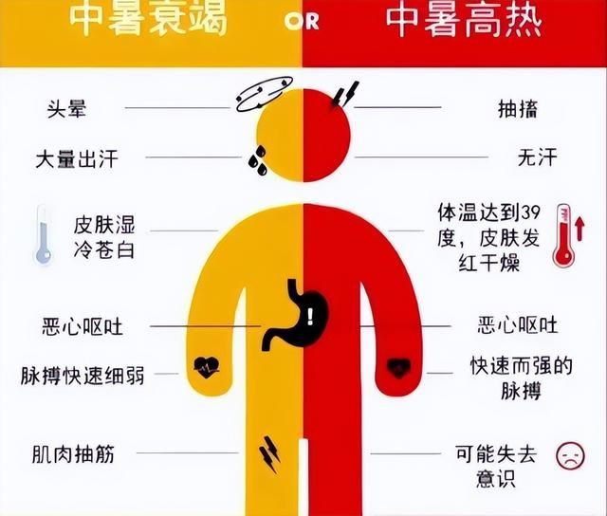
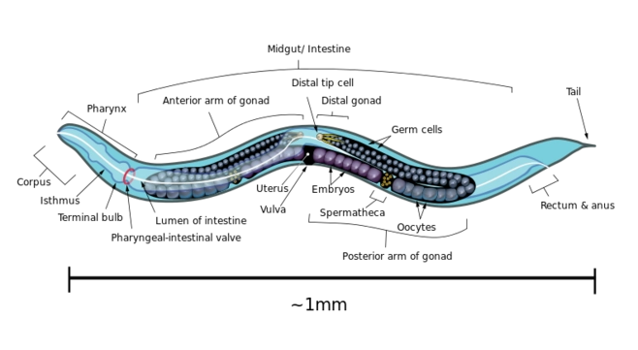
Background
02
Heatstroke:
- Heat stress–induced
Dysthermoregulation
Circulatory failure and multiple organ dysfunctions…
The molecular mechanisms still remain largely unknown
What we know:
Caenorhabditis elegans: heat stress causes pervasive necrotic cell death
How about vertebrates?
(Kourtis et al., 2012)

Slide 4
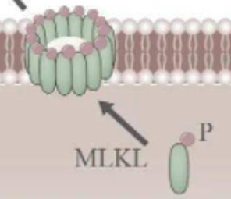
Background
02
In vertebrates:
Programmed necrosis is mediated by mixed lineage kinase domain-like (MLKL) or gasdermin family proteins (GSDM)
Form pores on cytoplasmic or intracellular membranes upon activation
*Programmed cell death:
Apoptosis (凋亡)
Pyroptosis (焦亡)
Necroptosis (坏死)
RIPK3 -----> Casp8 -----> Casp3 -----> GSDM -----> form pores
RIPK3 -----> MLKL -----> pMLKL -----> form pores
(Wallach et al., 2016)

Slide 5
Background
02
*Programmed cell death:
Apoptosis (凋亡)
Pyroptosis (焦亡)
Necroptosis (坏死)
RIPK3 -----> Casp8 -----> Casp3 -----> GSDM -----> form pores
RIPK3 -----> MLKL -----> pMLKL -----> form pores
Casp: Caspase, participate in programmed cell death
RIPK3: receptor-interacting protein kinase 3
★ Diseases resulting from 2 pathways above clinically
resemble heatstroke!
(Wallach et al., 2016)

Slide 6
Exp.1 - RIPK3 mediates heat stress–induced cell death and features of heatstroke
03
Hypothesis 1: Heat stress can induce cell death through RIPK3
We should test:
RIPK3 mediates heat stress-induced cell death and features of heatstroke
Heat stress triggers cell death through activating RIPK3 in vitro
(Yuan et al., 2022)

Slide 7
Exp.1 - RIPK3 mediates heat stress–induced cell death and features of heatstroke
03
1. RIPK3 mediates heat stress-induced cell death and features of heatstroke
Materials: mice
- WT
- Ripk3 −/−
- Mlkl −/−
- Mlkl −/− Casp8 −/−
Conditions:
- 39°C
- relative humidity of 60 ± 5%
(Yuan et al., 2022)

Slide 8
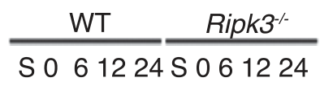
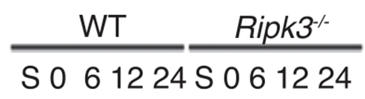
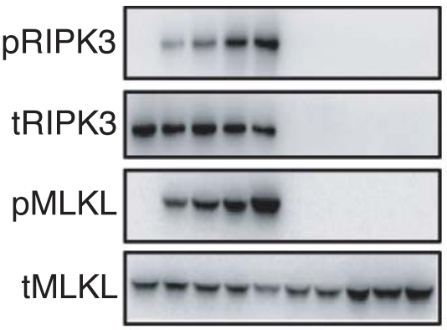
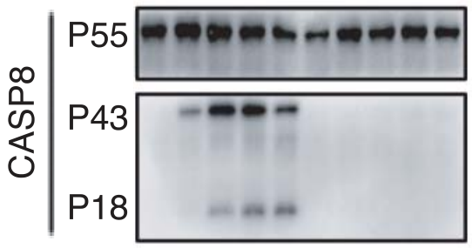
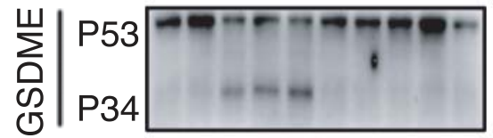
Exp.1 - RIPK3 mediates heat stress–induced cell death and features of heatstroke
03
RIPK3 -----> Casp8 -----> Casp3 -----> GSDM -----> form pores
RIPK3 -----> MLKL -----> pMLKL -----> form pores
P53: pro-GSDME
P34: activated
P55: pro-Casp8
P18: cleaved Casp8
t: total ; p: phosphorylated
(Yuan et al., 2022)

Slide 9
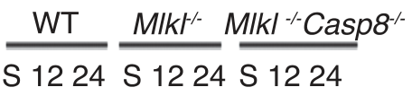
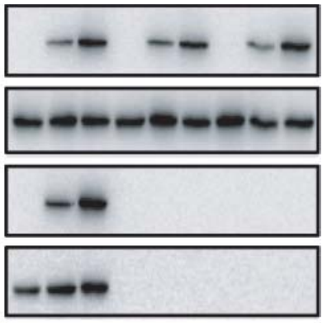
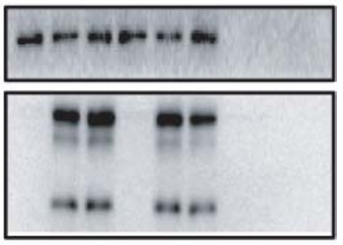
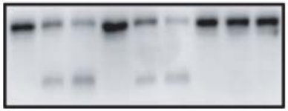
Exp.1 - RIPK3 mediates heat stress–induced cell death and features of heatstroke
03
RIPK3 -----> Casp8 -----> Casp3 -----> GSDM -----> form pores
RIPK3 -----> MLKL -----> pMLKL -----> form pores
P53: pro-GSDME
P34: activated
P55: pro-Casp8
P18: cleaved Casp8
t: total ; p: phosphorylated
(Yuan et al., 2022)

Slide 10
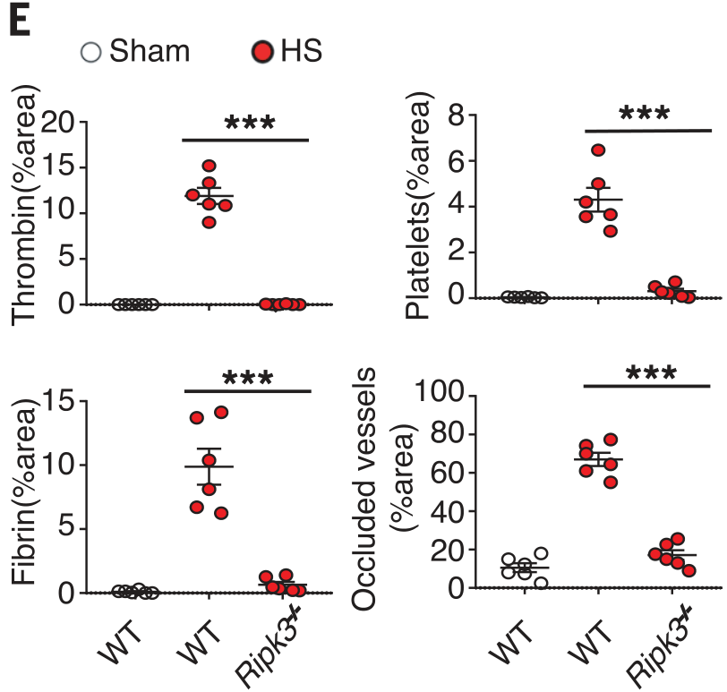
Exp.1 - RIPK3 mediates heat stress–induced cell death and features of heatstroke
03
RIPK3 -----> Casp8 -----> Casp3 -----> GSDM -----> form pores
RIPK3 -----> MLKL -----> pMLKL -----> form pores
Thrombin: thrombin generation
Platelets: platelet aggregation
Fibrin: fibrin deposition
Occluded vessels: occlusion of the microcirculation
(Yuan et al., 2022)

Slide 11
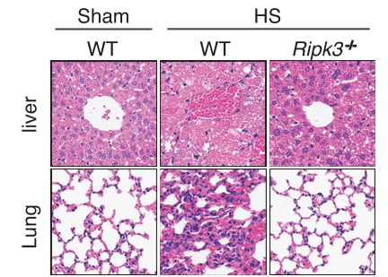
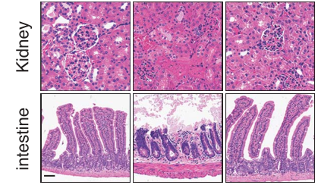
Exp.1 - RIPK3 mediates heat stress–induced cell death and features of heatstroke
03
(Yuan et al., 2022)

Slide 12
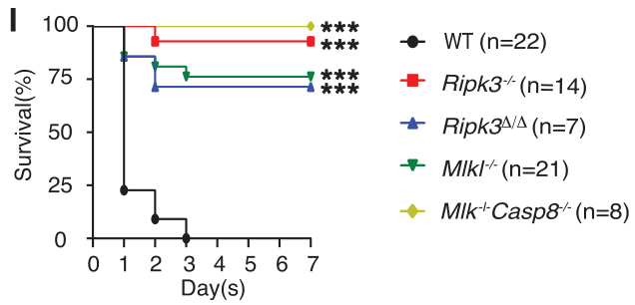
Exp.1 - RIPK3 mediates heat stress–induced cell death and features of heatstroke
03
RIPK3 -----> Casp8 -----> Casp3 -----> GSDM -----> form pores
RIPK3 -----> MLKL -----> pMLKL -----> form pores
(Yuan et al., 2022)

Slide 13
Exp.1 - RIPK3 mediates heat stress–induced cell death and features of heatstroke
03
2. Heat stress triggers cell death through activating RIPK3 in vitro
Materials:
L929 mouse fibroblasts
Ripk3 −/− (CRISPR-CAS9)
Blank / Ripk3 vectors
Vector: lentivirus
Conditions:
- 43°C , 2 hours
- relative humidity of 60 ± 5%
(Yuan et al., 2022)

Slide 14
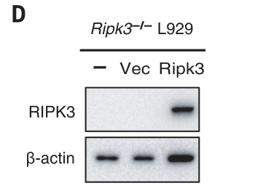
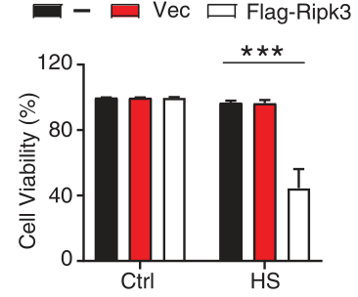
Exp.1 - RIPK3 mediates heat stress–induced cell death and features of heatstroke
03
(Yuan et al., 2022)

Slide 15
Exp.2 - Heat stress activates RIPK3 through ZBP1
04
From Exp.1 we know:
Casp8 -----> Casp3 -----> GSDM -----> form pores
MLKL -----> pMLKL -----> form pores
Heat stress -----> RIPK3
Here comes the question:
What about the details in Heat stress -----> RIPK3 ?
(Yuan et al., 2022)

Slide 16
Exp.2 - Heat stress activates RIPK3 through ZBP1
04
From previous research we know:
RIP (receptor-interacting protein) homotypic interaction motif (RHIM)
contains proteins that can interact with and activate RIPK3
That means:
RHIM -----> RIPK3
However:
RHIM contains 3 types: RIPK1,
TRIF (Toll/interleukin-1 receptor domain–
containing adapter-inducing interferon-b)
ZBP1 (Z-DNA binding protein 1)
(Yuan et al., 2022)

Slide 17
Exp.2 - Heat stress activates RIPK3 through ZBP1
04
Hypothesis 2: Heat stress can activate RIPK3 through RHIM
We should test:
RIPK1
Heat stress
TRIF
RIPK3
ZBP1
(Yuan et al., 2022)

Slide 18
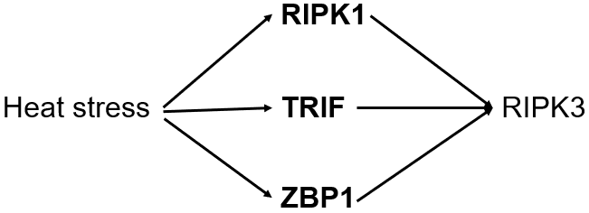
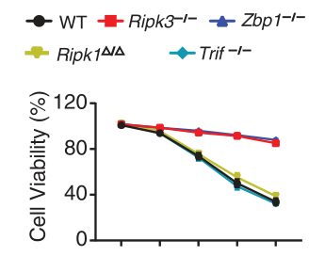
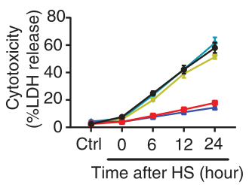
Exp.2 - Heat stress activates RIPK3 through ZBP1
04
RIPK3 -----> Casp8 -----> … -----> form pores
RIPK3 -----> MLKL -----> … -----> form pores
(Yuan et al., 2022)

Slide 19
Exp.2 - Heat stress activates RIPK3 through ZBP1
04
We get:
RIPK1
TRIF
RIPK3
Heat stress
ZBP1
(Yuan et al., 2022)

Slide 20
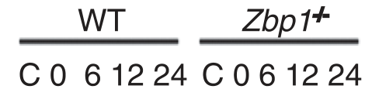
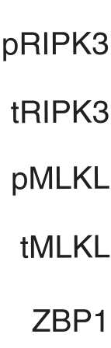
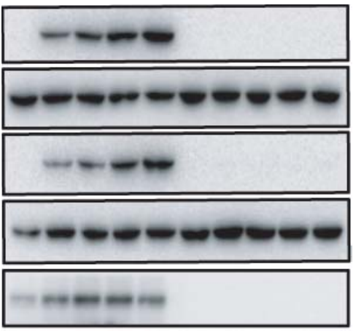
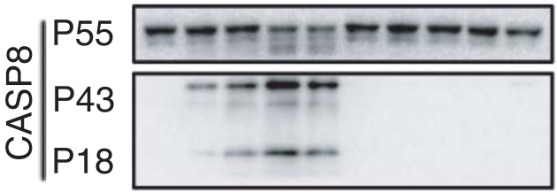

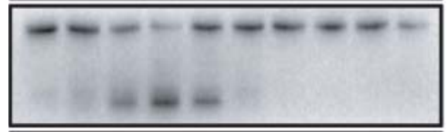
Exp.2 - Heat stress activates RIPK3 through ZBP1
04
Other experiments that verify the hypothesis:
Heat stress
ZBP1
RIPK3
Casp8 -----> Casp3 -----> GSDM -----> form pores
MLKL -----> pMLKL -----> form pores
(Yuan et al., 2022)

Slide 21
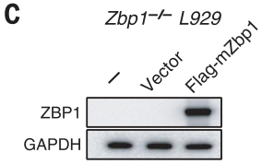
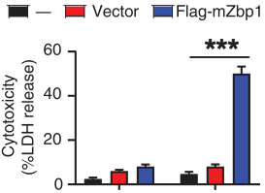
Exp.2 - Heat stress activates RIPK3 through ZBP1
04
Other experiments that verify the hypothesis:
Heat stress
ZBP1
RIPK3
Casp8 -----> Casp3 -----> GSDM -----> form pores
MLKL -----> pMLKL -----> form pores
(Yuan et al., 2022)

Slide 22
Exp.3 - Heat stress increases the expression of ZBP1 through HSF1
05
So far we know:
Heat stress
ZBP1
RIPK3
Casp8 -----> Casp3 -----> GSDM -----> form pores
MLKL -----> pMLKL -----> form pores
Can we find more through: Heat stress -----> ZBP1 ?
But ZBP1 is an upstream protein
It is reported that ZBP1 transcription rises along with the heat stress
(Yuan et al., 2022)

Slide 23
Exp.3 - Heat stress increases the expression of ZBP1 through HSF1
05
Hypothesis 3: Some transcription factor senses heat and elevates the expression of ZBP1
Without previous research, how can we find those factors?
Bioinformatics works！
(Yuan et al., 2022)

Slide 24
Exp.3 - Heat stress increases the expression of ZBP1 through HSF1
05
Jaspar: the bioinformatics tool of analyzing the promoter
region and identifying a predicted binding site
We find a factor heat shock transcription factor 1 (HSF1)
HSF1 can be activated by heat stress and promote the transcription of some proteins to help the host adapt heat shock
(Gomez-pastor et al., 2018)
(Yuan et al., 2022)

Slide 25
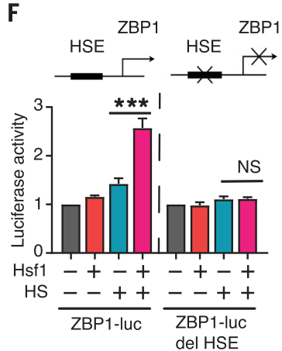
Exp.3 - Heat stress increases the expression of ZBP1 through HSF1
05
Transcriptional activity
HSE: heat shock element (HSE) site
ZBP1-luc: WT ZBP1 promoter
ZBP1-luc del HSE: ZBP1 promoter with a deletion of HSE
(Yuan et al., 2022)

Slide 26
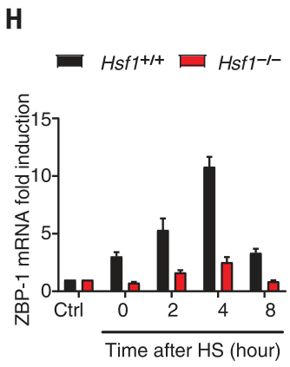
Exp.3 - Heat stress increases the expression of ZBP1 through HSF1
05
ZBP1 mRNA expression
(Yuan et al., 2022)

Slide 27
Exp.3 - Heat stress increases the expression of ZBP1 through HSF1
05
Finally, we made it!
Heat stress
ZBP1
Sensed by
Activate
Casp8 -----> Casp3 -----> GSDM -----> form pores
MLKL -----> pMLKL -----> form pores
RIPK3
HSF1
Promote transcription
(Yuan et al., 2022)

Slide 28
Exp.4* - Z–nucleic acid sensing is dispensable for heat stress–induced ZBP1 activation
06
Other tests…
It is known that ZBP1 is activated by virus-derived or endogenous Z–nucleic acids during development, viral infection, and other diseases
Does the pathway we find need Z-nucleic acid sensing?
(Yuan et al., 2022)

Slide 29
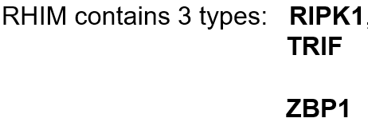
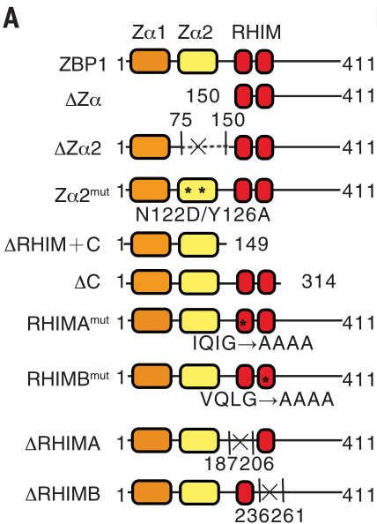
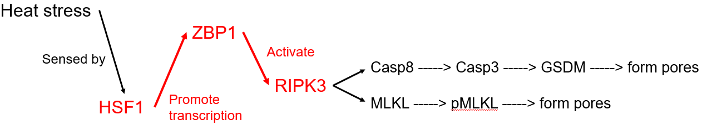
Exp.4* - Z–nucleic acid sensing is dispensable for heat stress–induced ZBP1 activation
06
Design mutants
Zα: Z-DNA sensing domain
RHIM: Activating RIPK3 domain
(Yuan et al., 2022)

Slide 30
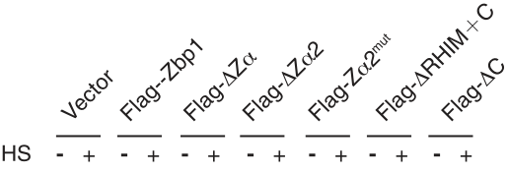
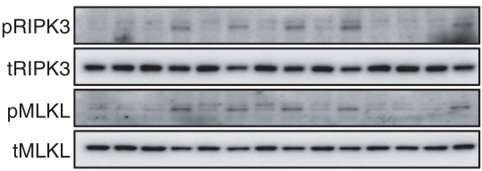

Exp.4* - Z–nucleic acid sensing is dispensable for heat stress–induced ZBP1 activation
06
(Yuan et al., 2022)

Slide 31
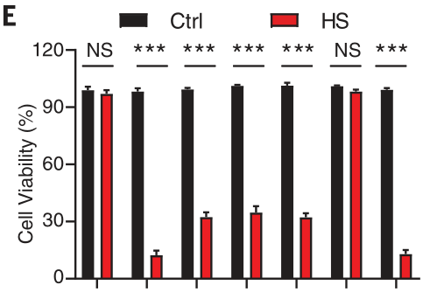
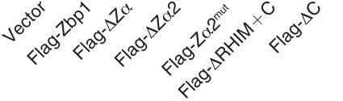
Exp.4* - Z–nucleic acid sensing is dispensable for heat stress–induced ZBP1 activation
06
(Yuan et al., 2022)

Slide 32

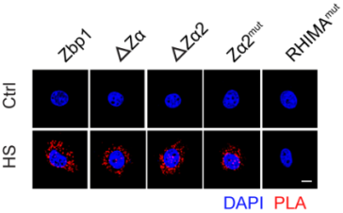
Exp.5* - Heat stress promotes aggregation of ZBP1 fusion proteins
07
Other characteristics of ZBP1…
A B
(Yuan et al., 2022)

Slide 33
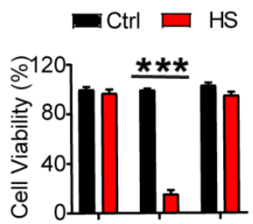
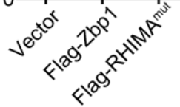
Exp.5* - Heat stress promotes aggregation of ZBP1 fusion proteins
07
Other characteristics of ZBP1…
A B
(Yuan et al., 2022)

Slide 34
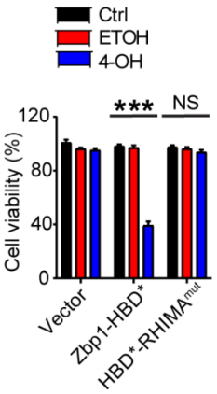
Exp.5* - Heat stress promotes aggregation of ZBP1 fusion proteins
07
Other characteristics of ZBP1…
HBD*: hormone-binding domain G521R mutant
4-OH: HBD dimerizer 4-hydroxytamxifen
Condition: No heat stress!
(Yuan et al., 2022)

Slide 35
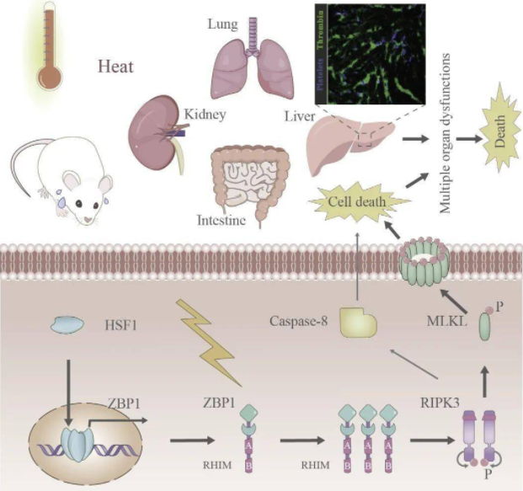
Exp.5* - Heat stress promotes aggregation of ZBP1 fusion proteins
07
(Yuan et al., 2022)

Slide 36
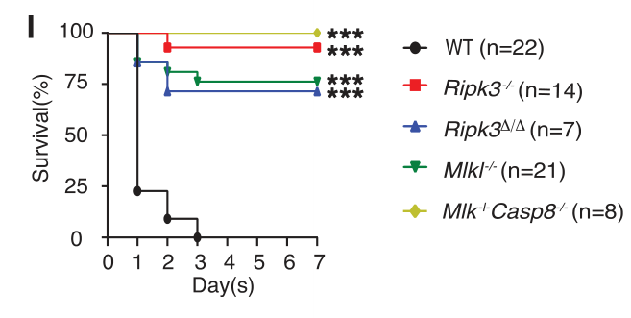
Critics
08
1. An article with tremendous significance
2. There exist some mistakes…but the defects cannot obscure the virtues.
(Yuan et al., 2022)

Slide 37

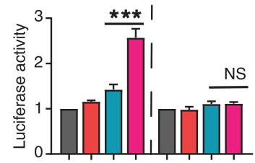
Critics
08
3. Statistics & Biostatistics
(Yuan et al., 2022)

Slide 38
Critics
08
4. Scientific thought & logic
Reverse thinking!
(Yuan et al., 2022)

Slide 39
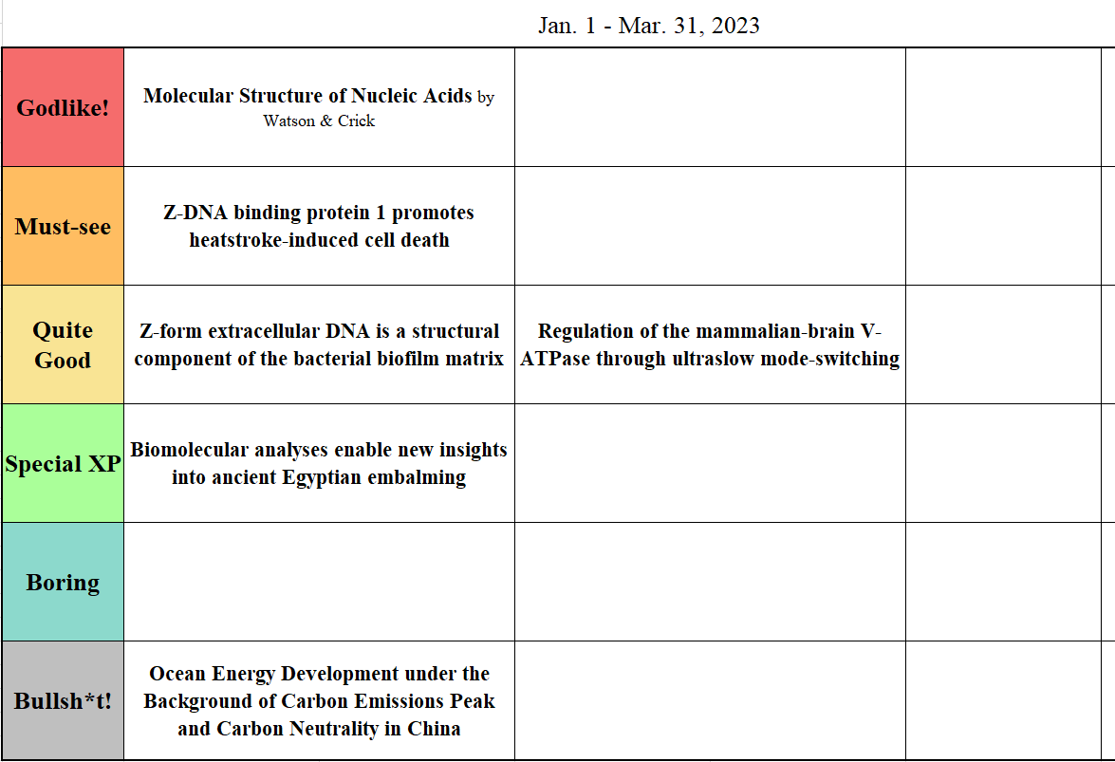
Critics
08
5. Ranking…

Slide 40
References
D. Wallach, T. B. Kang, C. P. Dillon, D. R. Green, Science 352, aaf2154 (2016).
N. Kourtis, V. Nikoletopoulou, N. Tavernarakis, Nature 490, 213–218 (2012).
R. Gomez-Pastor, E. T. Burchfiel, D. J. Thiele, Nat. Rev. Mol. Cell Biol. 19, 4–19 (2018).
Z-DNA binding protein 1 promotes heatstroke-induced cell death. Science. (2022). Retrieved February 15, 2023, from
https://www.science.org/doi/10.1126/science.abg5251

Slide 41
THANK YOU

