Slide 1
NetWave Broadband Management System
An Automated ISP Billing, Payment, and Notification Solution
Submitted By: [Your Name / Team Members]
Guided By: [Your Professor/Guide Name]
Institution: [Your College/University Name]

Slide 2
Abstract / Project Overview
NetWave is a comprehensive, cloud-based Broadband Management System designed for Internet Service Providers (ISPs).
Core Purpose: To automate billing cycles, streamline online payments, and improve customer communication.
Key Integrations: Features Razorpay for secure payments, automated PDF invoice generation, multichannel notifications (SMS, Email, WhatsApp), and an AI-powered customer support assistant.

Slide 3
Problem Statement
Local ISPs often rely on manual data entry and physical ledgers for managing subscriptions.
Delayed Payments: Lack of automated reminders leads to missed due dates and service interruptions.
Disjointed Systems: Customer support, billing, and technical staff operate in silos without a unified dashboard.
Poor Customer Experience: Customers lack self-service portals to view bills, download invoices, or instantly pay online.

Slide 4
Objectives
Automate Billing: Automatically generate weekly/monthly bills for broadband subscriptions.
Streamline Payments: Provide a frictionless checkout experience using Razorpay.
Enhance Communication: Deliver real-time payment reminders and receipts via Email, SMS (MSG91), and WhatsApp.
Improve Support: Introduce an OpenAI-powered chatbot to resolve basic customer queries instantly.
Centralize Management: Build distinct, secure portals for Admins, Staff, and Customers.

Slide 5
Existing System
Manual Billing & Physical Receipts: Paper-based invoices that are easy to lose and hard to track.
Cash Collections: Heavy reliance on staff physically collecting cash, lacking proper digital audit trails.
No Real-Time Alerts: Customers are not notified when bills are generated or overdue.
Time-Consuming Support: Staff handles basic plan/billing queries manually via phone calls.

Slide 6
Proposed System
Cloud-Hosted Architecture: Highly available system accessible from anywhere.
Role-Based Access Control (RBAC): Secure access mapped to Admin, Staff, and Customer privileges.
Digital Invoicing: Automated, dynamically generated PDF bills available for direct download.
Omnichannel Notifications: Backend intelligently routes alerts via active channels.
AI-Assisted Self-Service: Customers can self-serve payments and ask the AI assistant for help.

Slide 7
Technology Stack
Frontend: React.js, Vite, Tailwind CSS (Hosted on Vercel)
Backend: Node.js, Express.js (Hosted on Render)
Database: MySQL (Cloud-hosted)
Authentication: JSON Web Tokens (JWT) & bcrypt for password hashing
Payment Gateway & Integrations: Razorpay API, Nodemailer, MSG91, Meta WhatsApp Cloud API, OpenAI API, PDFKit.

Slide 8
System Architecture / Workflow
Data Flow: React UI ↔ REST API ↔ MySQL Database
1. Admin generates a bill.
2. System saves the record and triggers the Notification Service (SMS/Email/WhatsApp).
3. Customer logs in and pays via Razorpay checkout.
4. Backend verifies payment, marks bill as 'Paid', generates PDF, and sends a digital receipt.
(Note: Refer to architecture diagrams in project report)

Slide 9
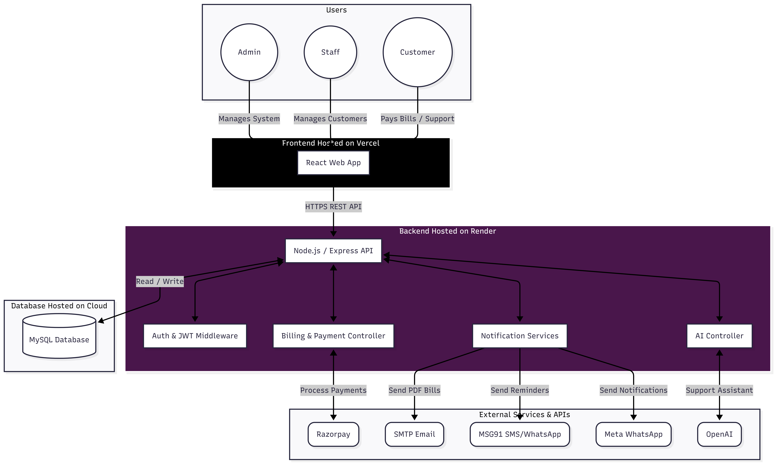
System Architecture

Slide 10
Methodology / Implementation
Agile Approach: Iterative development focusing on core modules (Auth -> Billing -> Notifications).
RESTful API Design: Backend built with decoupled services (billingController, aiController, emailService).
Security First: Environment variables for secrets, JWT for session management, and backend-side payment validation.
Dynamic PDF Generation: On-the-fly rendering of invoices using PDFKit only when a payment is verified.

Slide 11
Key Features / Modules
Admin/Staff Module: Manage customers, plans, view global payment history, and generate bills.
Customer Portal: View pending bills, pay online, access payment history, and download PDF receipts.
Notification Engine: Smart fallback system (WhatsApp -> SMS -> Email) for due dates and payment success.
AI Chat Assistant: GPT-powered bot trained to assist with NetWave broadband queries.

Slide 12
Screenshots / Demo
(Please insert screenshots of your working project here)
1. Admin Dashboard (showing total bills/revenue)
2. Customer Dashboard & AI Chat
3. Razorpay Payment Checkout Flow
4. Generated PDF Bill Example
5. Email/SMS Notification proof

Slide 13
Results & Testing
API Testing: Verified endpoint security and rate limiting.
Payment Verification: Successfully tested Razorpay test-mode transactions and backend signature validation.
Automated Tasks: Bill reminders accurately track dates and prevent duplicate SMS sends.
Performance: Frontend loads quickly via CDN; Backend processes PDFs efficiently.

Slide 14
Challenges Faced
API Integrations: Managing and standardizing error responses across multiple external APIs (Razorpay, MSG91, OpenAI).
Node.js Load Order: Resolving environment variable issues where modules evaluated `.env` files prematurely.
Dynamic Document Generation: Formatting the PDF bill dynamically to correctly align tables, user data, and logos.
Secure File Delivery: Implementing expiring, secure tokens for downloading bills without requiring full re-authentication.

Slide 15
Future Enhancements
Auto-Pay / Subscriptions: Implement Razorpay Subscriptions for automatic monthly deductions.
Ticketing System: Add a robust issue-tracking module for customers to report internet downtime.
Advanced Analytics: Add charts and graphs for Admins to visualize revenue trends and customer growth.
Mobile Application: Port the React application to React Native for iOS and Android apps.

Slide 16
Conclusion
The NetWave Broadband System successfully bridges the gap between manual ISP management and modern cloud operations.
By integrating reliable payment gateways and real-time communication tools, it significantly reduces administrative overhead.
The system provides a transparent, secure, and user-friendly experience for both the ISP staff and their customers.

Slide 17
References
Node.js & Express.js Official Documentation
React.js & Vite Documentation
Razorpay API Integration Guide
MSG91 API & Meta WhatsApp Cloud API References
OpenAI API Documentation
PDFKit Node.js Library Guide

