Slide 1
Attendance report using face recognition
Guided by: Prof. Vaishali mewada
prof. Dhruti pandya
Prepared by: Bhadreshkumar Dhakecha(18ce023)
Parthpuri Goswami(18ce027)

Slide 2
Content
Objective of project
Motivation
Description
Software/Hardware Requirement
Major Functionalities
Flow Chart
Screenshot of Pjoect
References

Slide 3
Objective of Project
In this project, a software for human face recognition is prepared and it take attendance of student and add in excel sheet.
This project also use in school, collages and industries etc.
This project is saving time of student as well as teacher.

Slide 4
Motivation
In School, collages and industries attendance is necessary and its also time consuming process so with this idea we save time of everyone and it is easier to everyone so that’s why we take this project.

Slide 5
Description
In our project first the authorized person or faculty select their necessary details than camera automatically open and it capture the face who stand front of it.
And than attendance fill in excel sheet of respective faculty.
And it will give average attendance of particular student.

Slide 6
Software/Hardware requirements
Software requirements
Python ide
Microsoft office
Hardware requirements
8 gb ram
I3 processor
10 gb memory
Web camera

Slide 7
Major Functionalities
GUI of home page
Face recognition
Add in excel sheet
Model creation

Slide 8
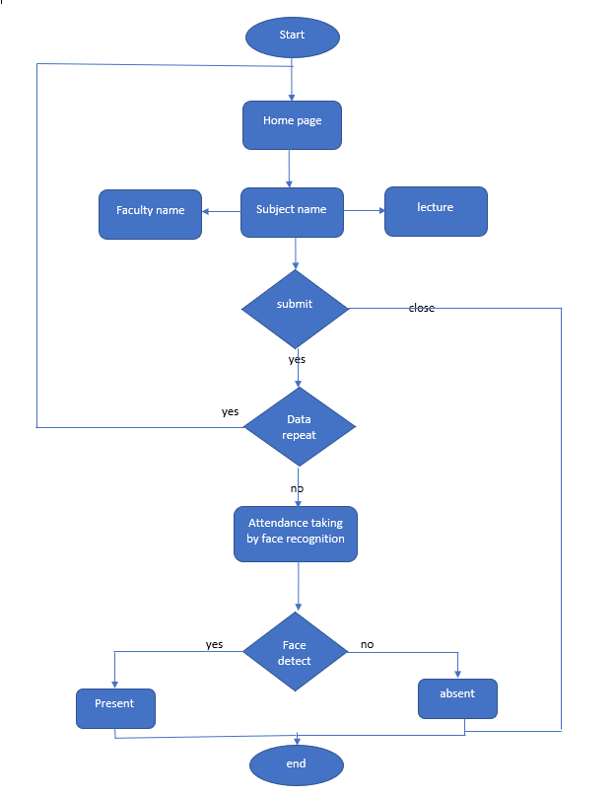
Flow chart

Slide 9
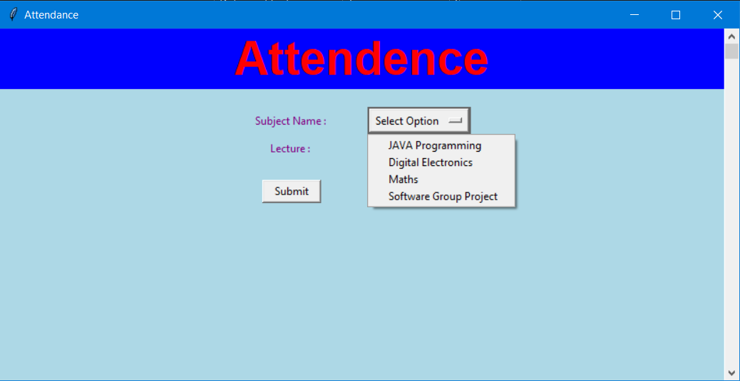
Screenshot of Project

Slide 10
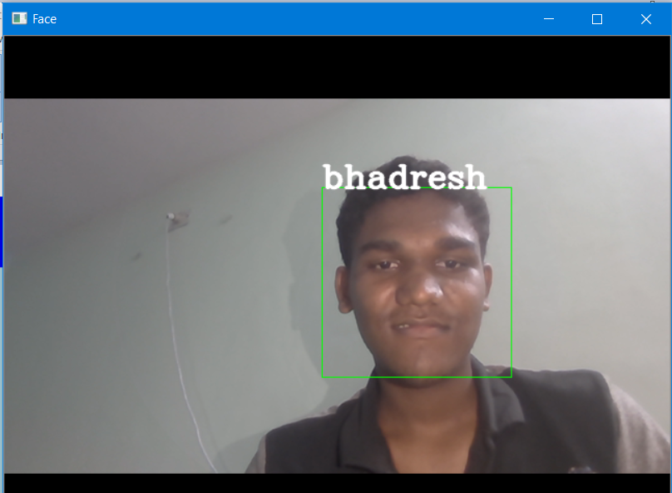
Continue…

Slide 11
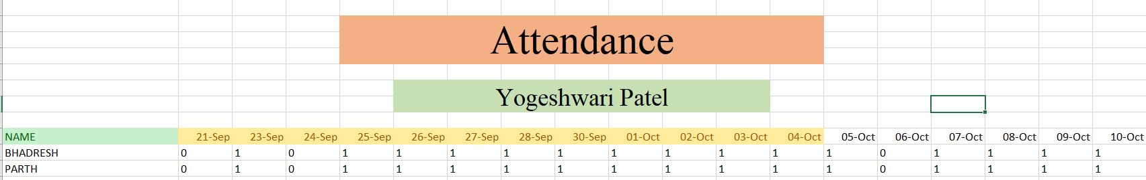
Continue…

Slide 12
References
https://docs.python.org/3/
https://opencv.org
https://openpyxl.readthedocs.io/en/stable/
https://www.geeksforgeeks.org/python-gui-tkinter/
https://www.geeksforgeeks.org/python-programming-language/

Slide 13
Thank You

