Slide 1

SMART INDIA HACKATHON 2026
Team - Circuit Crew
Problem Statement ID – 26187
Problem Statement Title - AI-Based Intelligent Video Analytics Platform for Border Surveillance using existing CCTV infrastructure.
Theme - Blockchain & Cybersecurity
PS Category - Software
Team ID - KRMU136
Team Name : Circuit Crew

Slide 2
TITLE: AI- Based Intelligent Video Analytics Platform for Border Surveillance using existing CCTV infrastructure.
Circuit Crew
Core Idea -
IBVAP converts existing IP-based CCTV cameras into an AI-powered border surveillance network without replacing the deployed camera infrastructure.
How the Solution Works
Live CCTV Streams
↓
AI Perception Engine
Human + Vehicle Detection | Tracking | Face Detection | ANPR
↓
Event Intelligence Layer
Virtual-Fence Intrusion | Night Movement | Suspicious Activity | Multi-signal Correlation
↓
Incident Engine
Risk/priority assignment | Real-time alert | Event timeline | Evidence snapshot/clip
↓
Command Dashboard
One operational view for monitoring, investigation and response.
How It Addresses the Problem
From passive video to actionable intelligence
Removes the need for continuous manual monitoring of every camera feed.
Reuses existing CCTV infrastructure instead of requiring smart-camera replacement.
Detects and tracks relevant objects automatically in real time.
Converts raw video into structured security events with location, time, object and evidence.
Enables faster identification and prioritisation of potential border incidents.
Designed as a scalable software layer that can integrate with existing command-and-control systems.
What Makes It Different
Not another CCTV dashboard — an event-driven surveillance system.
Camera-Agnostic
Works as an intelligence layer over existing IP cameras.
Context-Aware Detection
A person alone is not automatically an incident; the system combines object + location + movement + time + behaviour to identify meaningful events.
Incident-Centric Workflow
Instead of asking operators to watch video continuously, the platform brings high-priority events to the operator.
Evidence-First
Every critical alert can be linked with its timestamp, camera, detection metadata and captured evidence for investigation and audit.
Cybersecurity by Design
Access control, audit trails and tamper-evident event/evidence records protect the integrity of surveillance data.

Slide 3
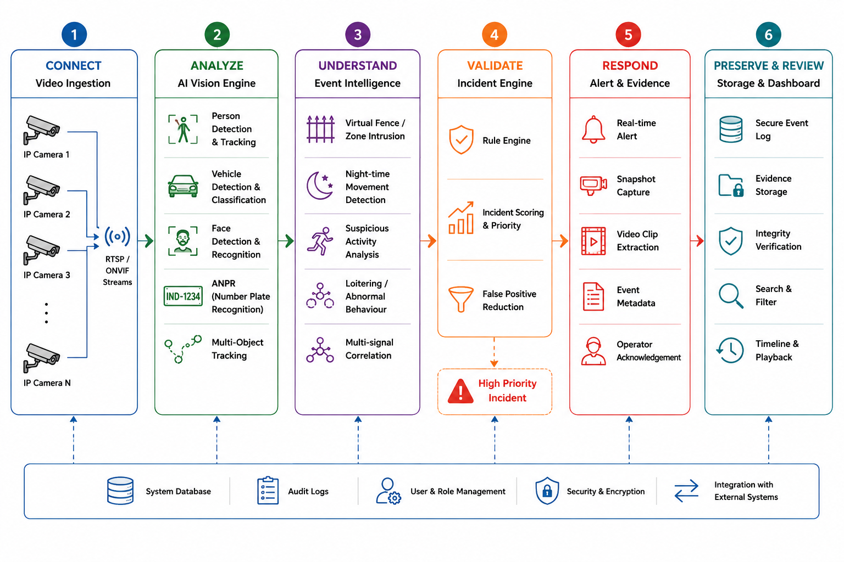
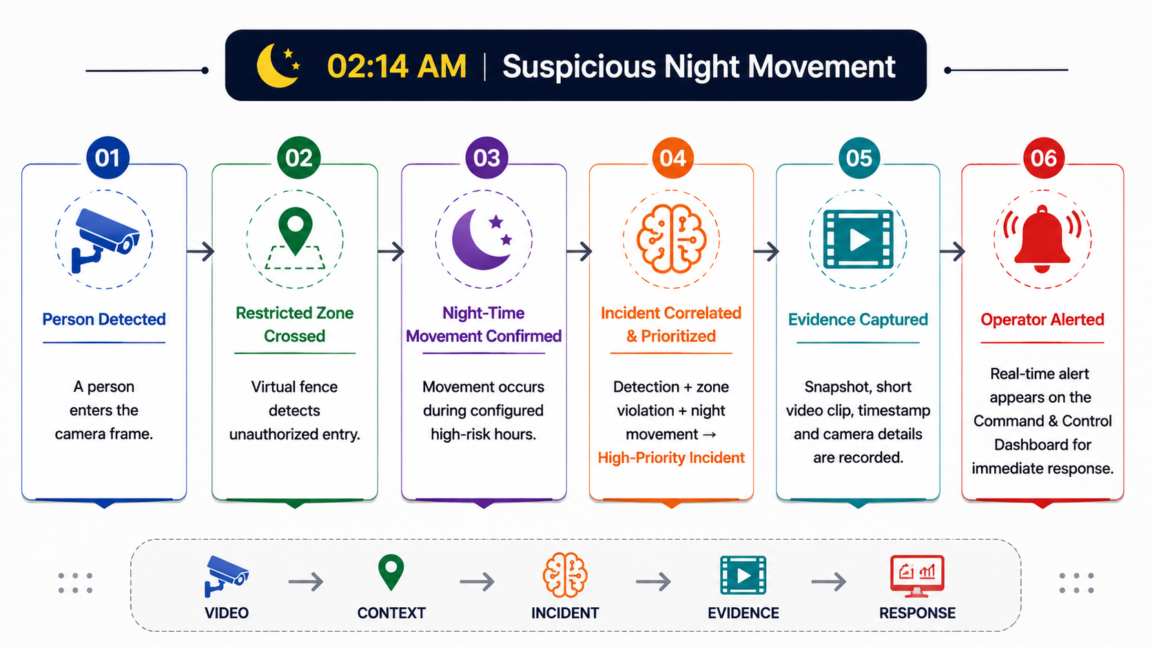








TECHNICAL APPROACH
Circuit Crew
TECHNOLOGY STACK
AI / Computer Vision
Python • OpenCV • YOLO
Real-time person and vehicle detection from IP-camera streams
ByteTrack / DeepSORT
Persistent multi-object tracking across video frames
OCR Engine
Number-plate detection + text recognition for ANPR
Face Recognition Module
Face detection and identity matching where authorized
Video & Backend
RTSP / ONVIF • GStreamer
Ingest and manage existing IP-CCTV streams
FastAPI • Python
Low-latency backend APIs and AI-service integration
WebSockets
Real-time alerts and live event updates
Data & Dashboard
PostgreSQL
Camera, event, incident and audit metadata
Redis
Fast event/alert handling and temporary state
React.js
Command & Control dashboard
Docker
Portable deployment across edge/server environments
Security & Deployment
RBAC + Encryption + Audit Logs
Controlled access to sensitive surveillance data
SHA-256 / Tamper-Evident Evidence Hashing
Integrity verification for captured evidence
Edge GPU + Central Server
Local inference for low latency; centralized monitoring and management
METHODOLOGY / IMPLEMENTATION FLOW

Slide 4
FEASIBILITY AND VIABILITY
Circuit Crew
Why IBVAP is Practical to Deploy
1. FEASIBILITY
2. CHALLENGES & RISKS
3. MITIGATION STRATEGY
Existing CCTV Infrastructure
→ Uses standard IP-based CCTV streams
→ No complete camera replacement required
Software-Defined Intelligence
→ AI capabilities added through software
→ Reduces dependency on dedicated smart-camera hardware
Edge + Central Architecture
→ Critical processing can happen near the camera
→ Central system handles monitoring, incidents and analytics
Modular Implementation
→ Person detection, vehicle analytics, ANPR and tracking can be deployed independently
→ New analytics can be added without redesigning the complete platform
Scalable Deployment
→ Prototype can start with a small camera group
→ Architecture can expand to multiple BOPs and command centers
Low-Light Conditions
→ Night surveillance may reduce detection accuracy
Network Reliability
→ Remote border locations may have intermittent connectivity
Computational Load
→ Multiple live streams require significant GPU/CPU resources
False Positives
→ Incorrect alerts may cause operator fatigue
Camera Diversity
→ Different resolutions, angles and environments affect model performance
Sensitive Data
→ Video, faces and vehicle information require controlled access and protection
Low-Light → Adaptive Processing
→ Image enhancement + night-specific detection + confidence thresholds
Network → Edge Intelligence
→ Process locally and transmit important events/evidence when connectivity is limited
Compute → Optimized AI Pipeline
→ GPU acceleration + frame sampling + parallel processing
False Alerts → Multi-Signal Validation
→ Object + zone + time + movement → stronger incident confidence
Camera Variation → Site Calibration
→ Camera-specific zones, thresholds and configuration
Security → Secure Evidence Pipeline
→ Encryption + RBAC + audit logs + evidence integrity verification

Slide 5





IMPACT AND BENEFITS
Circuit Crew
TARGET AUDIENCE
SECURITY IMPACT
ECONOMIC IMPACT
SOCIAL & ENVIRONMENTAL IMPACT
Border Security Forces / SSB Personnel
Faster identification of potential intrusions
Reduced dependence on continuous manual monitoring
Better situational awareness across multiple camera feeds
Administrators / Deployment Teams
Intelligence layer over existing CCTV infrastructure
Lower dependency on specialized surveillance hardware
Scalable deployment across strategic locations
Command & Control Teams
Centralized incident visibility
Real-time alerts with supporting evidence
Faster investigation through searchable event history
Earlier Detection
AI continuously analyses video and highlights events requiring attention.
Faster Response
Critical incidents reach operators in real time instead of relying only on manual observation.
Better Situational Awareness
Person, vehicle, movement, zone and event information can be viewed together.
Evidence-Driven Investigation
Alerts can be associated with snapshots, video clips, timestamps and event metadata.
Lower Infrastructure Cost
Leverages existing CCTV cameras instead of requiring complete smart-camera replacement.
Reduced Hardware Dependency
Advanced analytics are delivered primarily through software and computing infrastructure.
Scalable Investment
Deployment can grow incrementally—from a small camera group to multiple locations.
Operational Efficiency
Operators can focus attention on prioritized incidents instead of continuously watching every feed.
Safer Border Installations
Strengthens surveillance around vulnerable and strategic locations.
Reduced Human Monitoring Burden
AI assists personnel by filtering large volumes of video into relevant events.
Less Hardware Replacement
Reusing existing cameras can reduce unnecessary replacement of functioning surveillance infrastructure.
Remote-Site Support
Edge-based processing can help maintain local intelligence even where connectivity is unreliable.
MORE COVERAGE → LESS MANUAL MONITORING → FASTER DETECTION → FASTER RESPONSE
From Watching Cameras → To Acting on Intelligence

Slide 6
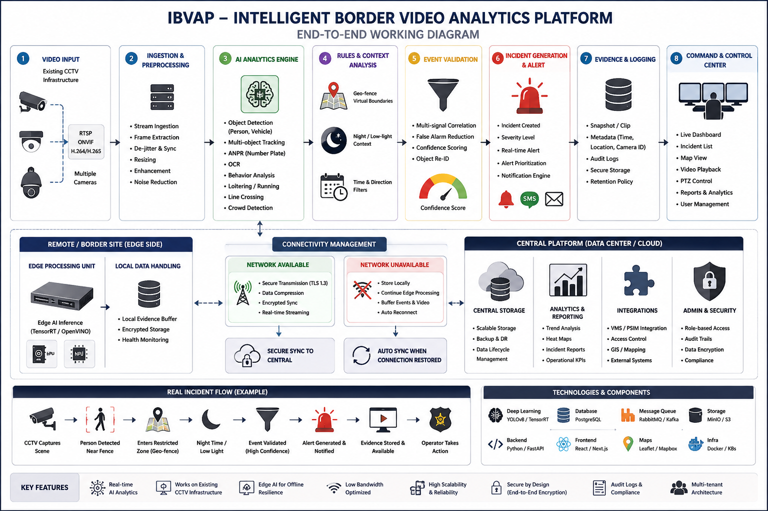
RESEARCH AND REFERENCES
Circuit Crew
1. Smart India Hackathon — Problem Statement 26187
AI-Based Intelligent Video Analytics Platform for Border Surveillance
🔗 https://www.sih.gov.in/
Reference: Official SIH Problem Statement
2. Ultralytics YOLO — Object Detection & Tracking
Reference for real-time person, vehicle and object detection.
🔗 https://docs.ultralytics.com/
3. ByteTrack — Multi-Object Tracking
Research reference for maintaining object identities across video frames.
🔗 https://arxiv.org/abs/2110.06864
4. ONVIF — IP Video Interoperability
Reference for standardized communication and interoperability with IP-based CCTV systems.
🔗 https://www.onvif.org/profiles/
5. PaddleOCR — Optical Character Recognition
Reference for OCR-based number-plate text recognition and scene-text processing.
🔗 https://github.com/PaddlePaddle/PaddleOCR
6. OpenCV — Computer Vision Library
Reference for video processing, frame manipulation and computer-vision operations.
🔗 https://opencv.org/
7. FastAPI — Backend API Framework
Reference for building high-performance backend APIs and AI-service integration.
🔗 https://fastapi.tiangolo.com/
8. Docker — Containerized Deployment
Reference for portable and reproducible deployment of application services.
🔗 https://docs.docker.com/

